Slide 1
THE BERYLLIUM ANOMALY
AND NEW PHYSICS
Invisibles/Elusives Network
Jonathan Feng, University of California, Irvine
22 November 2016

Slide 2







OUTLINE
A. J. Krasznhorkay et al., “Observation of Anomalous Internal Pair Creation in ⁸Be: A Possible Indication of a Light, Neutral Boson,” 1504.01527 [nucl-ex], PRL 116, 042501 (2016)
J. Feng et al., “Protophobic Fifth Force Interpretation of the Observed Anomaly in ⁸Be Nuclear Transitions,” 1604.07411 [hep-ph], PRL 117, 071803 (2016)
J. Feng et al., “Particle Physics Models for the 17 MeV Anomaly in Beryllium Nuclear Decays,” 1608.03591 [hep-ph]
Jonathan
Feng
Bart
Fornal
Iftah
Galon
Susan
Gardner
Jordan
Smolinsky
Tim
Tait
Flip
Tanedo

Slide 3
LIGHT, WEAKLY-COUPLED PARTICLES
There are currently many outstanding puzzles: neutrino masses, gauge hierarchy, strong CP, flavor, dark matter, baryogenesis, dark energy,...
Some of these motivate searches for new particles and forces at high energies
But some also motivate searches for new physics that is light, but weakly coupled
For example: neutrino masses, strong CP, and dark matter

Slide 4
AN EXAMPLE: DARK MATTER
All evidence for dark matter is gravitational. Perhaps it is in a hidden sector, composed of particles with no SM gauge interactions (electromagnetic, weak, strong)
This hidden sector may have a rich structure with matter and forces of its own
SM
Hidden
X
Lee, Yang (1956); Kobsarev, Okun, Pomeranchuk (1966); Blinnikov, Khlopov (1982);
Foot, Lew, Volkas (1991); Hodges (1993); Berezhiani, Dolgov, Mohapatra (1995); …

Slide 5

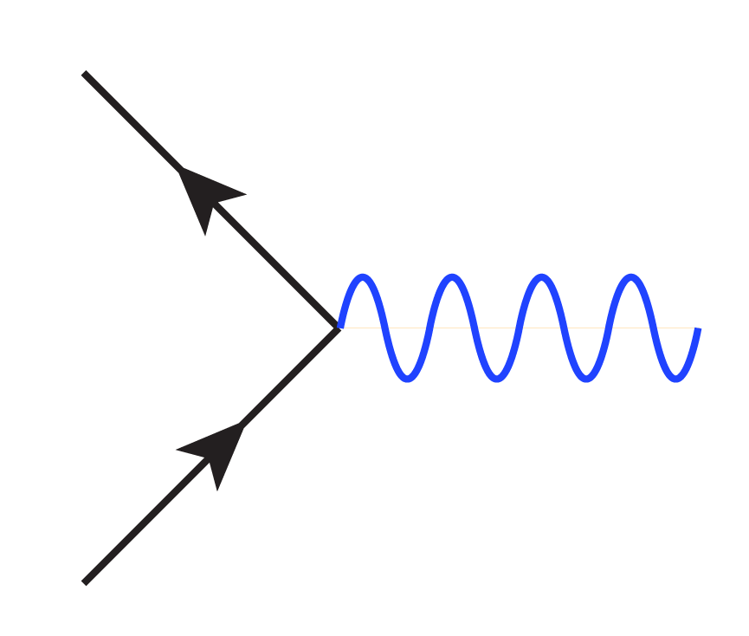
VECTOR PORTAL
Holdom (1986)
If the hidden sector has a massive U(1) gauge boson, the operator kinetic mixes the SM photon and the massive hidden photon
In the mass basis, one finds that the physical states are the massless SM photon γ and a massive “dark photon” A’
The SM photon does not couple to hidden particles. But the dark photon couples to SM particles with charges proportional to their SM charges
f_{h}
f
γ
A’
εeQ_{f}
f_{h}
f

Slide 6
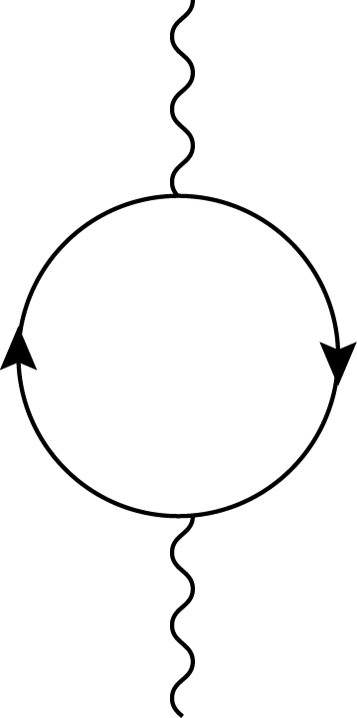
DARK PHOTONS
The kinetic mixing parameter: ε ~ 10⁻³ N from 1-loop effects, where N is the number of particles in the loop, even for arbitrarily heavy particles in the loop (non-decoupling)
A dark photon mass m_{A’} ~ 1-100 MeV may induce strong DM self-interactions or (with ε ~ 10⁻³) resolve the (g-2)_{μ} anomaly
This motivates searches for dark photons in a vast, unexplored (m_{A’}, ε) parameter space with, perhaps, a region of special interest with m_{A’} ~ 1-100 MeV and ε ~ 10⁻³
A’
N
γ

Slide 7
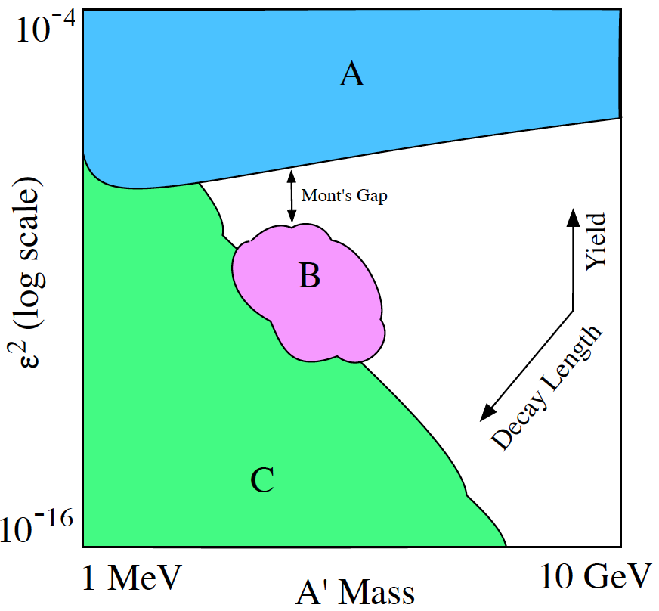
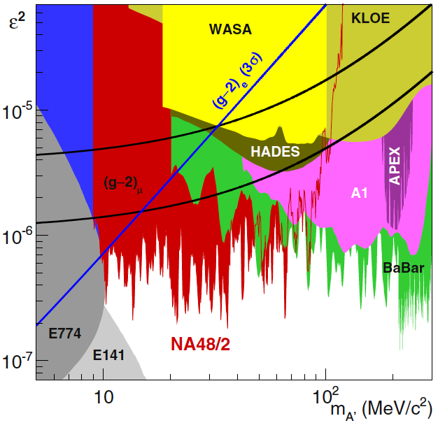
CURRENT CONSTRAINTS
The world-wide program to search for dark photons A’
Dark Sectors (2016)
A: Bump hunts
B: Displaced vertices (short decays)
C: Beam dumps (long decays)
More to be done, but experiments already exclude A’ as a (g-2)_{μ} solution

Slide 8
NEW PHYSICS IN NUCLEAR TRANSITIONS
Nuclear transitions can be powerful probes of MeV-scale new physics
Treiman, Wilczek (1978)
Donnelly, Freedman, Lytel, Peccei, Schwartz (1978)
Savage, McKeown, Filippone, Mitchell (1986)
A recent 6.8σ experimental anomaly might indicate the production of new particles in excited ⁸Be decays
J. Krasznahorkay et al., PRL, 1504.01527 [nucl-ex]

Slide 9
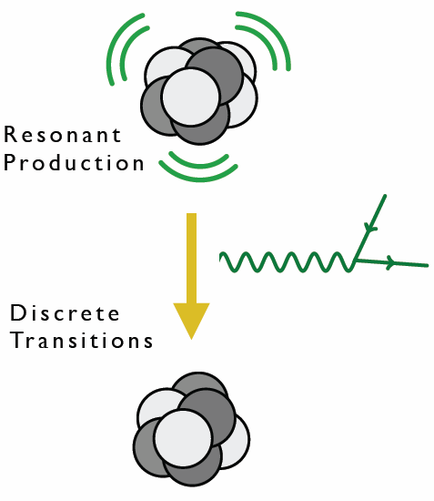
⁸BE AS A NEW PHYSICS LAB
⁸Be is composed of 4 protons and 4 neutrons
Excited states can be produced in large numbers through p + ⁷Li → high statistics “intensity” frontier
Excited states decay to ground state with relatively large energies (~20 MeV)
⁸Be nuclear transitions then provide interesting probes of light, weakly-coupled particles

Slide 10
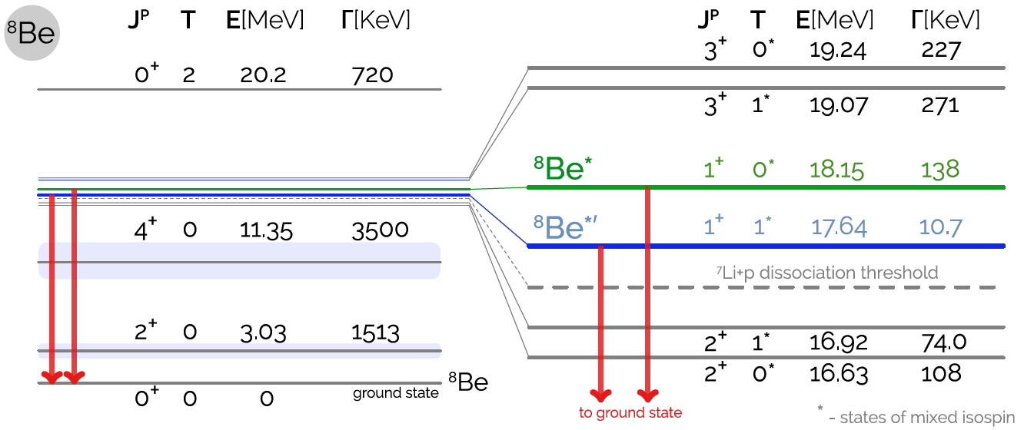
⁸BE SPECTRUM
Many excited states with different spins and isospins
Of special interest: the ⁸Be* (18.15) and ⁸Be*’ (17.64) states
1609.07411; based on Tilley et al. (2004); National Nuclear Data Center, http://www.nndc.bnl.gov/nudat2/

Slide 11
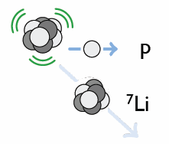
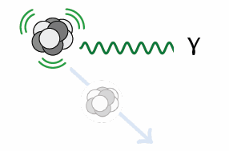
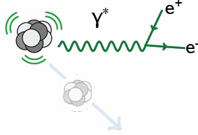
⁸BE* DECAY
Hadronic
B(p ⁷Li) ≈ 100%
Electromagnetic
B(⁸Be γ) ≈ 1.5 x 10⁻⁵
Internal Pair Creation
B(⁸Be e⁺ e⁻) ≈ 5.5 x 10⁻⁸

Slide 12
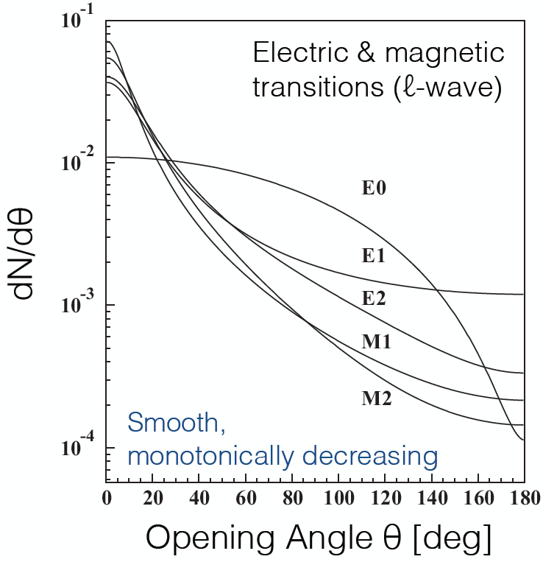
⁸BE* DECAY
Internal Pair Creation
B(⁸Be e⁺ e⁻) ≈ 5.5 x 10⁻⁸
Given the photon propagator, dN/dθ is sharply peaked at low e⁺e⁻ opening angle θ and is expected to be a monotonically decreasing function of θ
Gulyas et al. (2015); Rose (1949)

Slide 13
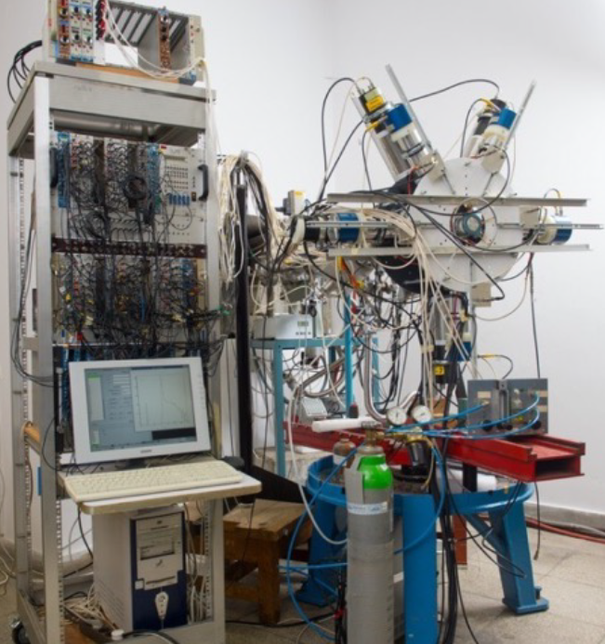
THE ATOMKI ⁸BE EXPERIMENT

Slide 14
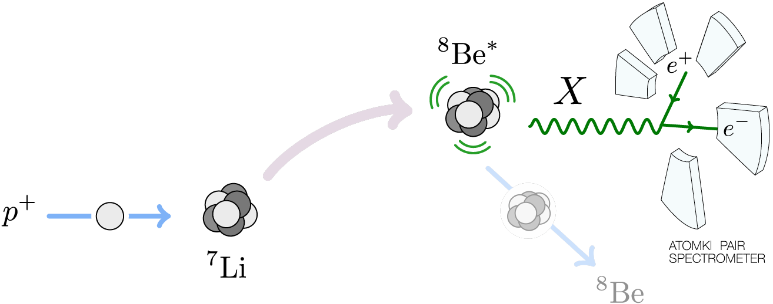
THE ATOMKI ⁸BE EXPERIMENT
A 1 μA p beam with ΔE_{p} ~ 10 keV strikes a thin ⁷Li foil target. The beam energy can be adjusted to select various ⁸Be excited state resonances.

Slide 15
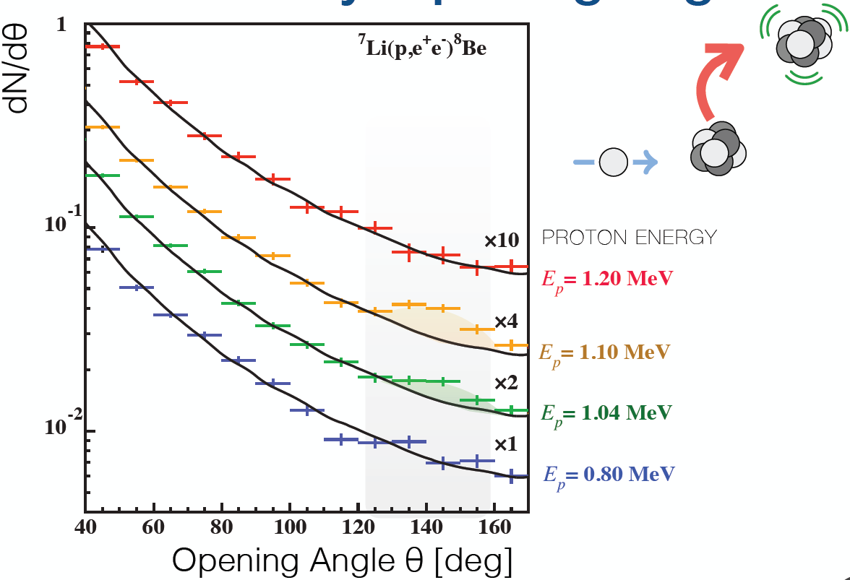
THE ATOMKI ANOMALY
A bump at ~140 degrees is observed as one passes through the ⁸Be* resonance
Background fluctuation probability: 5.6 x 10⁻¹² (6.8σ)
Krasznahorkay et al. (2015)

Slide 16
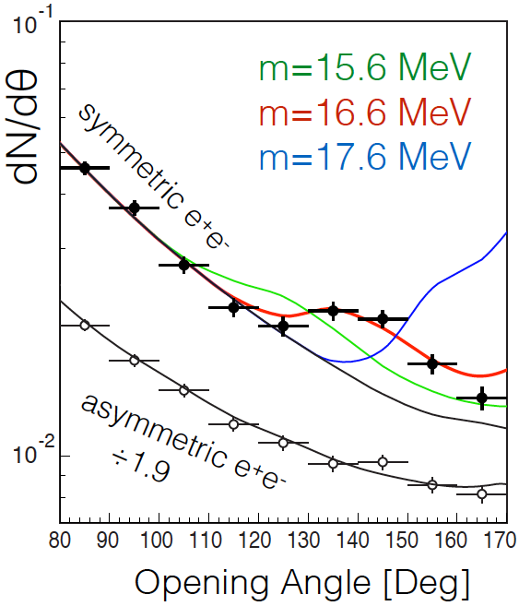
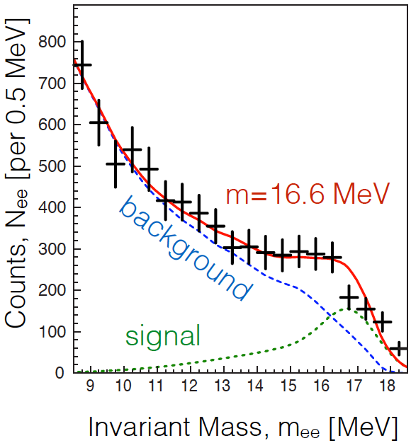
THE ATOMKI ANOMALY
The e⁺e⁻ opening angle θ (and invariant mass) distributions are well fit to a new particle: χ²/dof = 1.07
  m = 16.7 ± 0.35 (stat) ± 0.5 (sys) MeV
  B(⁸Be* → ⁸Be X) / B(⁸Be* → ⁸Be γ) = 5.6 x 10⁻⁶
Krasznahorkay et al. (2015)

Slide 17
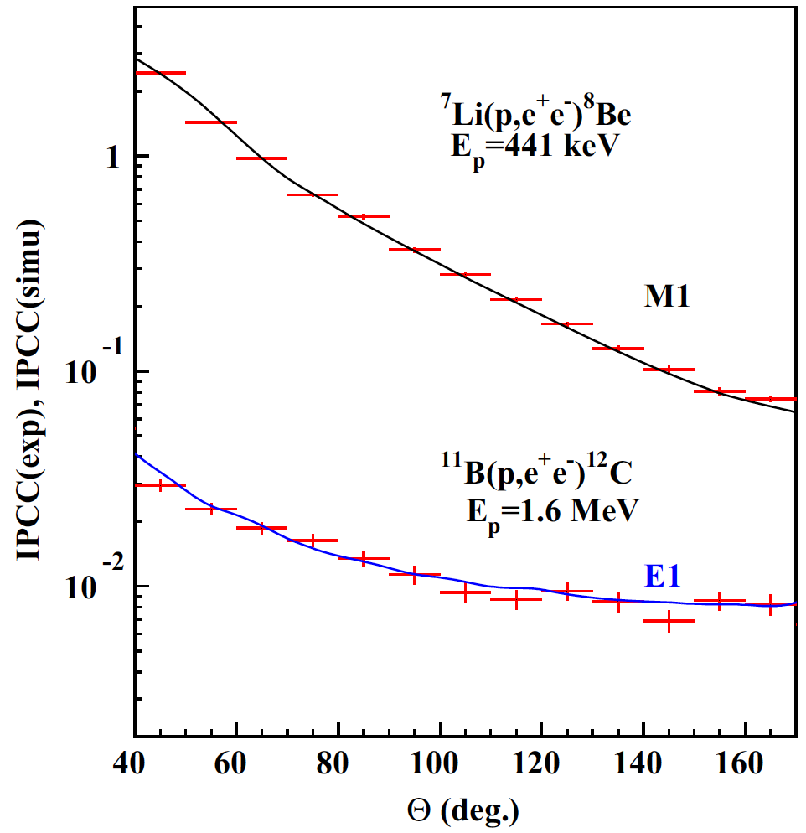
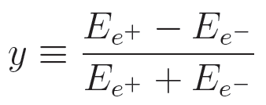
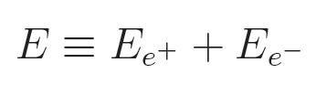
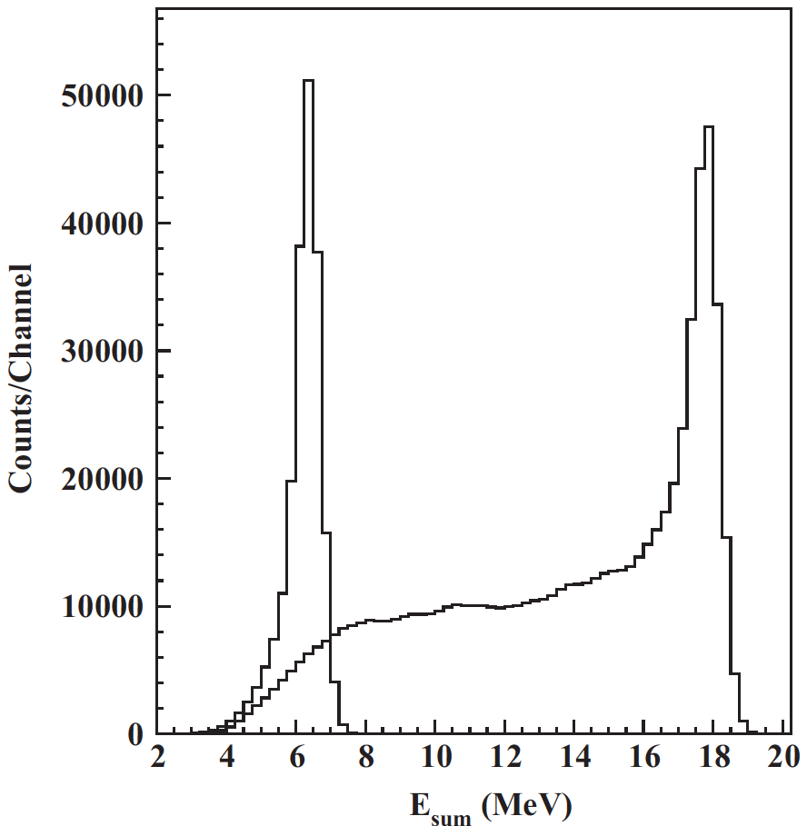
CROSS CHECKS
For example: other (lower energy) decays fit theoretical expectations well
The excess is confined to events with symmetric energies, |y| < 0.5 and large summed energies E > 18 MeV
Gulyas et al. NIM (2015)

Slide 18
SIGNAL CHARACTERISTICS
The excess consists of hundreds of events in each bin and is comparable to the background; this is not a statistical fluctuation
The excess is not a “last bin” effect: bump, not smooth excess
Comparable excess not seen for 17.64 MeV and other states; explainable by phase-space suppression for > 17 MeV particle
Explanations of the signal: (1) an as-yet-unidentified experimental problem, (2) an as-yet-unidentified nuclear theory effect, (3) new particle physics. In the first two cases, the excellent fit to a new particle interpretation is purely coincidental.
Clearly all explanations should be considered (and they are being considered!). Here focus on new particle interpretations.

Slide 19
NEW PHYSICS QUESTIONS
What kinds of neutral bosons are possible?
What are the required parton-level couplings?
Are these consistent with all other experiments?
Is there an anomaly-free model that predicts this?
What other experiments can check this?
Feng, Fornal, Galon Gardner, Smolinsky, Tait, Tanedo (2016); Gu, He (2016);
Chen, Liang, Qiao (2016); Jia, Li (2016); Kitahara, Yamamoto (2016); Ellwanger, Moretti (2016) ; ...

Slide 20
SPIN 0 NEUTRAL BOSONS
SCALARS
“DARK HIGGS”
J^{P} Assignments: 1⁺ → 0⁺ 0⁺
L Conservation: L = 1
Parity Conservation: P = (-1)^{L} = 1
Forbidden in parity-conserving theories
PSEUDOSCALARS
“AXION-LIKE PARTICLES”
We noted that the aγγ couplings are highly constrained at 17 MeV
But Ellwanger and Moretti (2016) noted that these constraints are modified by the required a → e⁺e⁻ decays and found phenomenologically viable parameters
Dobrich et al. (2015)

Slide 21
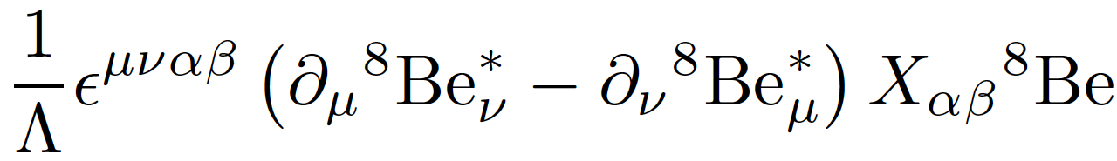

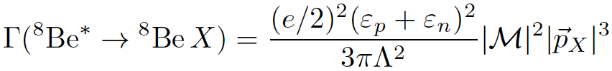
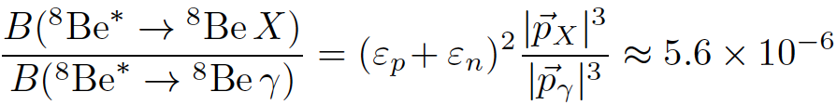


SPIN-1 GAUGE BOSONS
What quark-, nucleon-level couplings are required? In general requires calculating nuclear matrix elements
But for 1⁻ vector, in the EFT, there is only 1 operator
Neglecting isospin mixing,
The nuclear matrix elements and Λ cancel in the ratio
where and are the nucleon X-charges (in units of e)

Slide 22

THE REQUIRED PARTON-LEVEL COUPLINGS
To get the right signal strength:
For a dark photon with couplings proportional to SM couplings, this implies kinetic mixing parameter
~ 0.01
which is excluded
This cannot be a dark photon
??

Slide 23
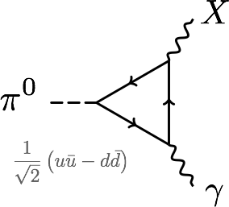
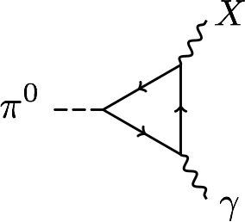
PROTOPHOBIA
The dominant constraints are null results from searches for π⁰ → X γ → e⁺ e⁻ γ
Eliminated if Q_{u}X_{u}– Q_{d}X_{d} ≈ 0 or 2X_{u} + X_{d} ≈ 0 or X_{p} ≈ 0
A protophobic gauge boson with couplings to neutrons, but suppressed couplings to protons, can explain the ⁸Be signal without violating other constraints
u, d
p, n

Slide 24
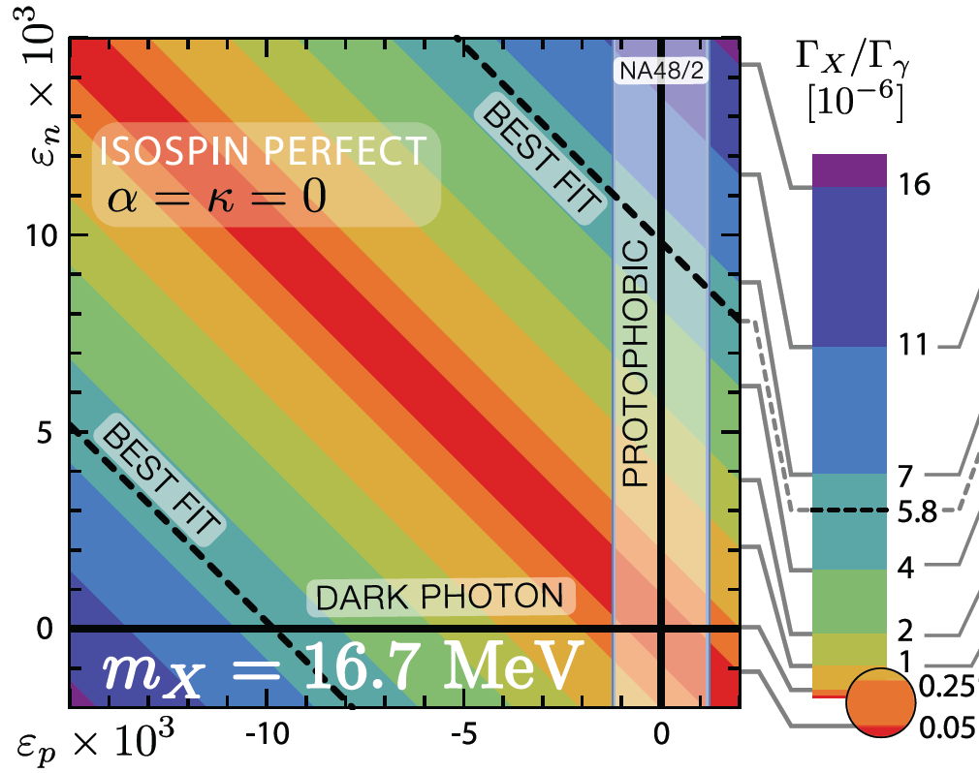
PROTOPHOBIC GAUGE BOSON
The ⁸Be anomaly can be explained by a protophobic gauge boson with ε_{n} ~ 10⁻² and ε_{p} < 10⁻³
Feng, Fornal, Galon Gardner, Smolinsky, Tait, Tanedo (2016)

Slide 25






EFFECT OF ISOSPIN MIXING
There are strong indications that the ⁸Be 1⁺ states are isospin-mixed
Barker (1966); Oothoudt, Garvey (1977); Pastore, Wiringa, Pieper, Schiavilla (2014)
In general, this can have a large effect on the width, changing
to
In the protophobic limit, however, the effect is O(10%)

Slide 26
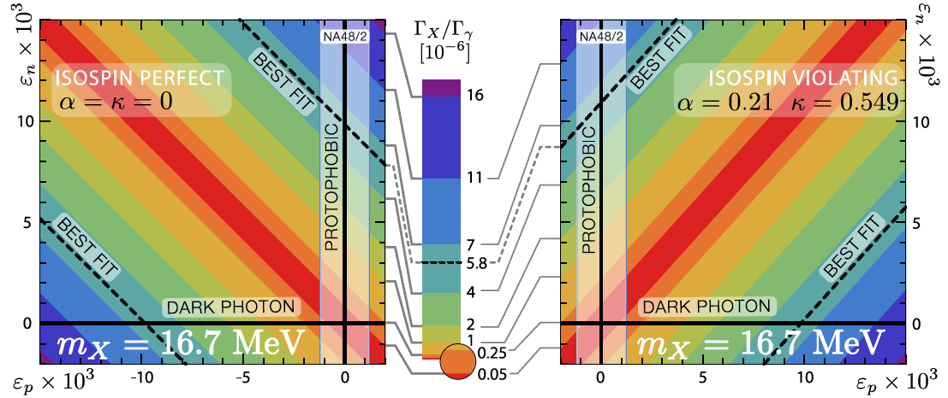
EFFECTS OF ISOSPIN MIXING
Feng, Fornal, Galon Gardner, Smolinsky, Tait, Tanedo (2016)

Slide 27
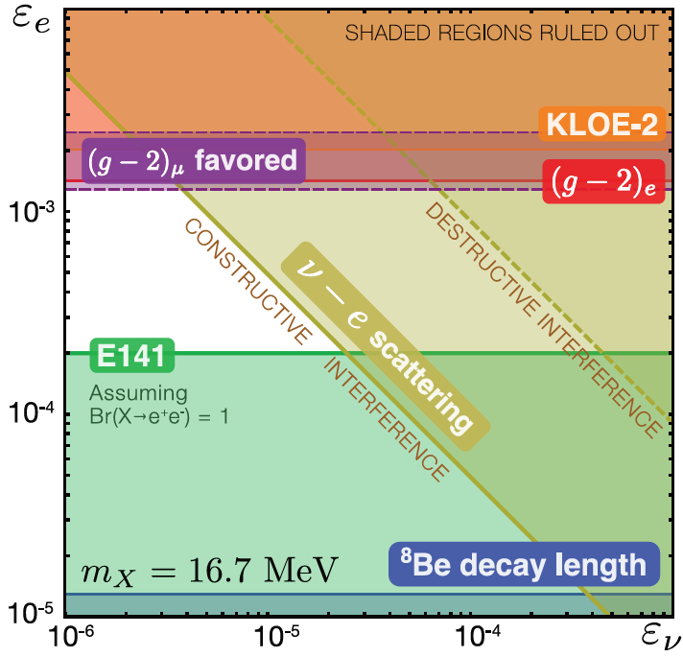
LEPTON COUPLING CONSTRAINTS
Consider all constraints and also the region favored by (g-2)μ
In the end, require 10⁻⁴ < ε_{e} < 10⁻³, and |ε_{e}ε_{ν}|^{1/2} < 3 x 10⁻⁴
1604.07411

Slide 28
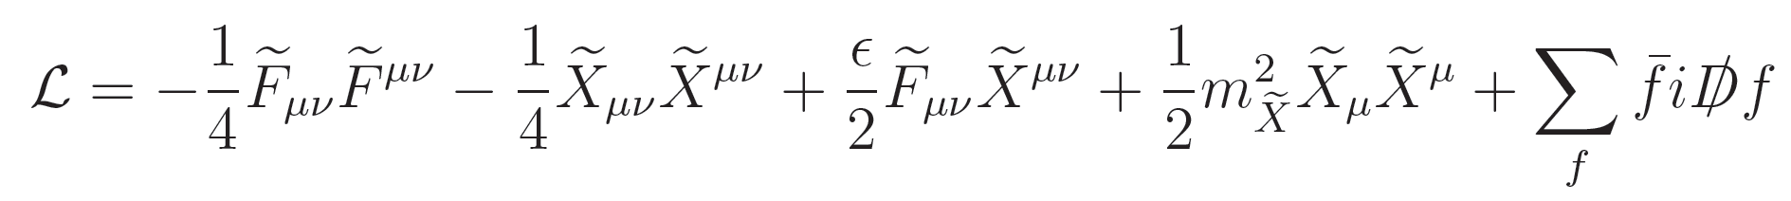
ANOMALY-FREE MODELS
Feng, Fornal, Galon Gardner, Smolinsky, Tait, Tanedo (2016)
How strange is protophobia? The Z boson is protophobic at low energies, as is a gauge boson coupling to B-L-Q or B-Q
The latter observation suggests a model-building strategy: consider a model with a light B-L or B gauge boson. It will generically kinetically mix with the photon:
In the mass basis, the SM photon couplings to SM fermions are unchanged, but the B-L or B gauge boson’s couplings to SM fermions will be shifted by Q.

Slide 29
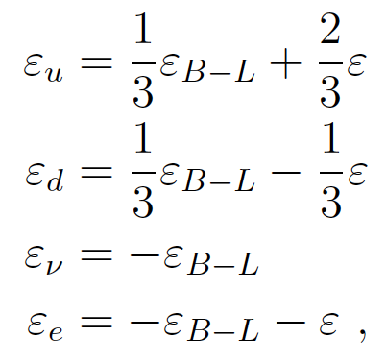
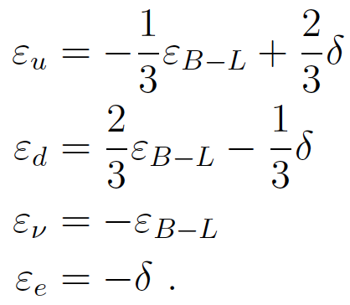

A B-L PROTOPHOBIC MODEL
Gauge the U(1)_{B-L} global symmetry of the SM. This is anomaly-free with the addition of 3 sterile neutrinos.
Generically the B-L boson kinetically mixes with the photon:
For ε ≈ -ε_{B-L} to O(10%) (small δ), we get B-L-Q charges: ε_{u} ≈ ε/3 and ε_{d} ≈ -2ε/3 (protophobia) and ε_{e} << ε_{u,d} . The neutrino X-charge is, however, generically too big.

Slide 30
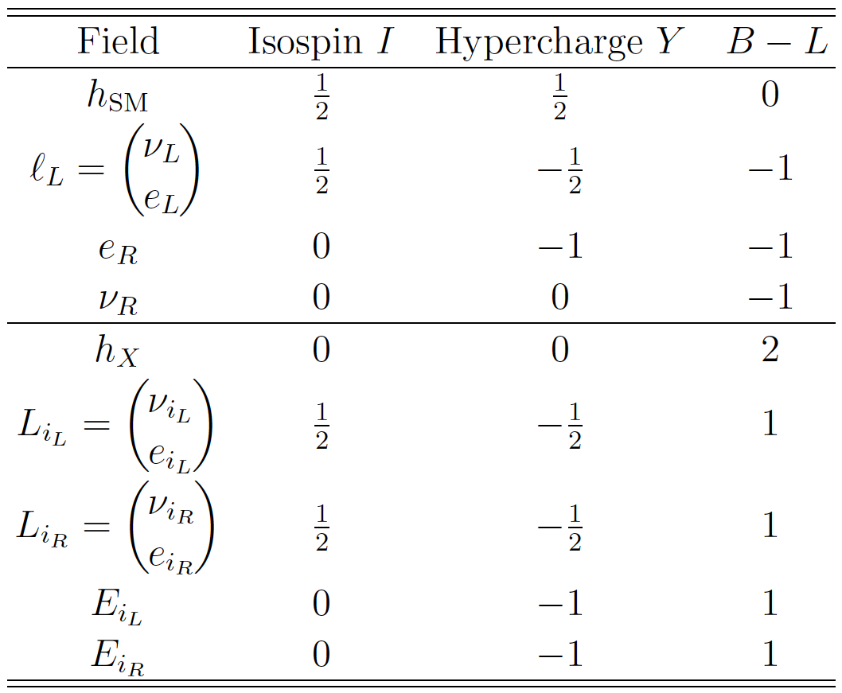
A B-L PROTOPHOBIC MODEL
The neutrino charges can be neutralized by mixing with new, vector-like “4th generation” leptons with opposite B-L charge.
When the B-L Higgs boson gets a ~10 GeV vev, it
  gives a 17 MeV mass to the B-L gauge boson
  Mixes the SM and new neutrino fields, neutralizing the neutrinos
  Generates a Majorana mass for the SM neutrinos → see-saw
Implies ~100 GeV 4th generation leptons

Slide 31
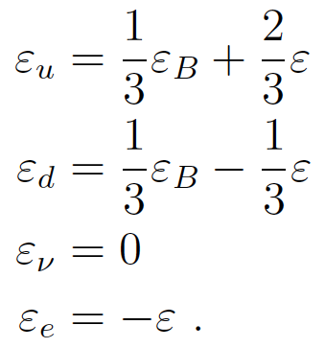
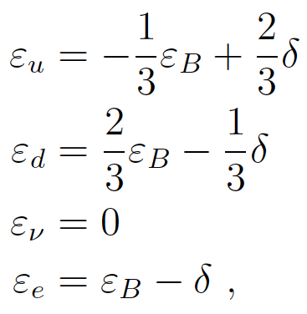

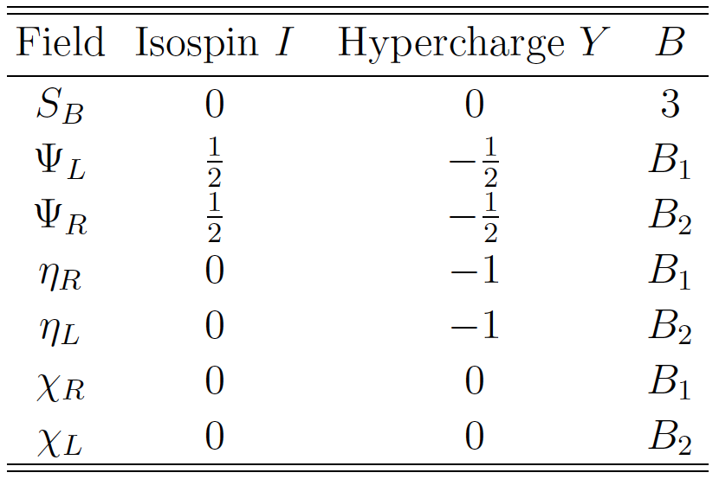
A U(1)_{B} PROTOPHOBIC MODEL
Alternatively, can gauge the U(1)_{B} global symmetry of the SM. After kinetic mixing,
Now the neutrino is automatically neutral, but we need new fields to cancel anomalies. One of these can be dark matter, and the X boson is then a dark force carrier.

Slide 32
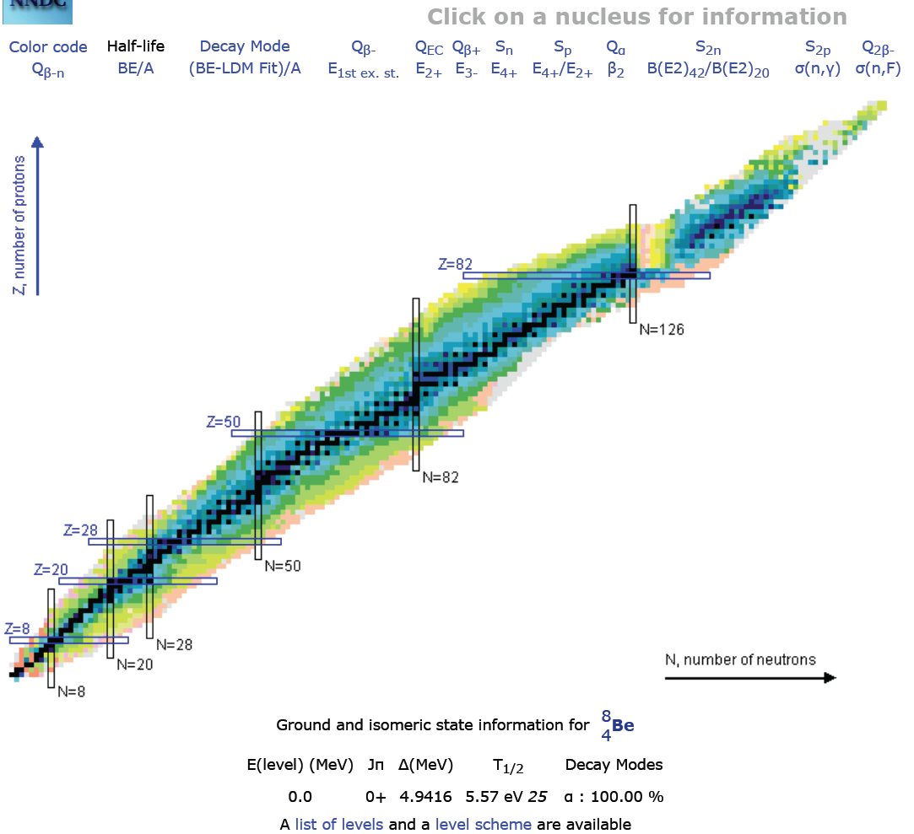
FUTURE TESTS: NUCLEAR PHYSICS
The most direct follow-up tests are to look again at nuclear IPC transitions
The ATOMKI group has new preliminary results with improved detectors for the 18.15 and 17.64 transitions
Other groups may be able to duplicate this in nuclear labs or at particle experiments where ⁸Be transitions are used as a calibration source of high-energy photons
Are other transitions possible? E.g., ¹⁰B (19.3), ¹⁰Be (17.8)

Slide 33
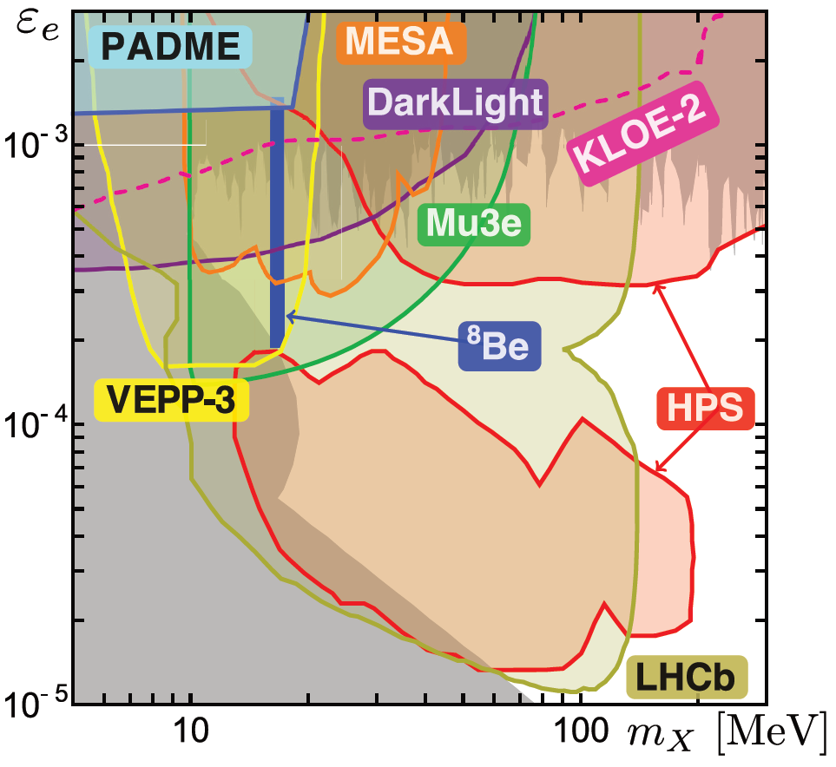
FUTURE TESTS: “DARK PHOTON” EXPTS
Also SHiP, SeaQuest, … There are a host of experiments that have long been planned for dark photon searches, and may now be sensitive to the 17 MeV range.
See “Advances in Dark Matter and Particle Physics 2016,” Messina, Italy, October 2016
1604.07411

Slide 34
CONCLUSIONS
There is currently a 6.8σ anomaly in ⁸Be* IPC decays. A particle interpretation yields a χ²/dof = 1.07 best fit with
  m = 16.7 ± 0.35 (stat) ± 0.5 (sys) MeV
  B(⁸Be* → ⁸Be X) / B(⁸Be* → ⁸Be γ) = 5.6 x 10⁻⁶
The data are consistent with a protophobic gauge boson that simultaneously resolves (to within 2σ) the discrepancy in (g-2)_{μ}
In simple SM extensions, the protophobic gauge boson is realized by a U(1)_{B-L} or U(1)_{B} gauge boson that kinetically mixes with the photon
Many opportunities for near future experimental tests

