Slide 1
THE BERYLLIUM ANOMALY
AND NEW PHYSICS
New Physics at the Intensity Frontier
CERN-EPFL-Korea Theory Institute
Jonathan Feng, University of California, Irvine
21 February 2017

Slide 2







OUTLINE
A. J. Krasznhorkay et al., “Observation of Anomalous Internal Pair Creation in ⁸Be: A Possible Indication of a Light, Neutral Boson,” 1504.01527 [nucl-ex], PRL 116, 042501 (2016)
J. Feng et al., “Protophobic Fifth Force Interpretation of the Observed Anomaly in ⁸Be Nuclear Transitions,” 1604.07411 [hep-ph], PRL 117, 071803 (2016)
J. Feng et al., “Particle Physics Models for the 17 MeV Anomaly in Beryllium Nuclear Decays,” 1608.03591 [hep-ph], PRD 95, 035017 (2017)
Jonathan
Feng
Bart
Fornal
Iftah
Galon
Susan
Gardner
Jordan
Smolinsky
Tim
Tait
Flip
Tanedo

Slide 3
NEW PHYSICS AT THE INTENSITY FRONTIER
There are currently many outstanding puzzles: neutrino masses, gauge hierarchy, strong CP, flavor, dark matter, baryogenesis, dark energy,...
Some of these motivate searches for new particles and forces at high energies: the energy frontier
But some also motivate searches for new physics that is light, but weakly coupled: the intensity frontier
Of particular interest here are connections to dark matter

Slide 4
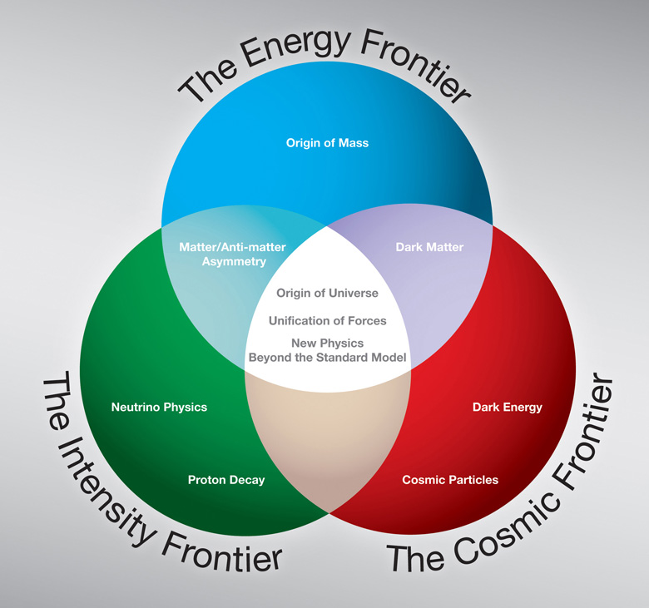
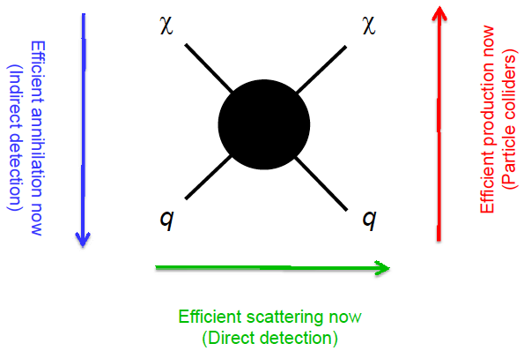
DARK MATTER AT THE INTENSITY FRONTIER
!!!

Slide 5
DARK SECTORS
All evidence for dark matter is gravitational. Perhaps it’s in a hidden sector, composed of particles with no SM gauge interactions (electromagnetic, weak, strong)
The dark sector may have a rich structure with matter and forces of its own
Visible
Sector
Dark
Sector
Lee, Yang (1956); Kobsarev, Okun, Pomeranchuk (1966); Blinnikov, Khlopov (1982);
Foot, Lew, Volkas (1991); Hodges (1993); Berezhiani, Dolgov, Mohapatra (1995);
Pospelov, Ritz, Voloshin (2007); Feng, Kumar (2008);...

Slide 6

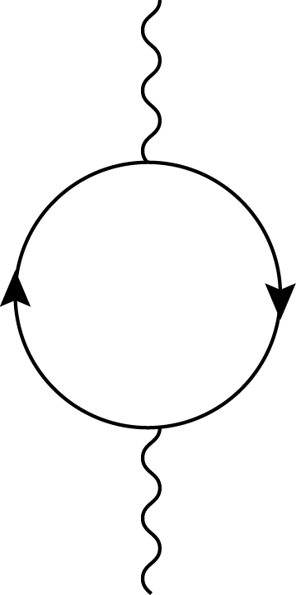
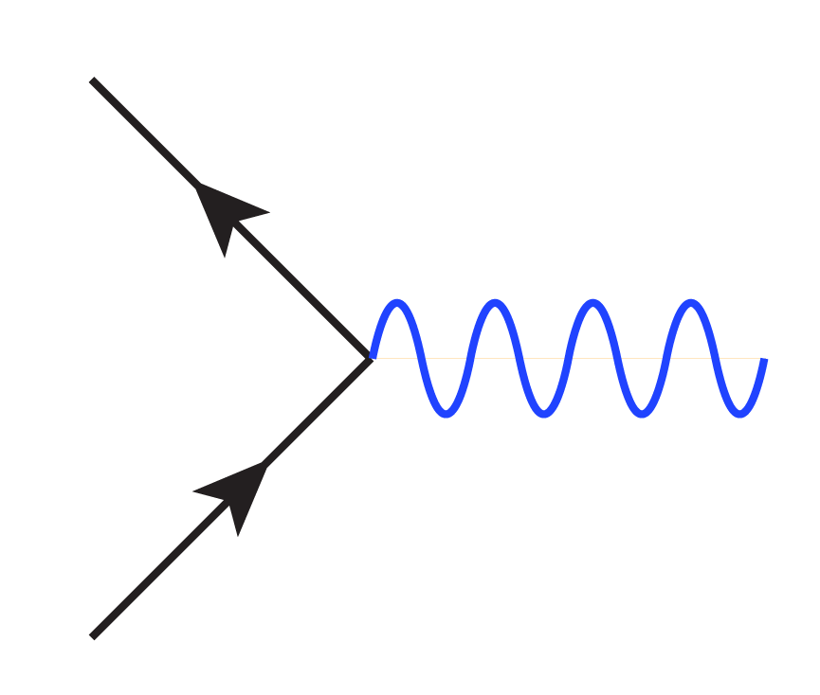
VECTOR PORTAL
Holdom (1986)
To detect a dark sector, we must know how it interacts with us
Suppose there are mediator particles with both dark sector and visible sector charges. This induces a kinetic mixing term , with ε ~ 10⁻³ e e_{h}, where the 10⁻³ comes from it being a 1-loop effect, and e and e_{h} are the visible and hidden sector charges
The physical state is a massive dark photon A’ with the same couplings as the SM photon, but suppressed by ε
f
εeQ_{f}
A
mediator
particles
A_{h}
  A’
f

Slide 7
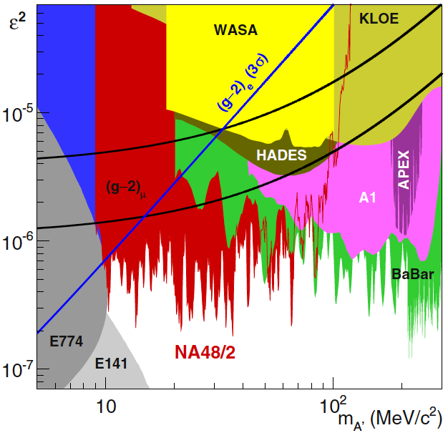
CURRENT CONSTRAINTS
In recent years, this has motivated a host of searches in the (mass, coupling) plane, with special interest around ε~10⁻³ and m_{A’} ~ MeV – GeV, where experiments can probe and muon g-2 can be resolved
_{Pospelov (2008)}
The dark photon resolution to the muon g-2 anomaly is now disfavored, but there is still a lot of parameter space to explore and many proposed experiments

Slide 8
DARK FORCES IN NUCLEAR PHYSICS
The interest in new, light gauge bosons opens up new connections to other branches of physics
In particular, for the MeV scale, nuclear physics becomes a relevant probe of new particles
_{Treiman, Wilczek (1978)}
Donnelly, Freedman, Lytel, Peccei, Schwartz (1978)
Savage, McKeown, Filippone, Mitchell (1986)
A recent 6.8σ experimental anomaly might indicate the production of new particles in excited ⁸Be decays
A. J. Krasznahorkay et al., PRL, 1504.01527 [nucl-ex]
Could these be new gauge bosons?
Feng, Fornal, Galon, Gardner, Smolinsky, Tait, Tanedo,
PRL, 1604.07411 [hep-ph]; PRD, 1608.03591 [hep-ph]

Slide 9
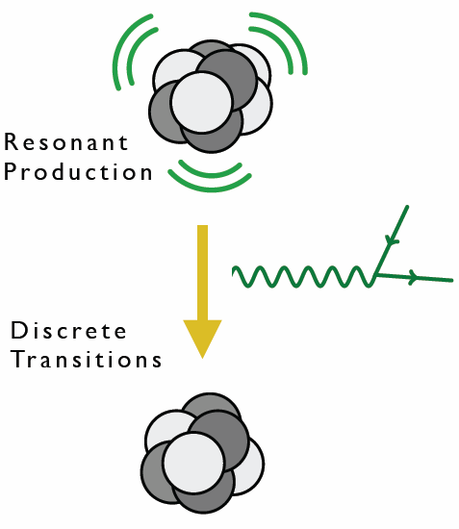
⁸BE AS A NEW PHYSICS LAB
⁸Be is composed of 4 protons and 4 neutrons
Excited states can be produced in large numbers through p + ⁷Li → high statistics “intensity” frontier
Excited states decay to ground state with relatively large energies (~20 MeV)
⁸Be nuclear transitions then provide interesting probes of light, weakly-coupled particles

Slide 10
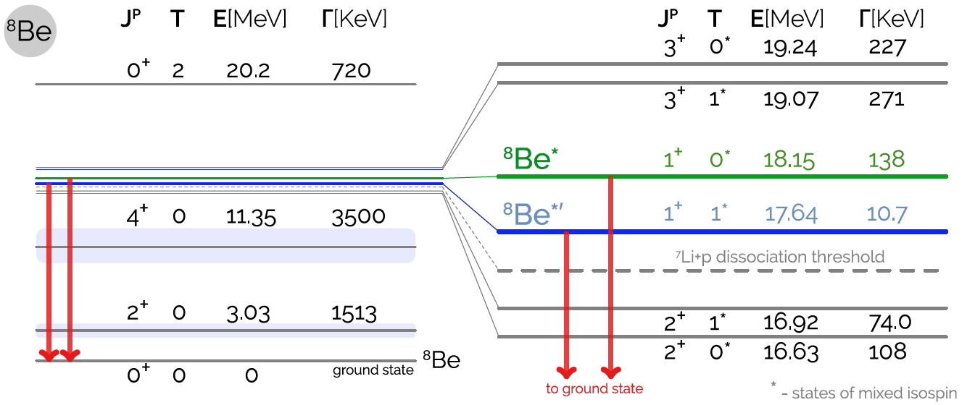
⁸BE SPECTRUM
Many excited states with different spins and isospins
Of special interest: the ⁸Be* (18.15) and ⁸Be*’ (17.64) states
1608.03591; based on Tilley et al. (2004), http://www.nndc.bnl.gov/nudat2, Wiringa et al. (2013)

Slide 11
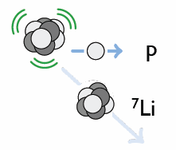
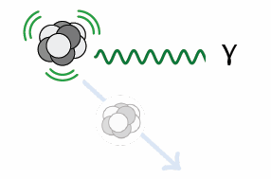
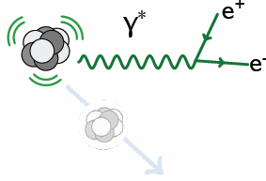
⁸BE* DECAY
Hadronic
B(p ⁷Li) ≈ 100%
Electromagnetic
B(⁸Be γ) ≈ 1.5 x 10⁻⁵
Internal Pair Creation
B(⁸Be e⁺ e⁻) ≈ 5.5 x 10⁻⁸

Slide 12
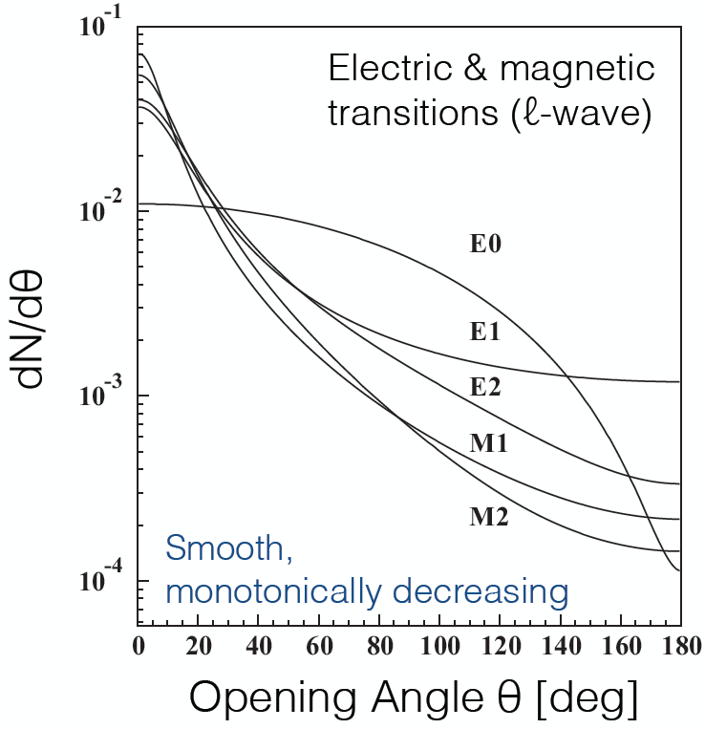
⁸BE* DECAY
Internal Pair Creation
B(⁸Be e⁺ e⁻) ≈ 5.5 x 10⁻⁸
For e⁺e⁻ produced by a virtual photon, dN/dθ is sharply peaked at low θ and is expected to be a monotonically decreasing function of θ
θ
Gulyas et al. (2015); Rose (1949)

Slide 13
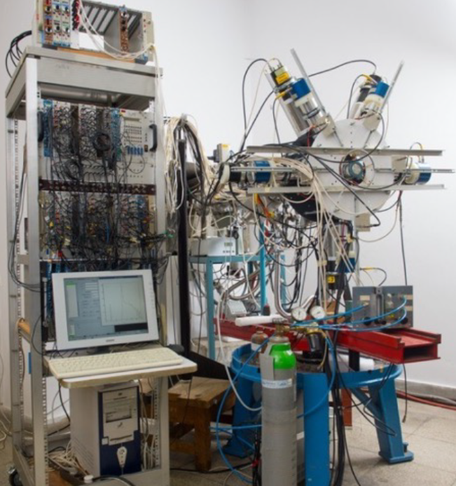
THE ATOMKI ⁸BE EXPERIMENT

Slide 14
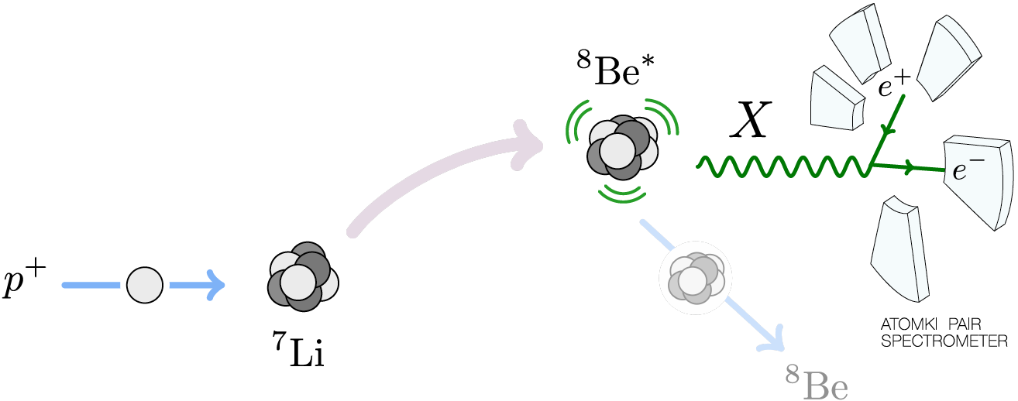
THE ATOMKI ⁸BE EXPERIMENT
A ~1 μA p beam with ΔE_{p} ~ 10 keV strikes a thin ⁷Li foil target. The beam energy can be adjusted to select various ⁸Be excited state resonances. Typical run time is ~ a week at each proton energy.

Slide 15
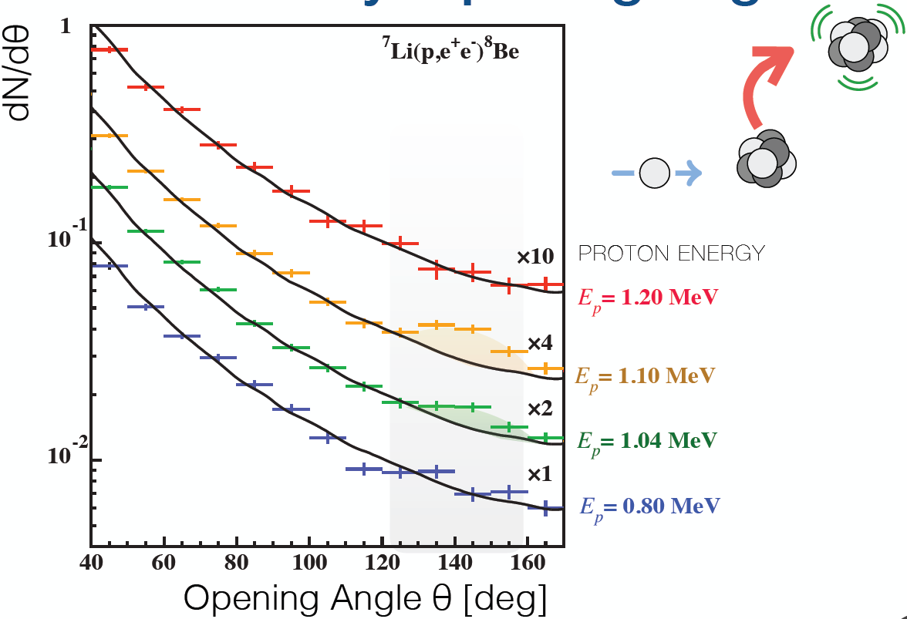
THE ATOMKI ANOMALY
A bump at ~140 degrees is observed as one passes through the ⁸Be* resonance
Background fluctuation probability: 5.6 x 10⁻¹² (6.8σ)
floating M1 + E1
Krasznahorkay et al. (2015)

Slide 16
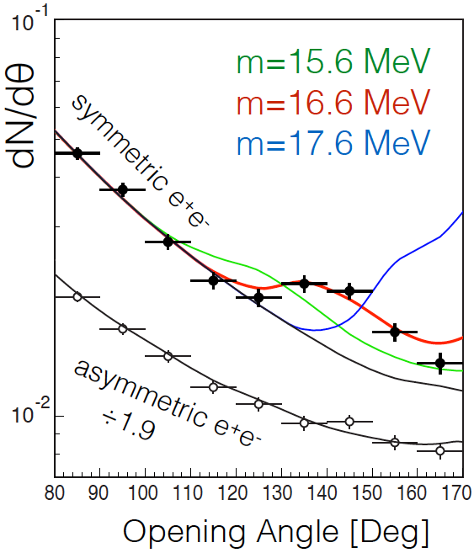
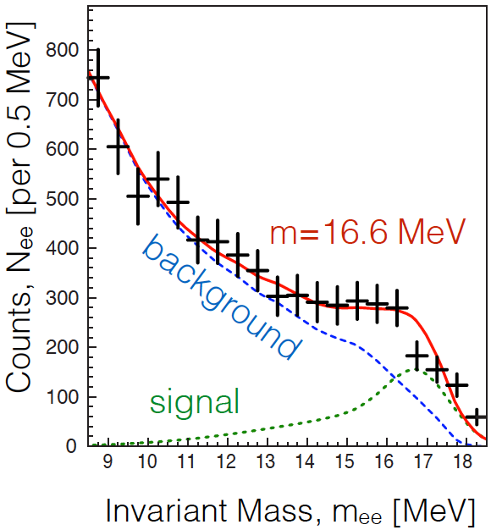
THE ATOMKI ANOMALY
The θ (and m_{ee}) distributions can be explained by postulating a new particle and the decay ⁸Be* → ⁸Be X, followed by X → e⁺e⁻
Best fit parameters: m = 16.7 ± 0.35 (stat) ± 0.5 (sys) MeV
B(⁸Be* → ⁸Be X) / B(⁸Be* → ⁸Be γ) = 5.6 x 10⁻⁶
χ²/dof = 1.07
Krasznahorkay et al. (2015)

Slide 17
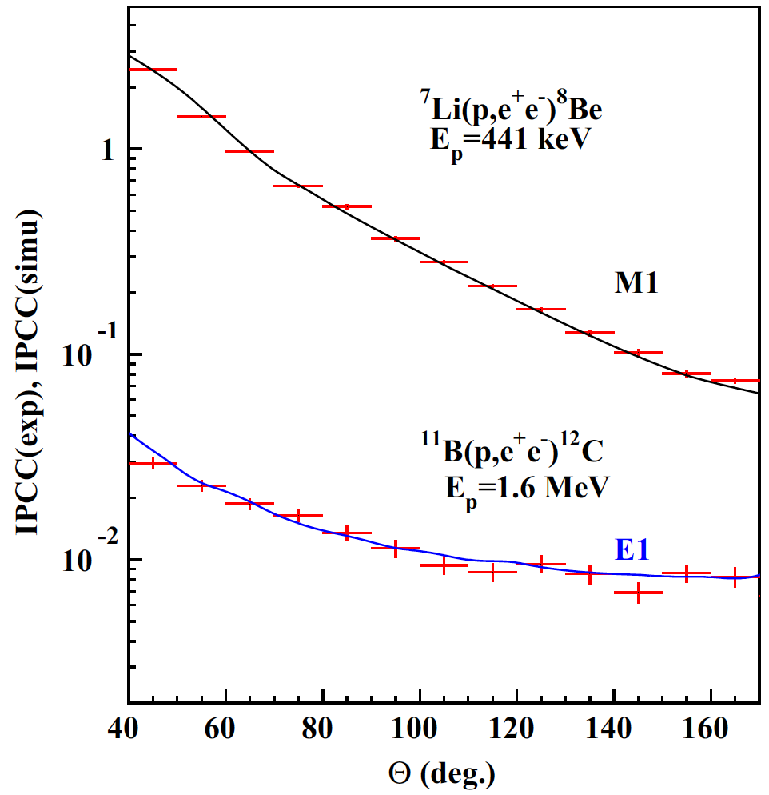
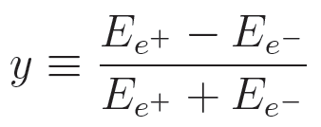
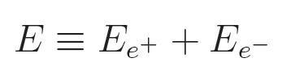
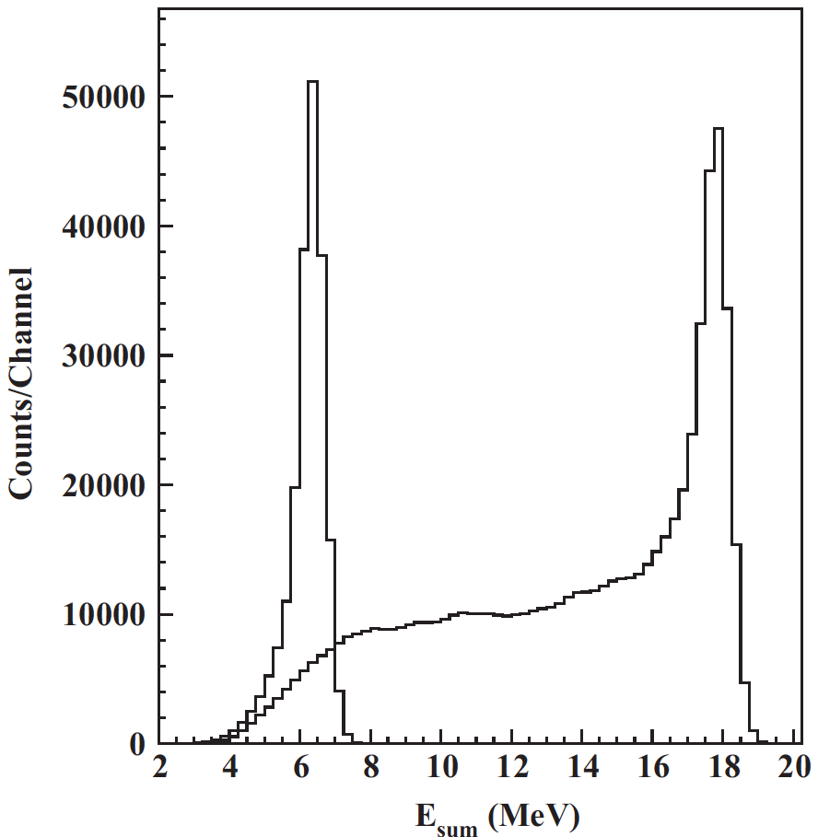
CROSS CHECKS
For example: other (lower energy) decays fit theoretical expectations well
The excess is confined to events with symmetric energies, |y| < 0.5 and large summed energies E_{sum} > 18 MeV, as expected for a new particle interpretation
⁸Be*’
Gulyas et al. NIM (2015)

Slide 18
POSSIBLE EXPLANATIONS
Three possibilities:
  (1) an as-yet-unidentified nuclear experimental problem
  (2) an as-yet-unidentified nuclear theory effect
  (3) new particle physics
(1) Nuclear Experiment
  The excess consists of hundreds of events in each bin and is comparable to the background; this is not a statistical fluctuation
  The excess is not a “last bin” effect: bump, not smooth excess
  Reports of conflicts with previous results of this collaboration have in some cases been highly exaggerated
  If resolved by nuclear experiment, the excellent fit to a new particle interpretation is purely coincidental
  Comparable bump not seen for 17.64 MeV state: explainable by phase-space suppression for 17 MeV particle, but smaller excess should eventually appear
  Hungarian group is now collecting data with improved detector, continues to see bump
  Similar experiments by other groups would be of great interest

Slide 19
POSSIBLE EXPLANATIONS
(2) Nuclear Theory
  Must explain bump in 18.15 IPC decays
  Must simultaneously explain lack of similarly-sized bump in (isospin-mixed) 17.64 IPC decays
  If resolved by nuclear theory, the excellent fit to a new particle interpretation is purely coincidental
  Preliminary results investigating interference effects reported at American Physical Society meeting in January by Zhang and Miller
  Further work would be of great interest
(3) Particle Physics
  If it’s new physics, what kind of new particle can it be?
  Is it consistent with all other experiments?
  Are there complete particle physics models that can incorporate this new particle?
  What other experiments can confirm or exclude this?
Feng, Fornal, Galon Gardner, Smolinsky, Tait, Tanedo (2016); Gu, He (2016);
Chen, Liang, Qiao (2016); Jia, Li (2016); Kitahara, Yamamoto (2016);
Ellwanger, Moretti (2016) ; Kozaczuk, Morrissey, Stroberg (2016); ...

Slide 20
WHAT KIND OF NEW PARTICLE CAN IT BE?
Some Quick Observations
Must couple to both quarks and electrons
Must be neutral
Must be a boson
Not everything works
For example: a spin 0 boson (“dark Higgs boson”)
J^{P} Assignments: 1⁺ → 0⁺ 0⁺
L Conservation: L = 1
Parity Cons.: P = (-1)^{L} = 1
Forbidden in parity-conserving theories
X

Slide 21
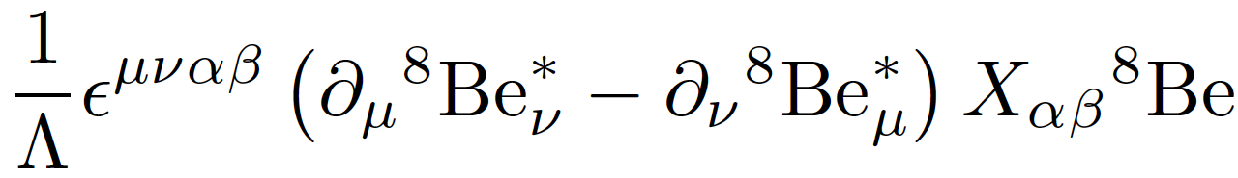

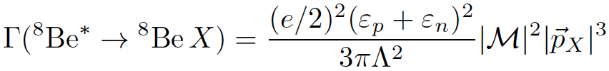
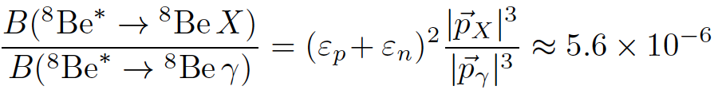


SPIN-1 GAUGE BOSONS
What quark-, nucleon-level couplings are required? In general requires calculating nuclear matrix elements
But for 1⁻ vector, in the EFT, there is only 1 operator
Neglecting isospin mixing,
The nuclear matrix elements and Λ cancel in the ratio
where and are the nucleon X-charges (in units of e)

Slide 22
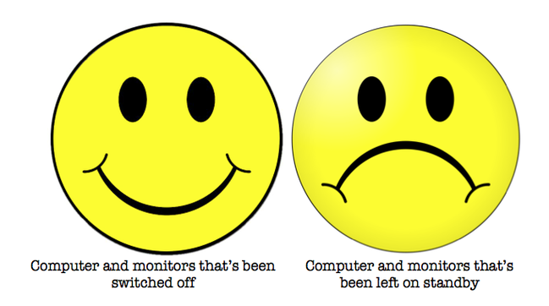

DARK PHOTON?
Consider the general case of a spin-1 gauge boson with couplings ε_{f}e to particle f
To get the right signal strength, need
For the special case of a dark photon with ε_{f} = εQ_{f}, this implies kinetic mixing parameter ε ~ 0.01, which is excluded
This is not a dark photon

Slide 23
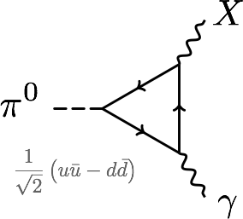
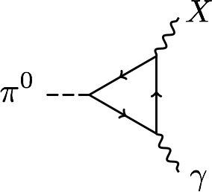
PROTOPHOBIA
At 17 MeV, the dominant constraints are null results from searches for exotic pion decays π⁰ → X γ → e⁺ e⁻ γ
Eliminated if Q_{u}X_{u}– Q_{d}X_{d} ≈ 0 or 2X_{u} + X_{d} ≈ 0 or X_{p} ≈ 0
A protophobic gauge boson with couplings to neutrons, but suppressed couplings to protons, can explain the ⁸Be signal without violating other constraints
u, d
p, n

Slide 24
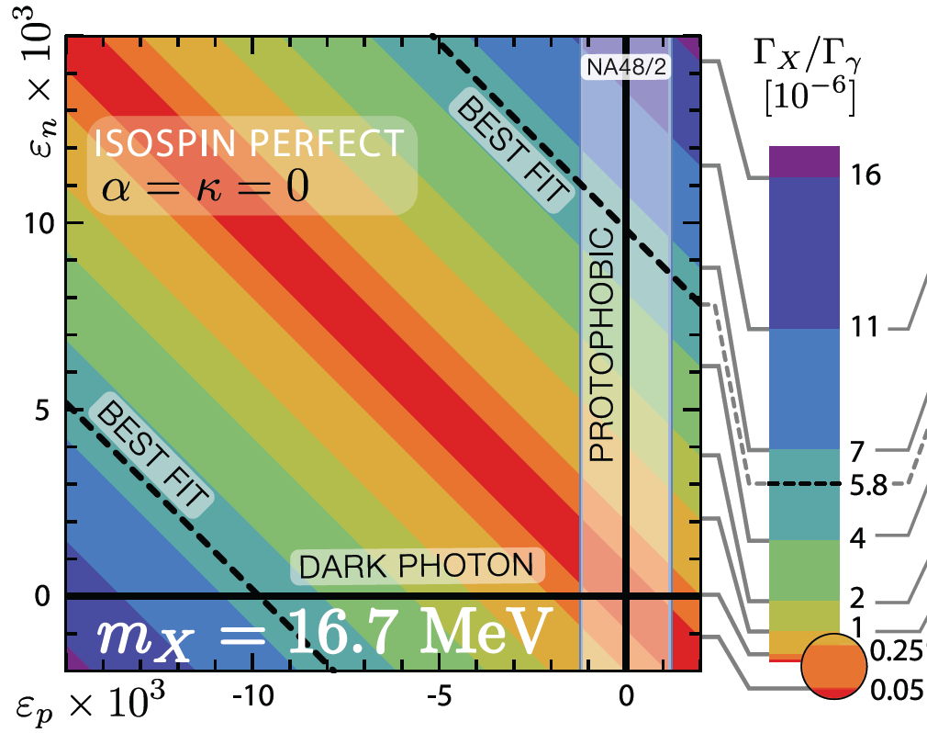
PROTOPHOBIC GAUGE BOSON
The ⁸Be anomaly can be explained by a protophobic gauge boson with ε_{n} ~ 10⁻² and ε_{p} < 10⁻³
Feng, Fornal, Galon Gardner, Smolinsky, Tait, Tanedo (2016)

Slide 25
LEPTON COUPLINGS AND MUON g-2
For a protophobic gauge boson, the NA48/2 “quark” constraints are weakened
Relaxing the dark photon restrictions, one can, then, take electron and muon couplings around 10⁻³
A protophobic gauge boson with such couplings can resolve both the ⁸Be and muon g-2 anomalies
Implies a milli-charged 5th force with range ~ 12 fm

Slide 26
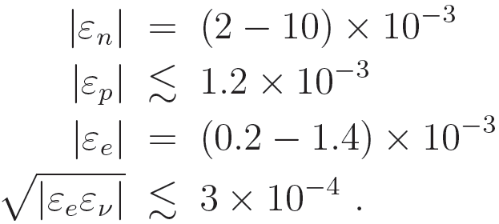
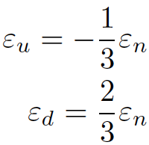
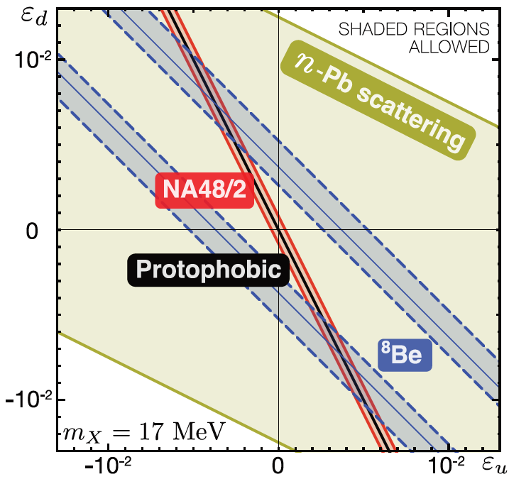
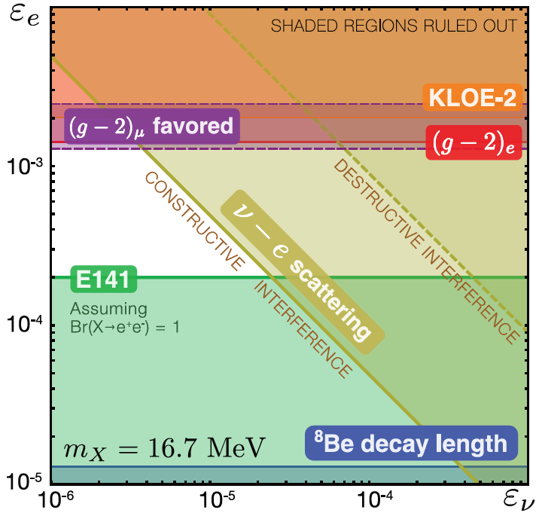
COUPLING CONSTRAINTS IN DETAIL
In the exact protophobic limit:
Feng, Fornal, Galon, Gardner, Smolinsky, Tait, Tanedo (2016)

Slide 27






EFFECT OF ISOSPIN MIXING
There are strong indications that the ⁸Be 1⁺ states are isospin-mixed
Barker (1966); Oothoudt, Garvey (1977); Pastore, Wiringa, Pieper, Schiavilla (2014)
In general, this can have a large effect on the width, changing
to
In the protophobic limit, however, the effect is O(10%)
Feng, Fornal, Galon Gardner, Smolinsky, Tait, Tanedo (2016)

Slide 28
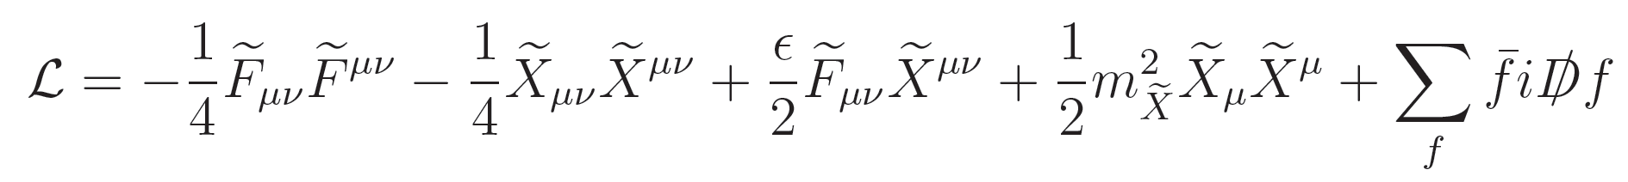
ANOMALY-FREE MODELS
Feng, Fornal, Galon Gardner, Smolinsky, Tait, Tanedo (2016)
How strange is protophobia? The Z boson is protophobic at low energies, as is a gauge boson coupling to B-L-Q or B-Q
The latter observation suggests a model-building strategy: consider a model with a light B-L or B gauge boson. It will generically kinetically mix with the photon:
In the mass basis, the SM photon couplings to SM fermions are unchanged, but the B-L or B gauge boson’s couplings to SM fermions will be shifted by Q.

Slide 29
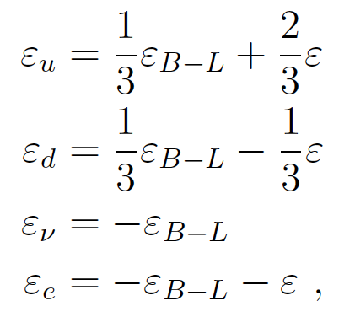
A B-L PROTOPHOBIC MODEL
Gauge the U(1)_{B-L} global symmetry of the SM. This is anomaly-free with the addition of 3 sterile neutrinos.
Generically the B-L boson kinetically mixes with the photon:
For ε ≈ -ε_{B-L}, we get B-L-Q charges:
ε_{u} ≈ ε/3, ε_{d} ≈ -2ε/3 (protophobia) and ε_{e} << ε_{u,d} (nice!)
The neutrino X-charge is, however, generically too big.

Slide 30
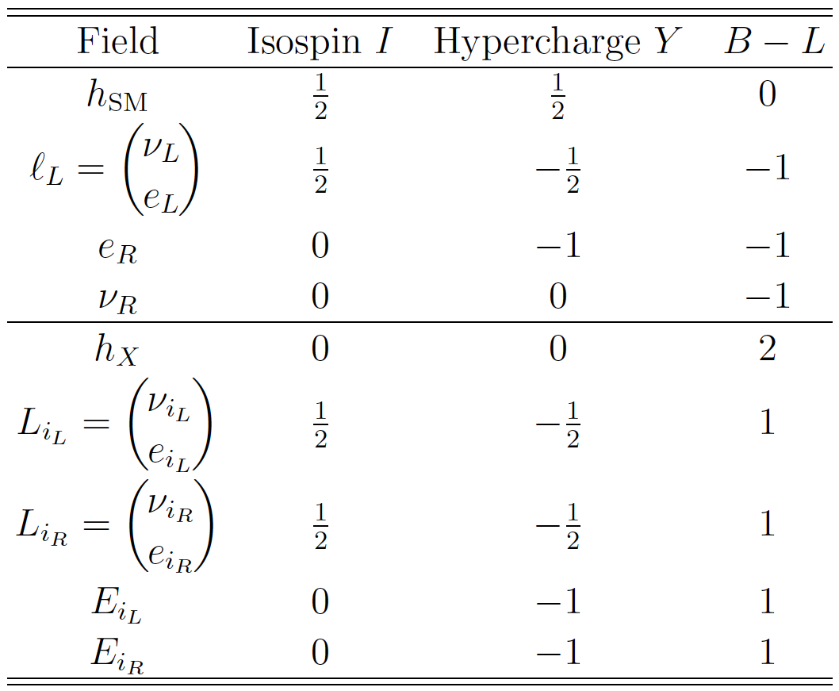
A B-L PROTOPHOBIC MODEL
The neutrino charges can be neutralized by mixing with new, vector-like “4th generation” leptons with opposite B-L charge.
When the B-L Higgs boson gets a ~10 GeV vev, it
  gives a 17 MeV mass to the B-L gauge boson
  Mixes the SM and new neutrino fields, neutralizing the neutrinos
  Generates a Majorana mass for the SM neutrinos → see-saw
Implies ~100 GeV 4th generation leptons

Slide 31
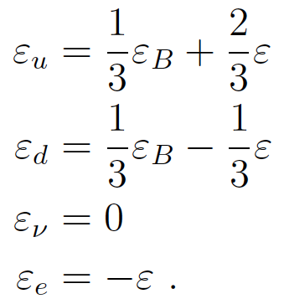
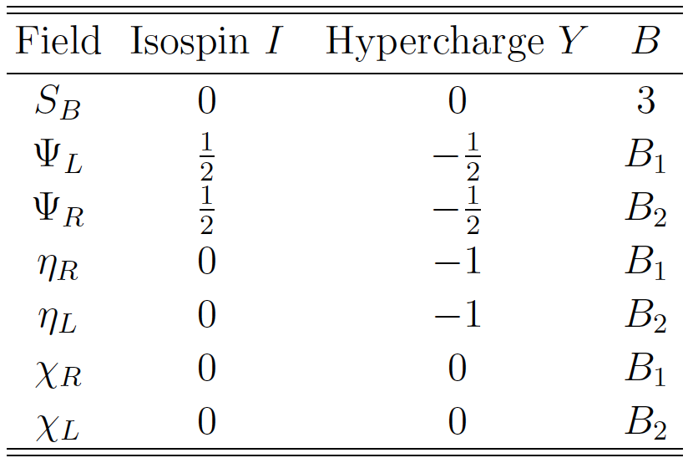
A U(1)_{B} PROTOPHOBIC MODEL
Alternatively, can gauge the U(1)_{B} global symmetry of the SM. After kinetic mixing,
Now the neutrino is automatically neutral, but we need new fields to cancel anomalies. One of these can be dark matter, and the X boson is then a dark force carrier.

Slide 32
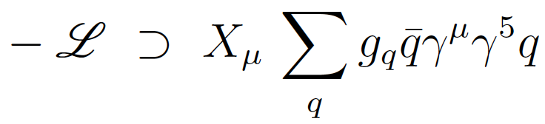
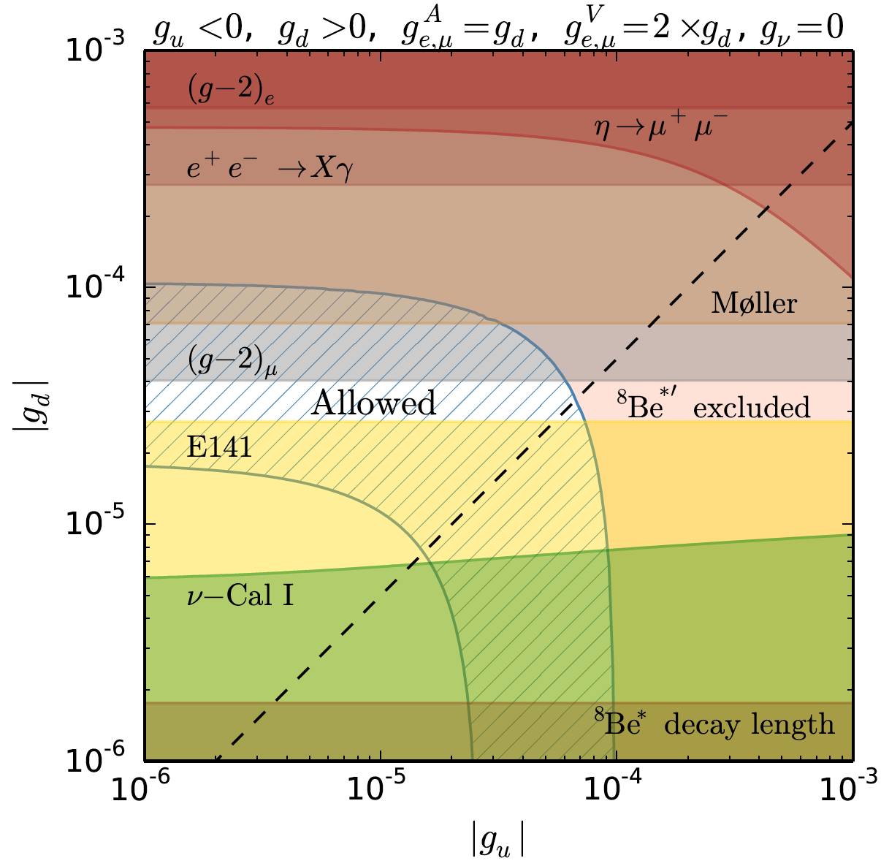
OTHER J^{P} MODELS
Pseudoscalars have also been explored and are also possible
_{Ellwanger, Moretti (2016)}
Axial vectors, which automatically decouple from pion decays, have been analyzed and are also possible
Kozaczuk, Morrissey, Stroberg (2016)

Slide 33
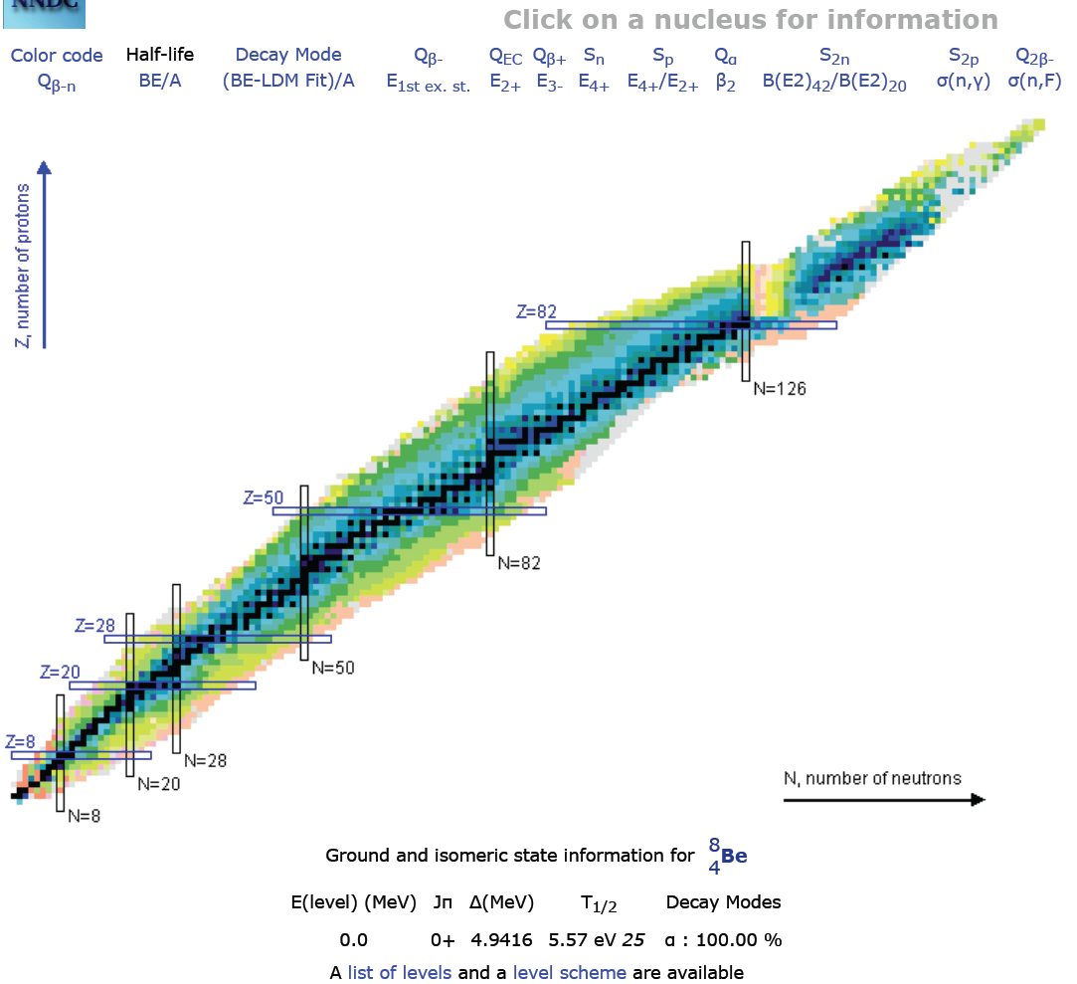
FUTURE TESTS: NUCLEAR PHYSICS
The most direct follow-up tests are to look again at nuclear IPC transitions
The ATOMKI group has new preliminary results with improved detectors for the 18.15 and 17.64 transitions
Other groups can duplicate this in nuclear labs or at particle experiments where ⁸Be transitions are used as a calibration source of high-energy photons
Are other transitions possible? E.g., ¹⁰B (19.3), ¹⁰Be (17.8)

Slide 34
FUTURE TESTS: PARTICLE PHYSICS
There are a host of collider experiments that have been planned for dark photon searches, and may now be sensitive to the 17 MeV range and electron couplings of the desired size
Generally they look for e⁺e⁻ → γX, possibly followed by X → e⁺e⁻
See “Advances in Dark Matter and Particle Physics 2016,” Messina, Italy, October 2016
1604.07411

Slide 35
CONCLUSIONS
There is currently a 6.8σ anomaly in ⁸Be* nuclear decays; the data are beautifully fit with χ²/dof = 1.07 by a new particle interpretation
A possible new physics explanation, consistent with all other constraints, is a protophobic gauge boson that also explains the muon g-2 anomaly
Is it new physics? All the possible resolutions appear non-trivial at present; further work is needed in nuclear and particle experiment and theory
Nuclear physics: bump in 17.64 8Be*’ is phase-space suppressed, but should eventually appear
Particle physics: the parameters m_{X} ~ 17 MeV, ε_{n} ~ (2-10) 10⁻³, ε_{e} ~ (2-14) 10⁻⁴ provide an interesting target for future experiments
A future ⁸Be null result would disfavor new physics, but a confirmation would still be subject to nuclear theory uncertainties; good ideas for complementary probes are welcome
The protophobic gauge boson is a reminder that variants on the standard light boson candidates are easily imagined and may be quite interesting

