Slide 1
THE FUTURE OF DARK MATTER AND DARK FORCES
International Symposium on the Future of Physics and Astronomy
T. D. Lee Institute, Shanghai Jiao Tong University
Jonathan Feng, University of California, Irvine
16 September 2017

Slide 2

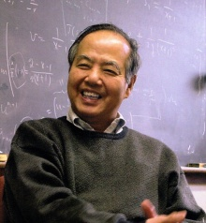


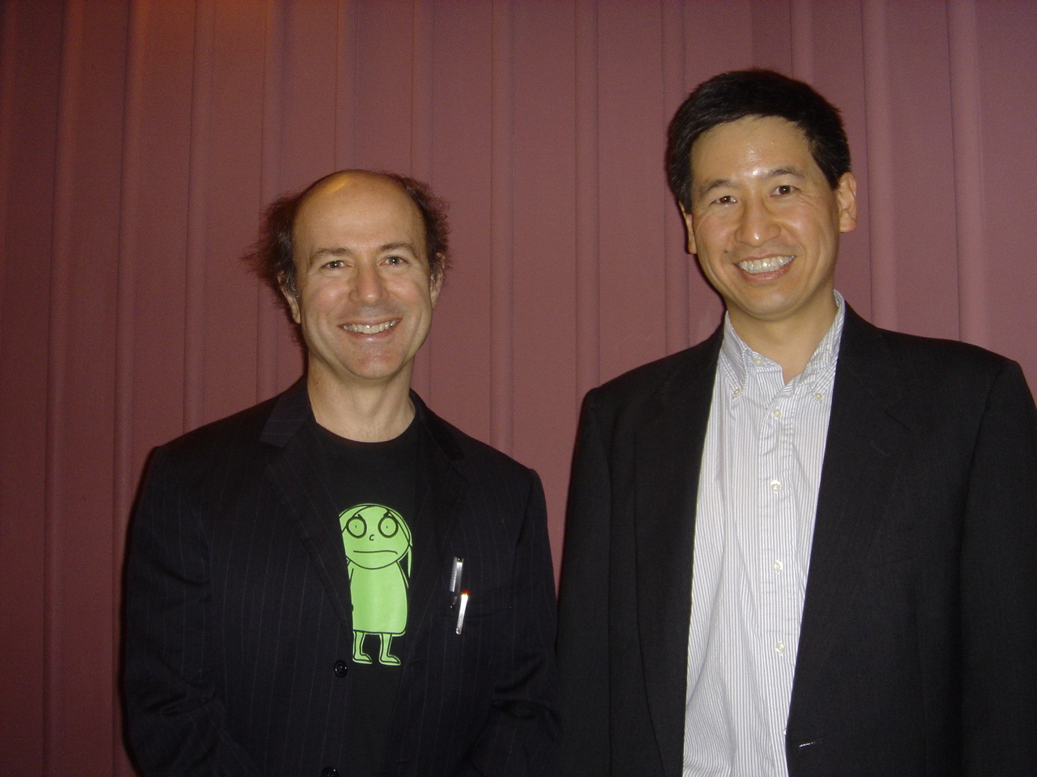
A HAPPY OCCASION
Birthplace of my father in 1937

Slide 3



DARK MATTER
“The Future of Physics and Astronomy”: Identifying dark matter is a central problem in both fields, and appreciation of its importance has grown rapidly in recent years
1997
2007
2017
LHC
LHC
LHC
Standard Model
Higgs Boson
Gauge Hierarchy
Dark Matter
Higgs Boson
Gauge Hierarchy
Higgs Boson
Dark Matter
Gauge Hierarchy

Slide 4
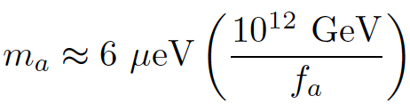
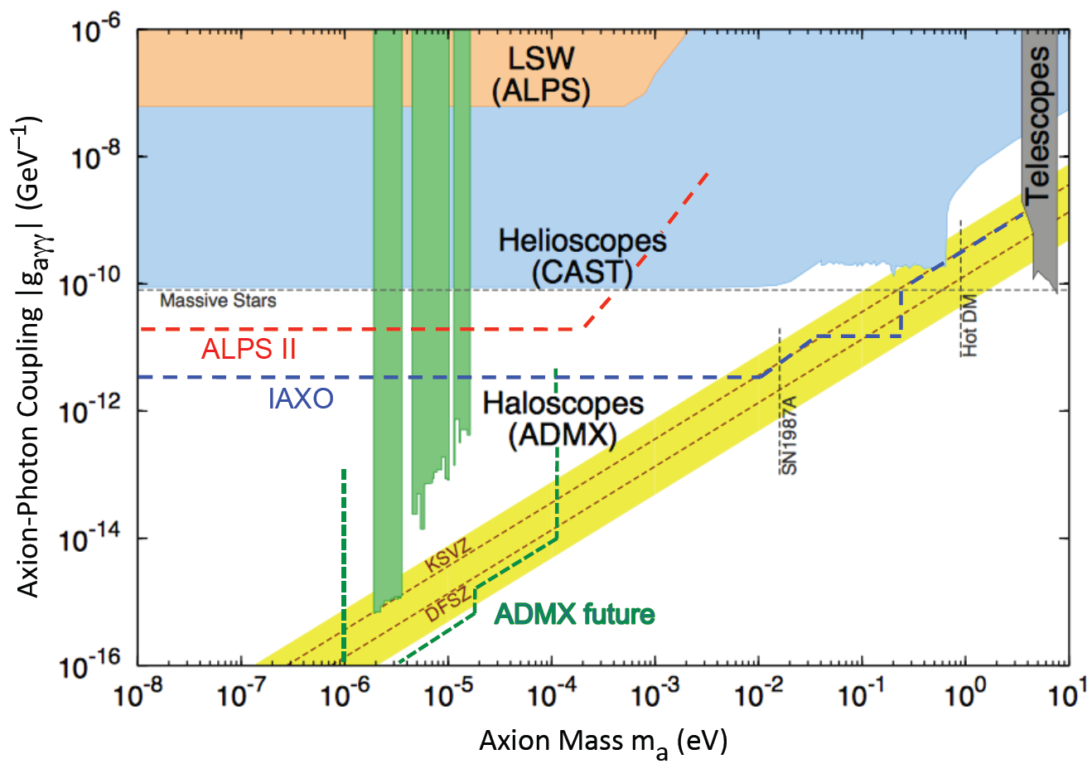
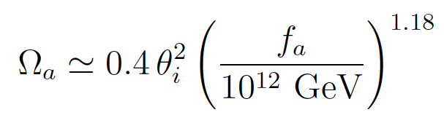
CLASSIC CANDIDATES
Three excellent candidates: sterile neutrinos, axions, WIMPs
Axions are highly motivated by the strong CP problem
Peccei, Quinn (1977); Wilczek (1978); Weinberg (1978)
For axion DM, if θ_{i} ~1, then
f_{a} ~ 10¹² GeV
m_{a} ~ 1-100 μeV
Graham, Irastorza, Lamoreaux, Lindner, van Bibber (2016)

Slide 5
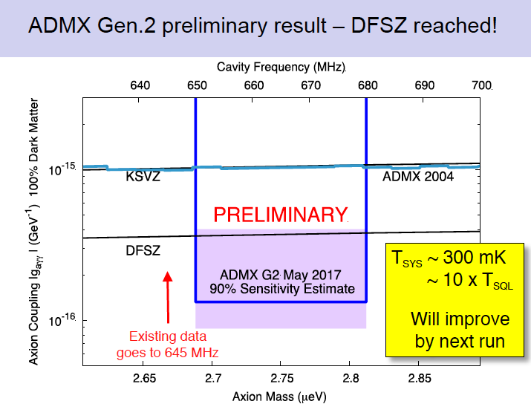
LATEST RESULTS: ADMX G2
van Bibber (2017)

Slide 6
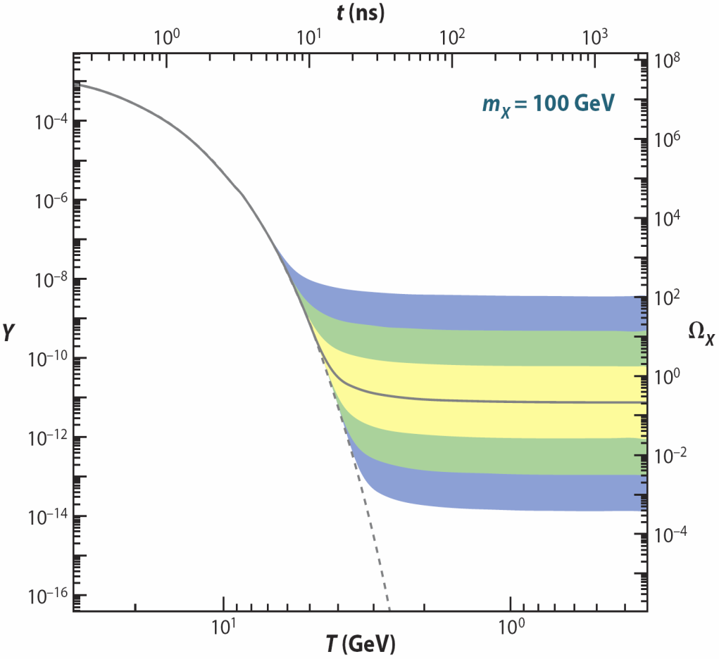
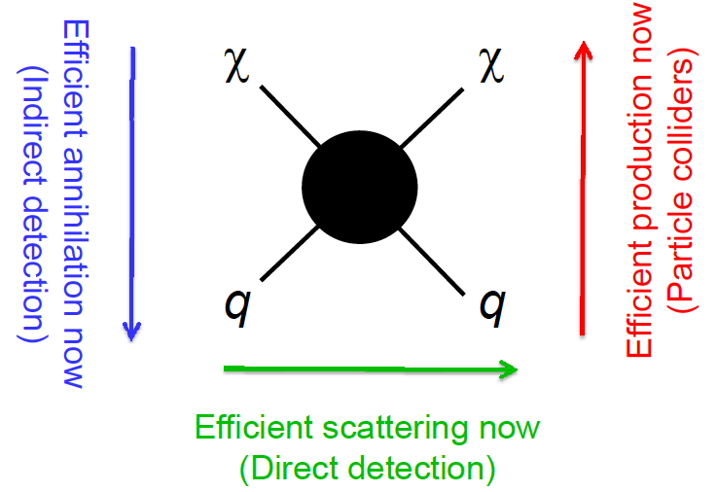
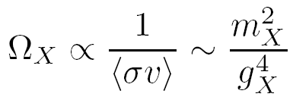
WIMPs
The WIMP Miracle
WIMP Searches
X
q
_
X
q
Feng (2008)
The WIMP miracle motivates diverse experiments that are (unfortunately) bigger, longer, and more expensive

Slide 7
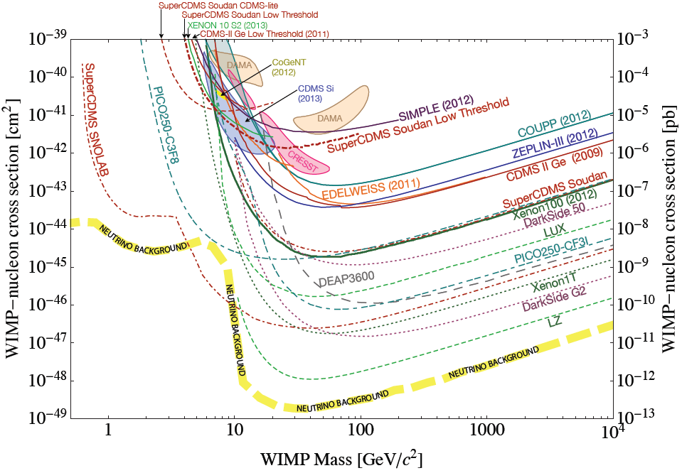
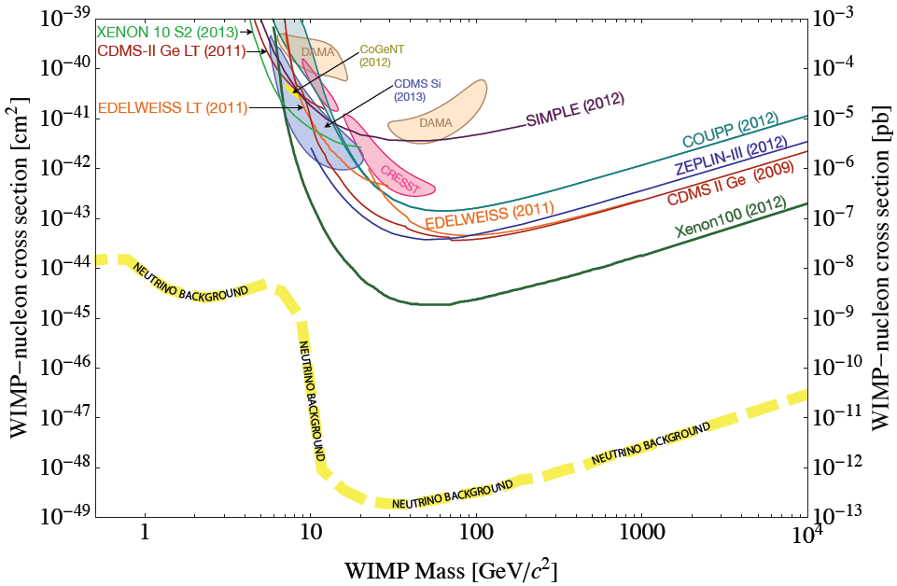
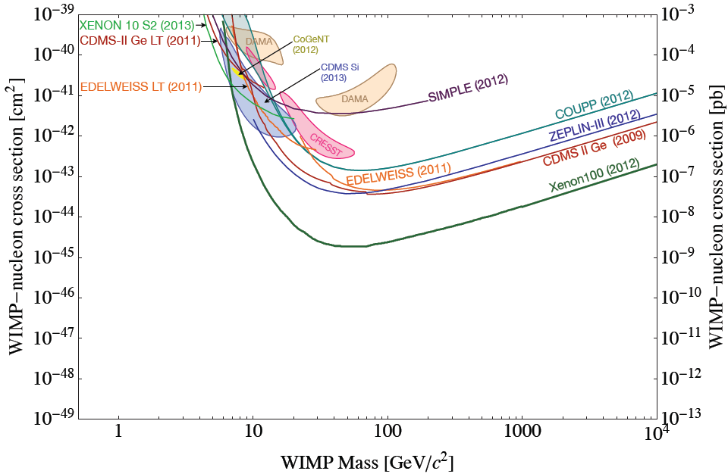
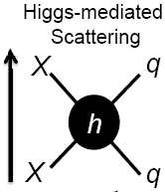
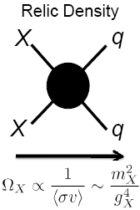
DIRECT DETECTION EXPERIMENTS (2013)
Asymmetric
n_{DM} ~ n_{B}

Slide 8
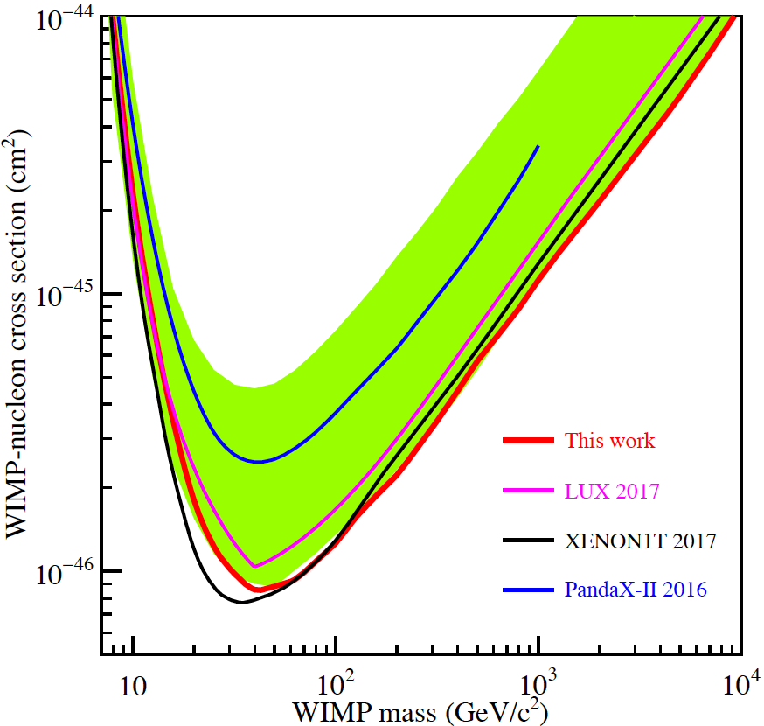
LATEST RESULTS: PandaX-II
August 2017

Slide 9
RECENT DEVELOPMENTS
In the last few years, these classic candidates have been generalized to broad classes of dark matter
Axions → Axion-like Particles (ALPs) → Ultralight DM
WIMPs → WIMPless DM→ Hidden Sector DM
New motivations, new anomalies, and new experimental search techniques have been identified, leading to a flurry of activity

Slide 10
DM CANDIDATES, ANOMALIES, SEARCH TECHNIQUES
zeV
aeV
feV
peV
neV
μeV
meV
eV
keV
MeV
GeV
TeV
PeV
30M☉
≈
QCD Axion
WIMPs
Ultralight Dark Matter
Hidden Sector Dark Matter
Black Holes
Hidden Thermal Relics / WIMPless DM
Asymmetric DM
Freeze-In DM
SIMPs / ELDERS
Beryllium-8
Muon g-2
Small-Scale Structure
Coherent Field Searches, Direct Detection, Nuclear and Atomic Physics, Accelerators
Microlensing
≈
zeV
aeV
feV
peV
neV
μeV
meV
eV
keV
MeV
GeV
TeV
PeV
30M☉
Cosmic Visions White Paper (2017)

Slide 11
DARK SECTORS
All evidence for dark matter is gravitational. Perhaps it’s in a hidden sector, composed of particles with no SM gauge interactions (electromagnetic, weak, strong)
This hidden sector may have a rich structure with matter and forces of its own
Lee, Yang (1956); Kobsarev, Okun, Pomeranchuk (1966); Blinnikov, Khlopov (1982);
Foot, Lew, Volkas (1991); Hodges (1993); Berezhiani, Dolgov, Mohapatra (1995); ...
SM
Hidden
X

Slide 12
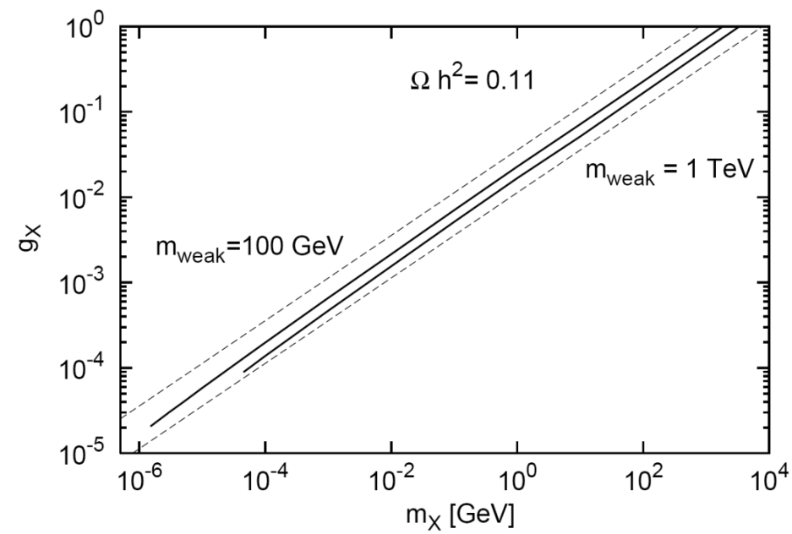
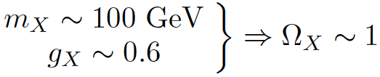
WIMPLESS DARK MATTER
Recall the WIMP miracle:
But now g_{X} doesn’t have to be 0.6!
Additional motivations: SUSY with GMSB or AMSB, small scale structure, ...
Feng, Kumar (2008); Feng, Tu, Yu (2008)
_{WIMPs}
_{WIMPless DM}
WIMPless Miracle → light, extremely weakly-coupled particles; new connections to other fields; smaller, faster, cheaper expts

Slide 13
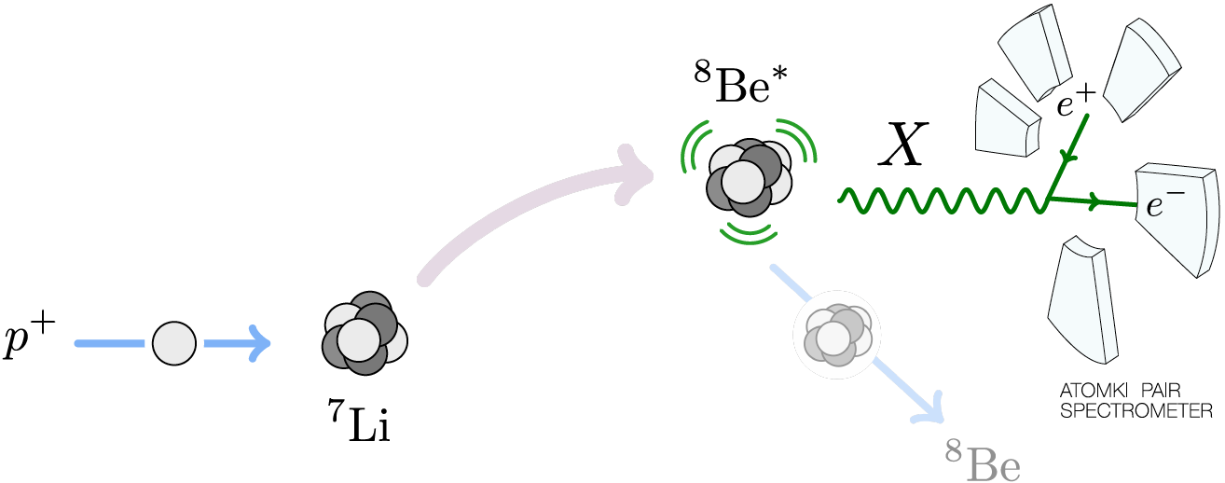
AN EXAMPLE: NUCLEAR PHYSICS
One can look for < 20 MeV new particles in decays of excited nuclei
Treiman, Wilczek (1978); Donnelly, Freedman, Lytel, Peccei, Schwartz (1978)
In particular, in rare internal pair creation events, can look for ⁸Be* → ⁸Be X → ⁸Be e⁺ e⁻ signal
    [⁸Be* → ⁸Be γ → ⁸Be e⁺ e⁻ background]

Slide 14
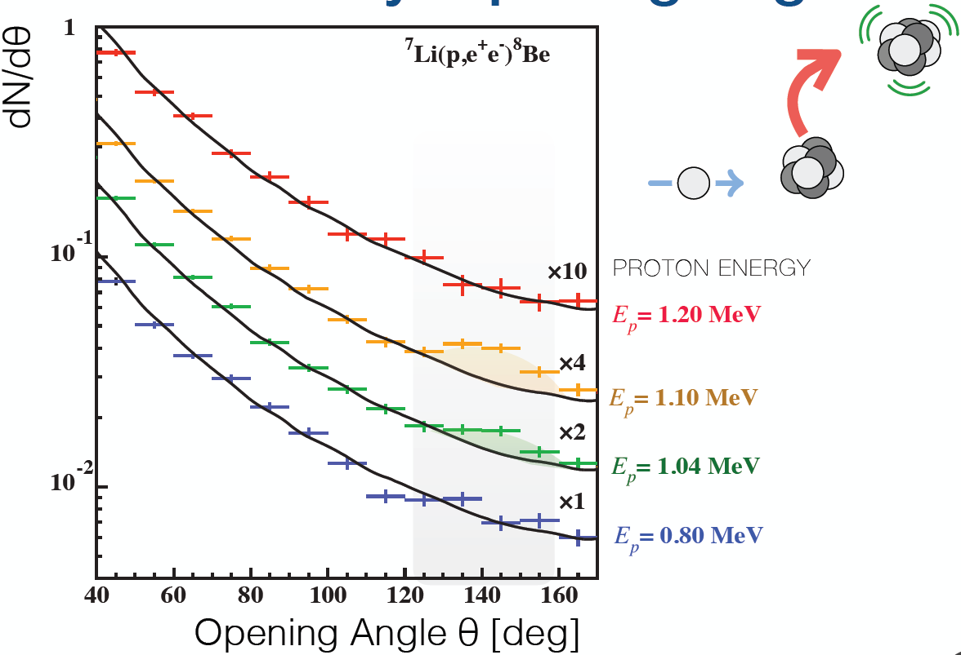
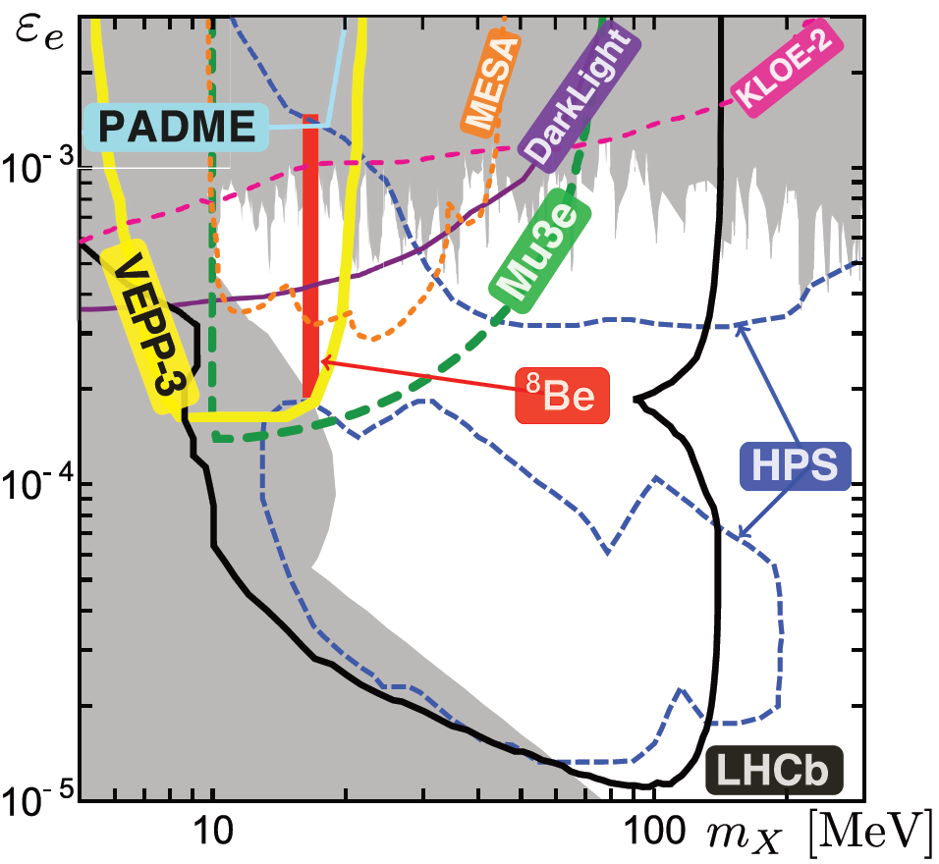
THE BERYLLIUM ANOMALY AND DARK FORCES
ATOMKI group has seen a 6.8σ excess at e⁺e⁻ opening angles of 135 deg
This can be consistently explained by a new 17 MeV boson, 5th force
Feng, Fornal, Galon, Gardner, Smolinsky, Tait, Tanedo (2016); Gu, He (2016); Ellwanger, Moretti (2016); Kozaczuk, Morrissey, Stroberg (2016);...
Krasznahorkay et al. (2015)
There is now preliminary supporting evidence from the ATOMKI group, proposed followups (~$750K, 1 year)

Slide 15
CONCLUSIONS
Dark matter is one of the great scientific puzzles of our time and is leading evidence for new particles and forces
Classic candidates remain attractive...
  Dark matter: sterile neutrinos, axions, WIMPs
  WIMP miracle: heavy and weakly coupled
  Experiments: bigger, longer, more expensive
...but a new paradigm is also emerging
  Dark sector: dark Higgs, dark fermions, dark gauge bosons
  WIMPless miracle: light and extremely weakly coupled
  Experiments: smaller, faster, cheaper

