Slide 1
FASER
FORWARD SEARCH EXPERIMENT AT THE LHC
Physics Beyond Colliders Working Group Meeting
Jonathan Feng (UC Irvine) for the FASER group
(see https://twiki.cern.ch/twiki/bin/viewauth/FASER/WebHome)
14 June 2018

Slide 2

FASER
New physics searches at the LHC have traditionally focused on high p_{T}. This is appropriate for heavy and strongly-interacting particles.
  σ ~ fb to pb → N ~ 10³ – 10⁶ in 3 ab⁻¹, produced ~isotropically
However, if new particles are light and weakly-interacting, this may be completely misguided. Such particles may be produced, e.g., in π, K, B decays, so we should go where these particles are: low p_{T} .
  σ_{inel} ~ 100 mb → N_{π} ~ 10¹⁷ in 3 ab⁻¹, θ ~ m_{π} / TeV ~ 0.1 mrad
These light, weakly-interacting particles are long-lived and collimated. This motivates a small (~1 m³) and inexpensive experiment placed in the very forward region of ATLAS/CMS, a few 100 m downstream.

Slide 3
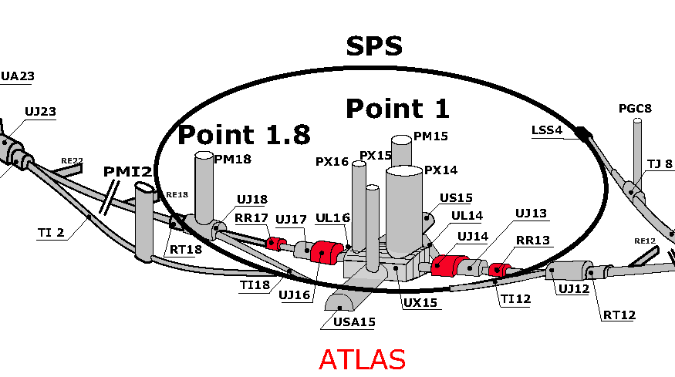
FASER LOCATION
TI18
FASER

Slide 4
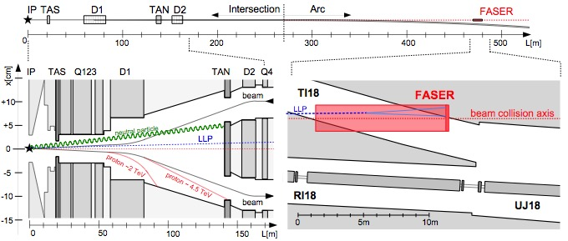
LONG LIVED PARTICLES IN FASER
LLP starts at IP, travels through TAN and other very forward infrastructure, then leaves the LHC tunnel, travels through 90m of rock, and decays to two highly energetic (~TeV) charged tracks in FASER.
FASER will be placed on the beam collision axis (“on-axis”); if the beam crossing angle = 300 μrad, the on-axis location at FASER shifts by 7 cm.
Felix Kling

Slide 5
AN EXAMPLE: DARK PHOTONS AT FASER
Pions at the IP
Simulations greatly refined by LHC data
Production is peaked at p_{T} ~ Λ_{QCD} ~ 250 MeV
Enormous event rates: N_{π}~10¹⁵ per bin
A’s at the IP
Production is peaked at p_{T} ~ Λ_{QCD} ~ 250 MeV
Rates highly suppressed by ε² ~ 10⁻¹⁰
But still N_{A’} ~ 10⁵ per bin
A’s decay in [480m, 483m]
Only highly boosted ~TeV A’s decay in FASER
Rates again suppressed by decay requirement
But still N_{A’} ~ 100 signal events, and almost all are within 20 cm of “on axis”
300 fb⁻¹

Slide 6
FASER SENSITIVITY REACHES
L
Present results for 2 simple cases
FASER 1: L = 3 m, R = 10 cm, V = 0.1 m³, 150 fb⁻¹ (Run 3)
FASER 2: L = 5 m, R = 1 m, V = 16 m³, 3 ab⁻¹ (HL-LHC)
Larger and smaller detectors are certainly possible, but these give a feel for the range of sizes and their implications for physics reach.
Below, FASER contours are updated for PBC; other experiments’ contours are their full reaches from the literature.
R

Slide 7
BC1: DARK PHOTON SENSITIVITY REACH
For low ε, FASER is not competitive with SHiP.
For high ε, FASER may have world-leading sensitivity. Note: contours are very closely spaced: ~50% signal efficiency, N=3 vs.10, e⁺e⁻ vs. e⁺e⁻ + μ⁺μ⁻, L=3m vs. 5m, … each lead to nearly imperceptible shifts in reach.

Slide 8
SENSITIVITY REACH FOR OTHER MODELS
BC4: DARK HIGGS BOSON
Dark Higgs produced in B decays. N_{B}/N_{π}~10⁻² at FASER (N_{B}/N_{π}~10⁻⁷ at beam dumps)
Reach is complementary to other proposed experiments
BC9: ALP WITH PHOTON
~TeV photon from IP collides with TA(X)N, creates ALP through Primakoff, and a → γγ in FASER
Requires calorimeter

Slide 9
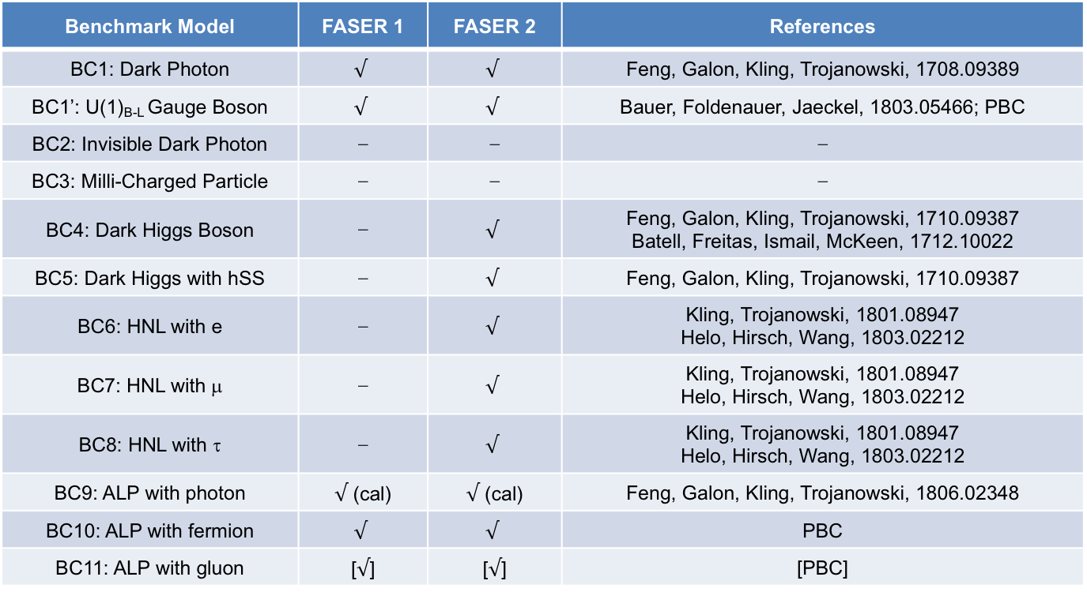
PBC BENCHMARK SUMMARY
FASER has a full physics program: can discover all candidates with renormalizable couplings (dark photon, dark Higgs, HNL); ALPs with all types of couplings (γ, f, g); and examples that are not PBC benchmarks.
Benchmark Model | FASER 1 | FASER 2 | References
BC1: Dark Photon | $$√$$ | $$√$$ | Feng, Galon, Kling, Trojanowski, 1708.09389
BC1’: U(1)_{B-L} Gauge Boson | $$√$$ | $$√$$ | Bauer, Foldenauer, Jaeckel, 1803.05466; PBC
BC2: Invisible Dark Photon | ⎼ | ⎼ | ⎼
BC3: Milli-Charged Particle | ⎼ | ⎼ | ⎼
BC4: Dark Higgs Boson | ⎼ | $$√$$ | Feng, Galon, Kling, Trojanowski, 1710.09387 Batell, Freitas, Ismail, McKeen, 1712.10022
BC5: Dark Higgs with hSS | ⎼ | $$√$$ | Feng, Galon, Kling, Trojanowski, 1710.09387
BC6: HNL with e | ⎼ | $$√$$ | Kling, Trojanowski, 1801.08947 Helo, Hirsch, Wang, 1803.02212
BC7: HNL with μ | ⎼ | $$√$$ | Kling, Trojanowski, 1801.08947 Helo, Hirsch, Wang, 1803.02212
BC8: HNL with τ | ⎼ | $$√$$ | Kling, Trojanowski, 1801.08947 Helo, Hirsch, Wang, 1803.02212
BC9: ALP with photon | $√$ (cal) | $√$ (cal) | Feng, Galon, Kling, Trojanowski, 1806.02348
BC10: ALP with fermion | $$√$$ | $$√$$ | PBC
BC11: ALP with gluon | [$√$] | [$√$] | [PBC]

Slide 10
FASER LOCATION
Credit: Mike Lamont
Credit: Francesco Cerutti
Credit: Mike Lamont

Slide 11
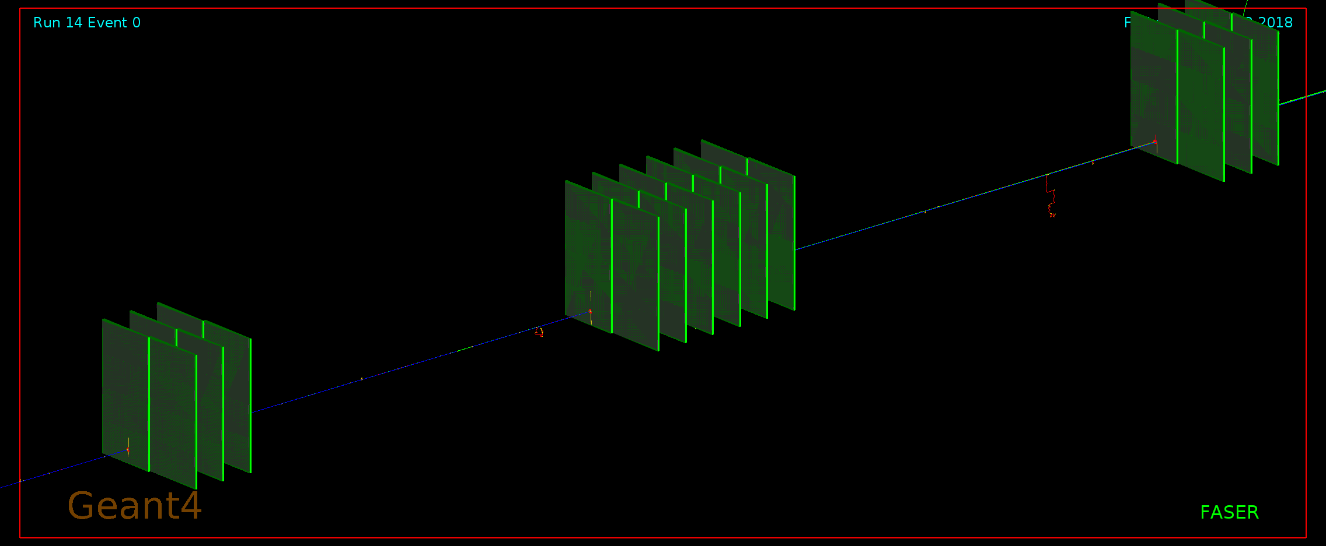
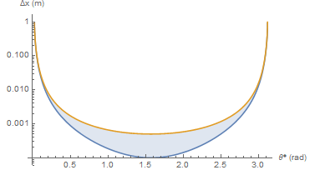
DETECTOR LAYOUT
Currently being optimized with Geant4 study: length of decay volume vs. length of tracker volume, number and placement of tracking layers, strength and region of magnetic field.
E.g., 1 TeV A’ → e⁺e⁻ : even a 0.5 T magnetic field over 1m is sufficient to separate ~50% of the charged tracks by > 1 mm, and some much more (asymmetric decays).
Considering permanent dipole magnetic (no services).
Asymmetric decays
Track separation
Decay angle in A’ frame

Slide 12
BACKGROUNDS
The signal is striking: two opposite-sign, high energy (E > 500 GeV) charged particles that originate from a common vertex in a small, empty decay volume, point back to the IP through 90 m of rock, and are consistent with bunch crossing timing.
Of course, neutrinos and muons get through, but the resulting backgrounds appear to be negligible.
300 fb⁻¹
1708.09389
FLUKA study: Marta Sabate-Gilarte,
Francesco Cerutti, Andrea Tsinganis

Slide 13
MORE BACKGROUNDS
Recent FLUKA study finds that proton showers in dispersion suppressor and beam-gas background (from “beam 2”) are also negligible.
The dispersion of the machine means activity close to FASER from diffractive proton losses is very small. It would be orders of magnitude higher 50m along LHC in either direction. The radiation level in TI18 is low (<10⁻² Gy/year), which is encouraging for detector electronics.
Marta Sabate-Gilarte, Francesco Cerutti, Andrea Tsinganis

Slide 14
IN SITU MEASUREMENTS
In Technical Shutdown 1 (TS1, next week), we will begin the first in situ measurements at the FASER site.
CERN survey team will map out and mark the “on-axis” line in TI18 to ~mm accuracy.
An emulsion detector has been prepared and will be placed at the FASER location in TS1, removed in TS2 (or before).
A BatMon (battery-operated radiation monitor) will also be installed.

Slide 15
SUMMARY AND TIMELINE
FASER is an opportunity for a small and inexpensive experiment to search for a full range of light and weakly-interacting particles, complementing other experiments. FASER collects data when ATLAS collects data, but is independent (requires only bunch crossing timing).
TS1 (next week): installation of BatMon, emulsion detector for validation of FLUKA study, first in-situ measurements.
Currently pursuing funding options and seeking CERN approval. If successful, a possible timeline and plan is
Install FASER 1 in LS2 (2019-20) for Run 3 (150 fb⁻¹)
    R = 10 cm, L = 3 m, requires lowering floor by 50cm in existing tunnel
    Target dark photons, B-L gauge bosons, ALPs, etc.
Install FASER 2 in LS3 (2023-25) for HL-LHC (3 ab⁻¹)
    R = 1 m, L = 5 m, requires some extension of existing tunnel
    Full physics program: dark photons, B-L, ALPs, dark Higgs, HNLs, etc.

Slide 16
BACKUP

Slide 17
FASER GROUP
More info: https://twiki.cern.ch/twiki/bin/viewauth/FASER/WebHome

Slide 18
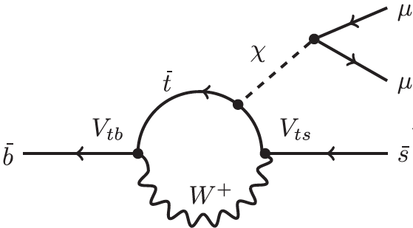
SENSITIVITY REACH FOR OTHER MODELS
BC1*: U(1)_{B-L} GAUGE BOSON
BC5: DARK HIGGS WITH hSS
φ
h
φ

Slide 19
SENSITIVITY REACH FOR OTHER MODELS
BC6/7/8: HNL WITH e/μ/τ
p_{T} ~ m_{D}, m_{B}
Reach similar for all 3 scenarios
BC10: ALP WITH FERMIONS

