Slide 1
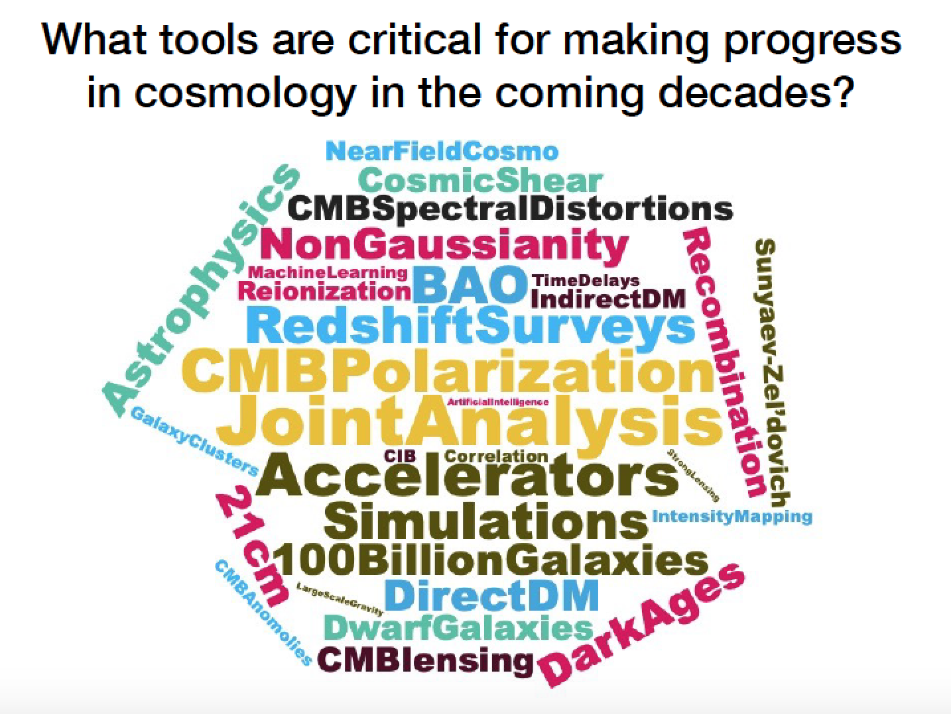

Slide 2
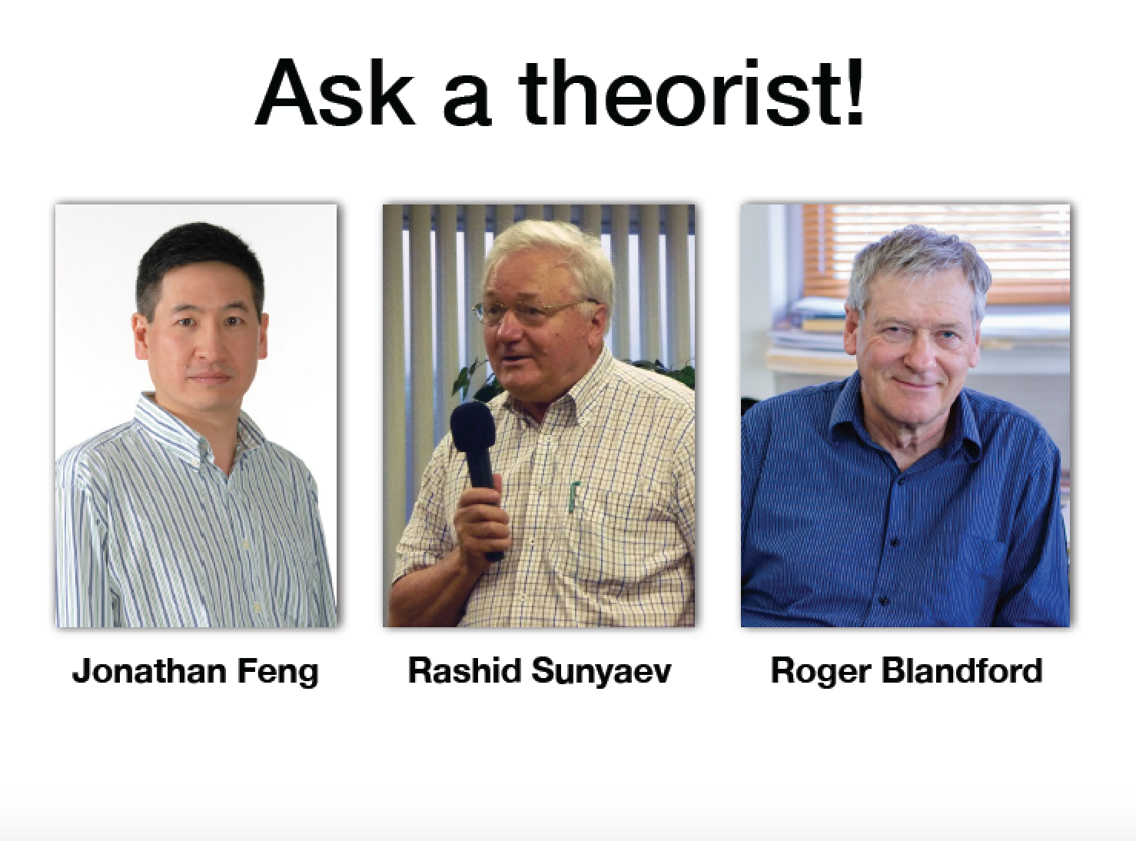

Slide 3
What tools are critical for making progress in cosmology in the coming decades?
Cosmic Controversies Panel
University of Chicago
Jonathan Feng, UC Irvine, 7 October 2019

Slide 4
DARK MATTER
For dark matter, the question is very timely
New community exercises underway in both astrophysics and particle physics
  Astro 2020
  European Strategy for Particle Physics Update 2020
  Snowmass 2021
Many new developments in dark matter
  WIMPs and other classic candidates not discovered, but remain interesting
  Other DM candidates are rising in prominence
  Both facts have implications for what tools and experiments will be needed for progress

Slide 5
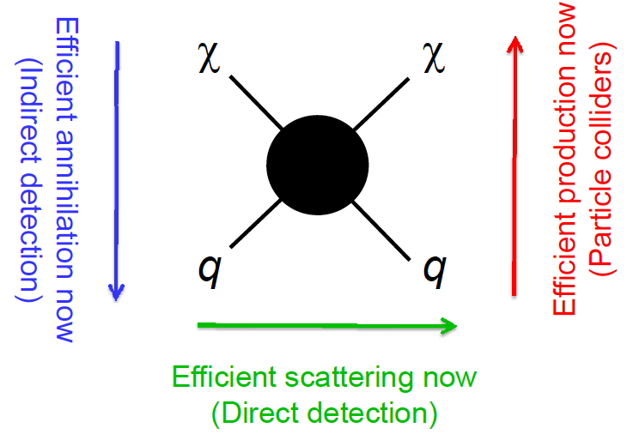
WIMP PARADIGM
For decades, the WIMP paradigm has been dominant, bolstered by the WIMP miracle and its many implications
Indirect detection: interesting signals in ν, γ, e⁺, pbar, …
Direct detection: mass matched to scattering off all nuclei
Colliders: almost all BSM signals, mono-X
2008

Slide 6
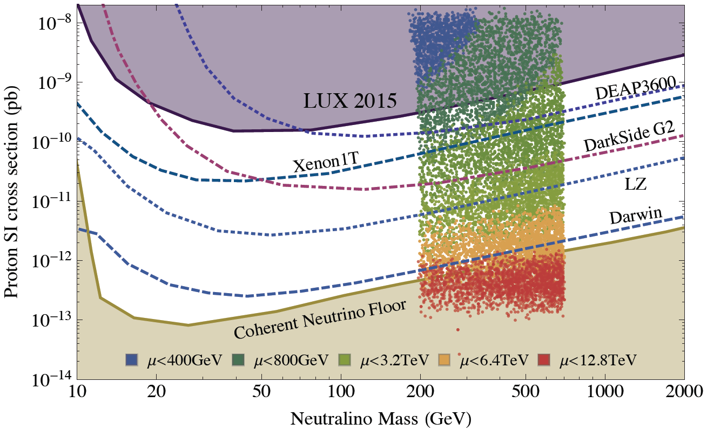
WIMP STATUS
Many constraints, but still viable. E.g., there are viable SUSY models with thermal relic neutralinos, and all squarks/sleptons below a few TeV.
There remain strong motivations to pursue direct detection down to the neutrino floor, both in xenon (XENON-nT, LZ, Panda-X, Darwin) and argon (Darkside-20K, ARGO).
For example: MSSM4G, MSSM + vector-like 4th generation.
DM is 200-700 GeV and Bino-like, so scatters very weakly, but freezes out correctly through χχ → τ₄τ₄.
Abdullah, Feng, Iwamoto, Lillard ( 2016)

Slide 7
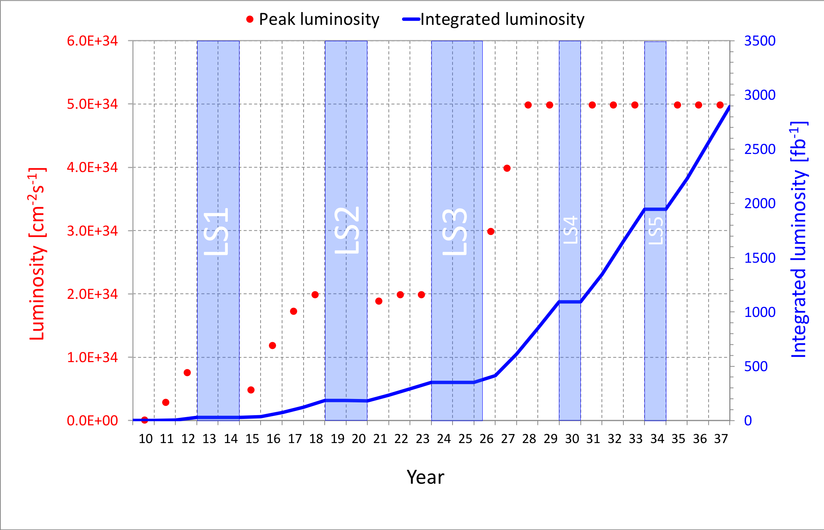
COLLIDER SEARCHES
For the next many years, the energy frontier will continue to be dominated by the LHC and HL-LHC.
The LHC is currently in Long Shutdown 2, but will start up again in 2021 and run till ~2037. Will we find new particles through conventional searches?
What other approaches can enhance the prospects for discovering DM and other new particles?

Slide 8
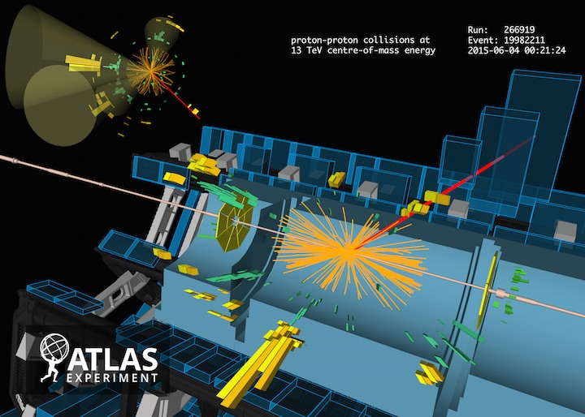
MACHINE LEARNING
Machine learning is now able to optimize searches over conventional methods.
For example: identifying the originating quark / gloun from a hadronic shower.

Slide 9
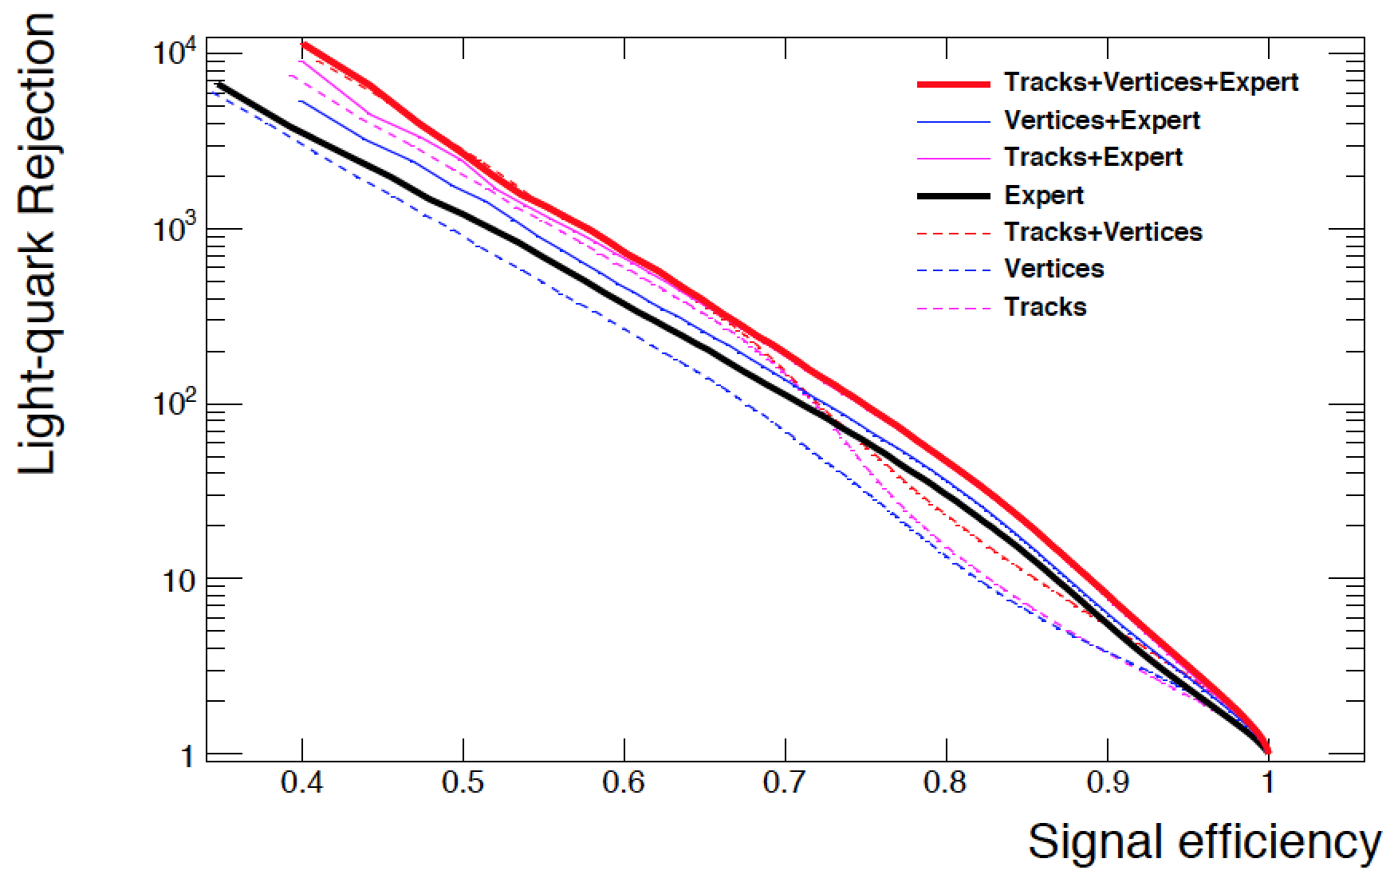
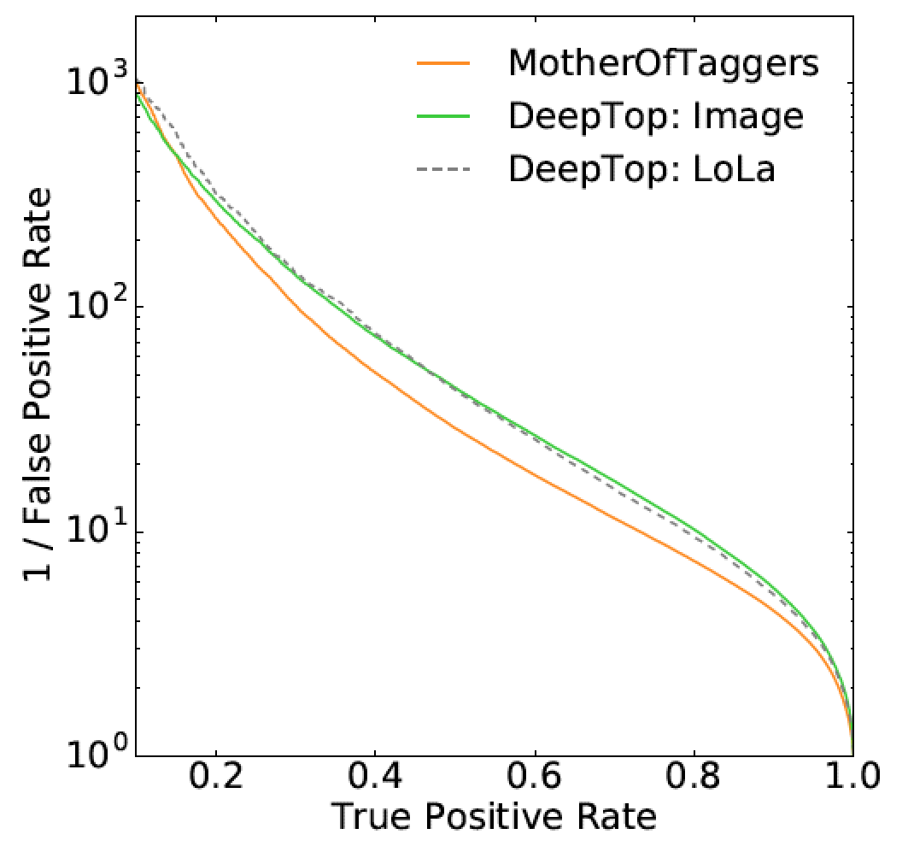
MACHINE LEARNING
Examples: b-quark tagging (left) and top-quark tagging (right). Top curves are from neural network, bottom curves are using expert-curated variables (note log scale).
Guest, Collado, Baldi, Hsu, Urban, Whiteson (2016)
Butter, Kasieczka, Plehn, Russell (2018)

Slide 10
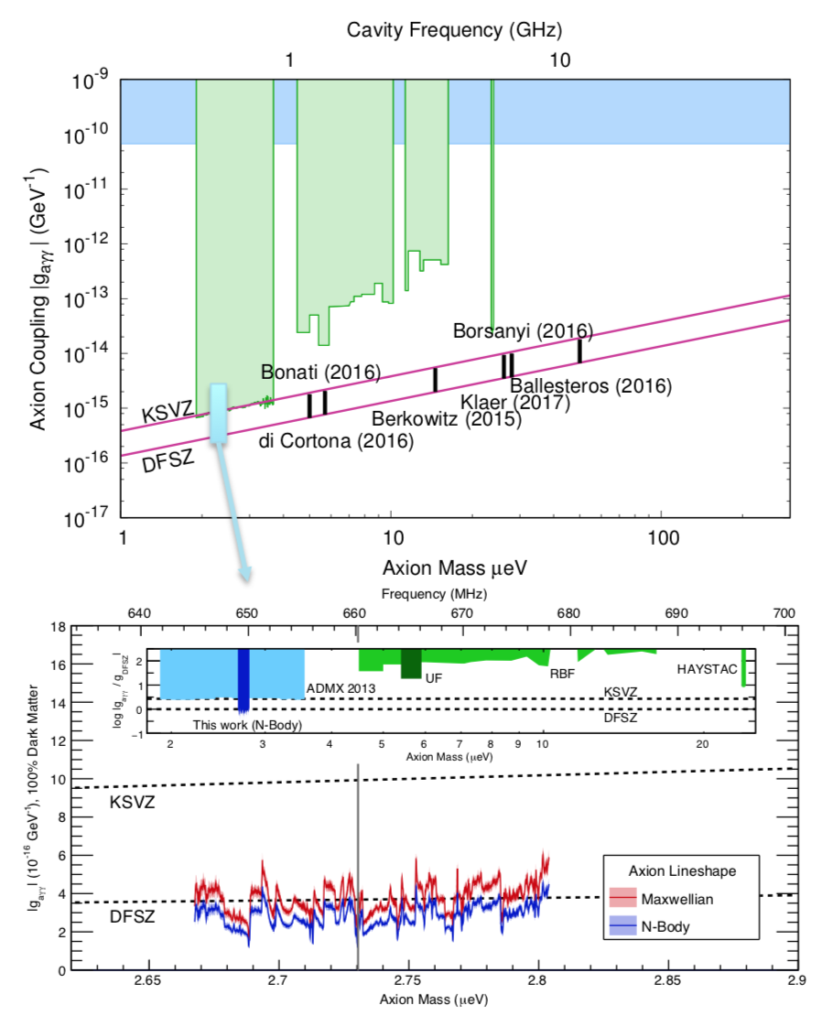
AXIONS
The QCD axion remains a highly motivated DM candidate.
ADMX-G2 has finally probed down to the canonical sensitivity and mass range.
Strong motivation to continue to higher (and lower) masses.
ADMX-G2 (2018)

Slide 11
NEW CANDIDATES
Of course, the absence of a compelling DM signal (and, in fact, a compelling BSM signal of any kind) motivates the study of other possibilities.
In recent years, there has been a huge growth in the number of DM candidates under investigation.
Most exciting, many of these motivate relatively small, cheap, and fast experiments.

Slide 12
Dark Matter Candidates, Anomalies, and Search Techniques
zeV
aeV
feV
peV
neV
μeV
meV
eV
keV
MeV
GeV
TeV
PeV
30M☉
≈
QCD Axion
Sterile Neutrino
WIMPs
Ultralight Dark Matter
Hidden Thermal Relics / WIMPless DM
Black Holes
SIMPs / ELDERS
Asymmetric DM
X-ray Line
Beryllium-8
Muon g-2
Small-Scale Structure
Coherent Field Searches
Nuclear and Atomic Physics
Microlensing
Direct Detection (Low-Threshold and Spin-Dependent)
Accelerators
≈
zeV
aeV
feV
peV
neV
μeV
meV
eV
keV
MeV
GeV
TeV
PeV
30M☉
Cosmic Visions Report (2017)
Notes:
Targets: Freeze-In, Inflation Mechanism, Misalignment Mechanism

Slide 13

THE NEW PARTICLE LANDSCAPE
Particle
Expts
Mass
MeV
GeV
TeV
1
Already
Discovered
Strongly Interacting
Heavy Particles
Interaction Strength
10⁻³
Weakly Interacting
Light Particles
Impossible to
Discover
10⁻⁶

Slide 14
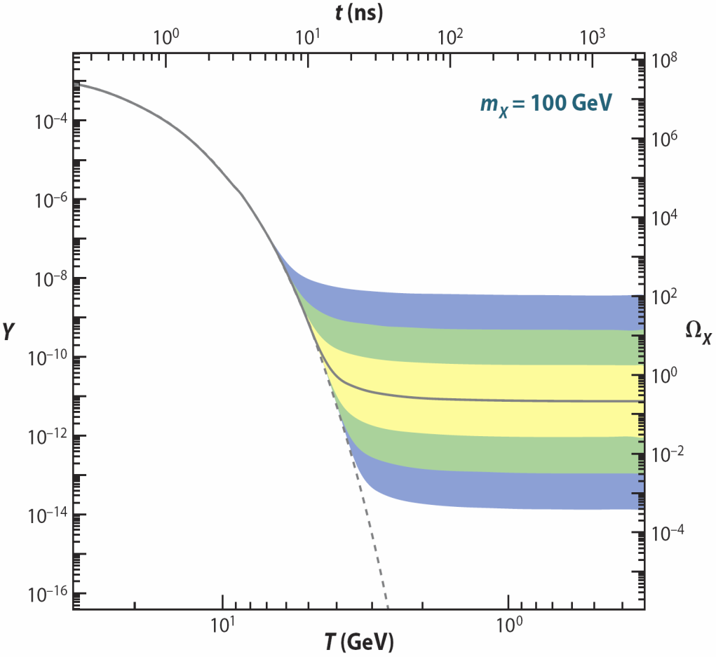
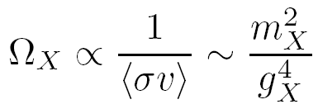
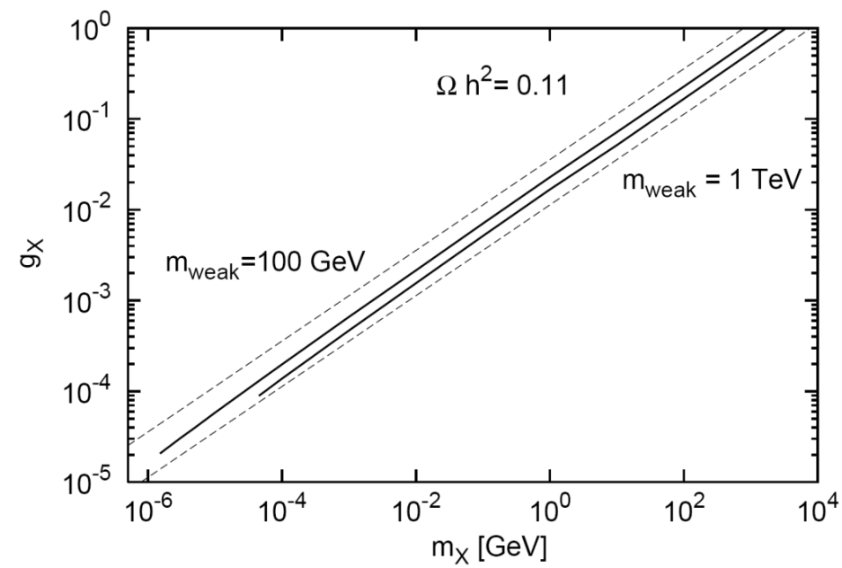
LIGHT, WEAKLY-INTERACTING PARTICLES
The possibility that new particles are light and very weakly-interacting also has a cosmological motivation.
The thermal relic density is
DM
SM
DM
SM
time
WIMP Miracle: ~100 GeV to 1 TeV masses, strong couplings → right abundance
WIMPless Miracle: lighter particles, weaker interactions → right abundance
_{Boehm, Fayet (2003);}
Pospelov, Ritz, Voloshin (2007); Hooper, Zurek (2008)
_{WIMP DM}
Feng, Kumar (2008); Feng, Tu, Yu (2010)
_{WIMPless DM}

Slide 15
THE NEW PARTICLE LANDSCAPE
Particle
Expts
Mass
MeV
GeV
TeV
1
Already
Discovered
Strongly Interacting
Heavy Particles
Too Little to be
Dark Matter
Interaction Strength
10⁻³
Just Right to be Dark Matter
Weakly Interacting
Light Particles
Impossible to
Discover
Too Much to be Dark Matter
10⁻⁶

Slide 16

DARK SECTORS
Light, weakly interacting particles naturally emerge from generalizing dark matter → dark sectors.
E.g: suppose there’s a dark sector with DM and its own EM force. It can interact with the SM through a dim 4 operator:
The result is a weakly interacting (since interactions are induced by a loop) particle (“mediator”): the dark photon.
Other mediator possibilities: dark scalar, dark fermion.
SM
U(1)_{EM}
Dark Sector
DM, U(1)
M
Holdom (1986)

Slide 17
STRUCTURE FORMATION WITH SIDM
The possibility of a dark sector naturally allows DM to be strongly self-interacting. It is even more motivated by the idea of a light thermal relic with mass around MeV – GeV, which naturally generates σ/m ~ barn/GeV ~ cm²/g.
From this viewpoint, perhaps “Is a theory beyond Cold Dark Matter needed to describe structure formation?” should be “What can structure formation tell us about dark matter’s self-interactions and other properties?”
Strong motivation for N-body simulations with SIDM and DM with other properties.
SM
Dark Sector

Slide 18
LIGHT, WEAKLY INTERACTING PARTICLES
The possibility of light, weakly interacting particles can be explored without enormous investments.
It puts a premium on new ideas, new techniques, new collaborations between theorists and experimentalists.
Many new ideas in indirect detection and direct detection, both for existing DM detectors and in proposed experiments (see earlier talks).
Also many new ideas for collider and accelerator experiments probing light, weakly interacting particles and/or long-lived particles

Slide 19
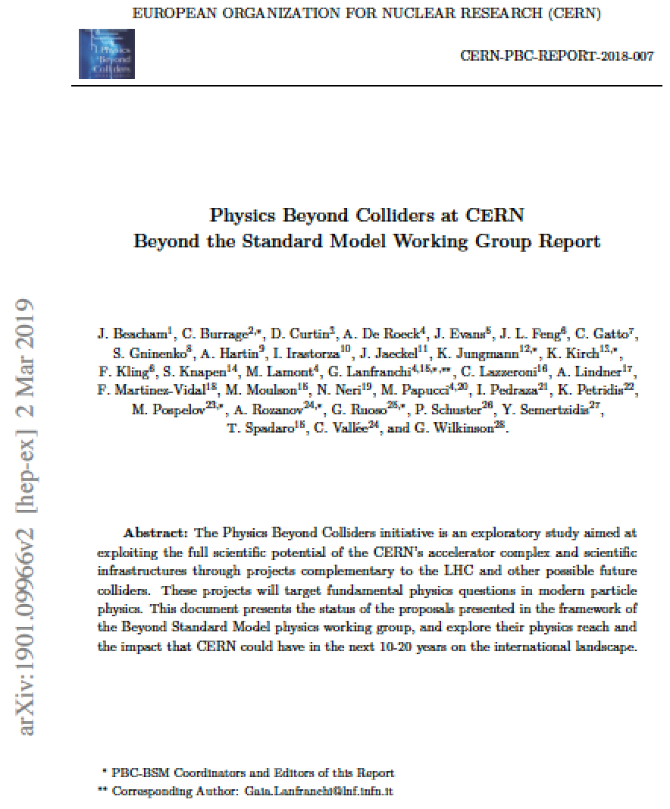
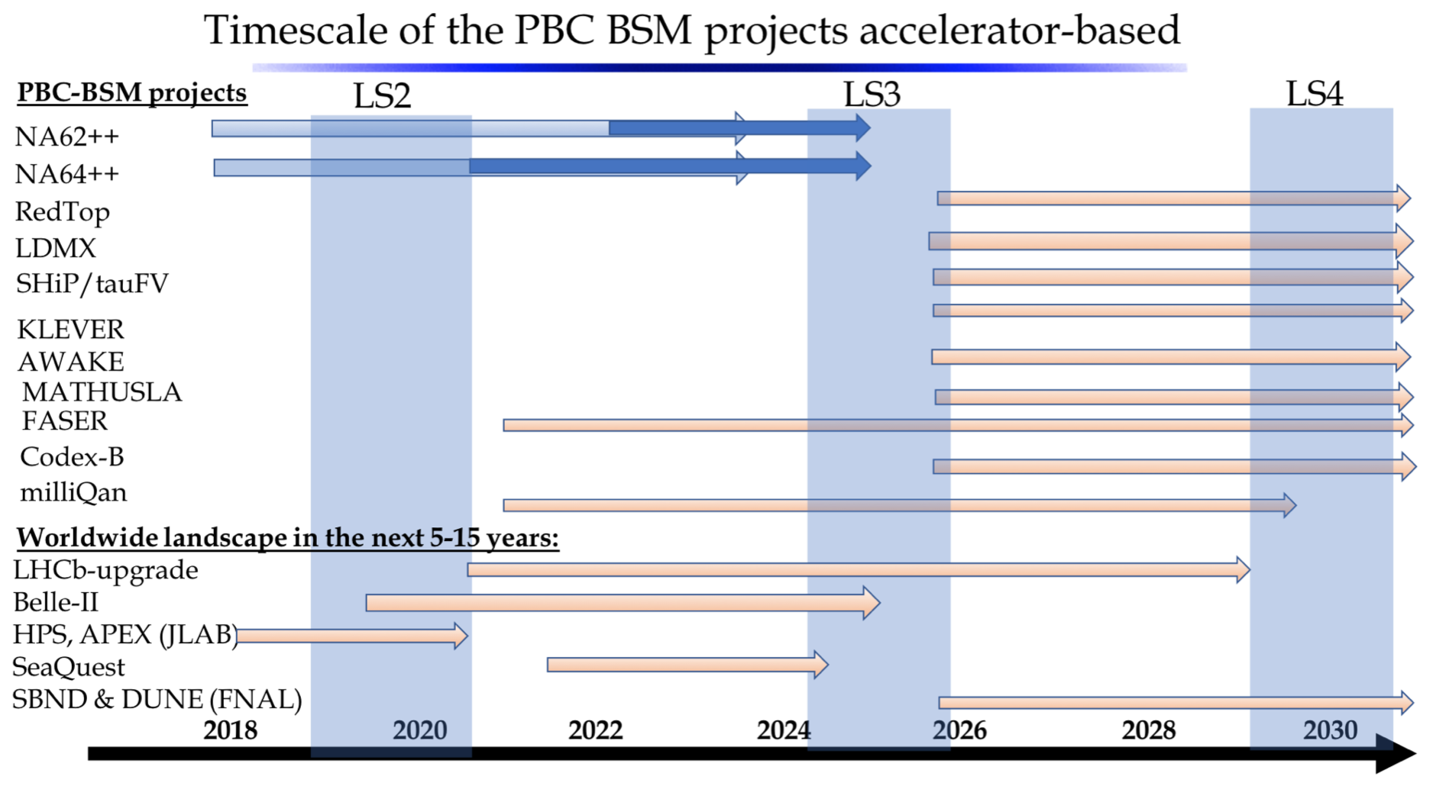
NEW COLLIDER/ACCELERATOR EXPERIMENTS
A wealth of new experiments, some on very short timescales

Slide 20

FASER: FORWARD SEARCH EXPERIMENT
New physics searches at the LHC focus on high p_{T} . This is appropriate for heavy, strongly interacting particles, like TeV-scale superpartners
However, if new particles are light and weakly interacting, this may be completely misguided
  Light and weakly-interacting → we can be produced in π, K, D, B decays, but they are typically produced along the beamline, where the detectors have a blind spot
Conclusion: we can enhance the LHC’s discovery reach by putting a detector where the pions are: at low p_{T} along the beamline
Feng, Galon, Kling, Trojanowski (2017)

Slide 21
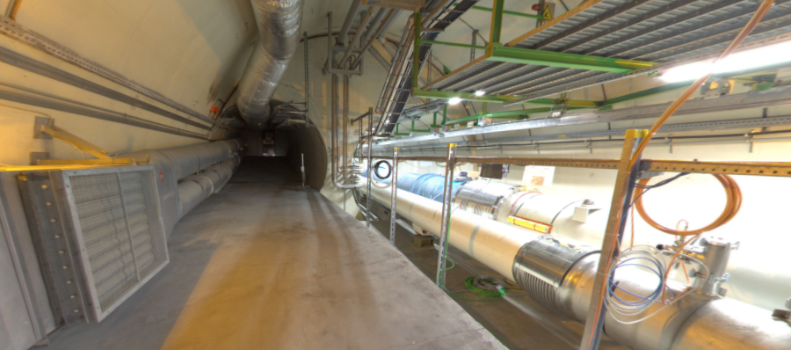
FASER LOCATION
The view looking west
New Particles
(Dark Sector)
LHC Beamline
(Visible Sector)

Slide 22
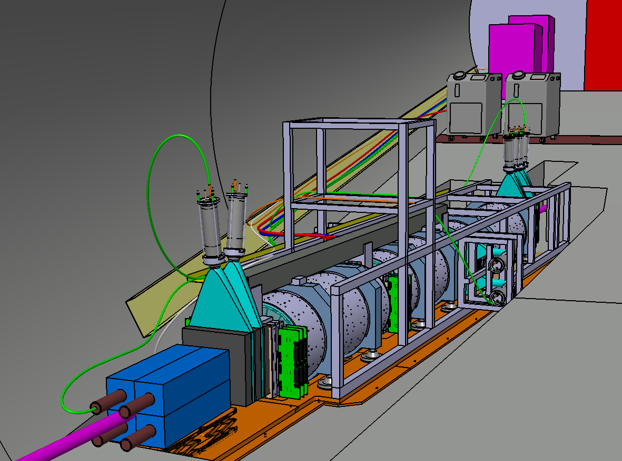
FASER DETECTOR
Cylindrical decay volume: L = 1.5m, R = 10cm
Total volume: 5m x 1m x 1m
A tabletop experiment!
Main Crate
Chillers
Tracker Crate
TRK Backbone
Cable Tray
Upper Frame
Aluminum + Steel plates
(interface to the floor)
ECAL

Slide 23
DARK PHOTON SENSITIVITY REACH
FASER was approved and funded in early 2019 by CERN and the Heising-Simons and Simons Foundations.
Now under construction with very helpful contributions from LHCb and ATLAS SCT Collaborations.
FASER probes new parameter space with just 1 fb⁻¹ starting in 2021
Possible upgrade to FASER 2 for HL-LHC will increase (Lum*Vol) by ~10⁶.
FASER

Slide 24





FASER COLLABORATION
46 collaborators, 18 institutions, 8 countries
Henso Abreu (Technion), Claire Antel (Geneva), Akitaka Ariga (Bern), Tomoko Ariga (Kyushu/Bern), Jamie Boyd (CERN), Dave Casper (UC Irvine), Franck Cadoux (Geneva), Xin Chen (Tsinghua), Andrea Coccaro (INFN), Candan Dozen (Tsinghua), Yannick Favre (Geneva), Jonathan Feng (UC Irvine), Didier Ferrere (Geneva), Iftah Galon (Rutgers), Stephen Gibson (Royal Holloway), Sergio Gonzalez-Sevilla (Geneva), Shih-Chieh Hsu (Washington), Zhen Hu (Tsinghua), Peppe Iacobucci (Geneva), Sune Jakobsen (CERN), Roland Jansky (Geneva), Enrique Kajomovitz (Technion), Felix Kling (SLAC), Susanne Kuehn (CERN), Lorne Levinson (Weizmann), Congqiao Li (Washington), Josh McFayden (CERN), Sam Meehan (CERN), Friedemann Neuhaus (Mainz), Hidetoshi Otono (Kyushu), Brian Petersen (CERN), Helena Pikhartova (Royal Holloway), Michaela Queitsch-Maitland (CERN), Jakob Salfeld-Nebgen (CERN), Osamu Sato (Nagoya), Kristof Schmieden (CERN), Matthias Schott (Mainz), Anna Sfyrla (Geneva), Savannah Shively (UC Irvine), Jordan Smolinsky (UC Irvine), Aaron Soffa (UC Irvine), Yosuke Takubo (KEK), Eric Torrence (Oregon), Sebastian Trojanowski (Sheffield), Dengfeng Zhang (Tsinghua), Gang Zhang (Tsinghua)

Slide 25
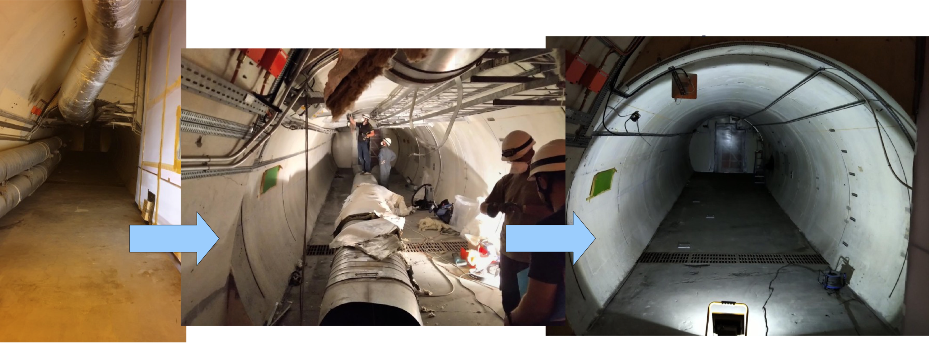
FASER LOCATION NOW
In TI12, unused ventilation ducts, cables, etc. have been removed to prepare for FASER trench excavation and installation.

Slide 26
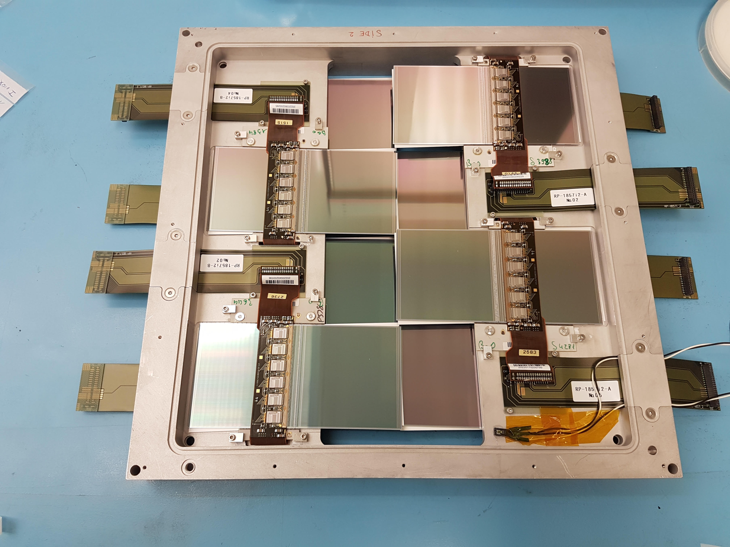
FASER CONSTRUCTION NOW
The main component of FASER is the tracker, composed of spare SCT modules from ATLAS. 8 SCT modules make up a 24cm x 24cm tracking layer, 3 layers make up a tracking station, and FASER has 3 tracking stations. Tests of prototype tracking layers have started.

Slide 27
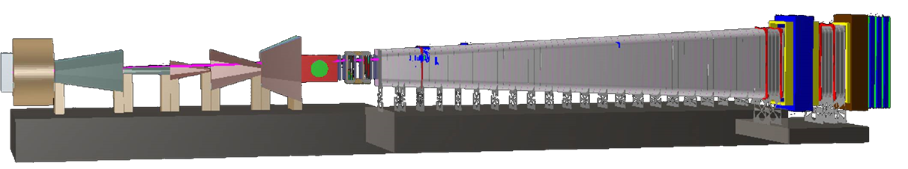
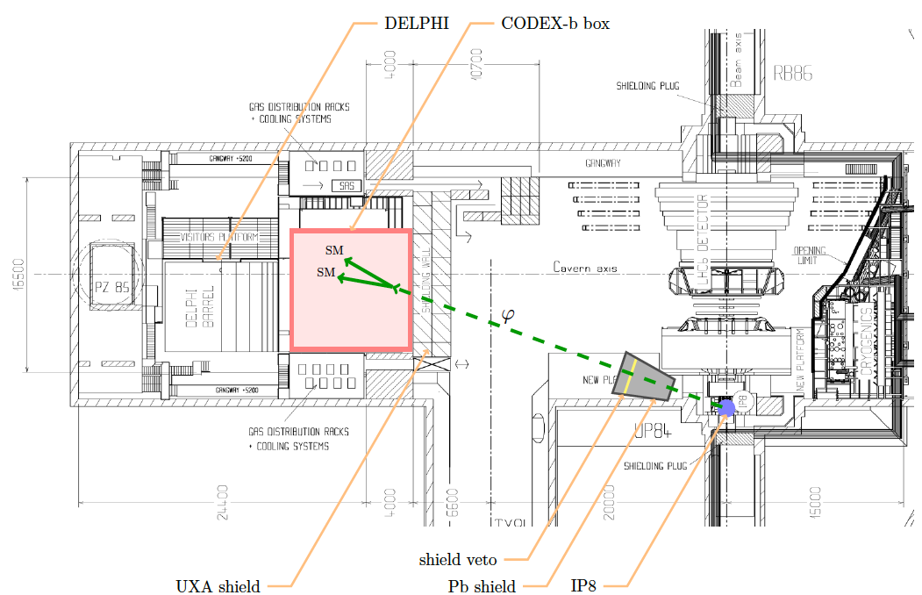
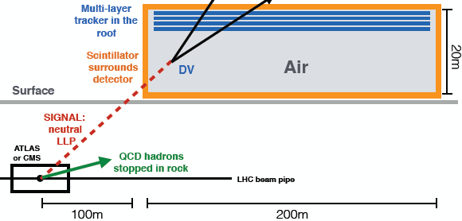
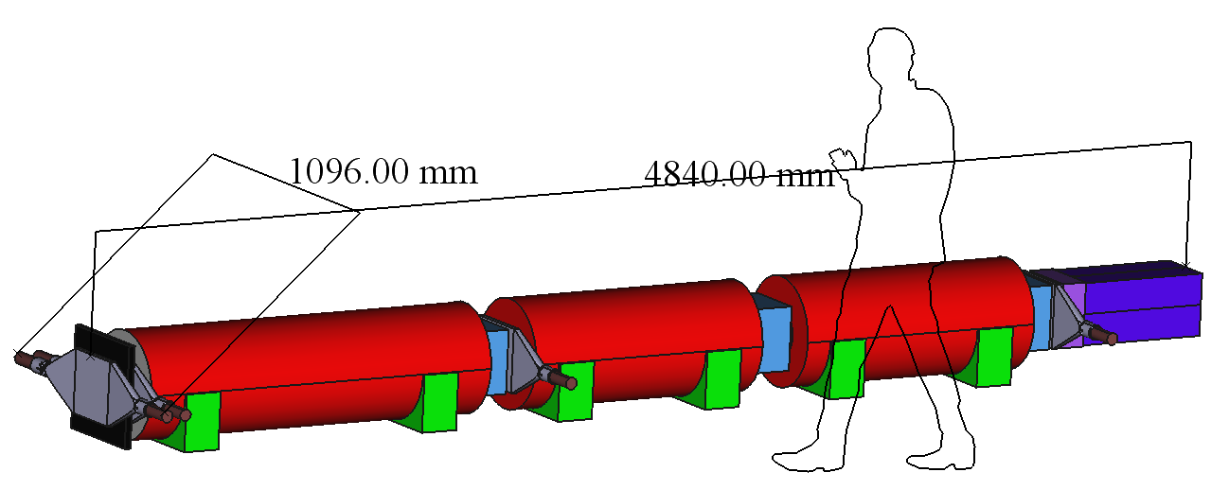
COMPLEMENTARY EXPERIMENTS AT THE LHC
SHiP
CODEX-b
~1000 m³, ~100M CHF + beam
Alekhin et al. (2015)
~1000 m³ ~ 1 mIKEAs
Gligorov, Knapen, Papucci, Robinson (2017)
FASER
MATHUSLA
~1 m³ ~ 1 μIKEAs
~800,000 m³ ~ 1 IKEA, ~$50M
Feng, Galon, Kling, Trojanowski (2017)
Chou, Curtin, Lubatti (2016)

