Slide 1



FORWARD PHYSICS AND BSM
Open Questions and New Ideas
Snowmass Energy Frontier Workshop
Jonathan Feng, UC Irvine, 21 July 2020

Slide 2

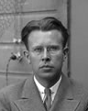
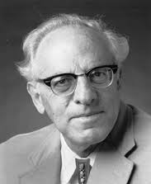
THE BSM LANDSCAPE
Particle
Colliders
Mass
MeV
GeV
TeV
1
Already
Discovered
Strongly Interacting
Heavy Particles
Interaction Strength
New Targets of Small Experiments, Forward Physics
Traditional Targets
of Big Experiments, High pT Physics
10⁻³
Weakly Interacting
Light Particles
Impossible to
Discover
10⁻⁶

Slide 3
FORWARD PHYSICS AND NEW PHYSICS
As the LHC runs at higher energies and much higher luminosities in the next 15 years, how can its potential be maximally exploited?
For decades, attention has focused on high p_{T} , low cross section (fb, pb, nb) physics.
But the total cross section is ~100 mb, and most of it and most of the highest energy particles are in the far forward region at low p_{T} .
In recent years, it has become clear that there is an entire physics program that remains to be explored in the far forward region, and this can be done with relatively small additional investments.
The proposal: create a Forward Physics Facility for the HL LHC. Enlarge an existing cavern in the far forward region of ATLAS to house a suite of experiments with groundbreaking new capabilities for neutrinos, BSM searches, QCD, dark matter, dark sectors, and cosmic rays.

Slide 4

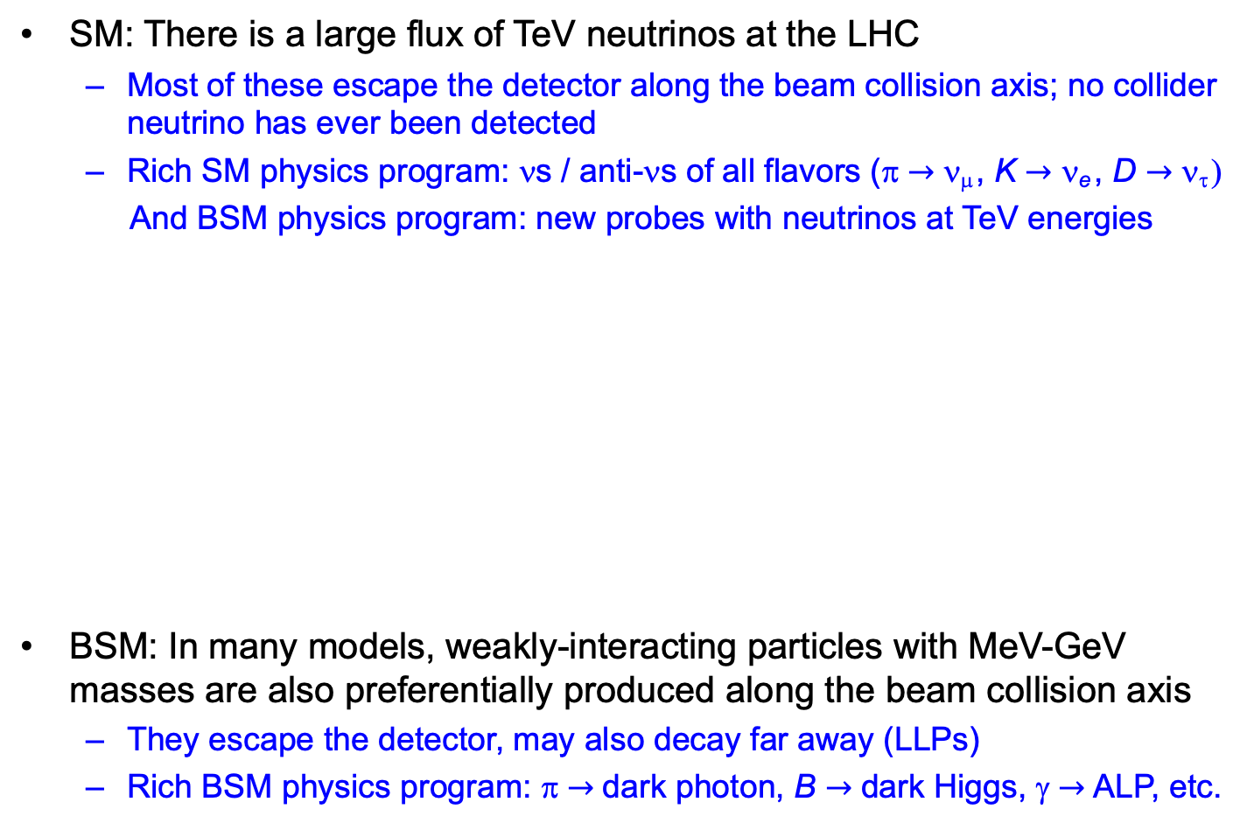
SM AND BSM PHYSICS POTENTIAL
SM: There is a large flux of TeV neutrinos at the LHC
  Most of these escape the detector along the beam collision axis; no collider neutrino has ever been detected
  Rich SM physics program: νs / anti-νs of all flavors (π $→$ ν_{μ} , K $→$ ν_{e} , D $→$ ν_{τ} )
  And BSM physics program: new probes with neutrinos at TeV energies
BSM: In many models, weakly-interacting particles with MeV-GeV masses are also preferentially produced along the beam collision axis
  They escape the detector, may also decay far away (LLPs)
  Rich BSM physics program: π $→$ dark photon, B $→$ dark Higgs, γ $→$ ALP, etc.

Slide 5
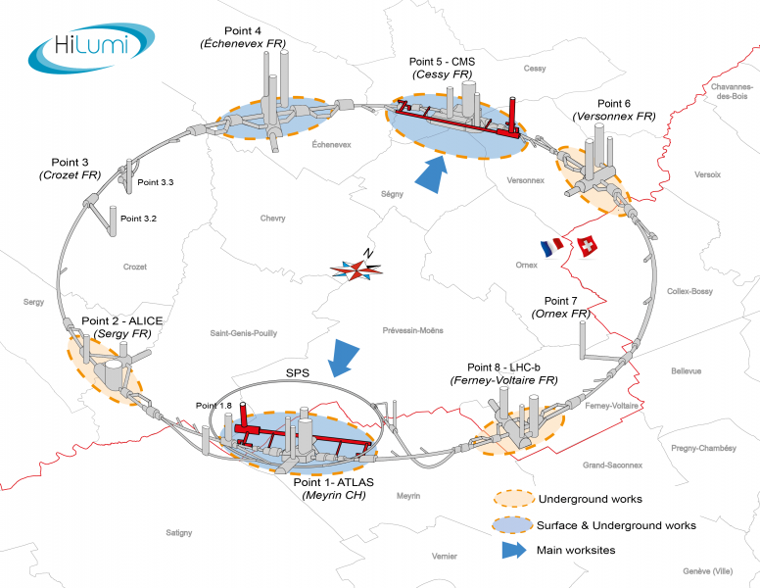
LHC TUNNELS
LHC tunnel infrastructure; HL-LHC tunnels in red (artist’s rendition)

Slide 6
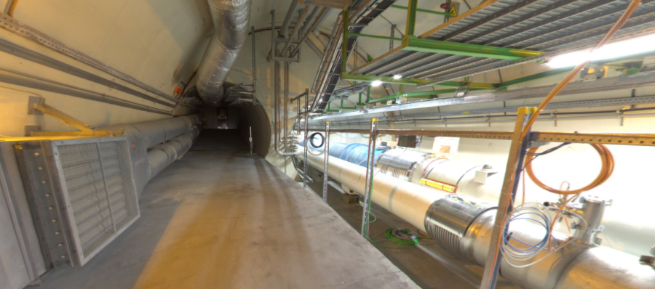
BEAM COLLISION AXIS
Beam collision axis passes
through 100 m of rock, emerges in tunnel TI12 near cavern UJ12
UJ12
TI12 near UJ12
The view in UJ12 looking west
TI12
Beam collision axis
LHC beamline

Slide 7
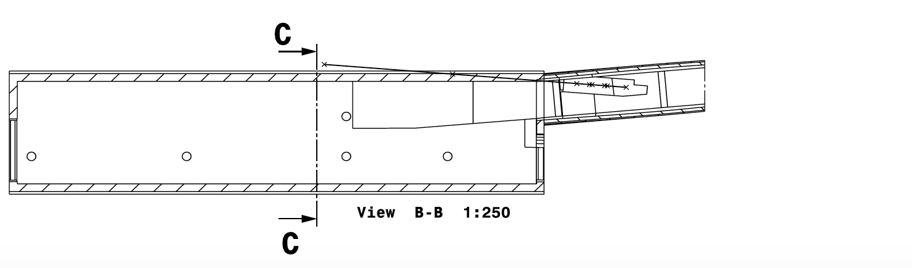
FORWARD PHYSICS FACILITY
A few experiments are under construction or proposed for this location. But they are severely limited by the tunnels and infrastructure that were created long ago (in the 1980’s for LEP!) and long before the physics potential of this space was appreciated.
FASER, FASERν
Beam Collision Axis
Tunnel TI12
Cavern UJ12
30 m
Dougherty (2020)

Slide 8
FORWARD PHYSICS FACILITY
More generally, the potential of “external” detectors (MoEDAL, FASER, milliQan, Codex-b, MATHUSLA, FMS, …) is increasingly appreciated.
They all require surveying, civil engineering, and support services that are currently being developed piecemeal.
The Forward Physics Facility would consolidate many of these activities, support a suite of far forward experiments, and lead to a huge gain in sensitivity to new physics, neutrino studies, and hadronic physics.
FORWARD
PHYSICS
FACILITY
Beam Collision Axis
30 m
Dougherty (2020)

Slide 9
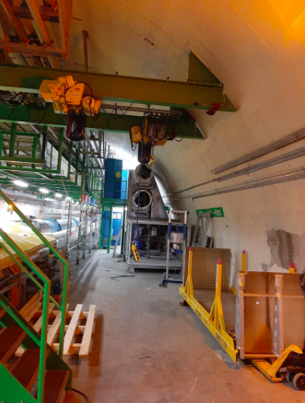
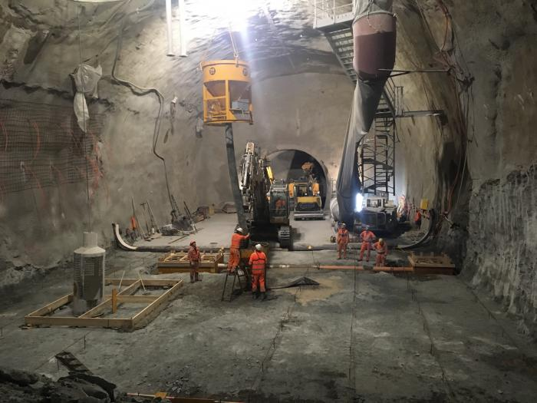
UJ12 AND UJ 18 CAVERNS
The Forward Physics Facility would require widening a pre-existing cavern, UJ12 or UJ18, by a few meters.
Requires civil engineering near the LHC beam, but not much compared to what has already been invested in the HL LHC.
Beam collision axis
HL LHC
UJ12

Slide 10
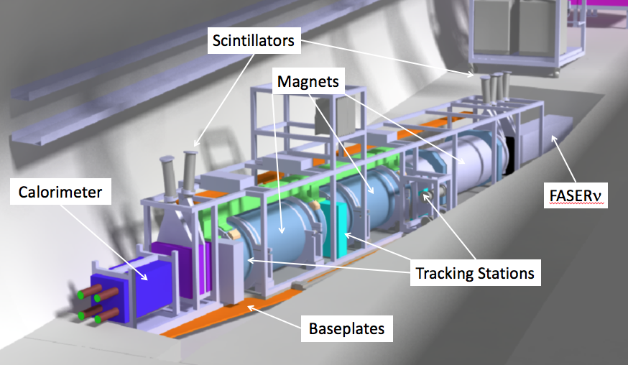
WHAT’S IT GOOD FOR?
FASER and FASERν are approved, funded, under construction for Run 3.
  50cm deep trench puts the detectors on axis. Coverage: η > 9, total length: 6 m.
  FASER: tracker and calorimeter, detects LLP decay to pair of TeV charged tracks. Background negligible (FLUKA simulations validated by prototype detector in 2018).
  FASERν: emulsion detector, detects CC and NC neutrino interactions.
SND@LHC also been proposed as a (slightly) off-axis ν expt in TI18.
LLP
ν
e⁺
e⁻

Slide 11
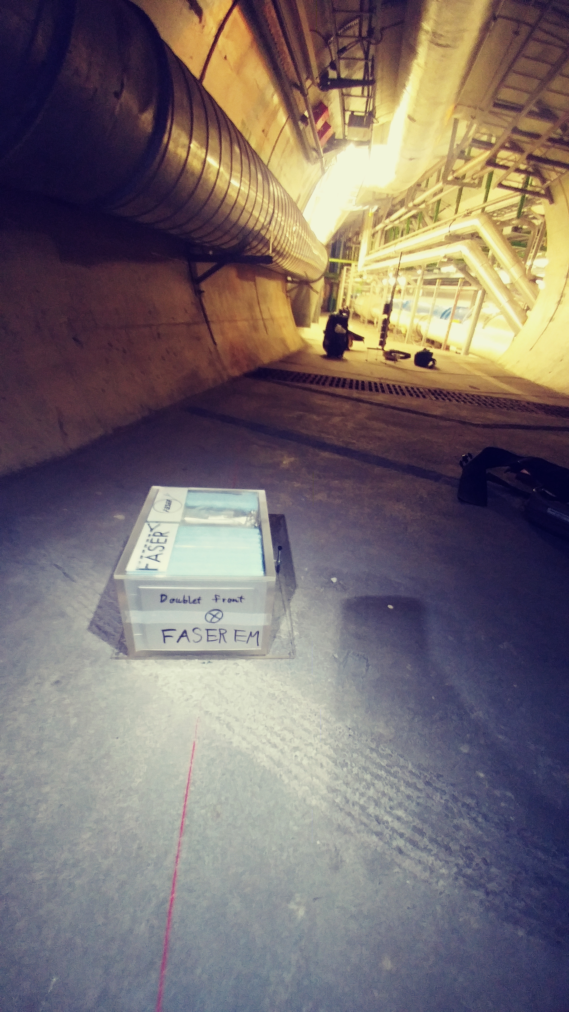
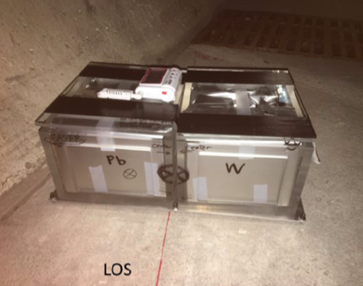
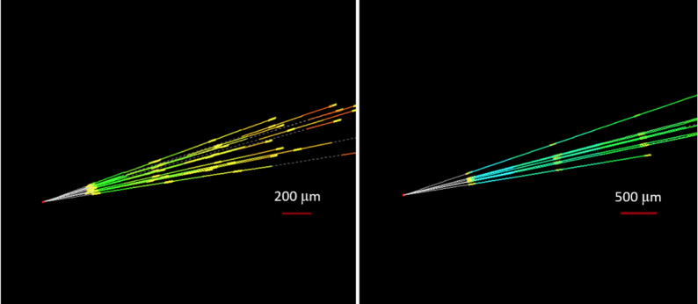
NEUTRINO PHYSICS
No collider neutrino has ever been detected.
1984: de Rujula and Ruckl: to detect neutrinos, look in the forward direction.
2018: FASER pilot ~30 kg emulsion detectors collected 12.5 fb⁻¹ on the beam collision axis (installed and removed during Technical Stops).
2020: Expect ~10 neutrino interactions. Several neutral vertices identified, likely to be neutrinos. Analysis ongoing.

Slide 12
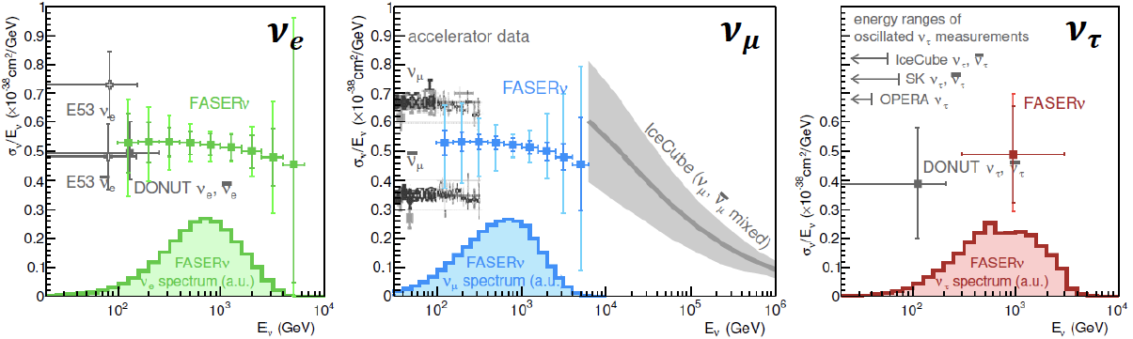
NEUTRINO PHYSICS
2021-24: FASERν will collect data with 1.3 ton tungsten/emulsion in Run 3
  Detect ~1000 ν_{e} , ~10,000 ν_{μ} , and ~10 ν_{τ} .
  Probe neutrino properties at energies E_{ν} ~ TeV, first direct exploration of this energy range for all 3 flavors.
2027-36: With Forward Physics Facility, can upgrade to ~10 tons in HL-LHC
  Detect ~100,000 ν_{e} , ~1,000,000 ν_{μ} , and ~1000 ν_{τ} .
  Study production, propagation, and interactions for all 3 ν flavors, lepton universality, ν oscillations, ν_{τ} magnetic moment, NSI, neutrino tridents, …
  FPF will open up a new world of TeV neutrino physics at colliders.
FASER Collaboration 1908.02310 (2019)

Slide 13
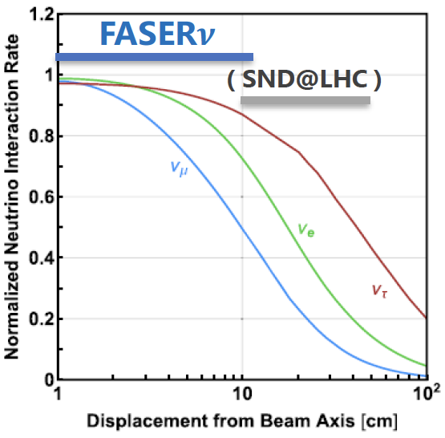
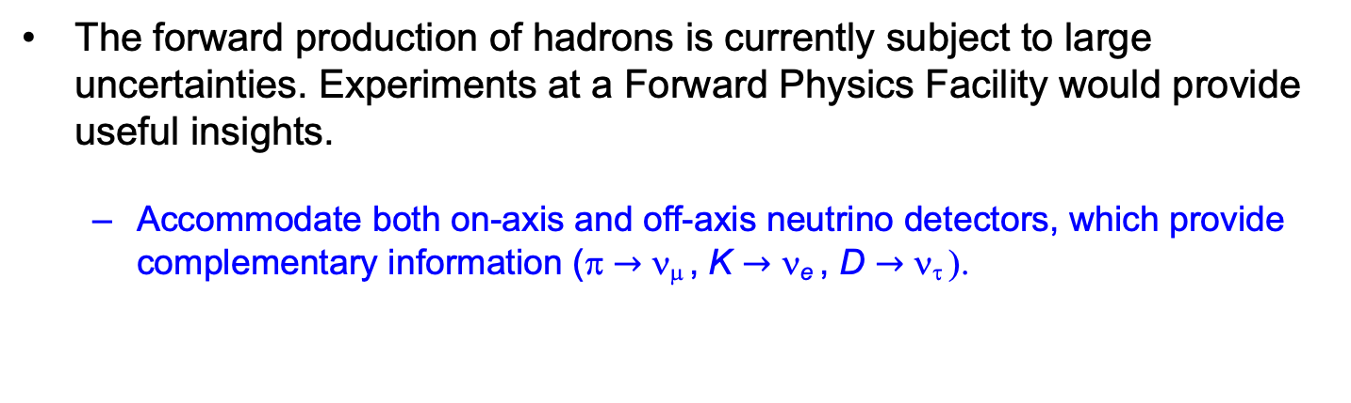
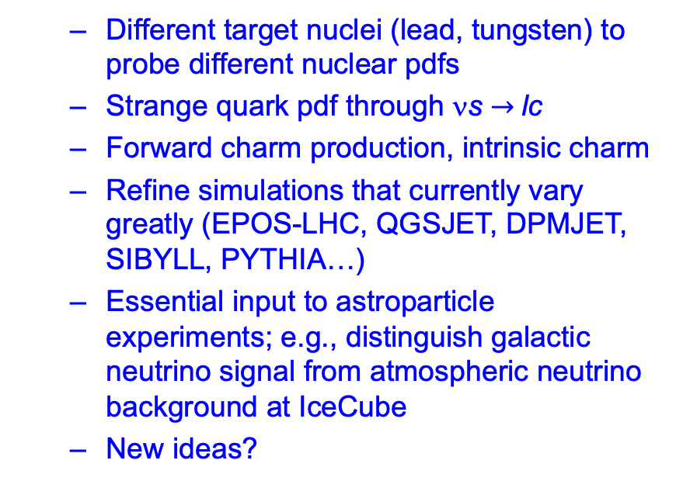
QCD PHYSICS
The forward production of hadrons is currently subject to large uncertainties. Experiments at a Forward Physics Facility would provide useful insights.
  Accommodate both on-axis and off-axis neutrino detectors, which provide complementary information (π $→$ ν_{μ} , K $→$ ν_{e} , D $→$ ν_{τ} ).
See Garzelli, Kling, EF5/EF6/EF7 brainstorming session
  Different target nuclei (lead, tungsten) to probe different nuclear pdfs
  Strange quark pdf through νs $→$lc
  Forward charm production, intrinsic charm
  Refine simulations that currently vary greatly (EPOS-LHC, QGSJET, DPMJET, SIBYLL, PYTHIA…)
  Essential input to astroparticle experiments; e.g., distinguish galactic neutrino signal from atmospheric neutrino background at IceCube
  New ideas?

Slide 14
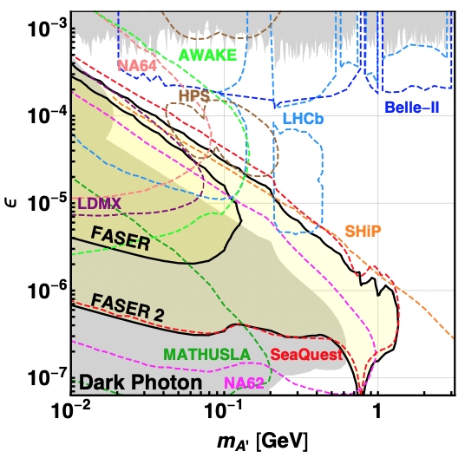
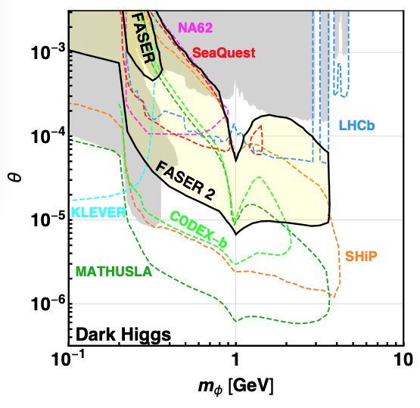
BSM PHYSICS
FASER probes new parameter space in many models with just 1 fb⁻¹. Simply running through HL LHC will extend sensitivity by ~3000.
With a Forward Physics Facility, could upgrade
FASER (R=10cm, L=1.5m, Run 3) → FASER 2 (R=1m, L=5m, HL LHC),
extending sensitivity by ~10⁶, complementary to other experiments.
FASER Collaboration, 1811.12522 (2018)

Slide 15
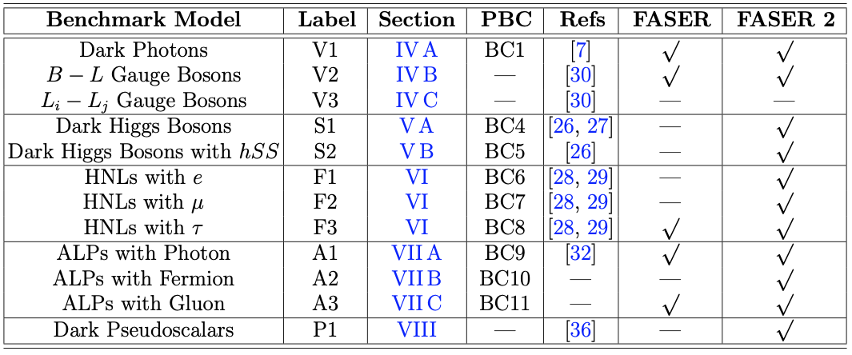
LLP SEARCHES
With a Forward Physics Facility, there is discovery potential for all portal particles (dark photons, dark Higgs bosons, heavy neutral leptons), ALPs with all types of couplings (photon, fermion, gluon), and many other models.
FASER Collaboration, 1811.12522 (2018)

Slide 16
SNOWMASS PLANS
The far forward region contains an entire physics program that has been underappreciated for decades. A rich physics case has already been explored in detail and is established and mature, but many other opportunities remain to be discovered.
For Snowmass, we would like to bring together people with diverse interests to study the physics potential and feasibility of the Forward Physics Facility at the HL LHC.
Snowmass provides an ideal setting: this is an inherently cross-frontier topic, with relevance for EF, NF, RF, CF, TF, and AF.
Short time window: if there is no Forward Physics Facility at the HL LHC, many of these physics opportunities will be left on the table and will disappear for decades.
We will be writing an LOI for the Forward Physics Facility, and all are invited to join; email jlf@uci.edu.

Slide 17
OPEN QUESTIONS
What other physics can be explored in the far forward region?
  Millicharged particles (PBC Benchmark 3)? Yu-Dai Tsai
  Invisibly decaying dark photons and dark matter detection (PBC Benchmark 2)? Brian Batell
  Other ideas?
What is the optimal design for each experiment?
What is the ideal mix of experiments? Could imagine on- and off-axis LLP searches, on- and off-axis detectors targeting neutrinos and QCD, a milli-charge search experiment, an invisible decay search experiment, …
How much space is required in UJ12 / UJ18? Is it feasible to construct the Forward Physics Facility in LS3 (2025-27)? Cost, schedule.

