Slide 1




FASTER, SMALLER, CHEAPER
AND THE NEW FRONTIER IN
PARTICLE SEARCHES AT THE LHC
Department Colloquium, University of Oregon
Jonathan Feng, UC Irvine, 7 October 2021

Slide 2
PARTICLE PHYSICS NOW

Slide 3
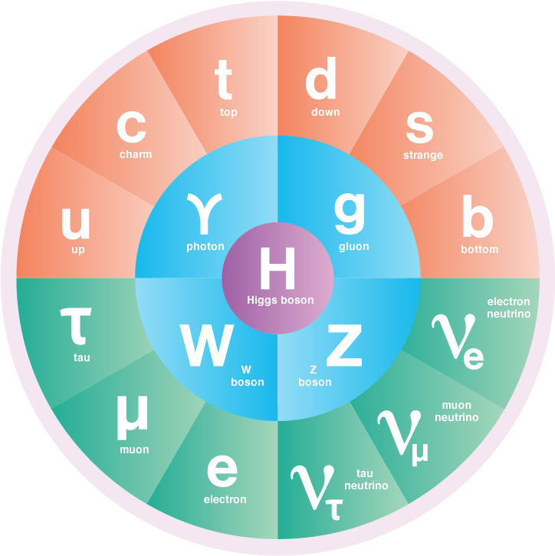
A BRIEF HISTORY OF PARTICLE PHYSICS
In the last century, we have been tremendously successful in discovering new particles and deepening our understanding of the laws of nature and the contents of the Universe.
The workhorse tools leading to much of this progress have been particle accelerators and colliders.

Slide 4
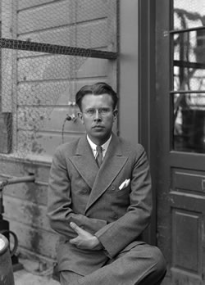
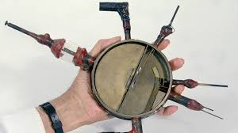
PARTICLE ACCELERATORS AND COLLIDERS
In the 1930’s, E. O. Lawrence made a cyclotron, which accelerated particles to higher velocities and energies.
The first cyclotron was small, but soon, bigger accelerators led to higher energies, which allowed heavier particles to be produced and discovered.

Slide 5

THE LARGE HADRON COLLIDER
The latest realization of Lawrence’s vision: the LHC in Geneva
.
FASER
Colliding protons at a center-of-mass energy of 13 TeV
Notes:
5

Slide 6

THE ATLAS DETECTOR
One of several giant detectors that observe particle collisions at the LHC
Notes:
6

Slide 7
HOW BIG IS BIG SCIENCE?
Size: Big. Colliders the size of cities, detectors the size of buildings.
Timescale: Long. The LHC was conceived in the 1980’s. It was constructed from 1998-2008, and has been running since 2008, with periodic shutdowns to upgrade and fix equipment.
Budget: Expensive. The cost of constructing the LHC and the various experiments was roughly $10 billion. The annual operations budget of CERN, the host laboratory, is about $1 billion/year, or roughly 1 coffee per year per EU citizen.
People: Many.

Slide 8
A RECENT CMS AUTHOR LIST

Slide 9
A RECENT CMS AUTHOR LIST (CONTINUED)

Slide 10
A RECENT CMS AUTHOR LIST (CONTINUED)

Slide 11
A RECENT CMS AUTHOR LIST (CONTINUED)

Slide 12
A RECENT CMS AUTHOR LIST (CONTINUED)
4000 collaborators from 230 institutions in 51 countries

Slide 13
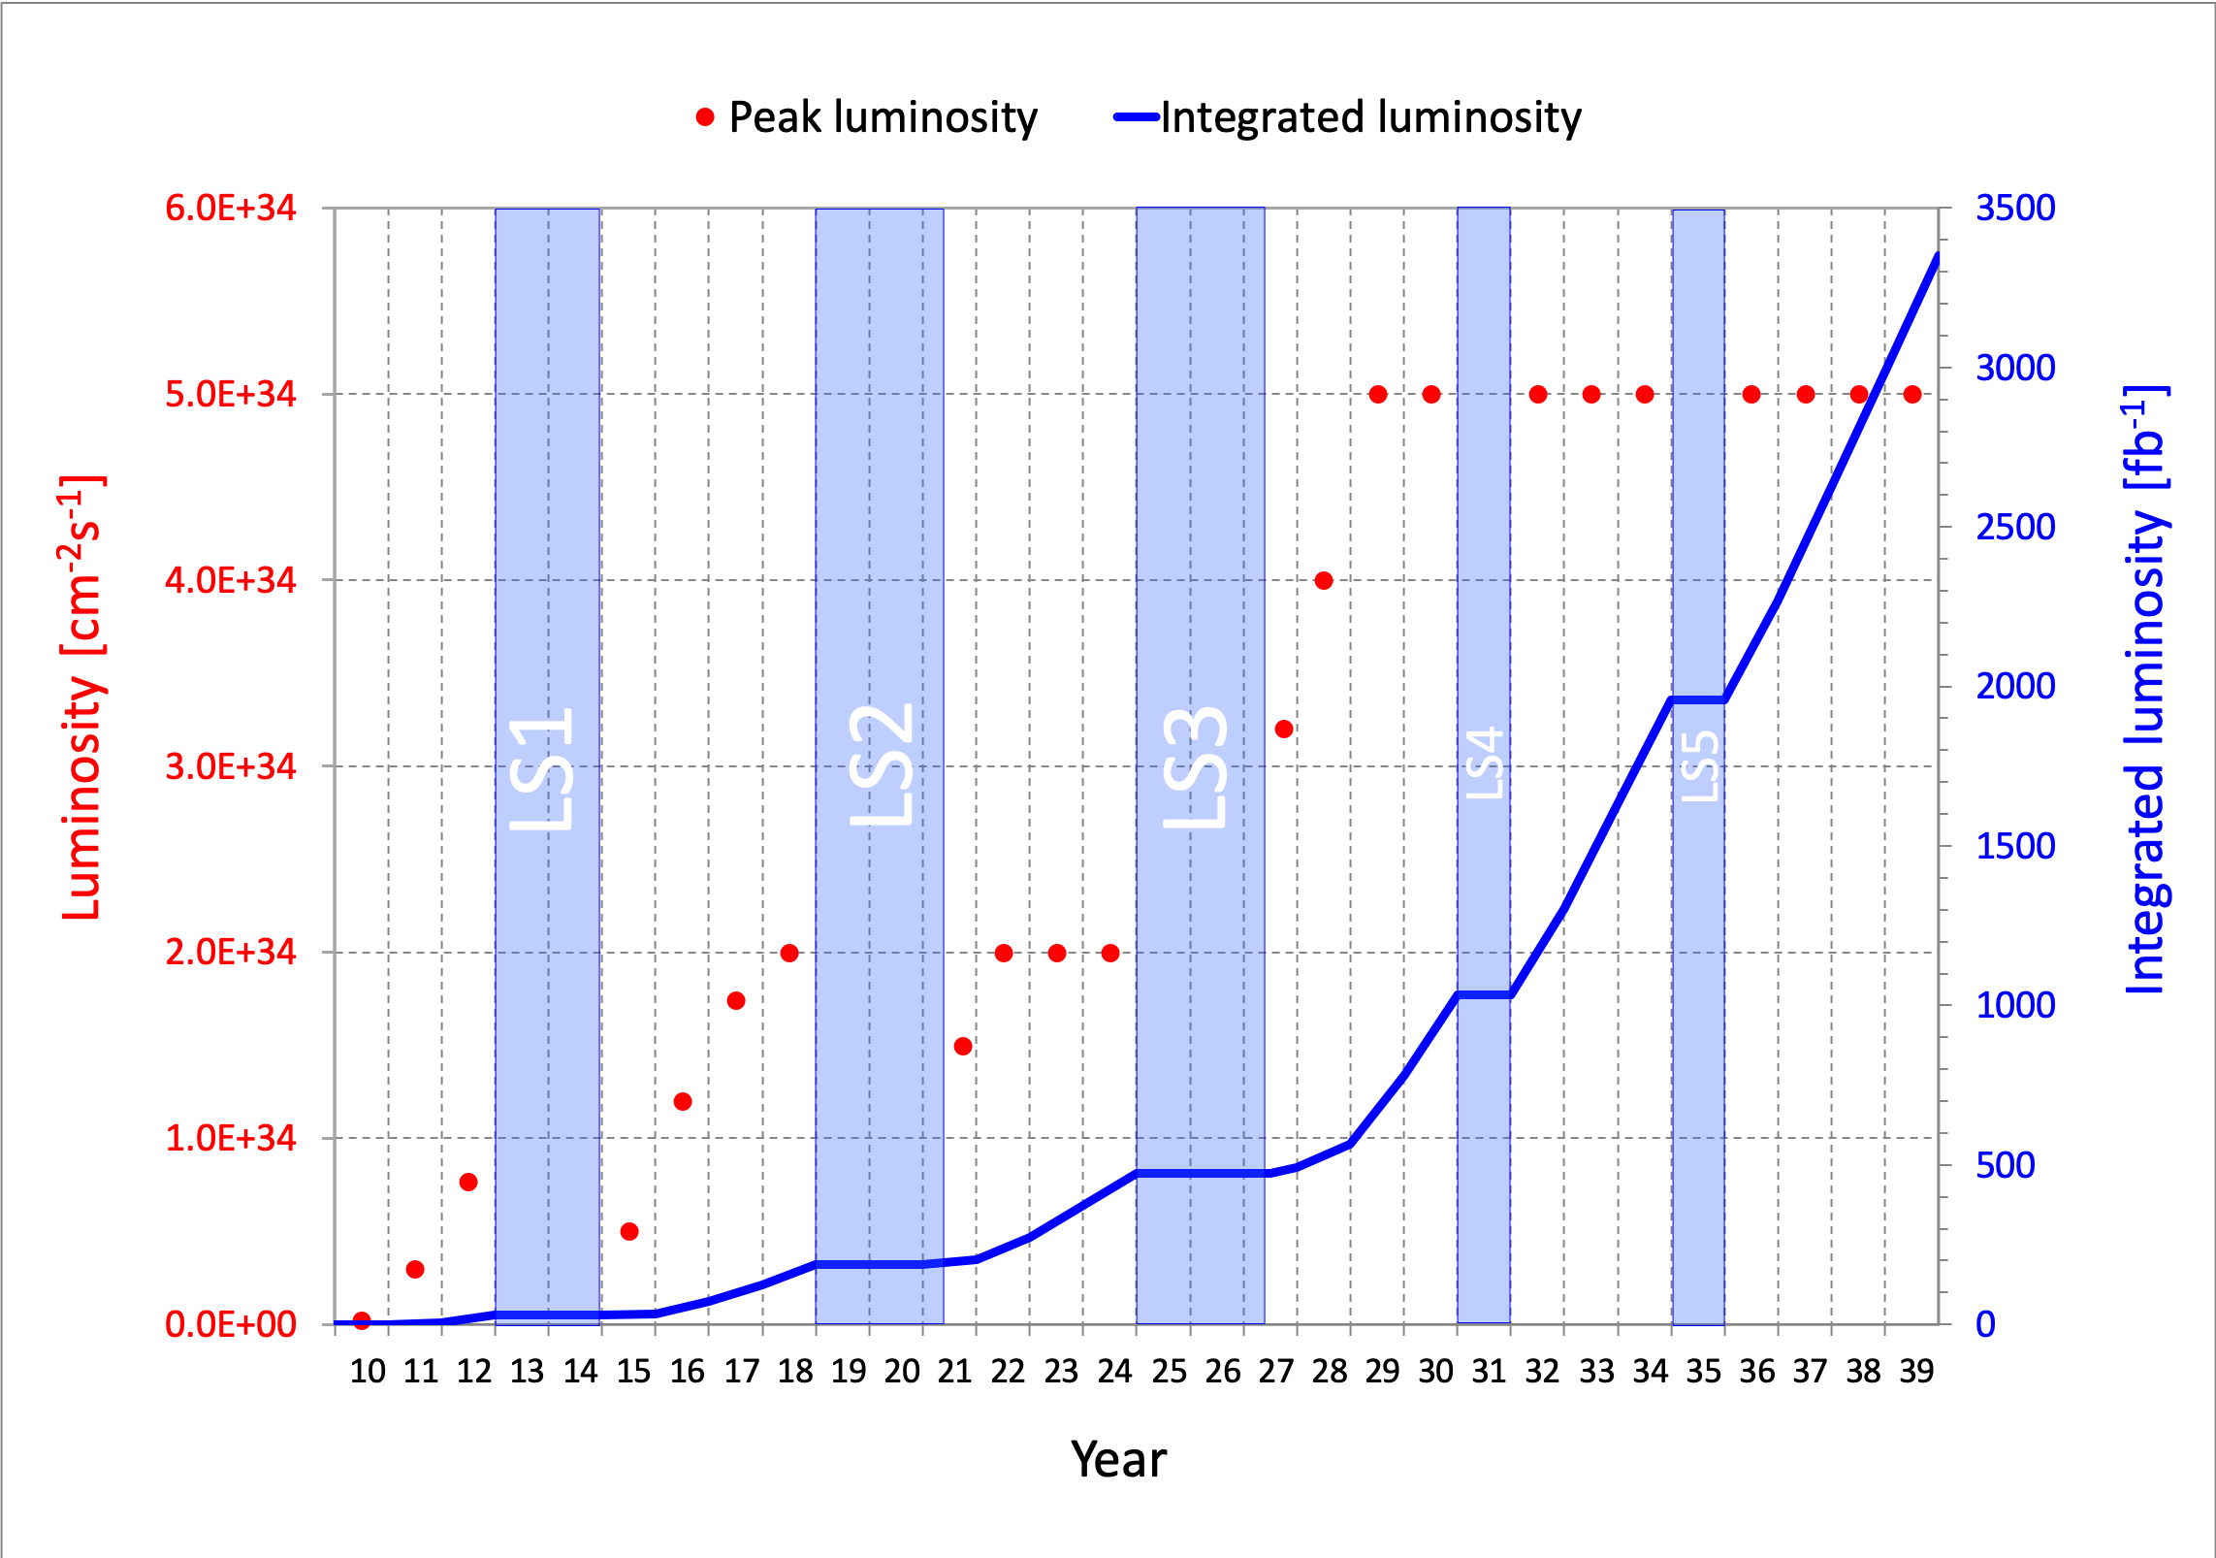
LHC: CURRENT STATUS
The discovery of the Higgs boson in 2012 completed the standard model of particle physics, a remarkable achievement, but so far there has been no other evidence for new particles.
The LHC is currently in Long Shutdown 2, but will start up again in 2022 and run till ~2037. Will we find new particles through conventional searches?
What other approaches can enhance the prospects for discovering new particles?

Slide 14
THE LIFETIME FRONTIER

Slide 15

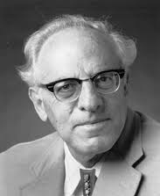
THE NEW PARTICLE LANDSCAPE
Particle
Colliders
Mass
MeV
GeV
TeV
1
Already
Discovered
Strongly Interacting
Heavy Particles
Interaction Strength
New Targets of Small Experiments
Traditional Targets
of Big Science
10⁻³
Weakly Interacting
Light Particles
Impossible to
Discover
10⁻⁶

Slide 16
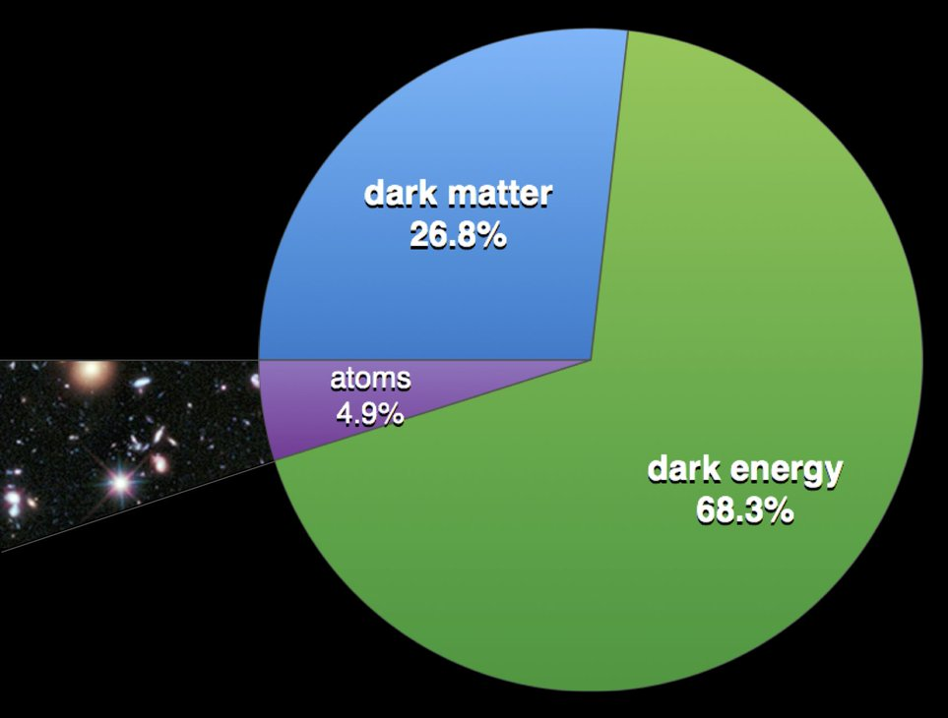
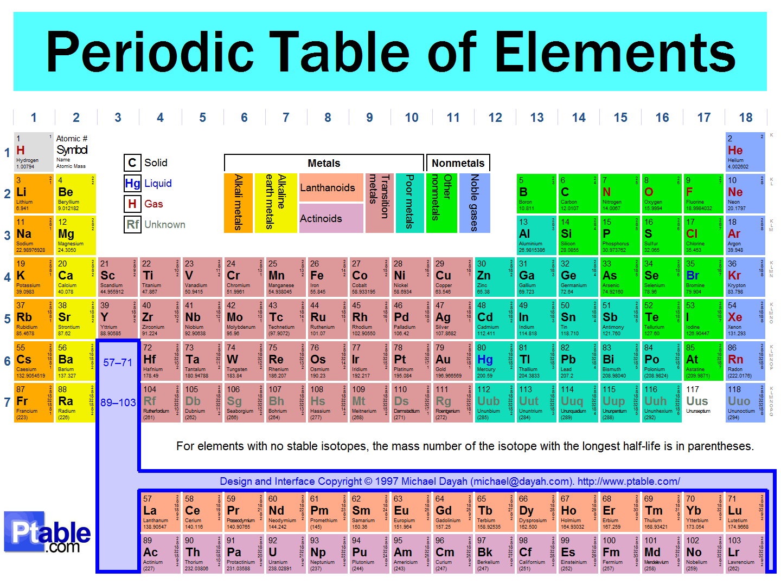
THE UNIVERSE TODAY
We now have an overall picture of the Universe.
We know a lot about a little: the normal matter (5%).
But we know little about a lot: dark matter / dark energy (95%). Most of the universe is still to be discovered and understood.

Slide 17
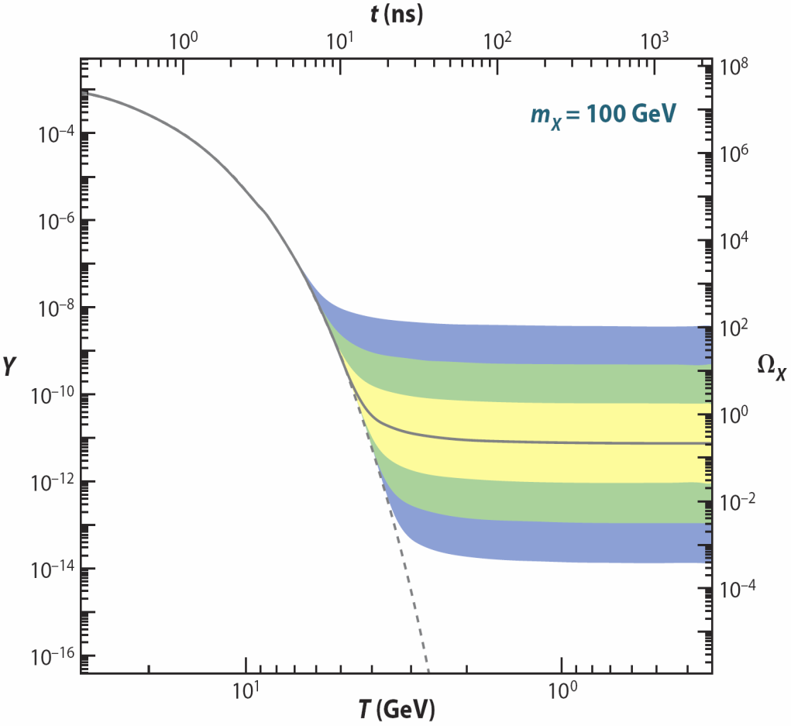
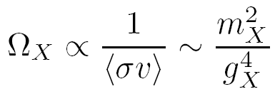
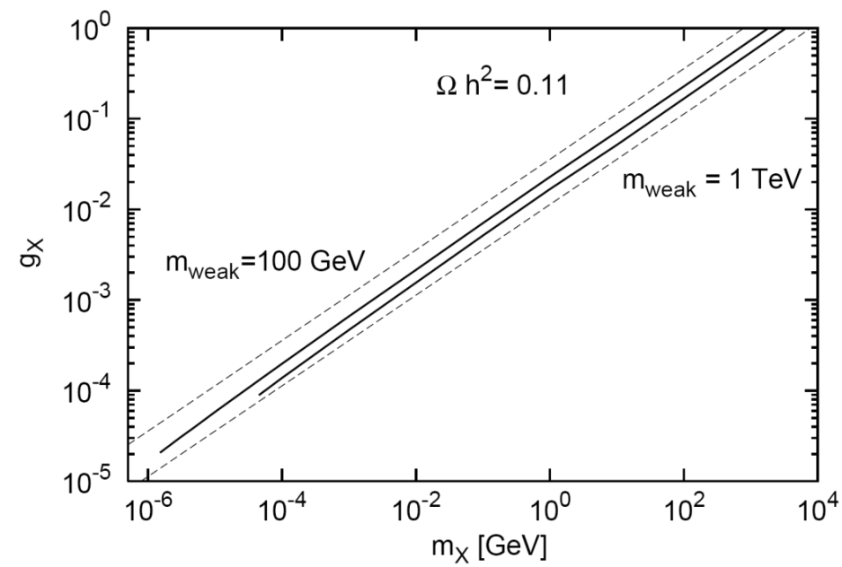
DARK MATTER
What properties should DM have?
A simple mechanism for generating DM: DM particles exist in the early universe, then pair annihilate until they “freeze out.”
The weaker their interactions, the more dark matter survives to the present day:
DM
SM
DM
SM
time
_{WIMP DM}
WIMP Miracle: ~100 GeV to 1 TeV masses, strong couplings → right abundance
WIMPless Miracle: lighter particles, weaker interactions → right abundance
Feng, Kumar (2008); Feng, Tu, Yu (2010)
_{WIMPless DM}

Slide 18

THE THERMAL RELIC LANDSCAPE
Particle
Colliders
Mass
MeV
GeV
TeV
1
Already
Discovered
Strongly Interacting
Heavy Particles
Too Little to be
Dark Matter
Just Right to
be Dark Matter
$$ε$$
Interaction Strength
10⁻³
Weakly Interacting
Light Particles
Impossible to
Discover
10⁻⁶
Too Much to be
Dark Matter

Slide 19
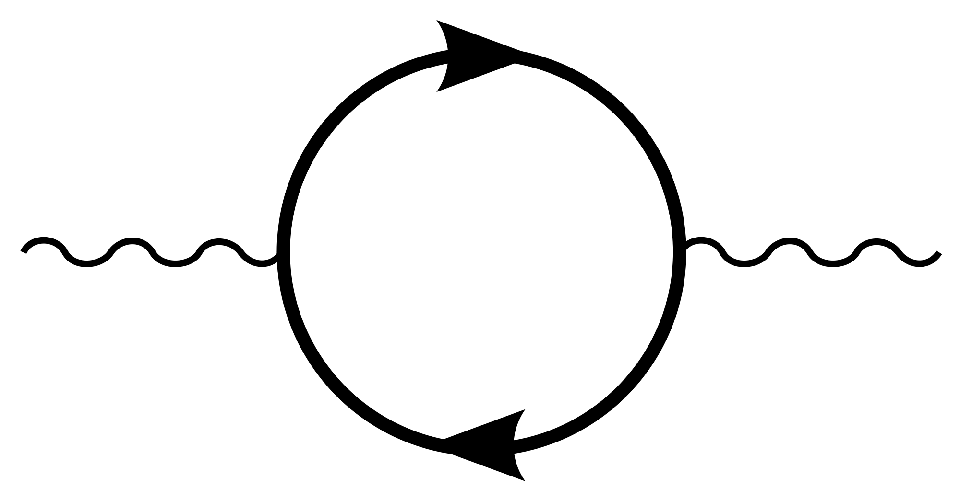
AN EXAMPLE: DARK PHOTONS
Suppose there is a dark sector that contains dark matter X and also a dark force: dark electromagnetism.
Generically, the force carriers of the SM and dark EM will mix
The resulting theory contains a new particle, the dark photon. It’s like a normal photon, except that it can have a small mass, and its couplings to charged particles are suppressed by a small parameter: it is a weakly-interacting, light particle.
Finding a dark photon would imply the discovery of a new fundamental force and also our first “portal” through which to view the dark sector.
SM
EM
Dark Sector
EM, X
M
A
A_{D}
Holdom (1986)

Slide 20
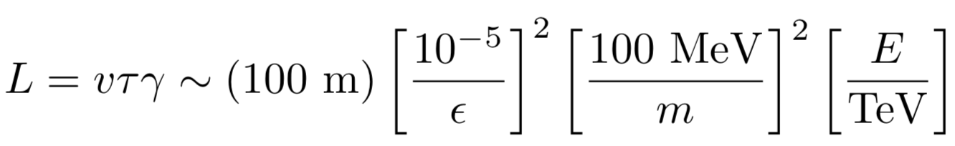
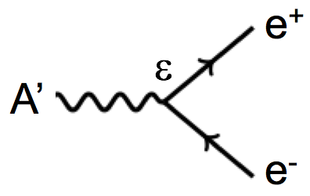
THE LIFETIME FRONTIER
What are the basic properties of light and weakly interacting particles?
Consider such a neutral particle with energy E ~ TeV, and
  mass between electron (0.5 MeV) and proton (1 GeV): take m ~ 100 MeV
  coupling between milli-charged and micro-charged: take ε ~ 10⁻⁵
They pass through matter essentially without interacting: radiation length is (10 cm) ε⁻² ~ 10⁹ m. The distance to the moon!
They go straight; unaffected by E and B fields.
They may decay to visible particles, but only after a long time:
Strong dependence on m and ε, but these are long-lived particles and decay lengths may be meters or kilometers: human length scales!

Slide 21
THE NEW PARTICLE LANDSCAPE
Particle
Colliders
Mass
MeV
GeV
TeV
1
Already
Discovered
Strongly Interacting
Heavy Particles
LONGER
LIFETIMES
Interaction Strength
10⁻³
Weakly Interacting
Light Particles
Impossible to
Discover
10⁻⁶

Slide 22
FASER

Slide 23

SEARCHES FOR NEW LIGHT PARTICLES
If new particles are light and weakly interacting, existing detectors are perfectly designed NOT to see them.
Existing detectors are designed to find new heavy particles. To make such particles, the colliding beam energy is converted mainly to rest mass, and so these particles are produced almost at rest and decay isotropically.
But new light particles are dominantly produced in glancing collisions and so travel along the beamline, where existing detectors have holes to let the colliding beams in.
To add insult to injury, light particles are long-lived, and so would anyway pass right through existing detectors and decay far away.

Slide 24
FASER: THE BASIC IDEA
Clearly what we need is a detector to complement existing detectors and cover their “blind spots.”
We can’t put such a detector too close to the interaction point, or it would block the beams.
But if we go far enough away, the protons beams are bent by magnets (it’s a circular collider!), whereas the new light particles will go straight.

Slide 25
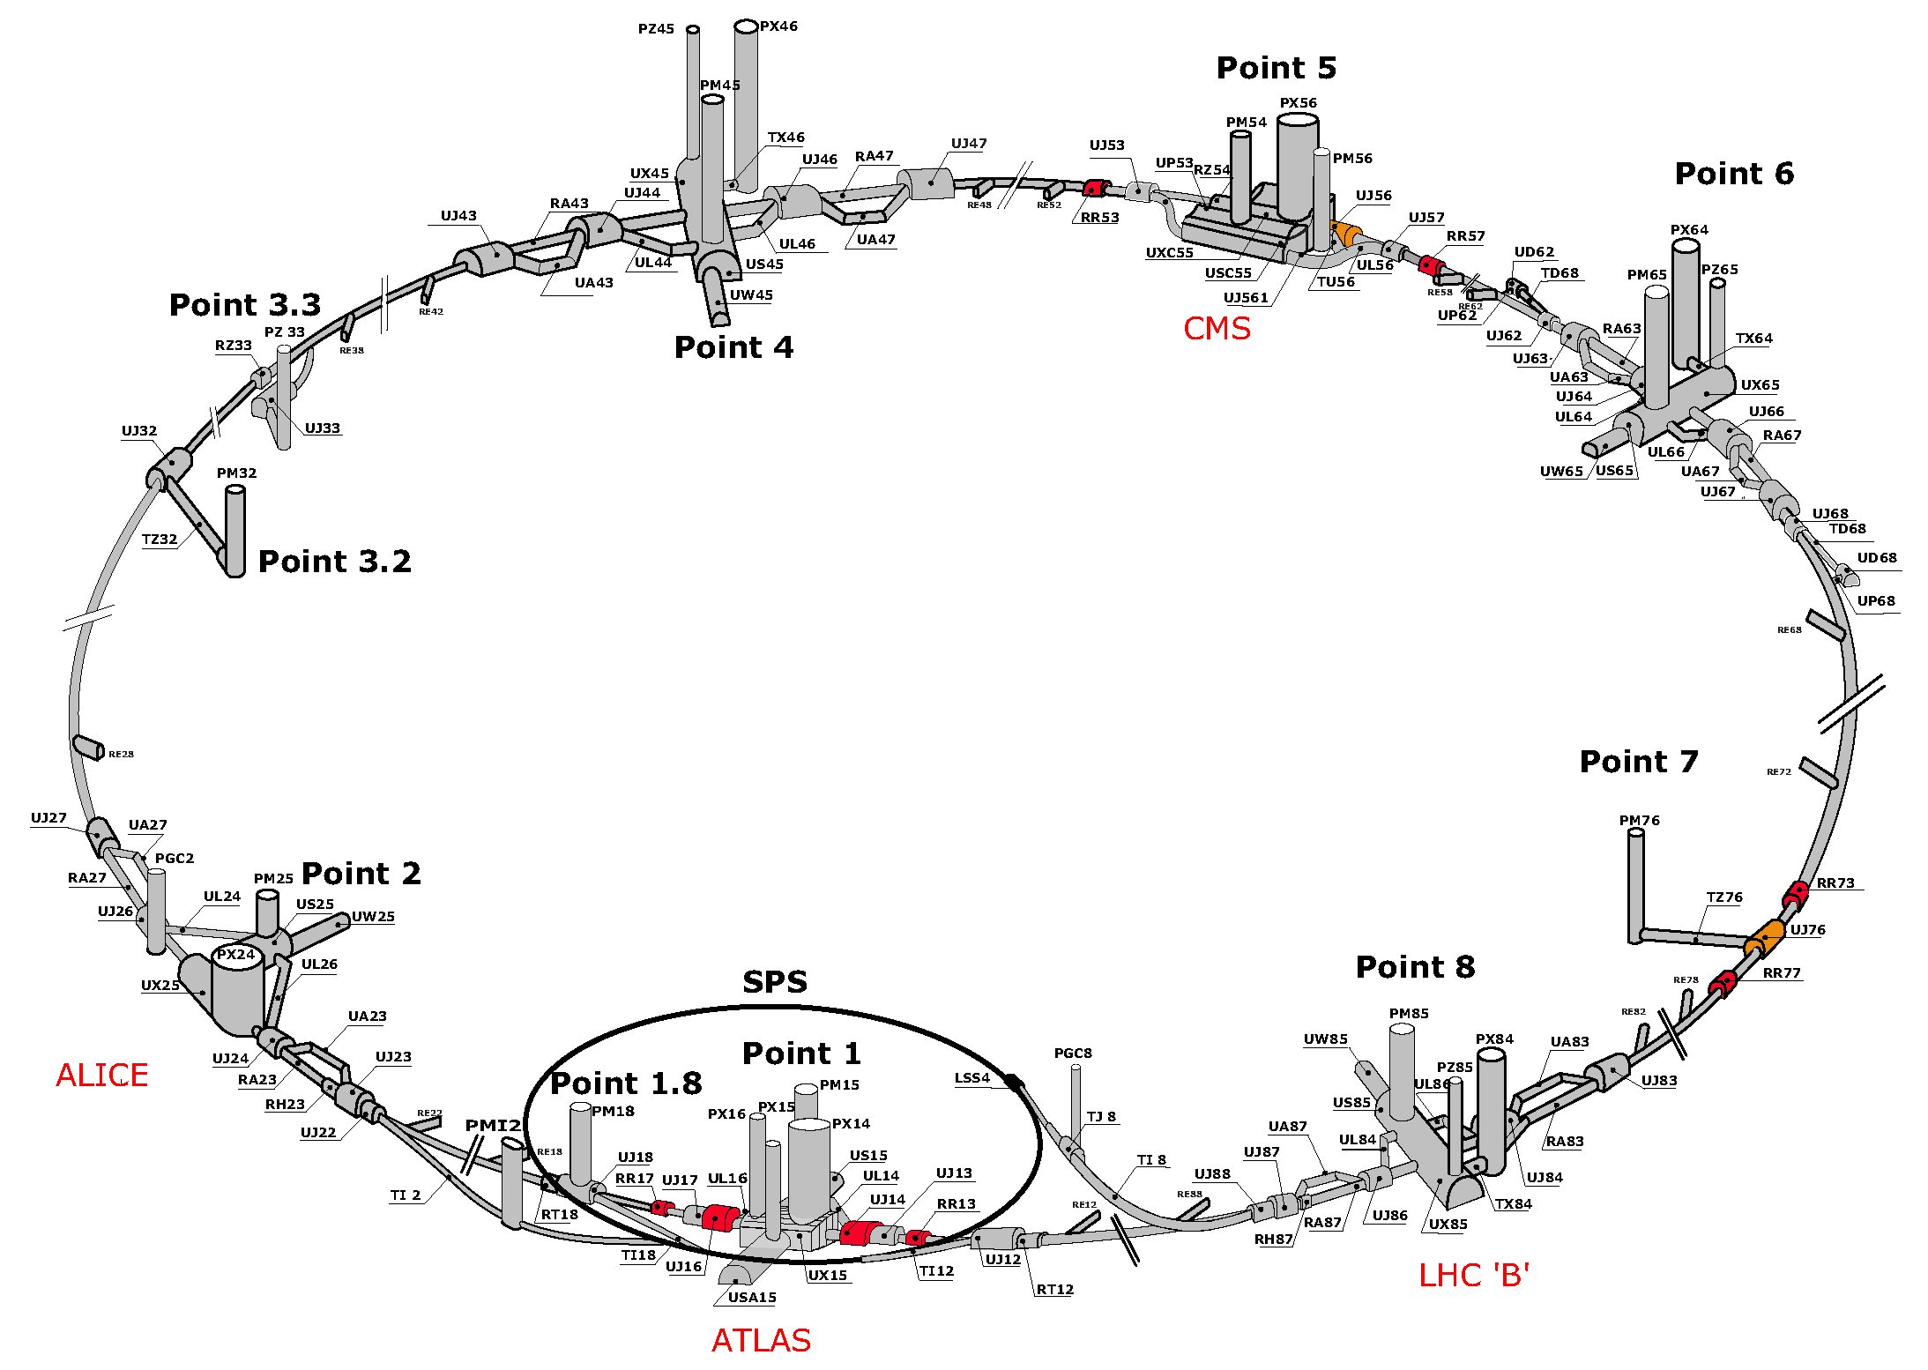
MAP OF LHC
FASER

Slide 26
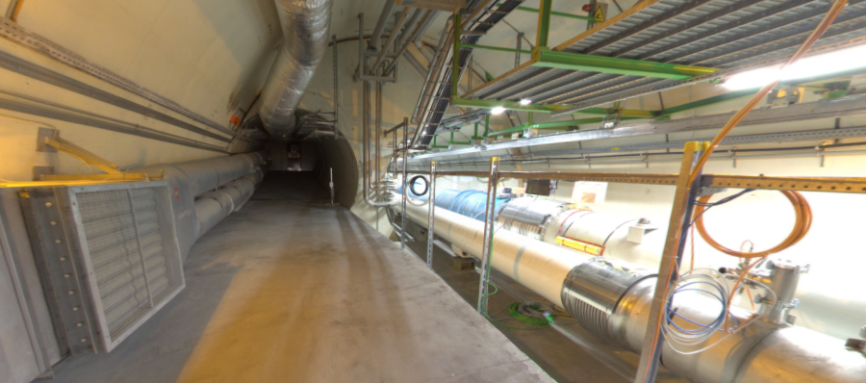
LOCATION OF FASER
Beam collision axis passes
through 100 m of rock, emerges in tunnel TI12, 480 m from ATLAS
UJ12
TI12 near UJ12
The view in UJ12 looking west (2018)
TI12
Beam collision axis
LHC beamline

Slide 27
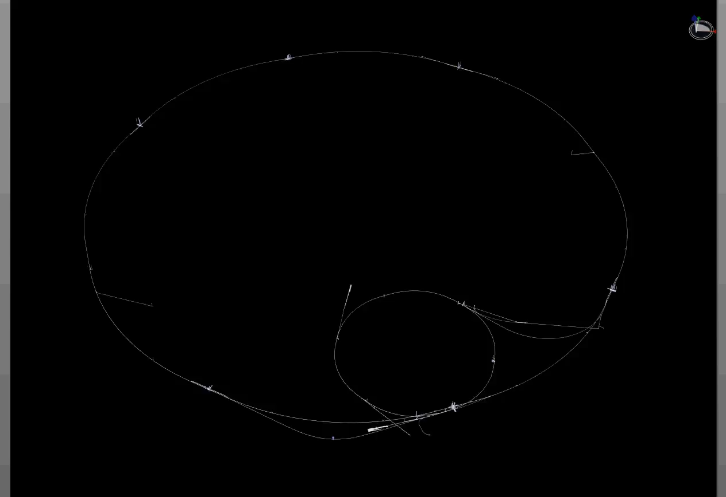
PARTICLE PATH FROM ATLAS TO FASER
Dougherty, CERN Integration (2019)

Slide 28
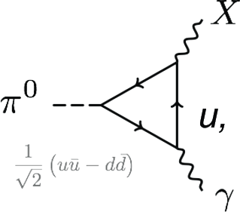
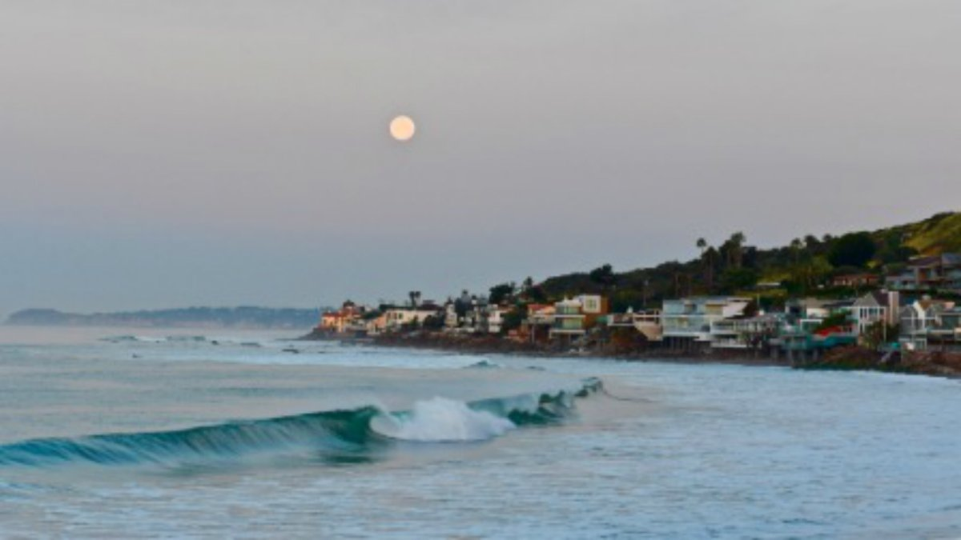
HOW BIG DOES THE DETECTOR HAVE TO BE?
Consider the dark photon: like normal photons, it can be produced in pion decay.
The typical transverse momentum is therefore m_{π} ~ Λ_{QCD} ~ 200 MeV.
For a TeV dark photon, the typical angle relative to the beampipe is 200 MeV/TeV = 0.2 mrad. Extremely collimated; cf. the moon: 7 mrad.
The spread in the transverse plane after traveling 480 m is therefore ~10 cm, smaller than a sheet of paper.
A’
ε
These considerations motivate a small, inexpensive experiment placed in the very forward region of ATLAS, 480 m downstream.

Slide 29
FASER: THE BASIC IDEA
In short, the population of TeV dark photons, or any other new particle produced in pion decay, or even K, D, B, decay, is far more collimated than shown in this diagram.

Slide 30

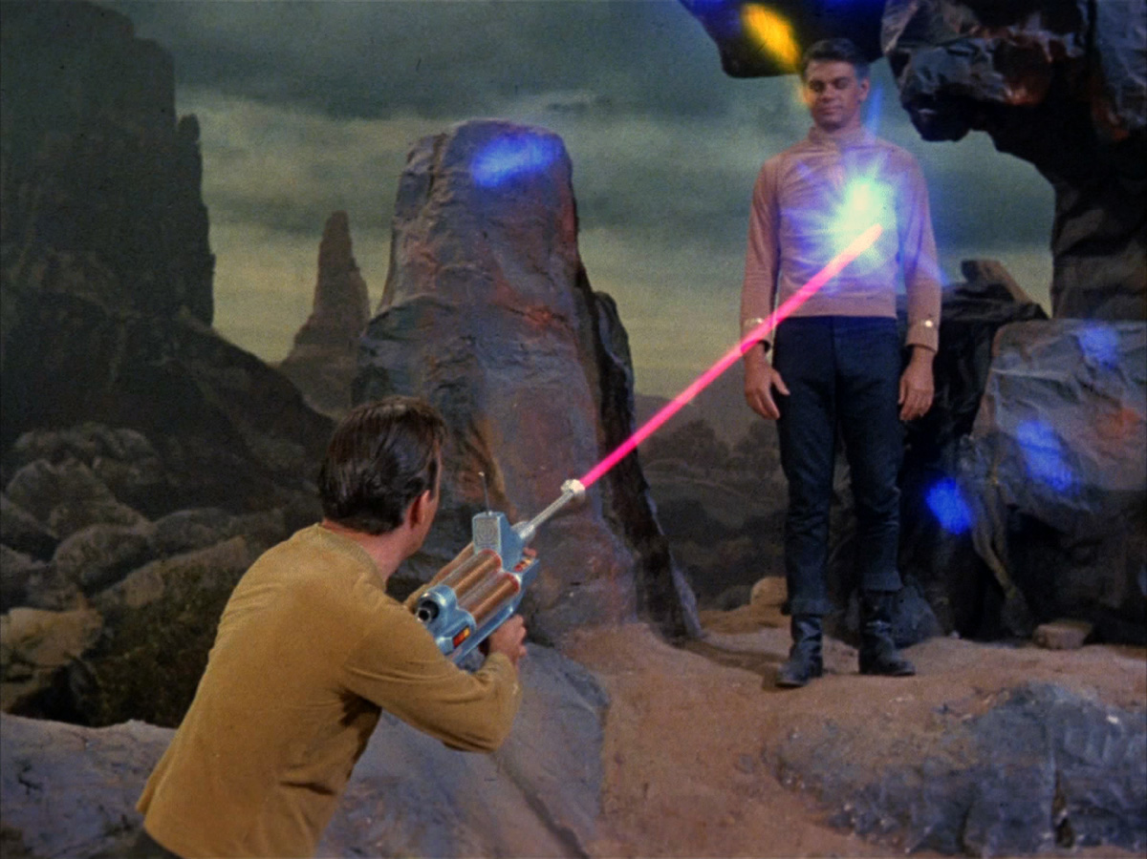
FORWARD SEARCH EXPERIMENT
“The acronym recalls another marvelous instrument that harnessed highly collimated particles and was used to explore strange new worlds.”
Feng, Galon, Kling, Trojanowski (2017)

Slide 31
DARK PHOTON SENSITIVITY REACH
Consider cylindrical detectors in two sizes
  FASER: R = 10 cm, L = 1.5 m, tabletop experiment!
  FASER 2: R = 1 m, L = 5 m, a possible upgrade
FASER probes new parameter space with just 1 fb⁻¹ starting in 2022.
Without upgrade, HL-LHC extends (L*Volume) by factor of 3000; possible upgrade to FASER 2 extends (L*Volume) by ~10⁶.
FASER
FASER and FASER 2
_{FASER Collaboration (2018)}
Feng, Galon, Kling, Trojanowski (2017)

Slide 32
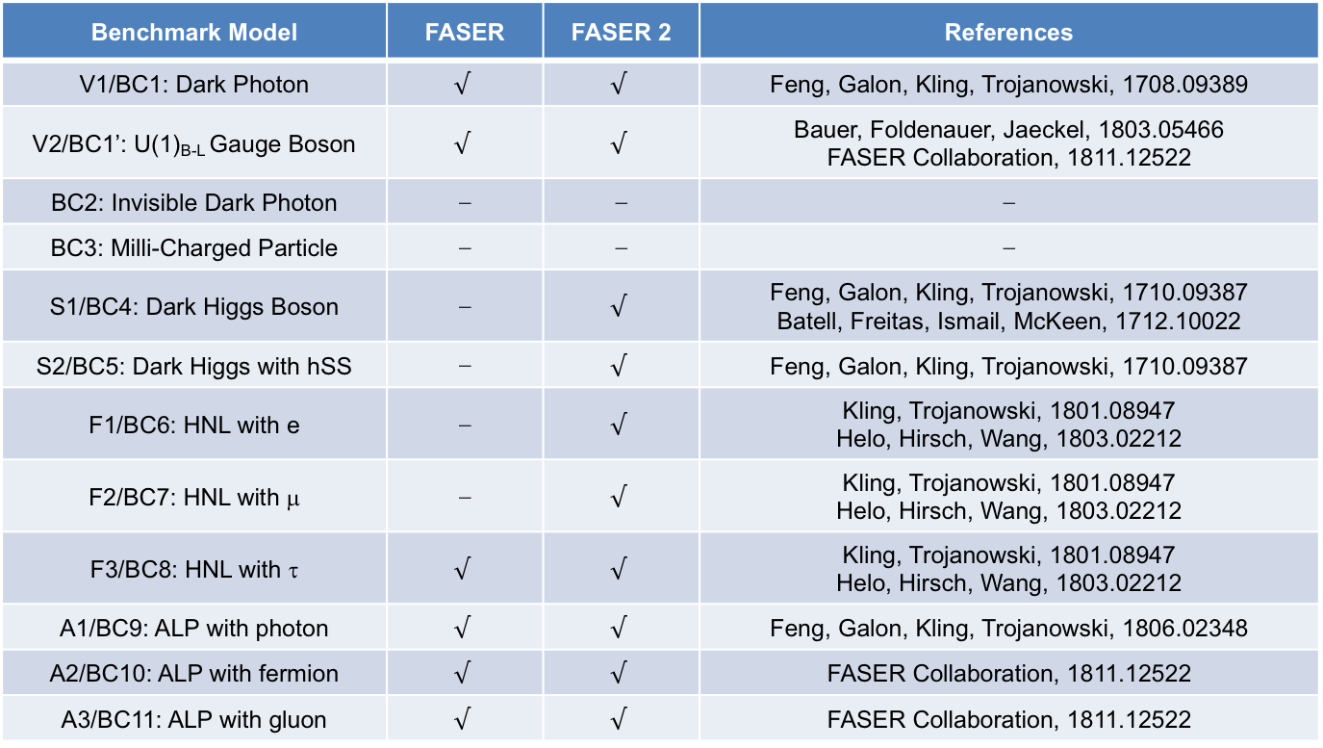
PHYSICS SUMMARY
Many other studies: FASER has discover prospects for all candidates with renormalizable couplings (dark photon, dark Higgs, HNL); ALPs with all types of couplings (γ, f, g); and many other examples; see 1811.12522.
Benchmark Model | FASER | FASER 2 | References
V1/BC1: Dark Photon | $$√$$ | $$√$$ | Feng, Galon, Kling, Trojanowski, 1708.09389
V2/BC1’: U(1)_{B-L} Gauge Boson | $$√$$ | $$√$$ | Bauer, Foldenauer, Jaeckel, 1803.05466 FASER Collaboration, 1811.12522
BC2: Invisible Dark Photon | ⎼ | ⎼ | ⎼
BC3: Milli-Charged Particle | ⎼ | ⎼ | ⎼
S1/BC4: Dark Higgs Boson | ⎼ | $$√$$ | Feng, Galon, Kling, Trojanowski, 1710.09387 Batell, Freitas, Ismail, McKeen, 1712.10022
S2/BC5: Dark Higgs with hSS | ⎼ | $$√$$ | Feng, Galon, Kling, Trojanowski, 1710.09387
F1/BC6: HNL with e | ⎼ | $$√$$ | Kling, Trojanowski, 1801.08947 Helo, Hirsch, Wang, 1803.02212
F2/BC7: HNL with μ | ⎼ | $$√$$ | Kling, Trojanowski, 1801.08947 Helo, Hirsch, Wang, 1803.02212
F3/BC8: HNL with τ | $$√$$ | $$√$$ | Kling, Trojanowski, 1801.08947 Helo, Hirsch, Wang, 1803.02212
A1/BC9: ALP with photon | $$√$$ | $$√$$ | Feng, Galon, Kling, Trojanowski, 1806.02348
A2/BC10: ALP with fermion | $$√$$ | $$√$$ | FASER Collaboration, 1811.12522
A3/BC11: ALP with gluon | $$√$$ | $$√$$ | FASER Collaboration, 1811.12522

Slide 33
FASER STATUS

Slide 34
FASER TIMELINE
September 2017: First theory paper
November 2017: Support from the two most famous living physicists
July 2018: Submitted LOI to CERN LHCC
October 2018: Approval from ATLAS SCT and LHCb Collaborations for use of spare detector modules
November 2018: Submitted Technical Proposal to LHCC
November 2018 – January 2019: Experiment funded by $1M grants from the Heising-Simons and Simons Foundations
March 2019: FASER fully approved by CERN LHCC and Research Board along with support for infrastructure costs
April 2019: 1st FASER Collaboration Meeting
November 2020 – March 2021: Installation of FASER in tunnel during Long Shutdown 2,commissioning of the detector
Early 2022: Start collecting data in Run 3

Slide 35

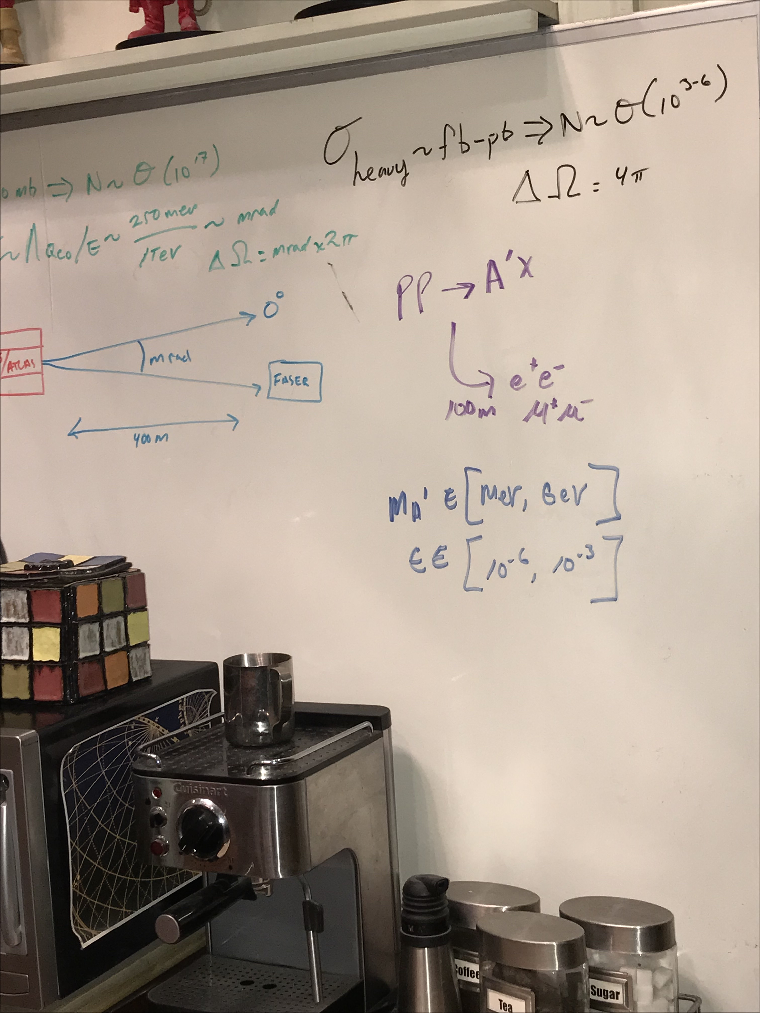
FASER ON BIG BANG THEORY
Credit: Saltzberg
Season 11, Episode 9, “The Bitcoin Entanglement” (November 2017)

Slide 36
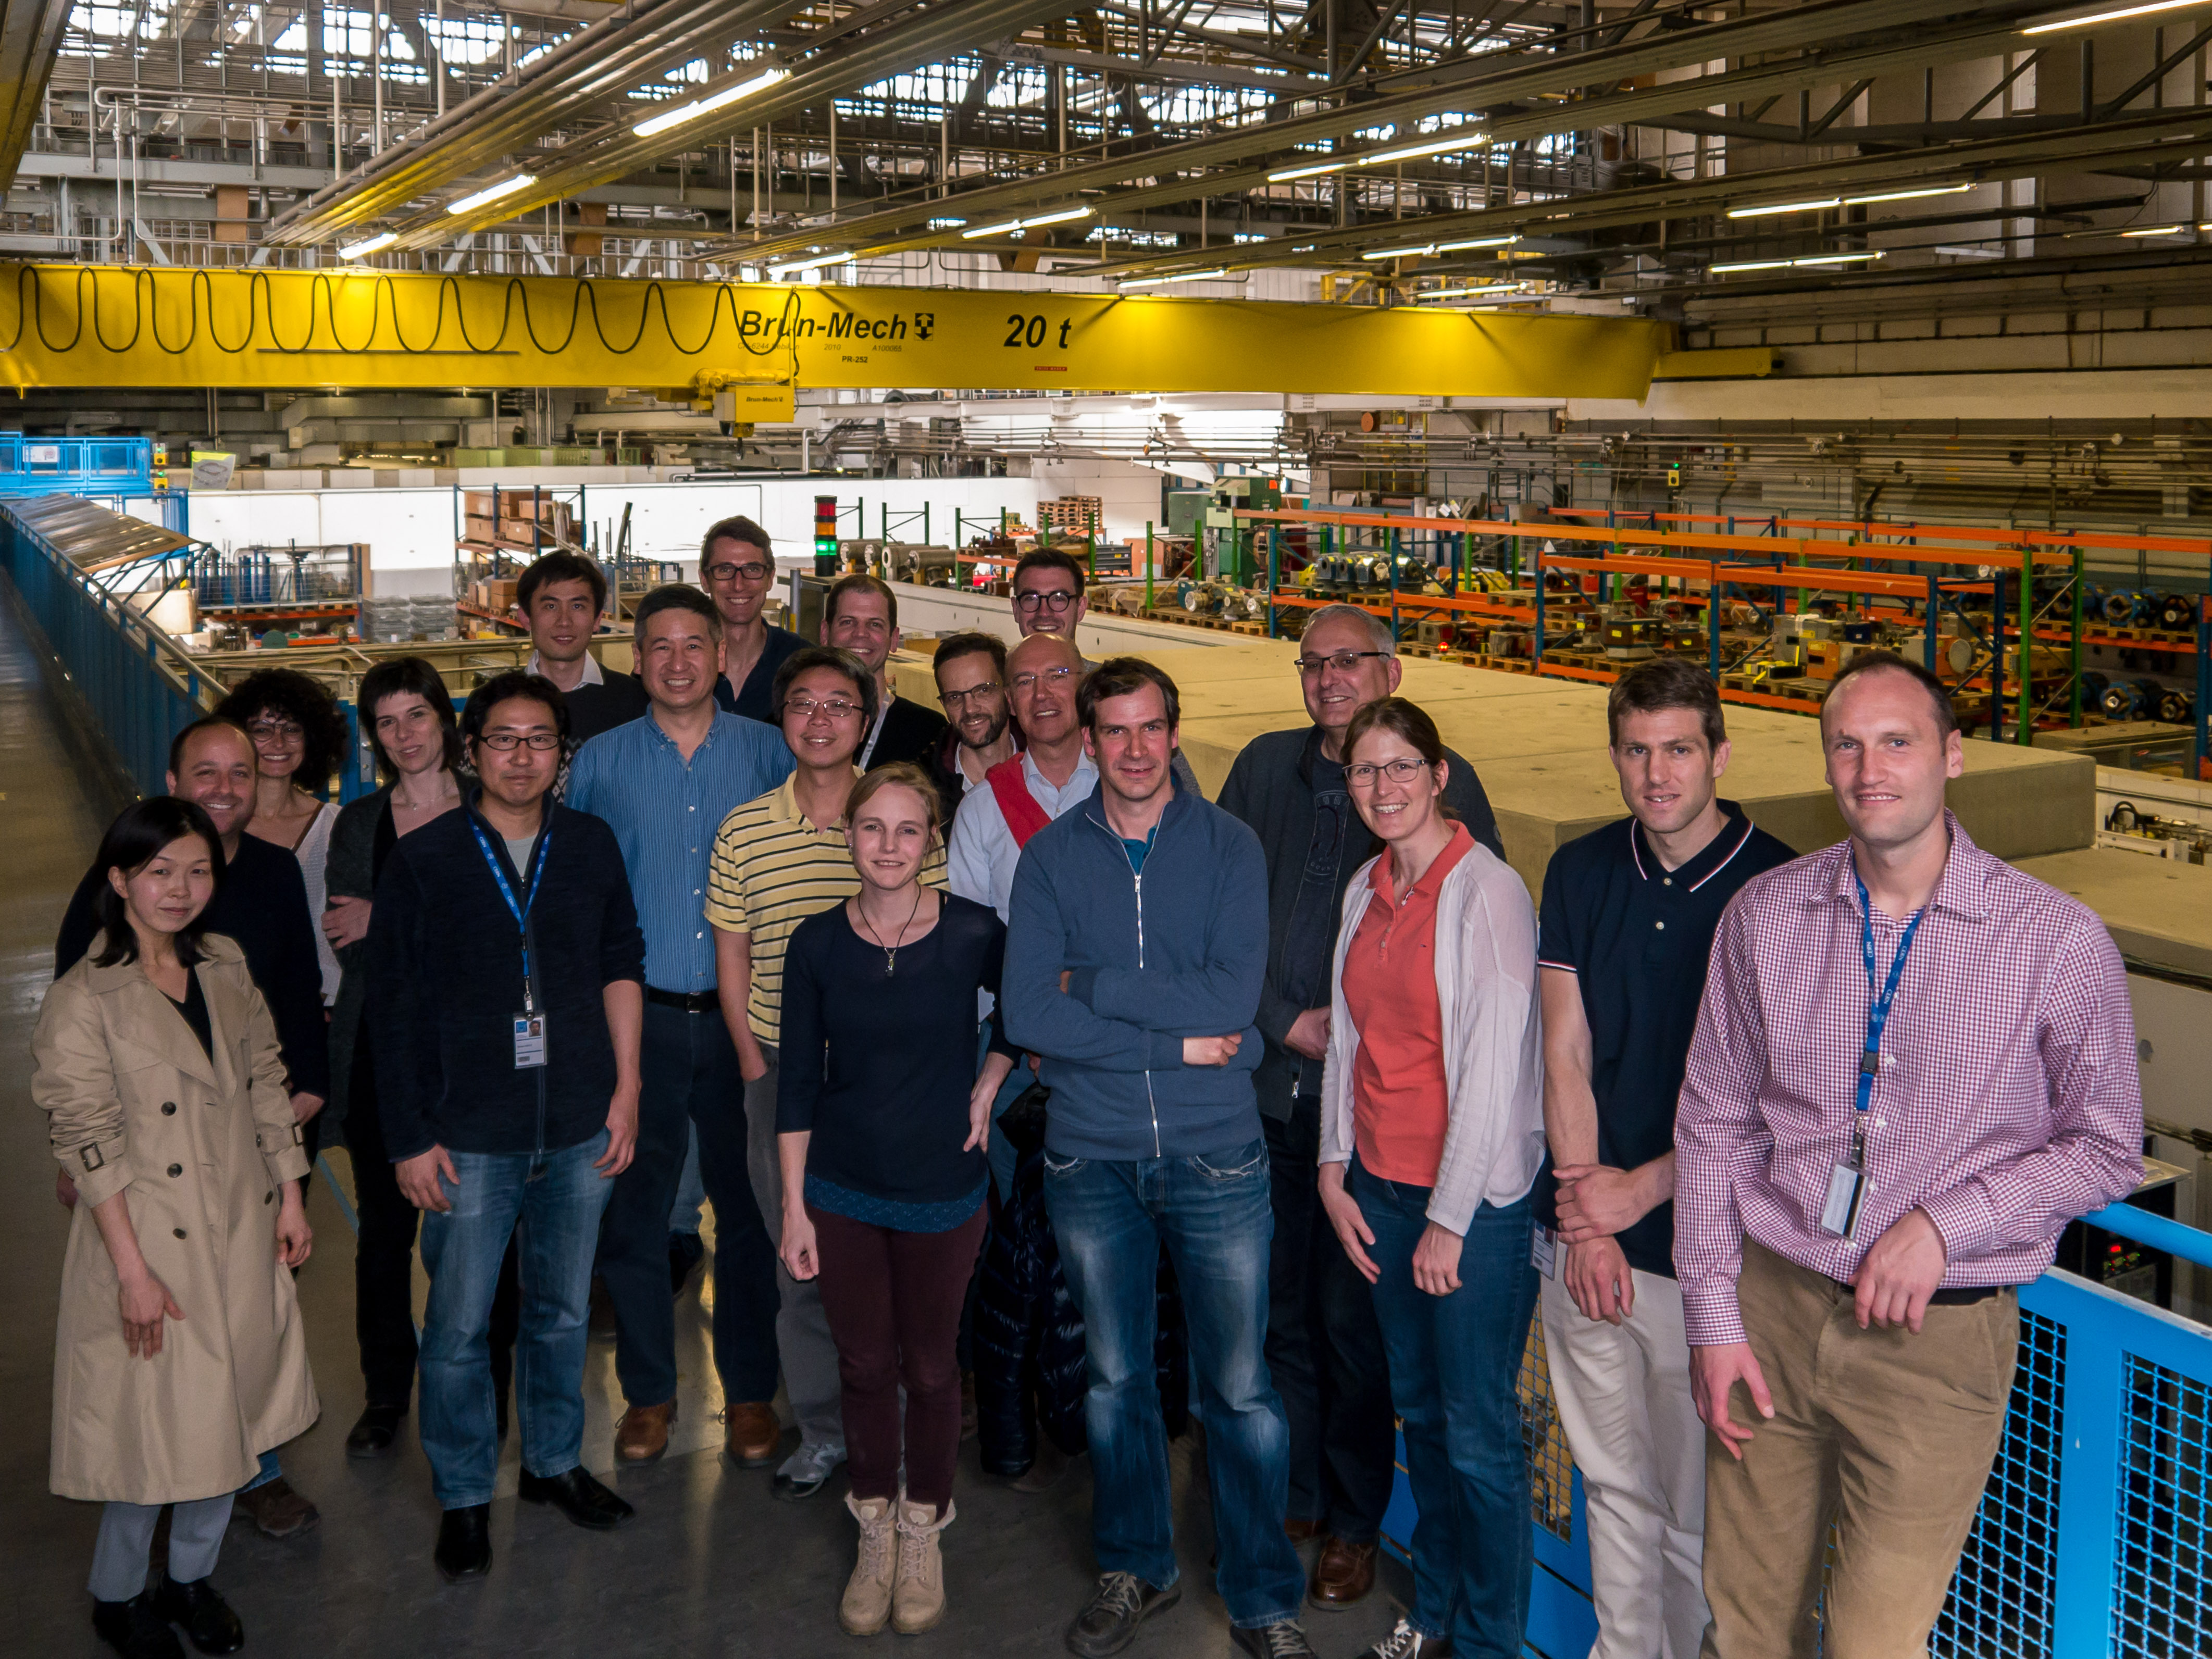
FIRST FASER COLLABORATION MEETING

Slide 37








THE FASER COLLABORATION TODAY
66 collaborators, 19 institutions, 8 countries
Henso Abreu (Technion), Yoav Afik (Technion), Claire Antel (Geneva), Akitaka Ariga (Bern), Tomoko Ariga (Kyushu/Bern), Florian Bernlochner (Bonn), Tobias Boeckh (Bonn), Jamie Boyd (CERN), Lydia Brenner (CERN), Franck Cadoux (Geneva), Dave Casper (UC Irvine), Charlotte Cavanagh (Liverpool), Xin Chen (Tsinghua), Andrea Coccaro (INFN), Monica D’Onofrio (Liverpool), Candan Dozen (Tsinghua), Yannick Favre (Geneva), Deion Fellers (Oregon), Jonathan Feng (UC Irvine), Didier Ferrere (Geneva), Stephen Gibson (Royal Holloway), Sergio Gonzalez-Sevilla (Geneva), Carl Gwilliam (Liverpool), Shih-Chieh Hsu (Washington), Zhen Hu (Tsinghua), Peppe Iacobucci (Geneva), Sune Jakobsen (CERN), Enrique Kajomovitz (Technion), Felix Kling (SLAC), Umut Kose (CERN), Susanne Kuehn (CERN), Helena Lefebvre (Royal Holloway), Lorne Levinson (Weizmann), Ke Li (Washington), Jinfeng Liu (Tsinghua), Chiara Magliocca (Geneva), Josh McFayden (Sussex), Sam Meehan (CERN), Dimitar Mladenov (CERN), Mitsuhiro Nakamura (Nagoya), Toshiyuki Nakano (Nagoya), Marzio Nessi (CERN), Friedemann Neuhaus (Mainz), Laurie Nevay (Royal Holloway), Hidetoshi Otono (Kyushu), Carlo Pandini (Geneva), Hao Pang (Tsinghua), Brian Petersen (CERN), Francesco Pietropaolo (CERN), Markus Prim (Bonn), Michaela Queitsch-Maitland (CERN), Filippo Resnati (CERN), Jakob Salfeld-Nebgen (CERN), Osamu Sato (Nagoya), Paola Scampoli (Bern), Kristof Schmieden (Mainz), Matthias Schott (Mainz), Anna Sfyrla (Geneva), Savannah Shively (UC Irvine), John Spencer (Washington), Yosuke Takubo (KEK), Ondrej Theiner (Geneva), Eric Torrence (Oregon), Serhan Tufanli (CERN), Benedikt Vormvald (CERN), Di Wang (Tsinghua), Gang Zhang (Tsinghua)

Slide 38
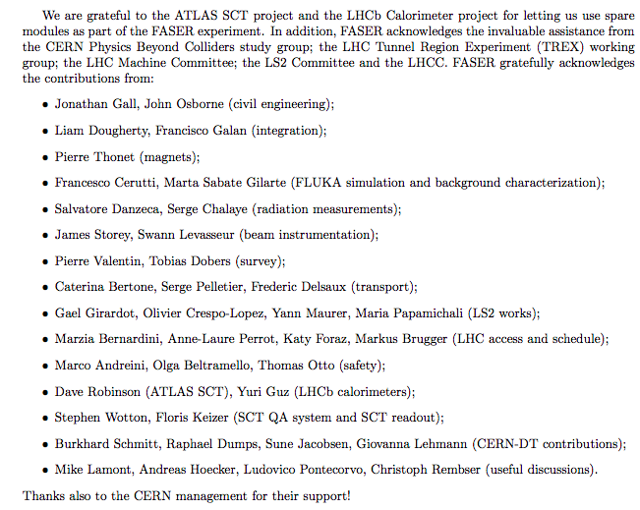
HELP FROM MANY OTHERS
The FASER Collaboration has received essential support from the Heising-Simons and Simons Foundations, CERN, the ATLAS SCT and LHCb Collaborations, and also many others at CERN and elsewhere

Slide 39
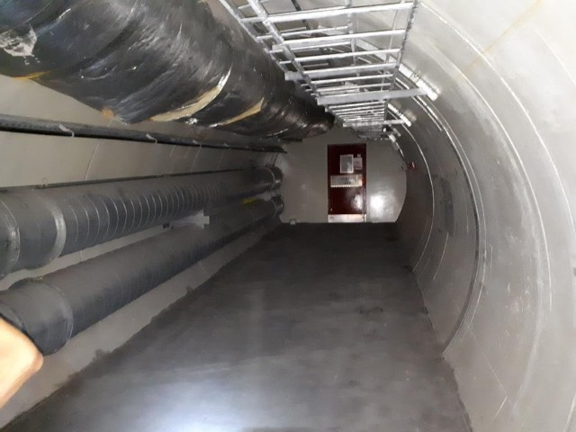
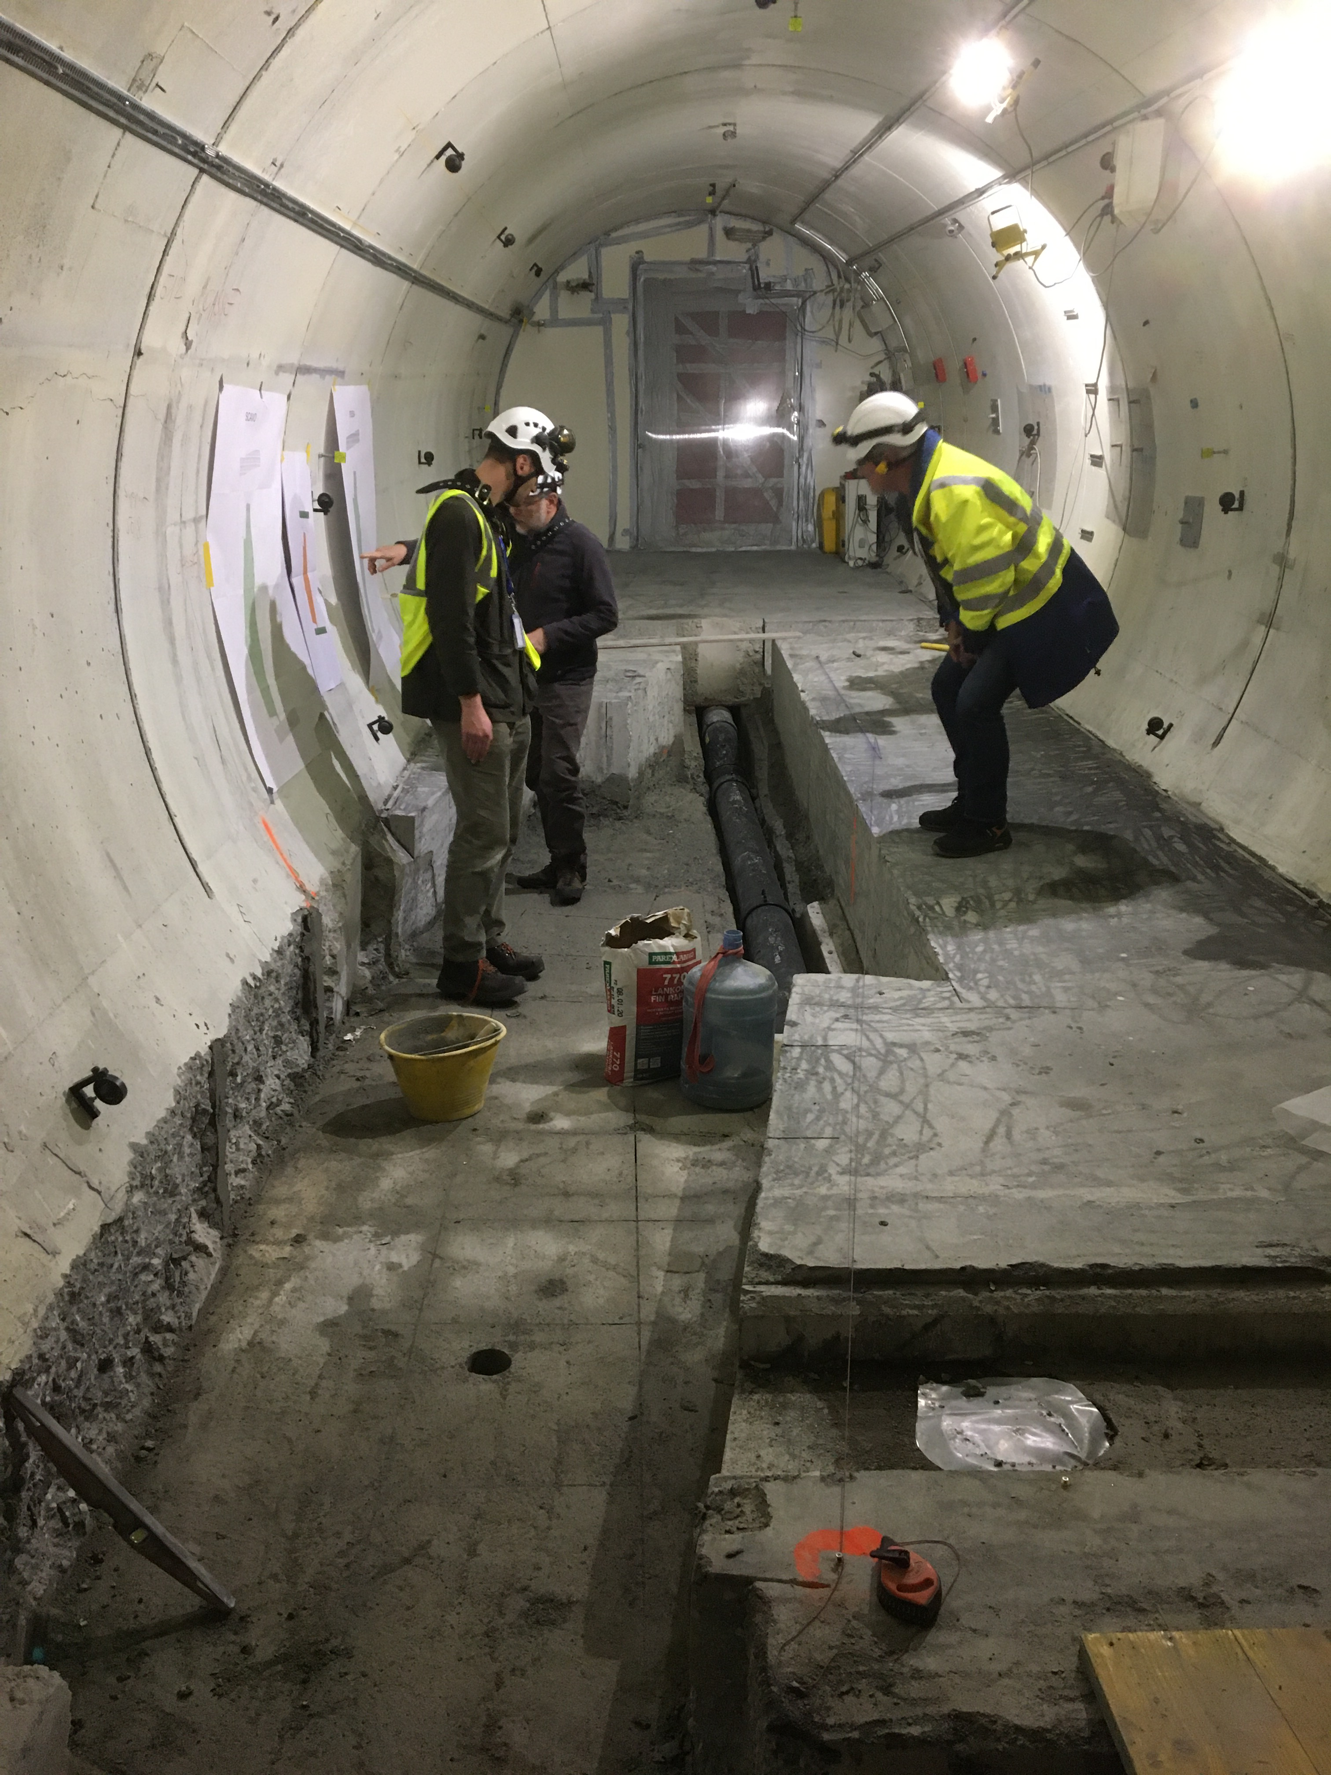
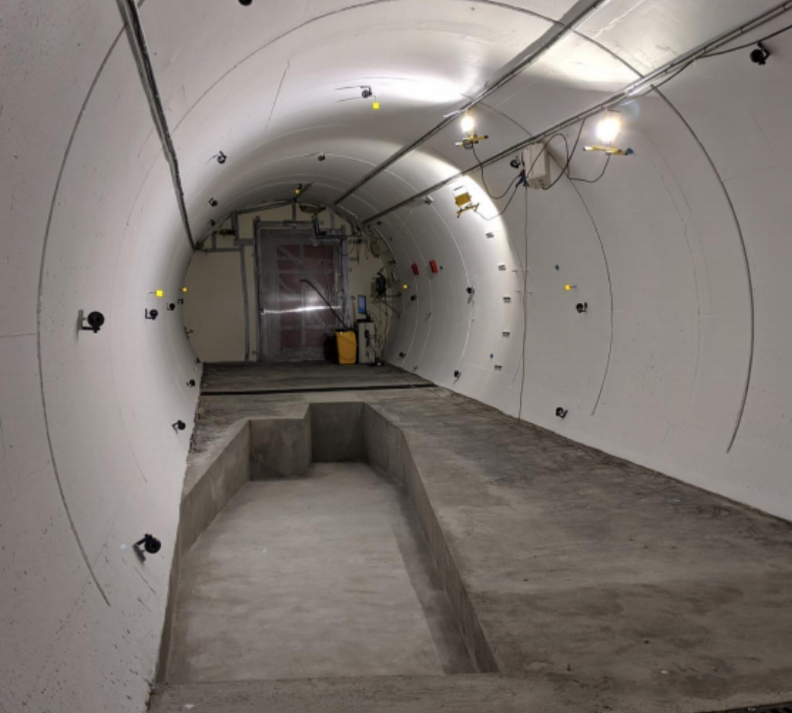
FASER IN TUNNEL TI12
The beam collision axis has been located to mm accuracy by the CERN survey department. To place FASER on this axis, a trench is required to lower the floor by 46 cm.
The trench was completed by an Italian firm just hours before COVID shut down CERN in Spring 2020.
2019
Spring 2020
Summer 2020

Slide 40
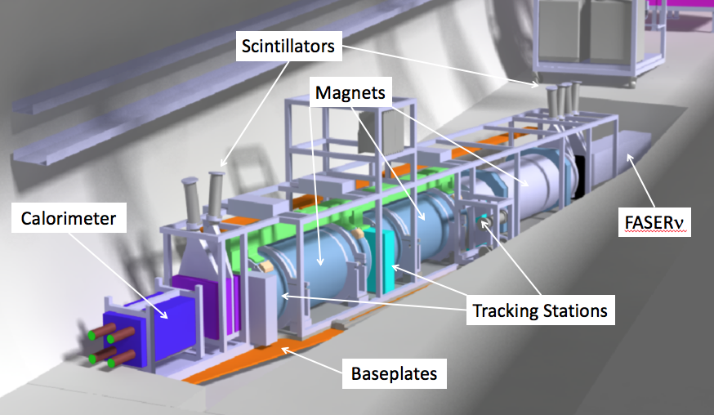
THE FASER DETECTOR
The signal is spectacular: 2 TeV, opposite-sign charged tracks pointing back to ATLAS IP; a “light shining through (100 m-thick) wall” experiment.
Permanent dipole magnets split the charged tracks, which are detected by 3 tracking stations and a calorimeter.
Scintillators veto incoming charged tracks.
LLP
ν
e⁺
e⁻

Slide 41
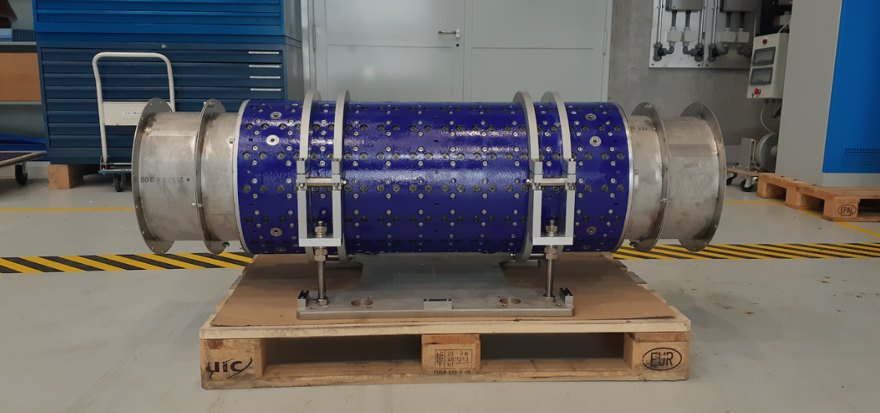
MAGNETS
FASER includes 3 magnets: 1.5 m, 1 m, and 1m long.
These magnets are 0.57 T permanent dipoles with an inner diameter of 20 cm, require little maintenance.
Constructed by the CERN magnet group.

Slide 42
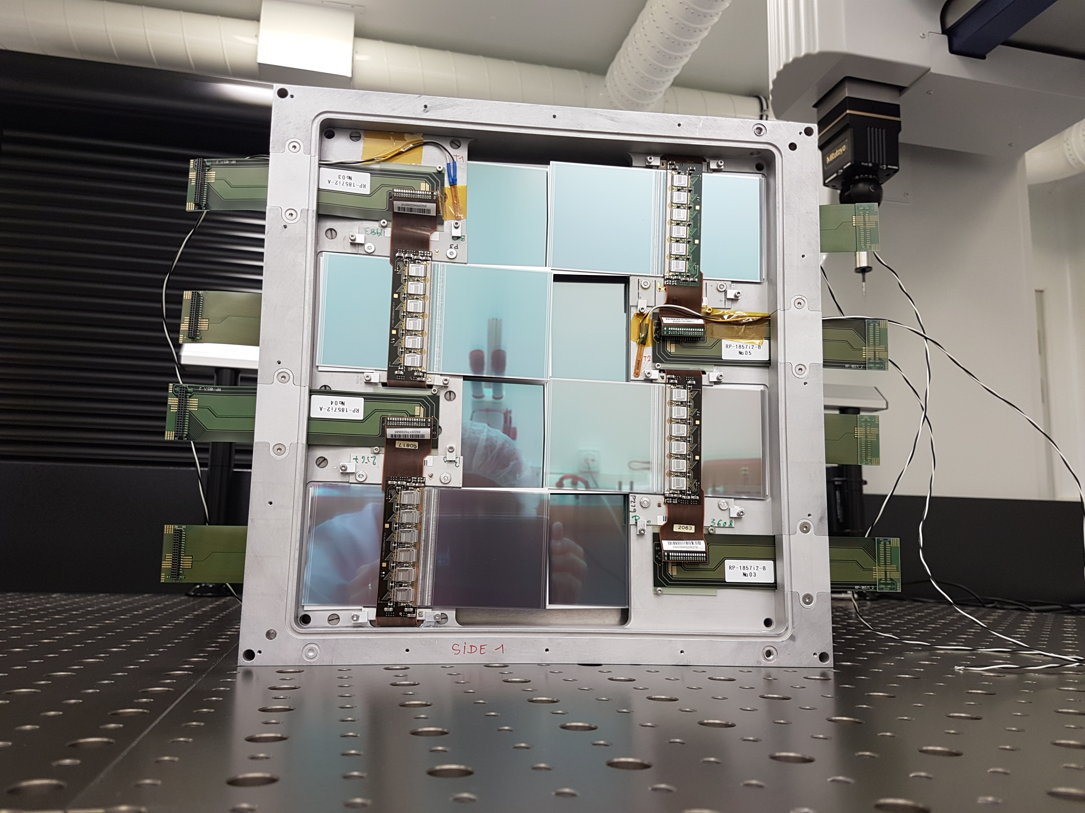
TRACKERS
8 ATLAS SCT modules per tracking plane, 3 tracking planes per tracking station, 3 tracking stations at FASER.

Slide 43
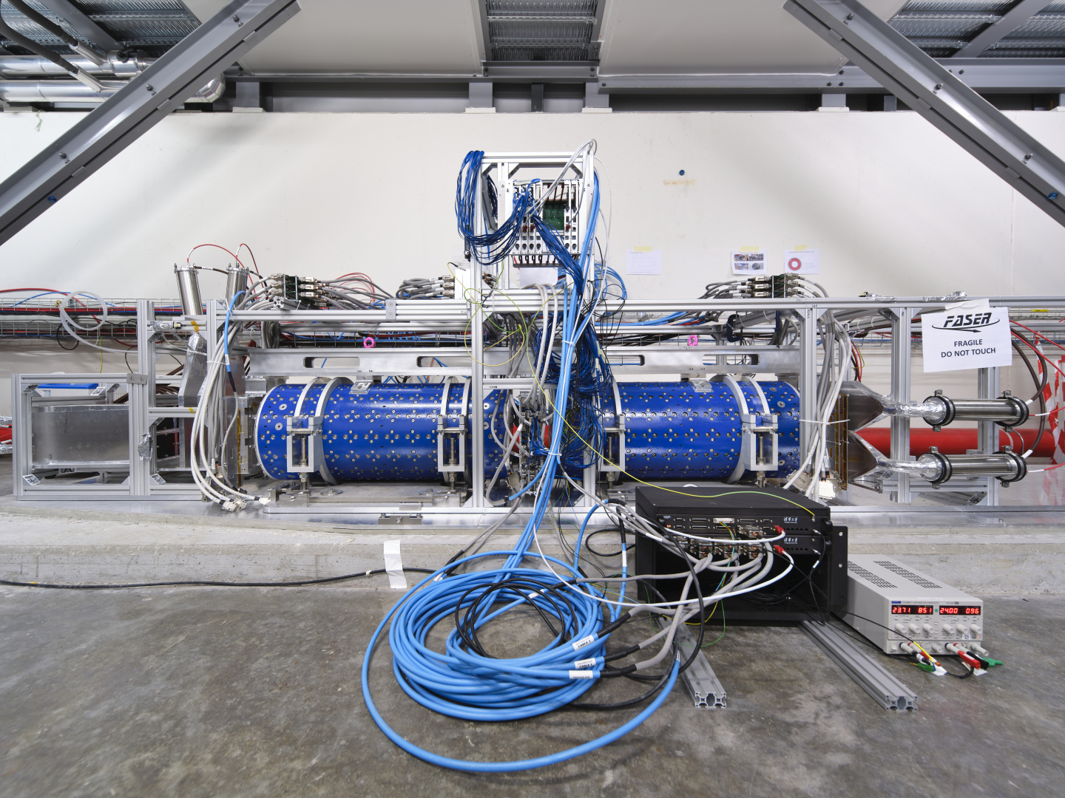
FASER CONSTRUCTION STATUS

Slide 44
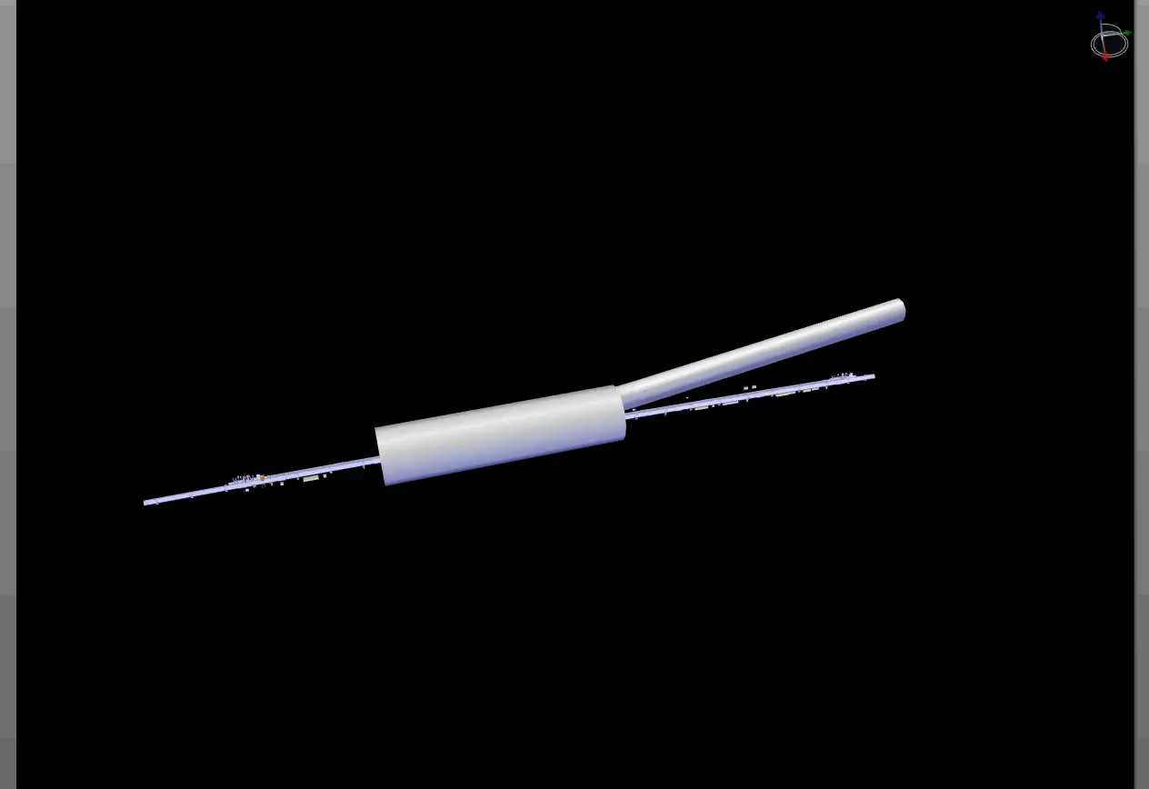
FASER INSTALLATION
Dougherty, CERN Integration (2019)

Slide 45
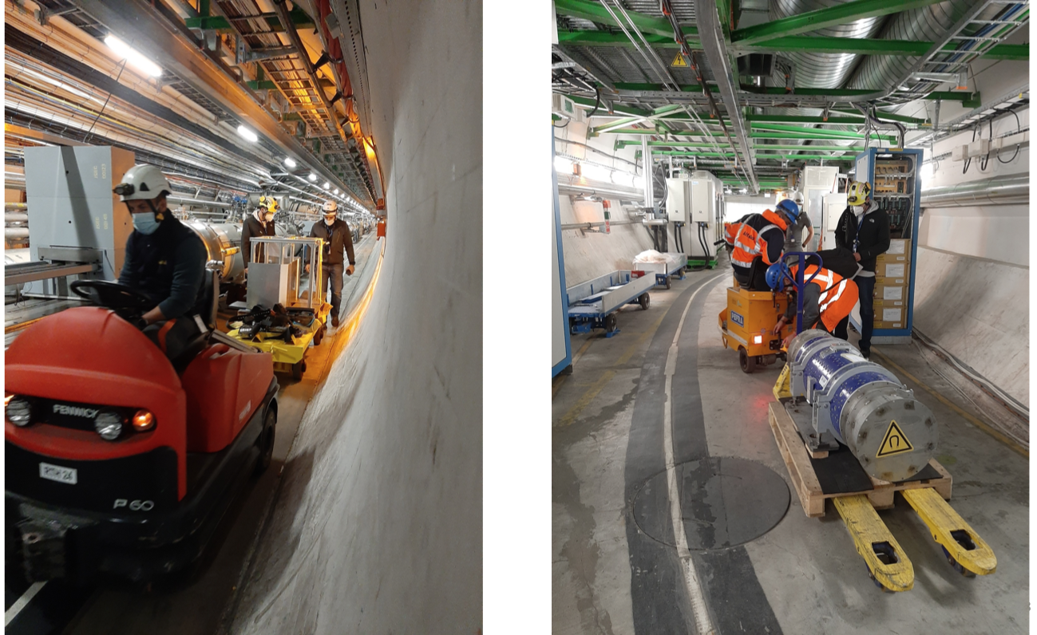
FASER INSTALLATION

Slide 46
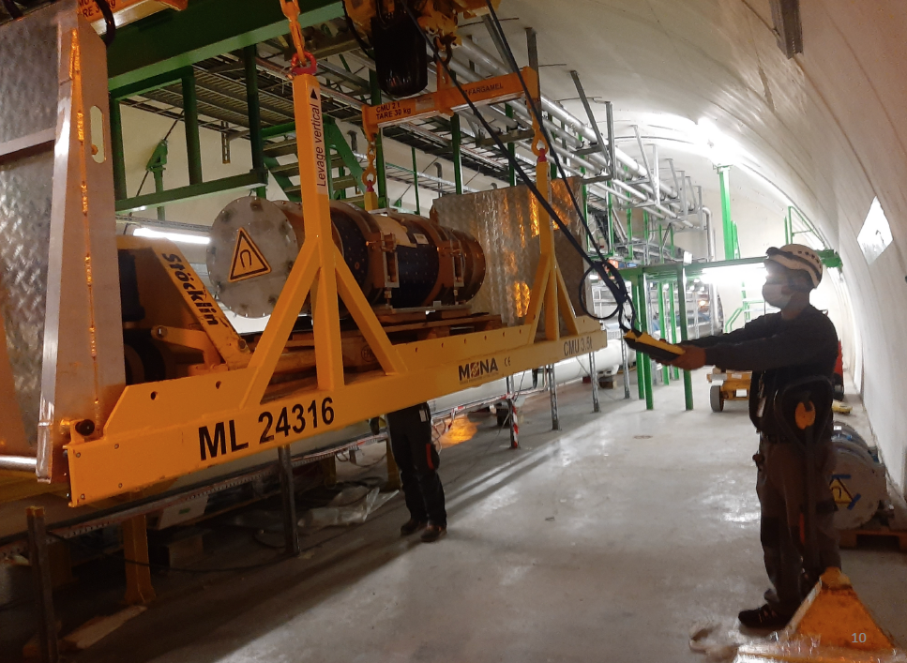
FASER INSTALLATION

Slide 47
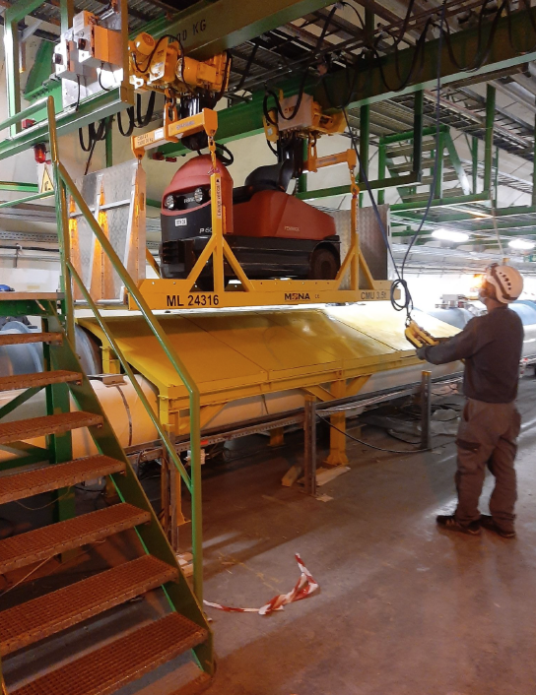
FASER INSTALLATION

Slide 48
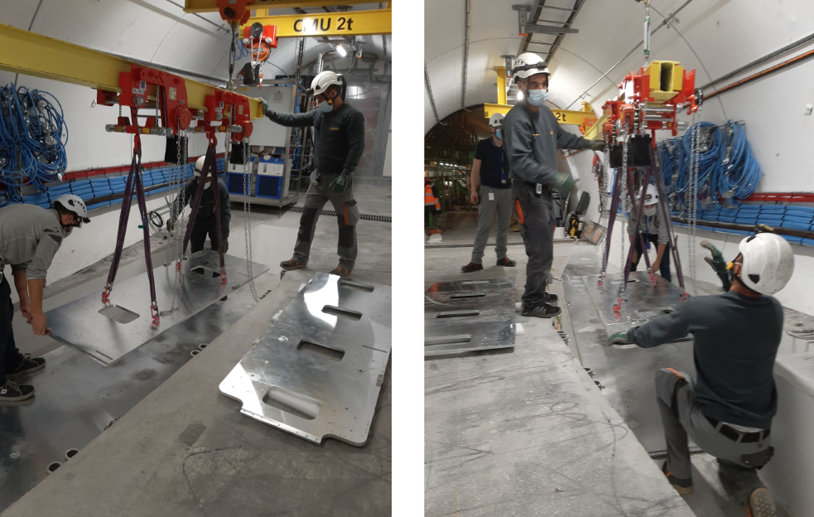
FASER INSTALLATION

Slide 49
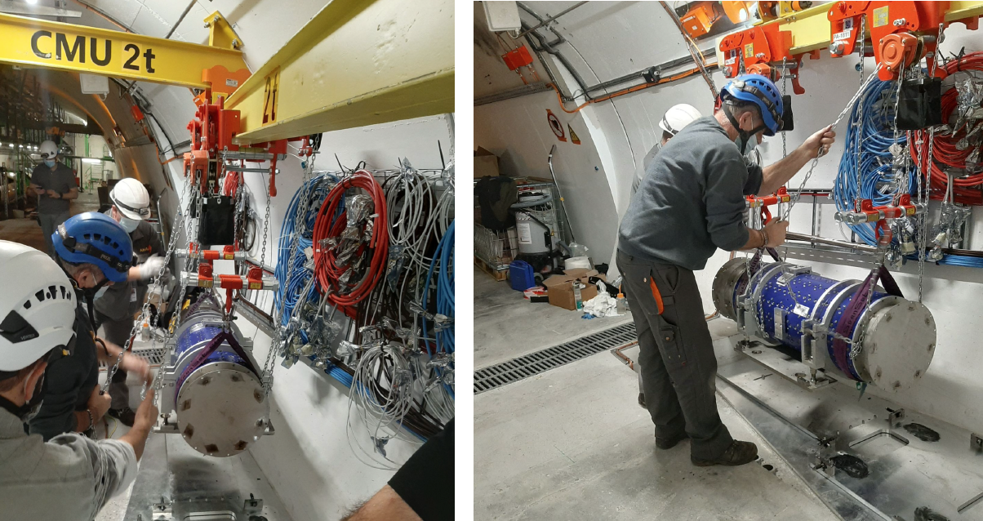
FASER INSTALLATION

Slide 50
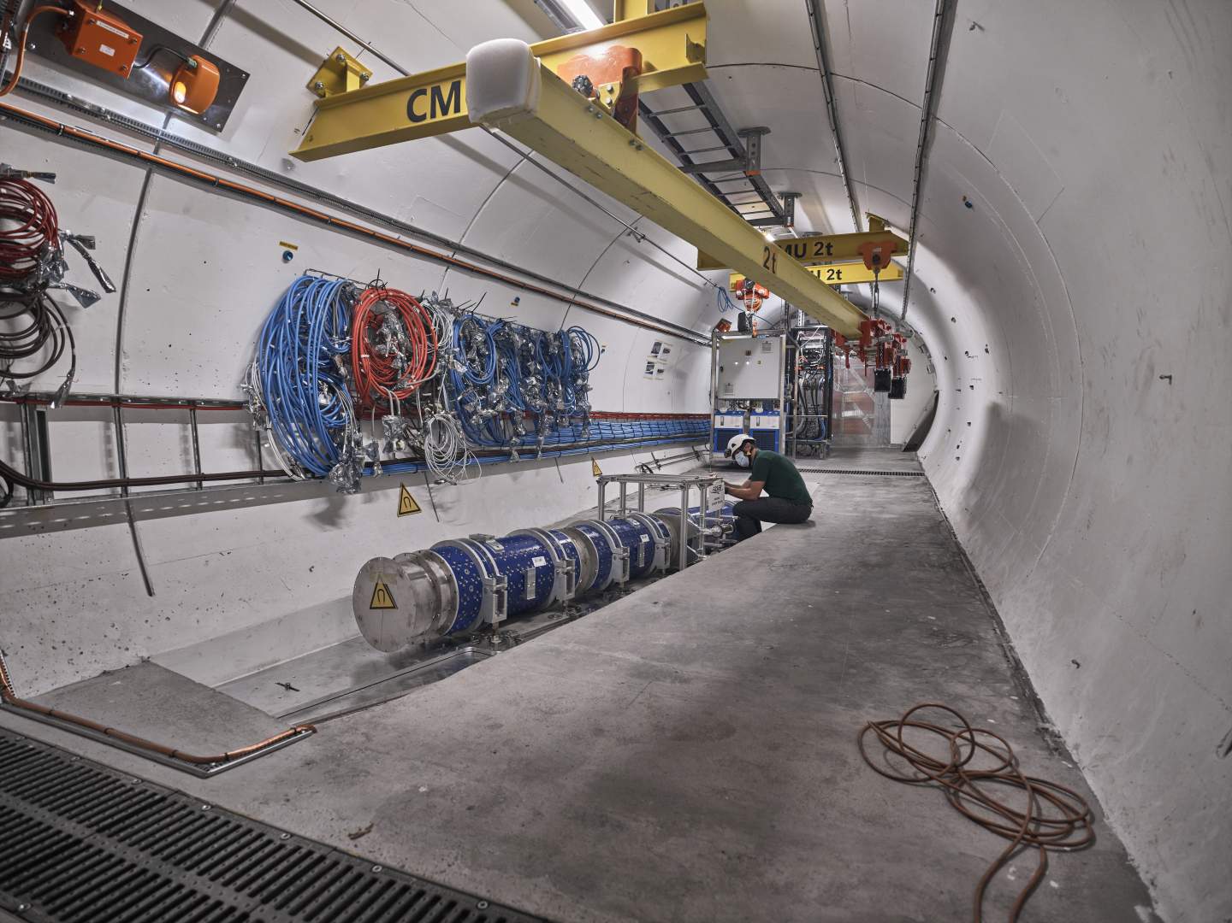
FASER CURRENT STATUS

Slide 51
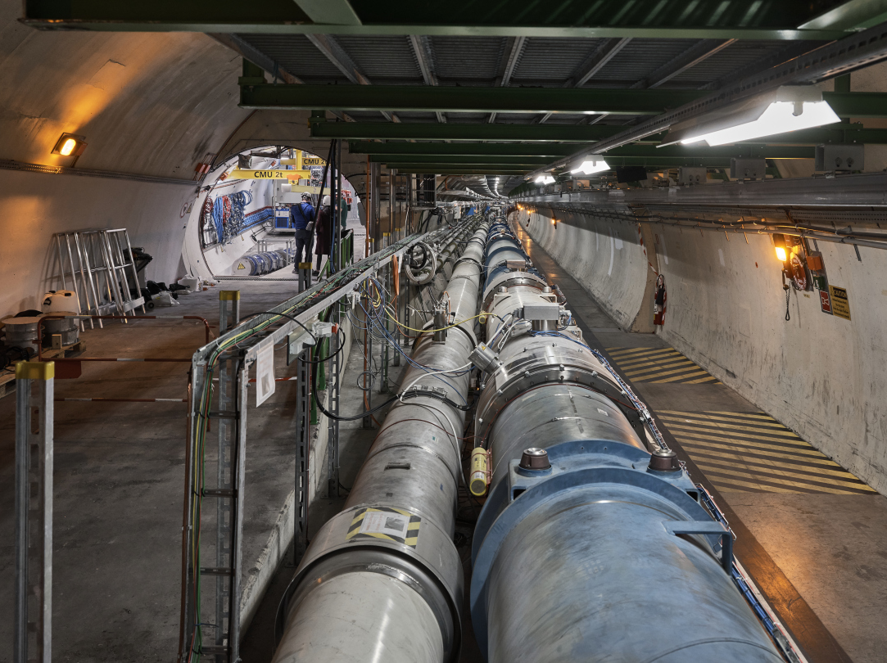
FASER CURRENT STATUS

Slide 52
FASERν

Slide 53
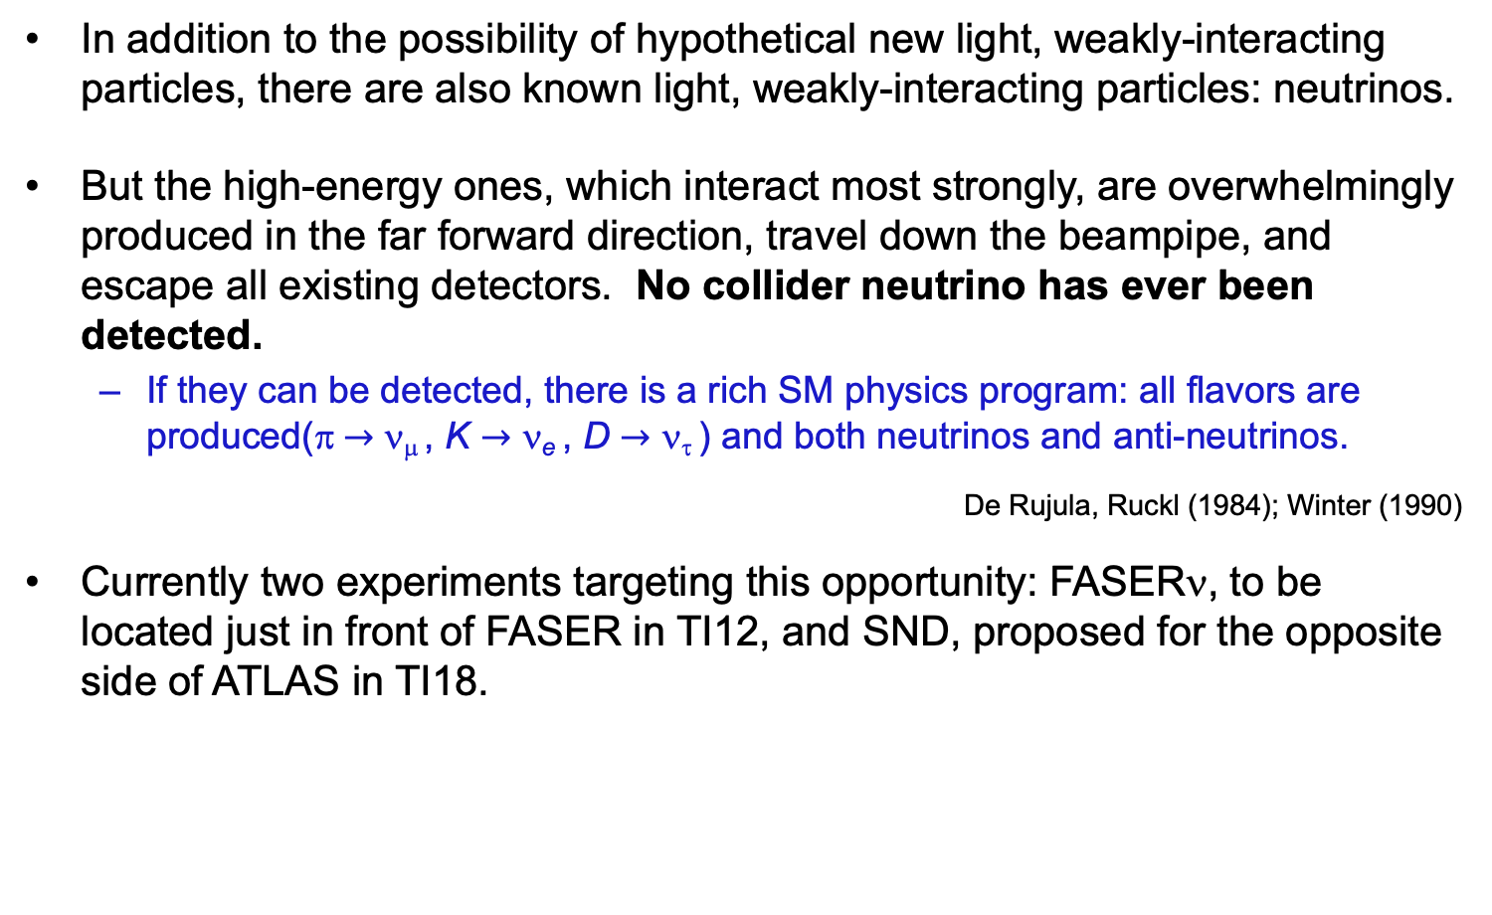
COLLIDER NEUTRINOS
In addition to the possibility of hypothetical new light, weakly-interacting particles, there are also known light, weakly-interacting particles: neutrinos.
But the high-energy ones, which interact most strongly, are overwhelmingly produced in the far forward direction, travel down the beampipe, and escape all existing detectors. No collider neutrino has ever been detected.
  If they can be detected, there is a rich SM physics program: all flavors are produced(π $→$ ν_{μ} , K $→$ ν_{e} , D $→$ ν_{τ} ) and both neutrinos and anti-neutrinos.
De Rujula, Ruckl (1984); Winter (1990)
Currently two experiments targeting this opportunity: FASERν, to be located just in front of FASER in TI12, and SND, proposed for the opposite side of ATLAS in TI18.

Slide 54
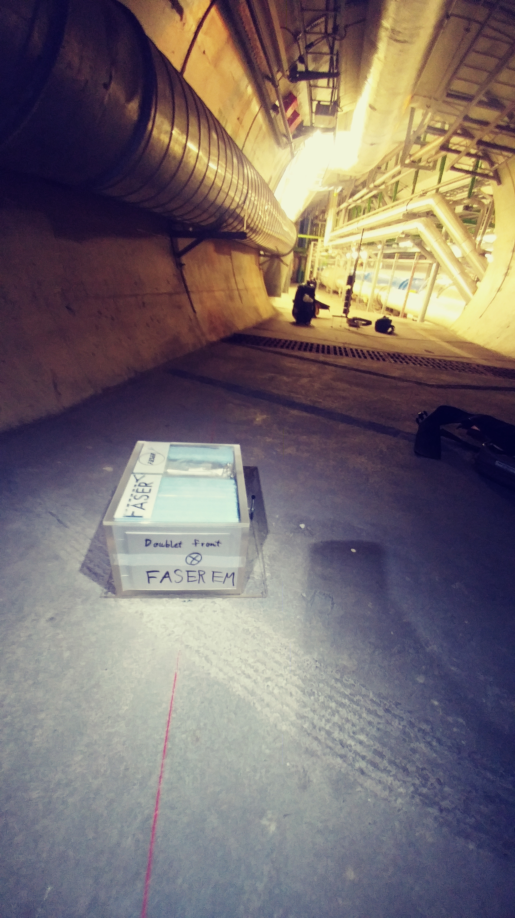
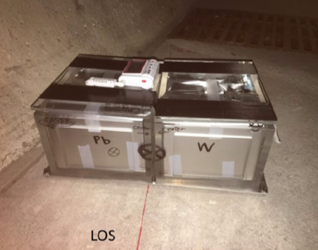
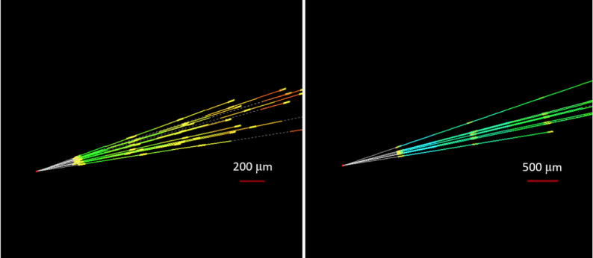
NEUTRINO FLUXES
In fact, we have probably already seen our first TeV collider neutrino.
2018: FASER pilot ~30 kg emulsion detectors collected 12.5 fb⁻¹ on the beam collision axis (installed and removed during Technical Stops).
Expect ~10 neutrino interactions. Several neutral vertices identified, likely to be neutrinos. Analysis ongoing.

Slide 55
THE FASERν DETECTOR
FASERν is designed to detect neutrinos of all flavors.
  25cm x 30cm x 1.1m detector consisting of 770 emulsion layers interleaved with 1mm-thick tungsten plates.
  Emulsion is swapped out every ~10-30 fb⁻¹, total 10 sets of emulsion for Run 3.
LLP
ν
e⁺
e⁻

Slide 56
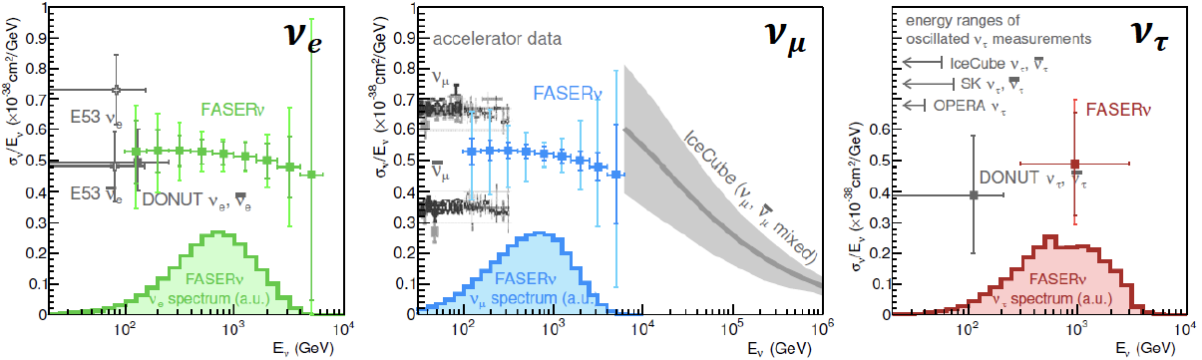
NEUTRINO PHYSICS
2022-24: FASERν will collect data with 1.1-tonne detector in Run 3
  Will detect the first collider neutrino.
  Will record ~1000 ν_{e} , ~10,000 ν_{μ} , and ~10 ν_{τ} interactions at TeV energies, the first direct exploration of this energy range for all 3 flavors.
  Will double the world’s supply of tau neutrinos.
  Will be able to distinguish muon neutrinos from anti-neutrinos by combining FASER and FASERν data, and so measure their cross sections independently.
FASER Collaboration 1908.02310 (2019)

Slide 57
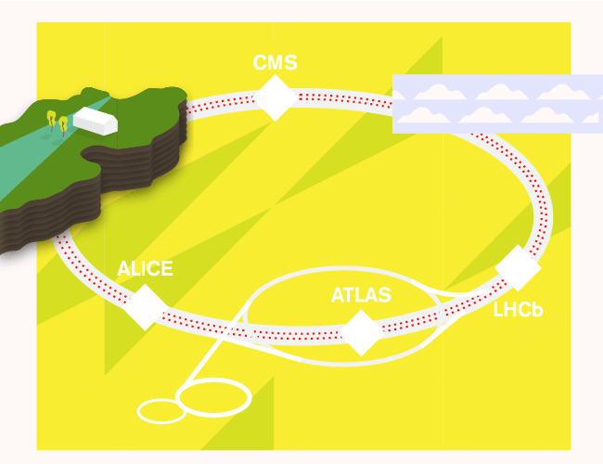
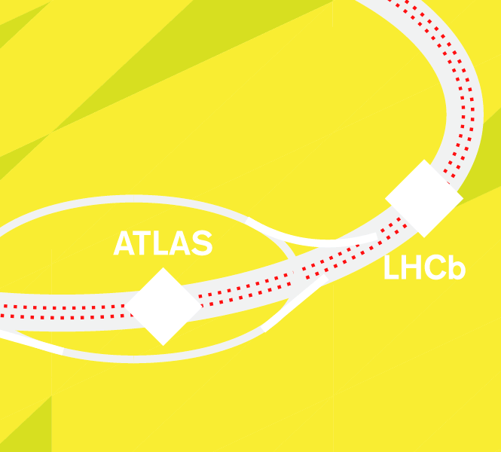

SUMMARY AND OUTLOOK
A new target for particle physics experiments: light and weakly-interacting particles at the lifetime frontier.
Fast, small, cheap experiments can provide world-leading sensitivities.
FASER: 18 months from theory paper to beginning of construction, fits on a tabletop, ~$2M. Data-taking begins 2022 with new neutrino measurements and discovery prospects for a host of proposed new particles.
More info: https://faser.web.cern.ch.
Branigan, Symmetry Magazine (2019)

