Slide 1
WELCOME AND INTRODUCTION
2nd Forward Physics Facility Meeting (FPF2)
27-28 May 2021
Jonathan Feng, UC Irvine

Slide 2
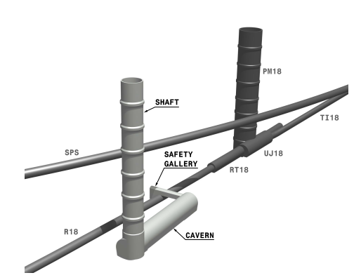
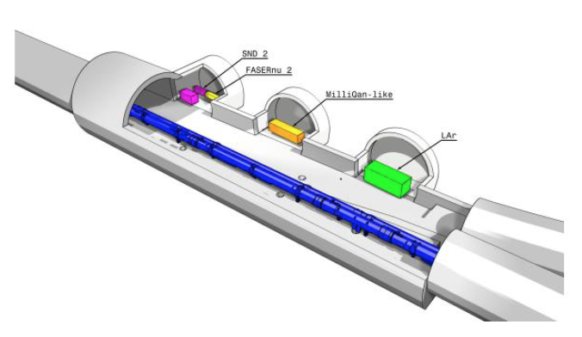
FORWARD PHYSICS FACILITY
The FPF Kickoff Meeting was held in November 2020. Significant progress since then:
Updated structure of Physics Beyond Colliders at CERN, including an FPF Working Group [Arduini].
Civil engineering, including development of the new cavern and alcove options [Balazs].

Slide 3
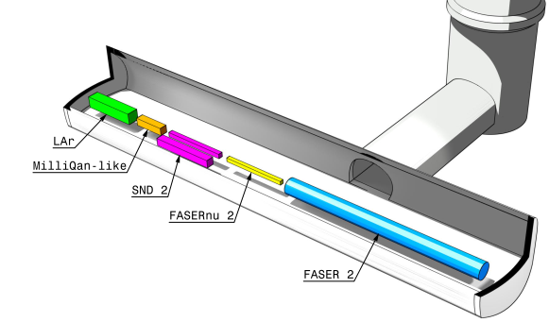
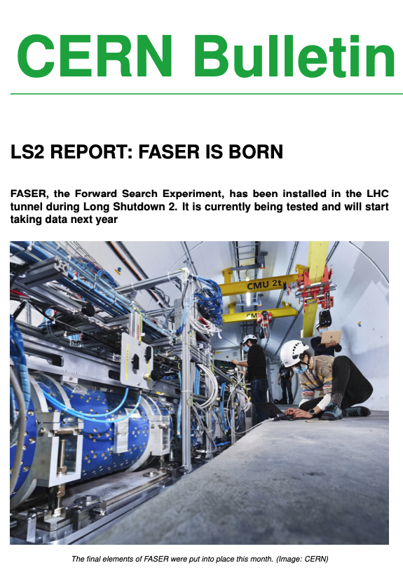
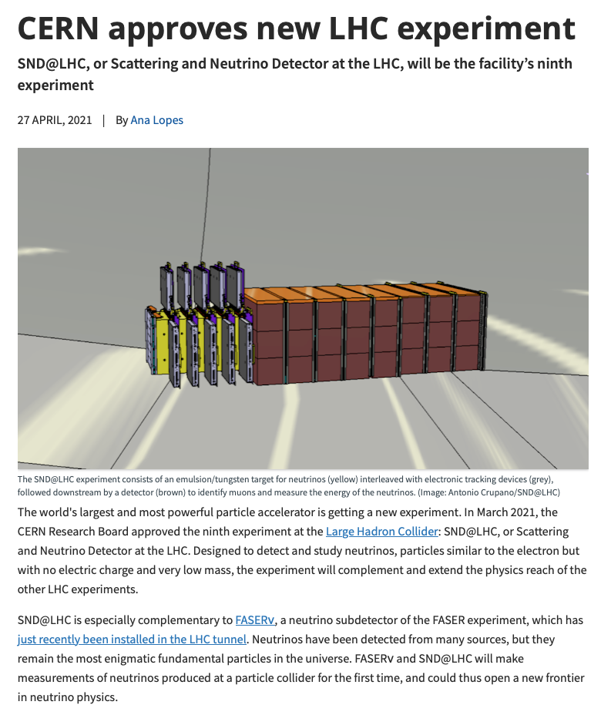
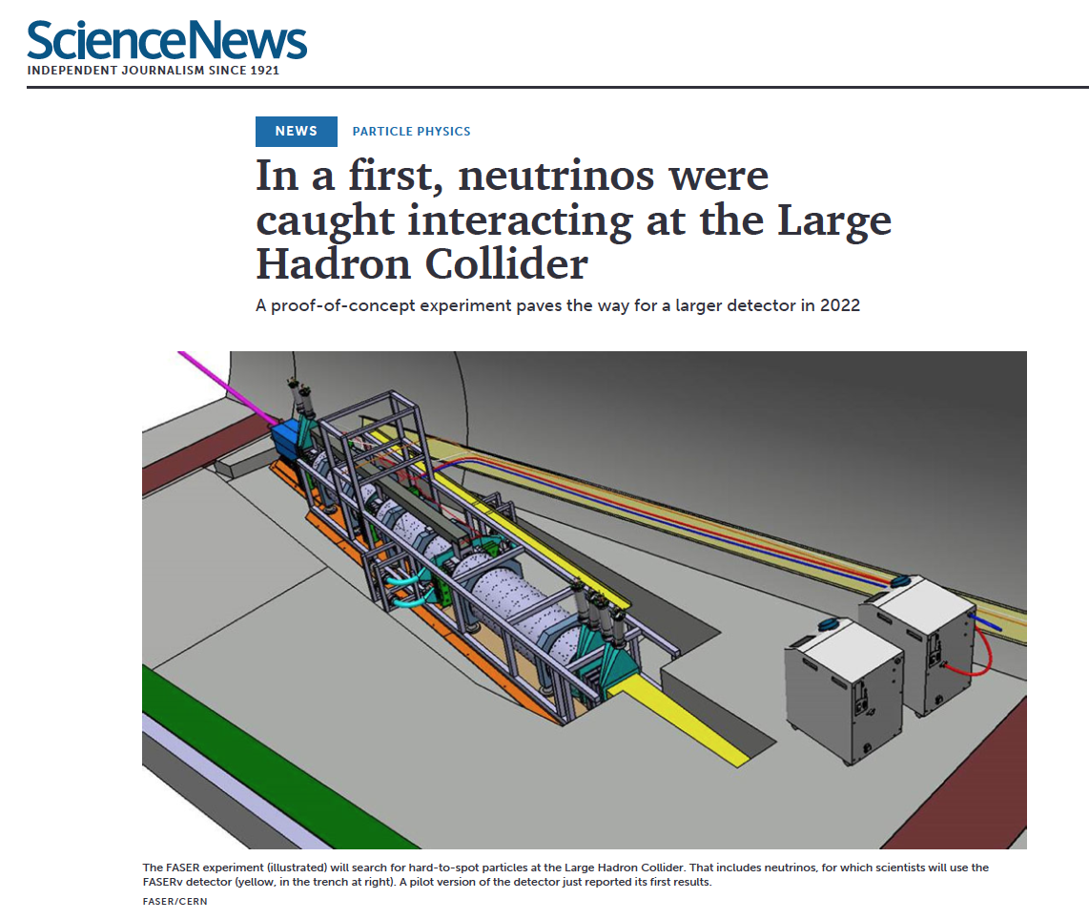
EXPERIMENTS AND PHYSICS POTENTIAL
MilliQan/FORMOSA [Citron]
FLArE [Trojanowski, Diwan, Resnati]
FASER/FASER2 [McFayden]
SND/SND2 [Di Crescenzo]
FASERν/FASERν2 [Ariga]
… and the physics cases for these and other interesting ideas [All]
25 March 2021
27 April 2021
26 May 2021

Slide 4
NOTES ON THE PROGRAM
Zoom links have been sent to registrants and are also now posted on the indico site. Note the different links for the parallel sessions.
In each session, ~20 minutes is set aside for “Further thoughts and discussion.” Following the successful example of the kickoff meeting, these are led by a chair/moderator/provocateur and we hope for open and free-flowing discussions. This meeting is not recorded.
Speakers and chairs: please stay on time; there is no buffer between sessions. Felix and Maria: “more German than Italian.”
At the end of both today and tomorrow, we will discuss future meetings (FPF3 and FPF4) and publication plans (short paper and long whitepaper). We look forward to your advice and contributions!

