Slide 1



LOOKING FORWARD
TO
FORWARD PHYSICS
Physics Colloquium, The Ohio State University
Jonathan Feng, UC Irvine, 7 December 2021

Slide 2
OUTLINE
MOTIVATIONS
FORWARD PHYSICS
FASER
FASERν
FORWARD PHYSICS FACILITY
SUMMARY

Slide 3
MOTIVATIONS

Slide 4
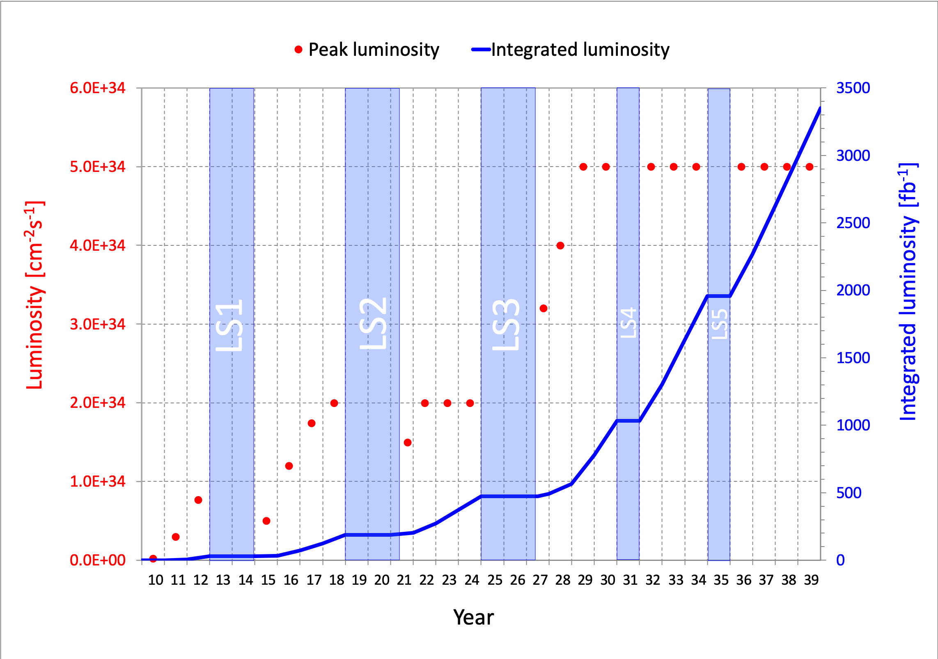
LHC: CURRENT STATUS
This is a critical time in particle physics: the Higgs boson was discovered in 2012, but there has been no evidence of new particles beyond the Standard Model from the LHC.
The LHC is currently in Long Shutdown 2, but will start up again in 2022 and run until ~2037. Will we find new particles?
More importantly, what can we do to enhance the prospects for discovering new physics?

Slide 5
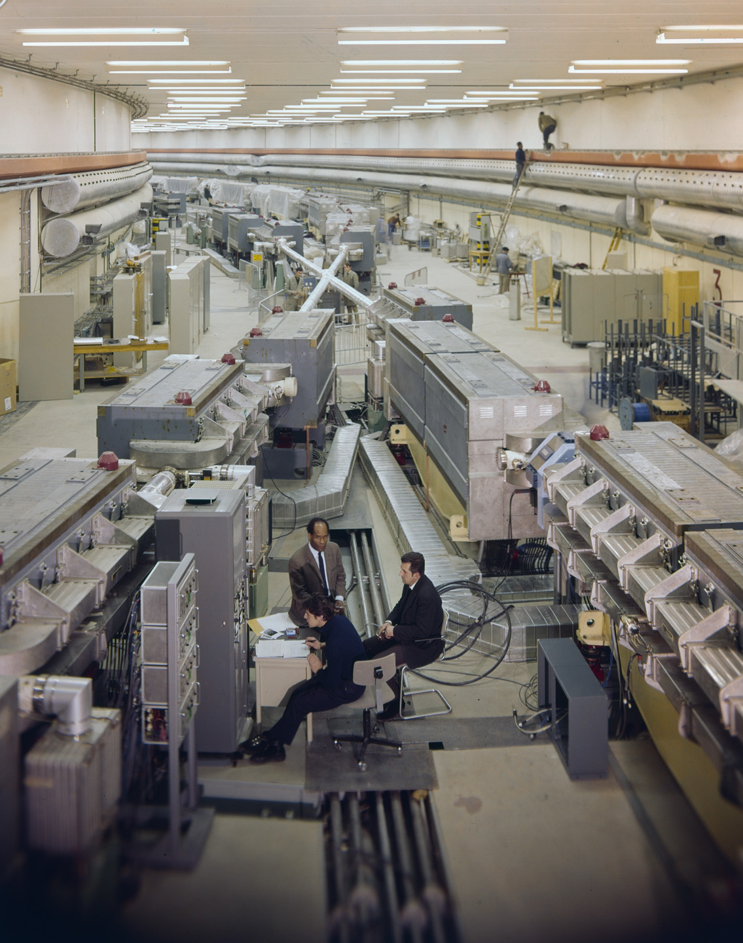
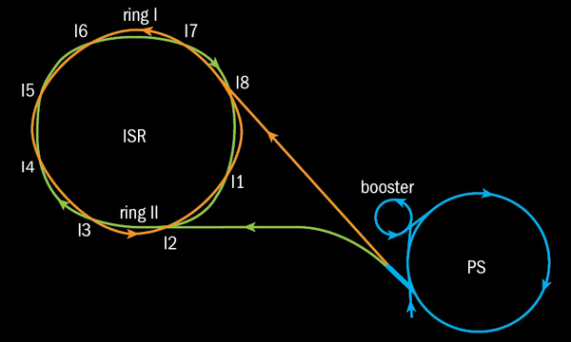
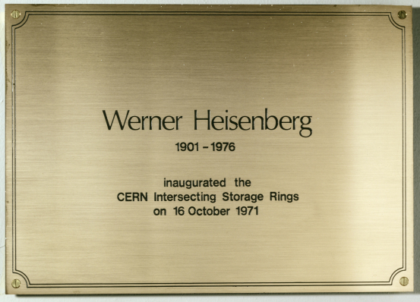
SOME HISTORY
This is the 50th anniversary of the birth of hadron colliders.
In 1971, CERN’s Intersecting Storage Rings (ISR), with a circumference of ~1 km, collided protons with protons at center-of-mass energy 30 GeV (later raised to 62 GeV).

Slide 6
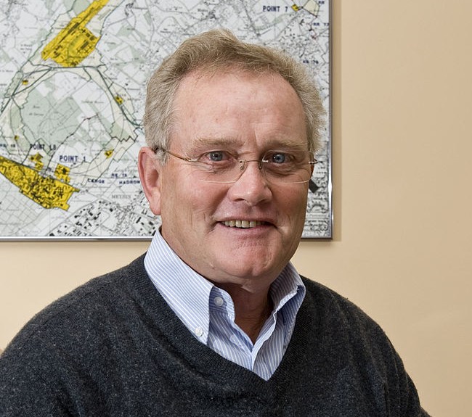
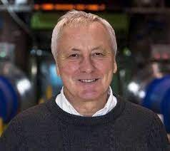
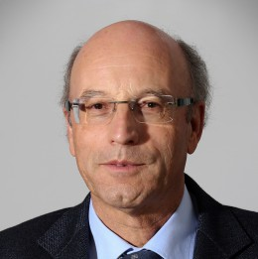
ISR’S LEGACY
On the occasion of the 50th anniversary of CERN’s ISR, there have been many fascinating articles and talks by eminent physicists looking back on the ISR’s legacy.
  “Enormous impact on accelerator physics, but sadly little effect on particle physics.” – Steve Myers, talk at “The 50th Anniversary of Hadron Colliders at CERN,” October 2021.
  “There was initially a broad belief that physics action would be in the forward directions at a hadron collider…. It is easy to say after the fact, still with regrets, that with an earlier availability of more complete… experiments at the ISR, CERN would not have been left as a spectator during the famous November revolution of 1974 with the J/ψ discoveries at Brookhaven and SLAC .” – Lyn Evans and Peter Jenni, “Discovery Machines,” CERN Courier (2021).

Slide 7
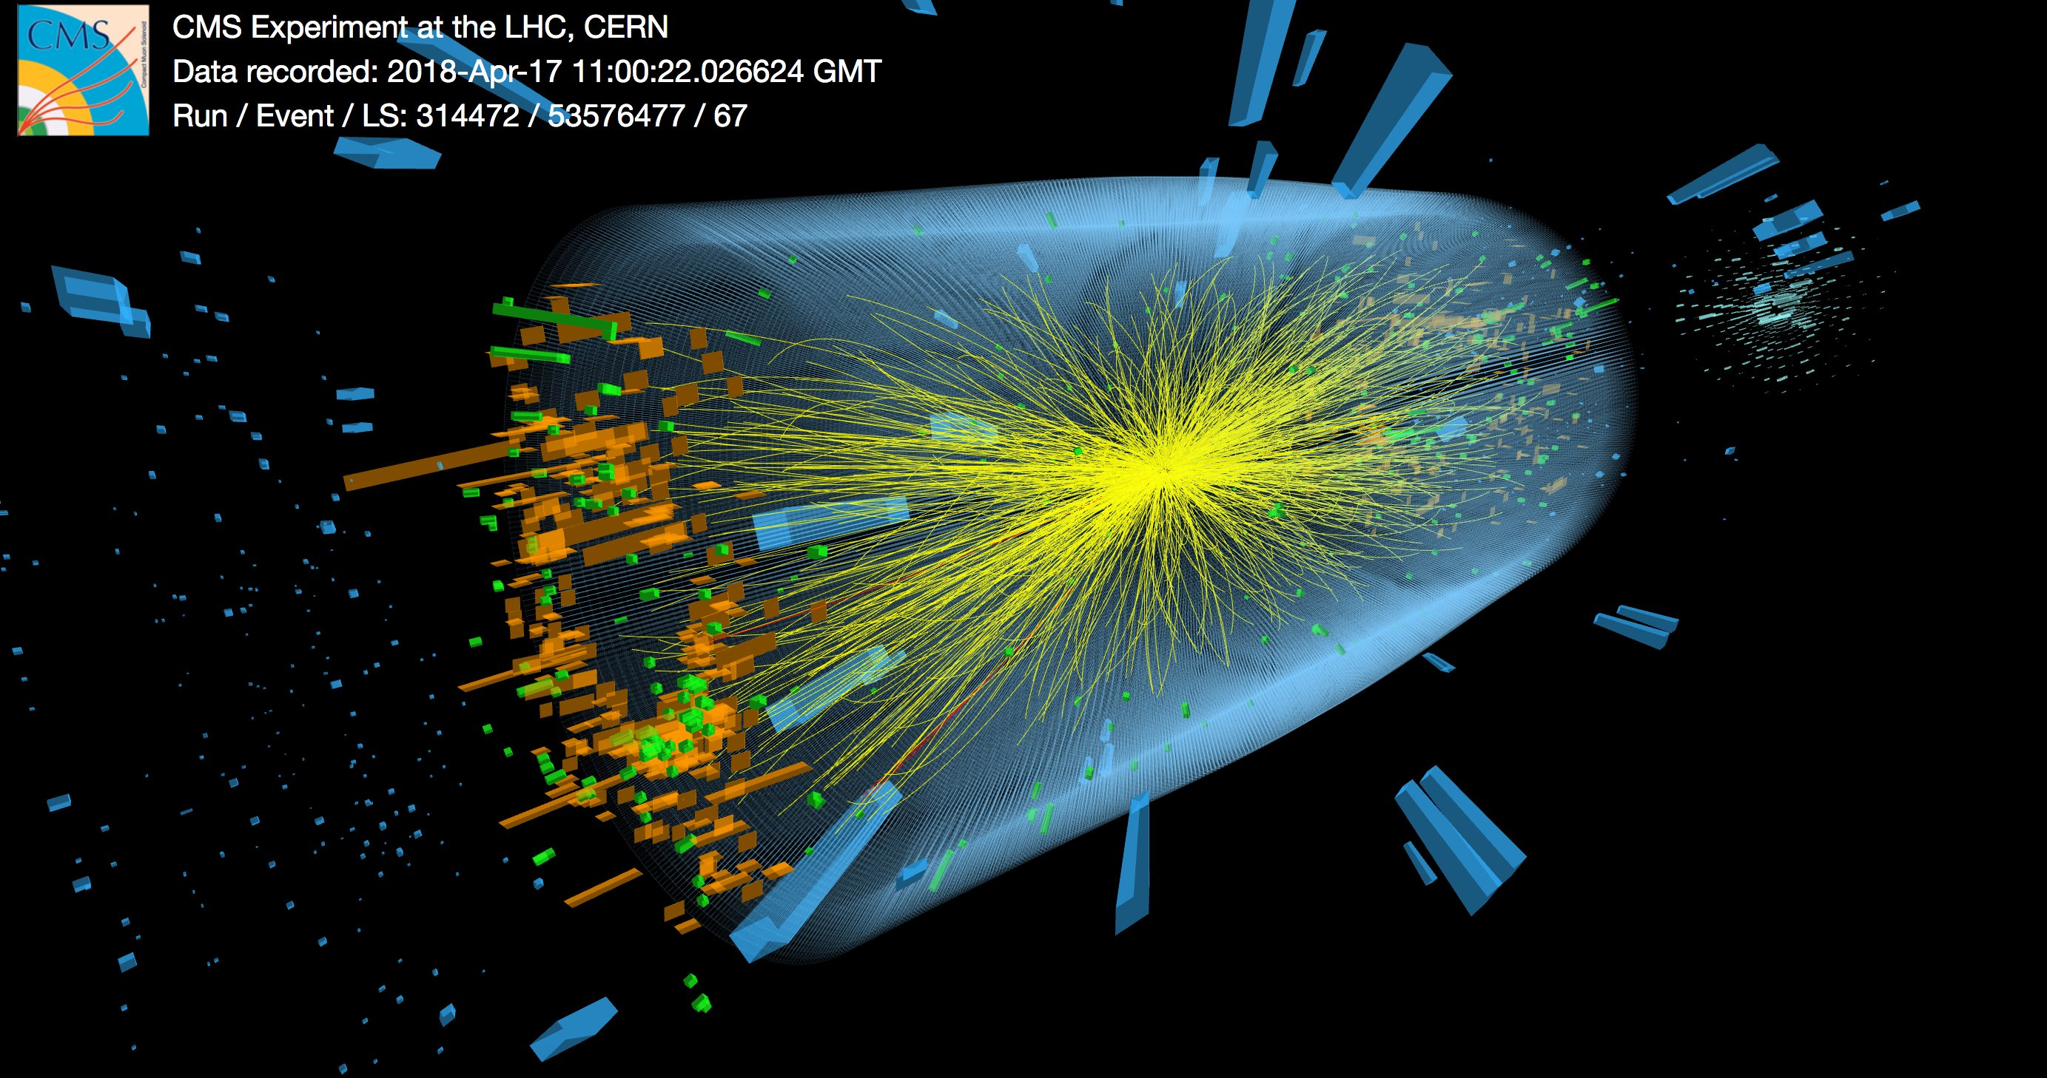
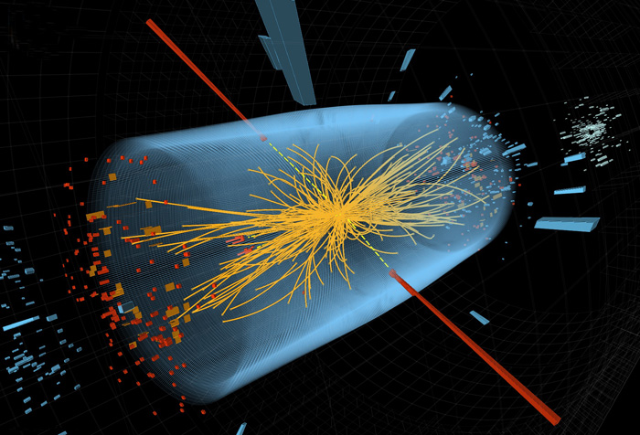
A CAUTIONARY TALE
Expected
  In 1971, physicists expected the most interesting events to be from the soft, glancing collisions of protons.
  These produce particles in the forward direction, along the beam line.
Actual
  In fact, the most interesting collisions were from hard collisions of quarks.
  These produced heavy particles, like charm and bottom quarks, that decayed to particles at large angles relative to the beamline.
The collider was creating new forms of matter, but the detectors focused on the forward region and missed them.

Slide 8

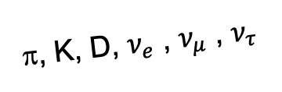
AN OBVIOUS QUESTION
Are we missing opportunities in a similar (but opposite) way at the LHC?
In contrast to the ISR days, there is now broad belief that the most interesting physics is at high p_{T} . Are we now missing revolutionary discoveries in the forward direction?
By far the largest fluxes of high-energy light particles (e.g., pions, kaons, D mesons, neutrinos) are in the far-forward direction.
This may also be true of many interesting new particle candidates: dark photons, axion-like particles, millicharged particles, dark matter, …
A’, a, mCPs, χ, …
π, K, D, $ν_{e}$ , $ν_{μ}$ , $ν_{τ}$

Slide 9

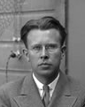
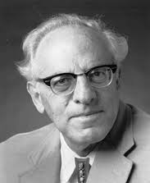
THE NEW PARTICLE LANDSCAPE
Particle
Colliders
Mass
MeV
GeV
TeV
1
Already
Discovered
Strongly Interacting
Heavy Particles
Interaction Strength
New Targets of Small Experiments
Traditional Targets
of Big Science
10⁻³
Weakly Interacting
Light Particles
Impossible to
Discover
10⁻⁶

Slide 10
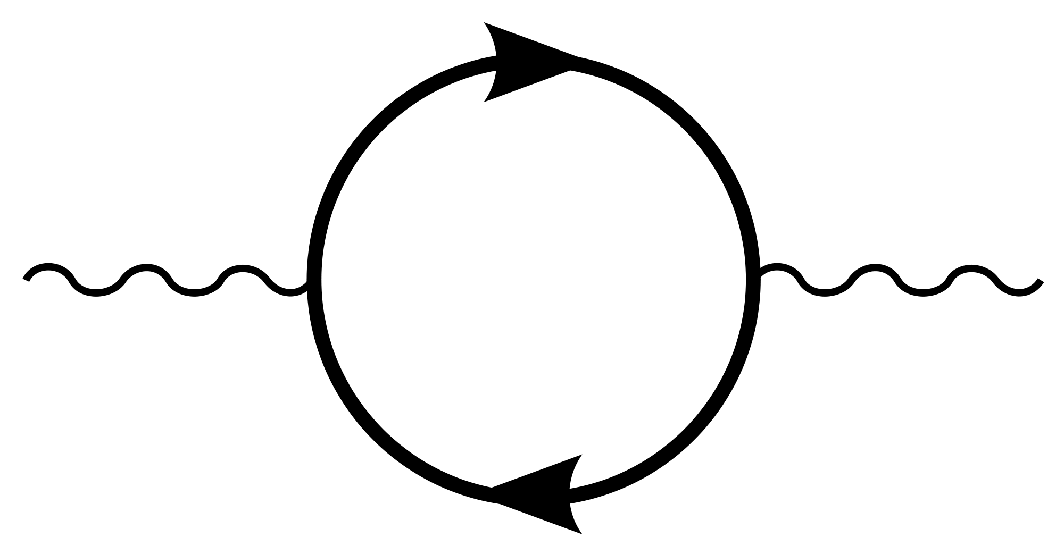

AN EXAMPLE: DARK SECTORS
Suppose there is a dark sector that contains dark matter X and also a dark force: dark electromagnetism.
The force carriers of the SM and dark EM will mix
  perhaps suppressed, but completely generic, since a renormalizable operator
The result? Two possibilities:
  Dark photons A’, like photons, but with mass m_{A’}, couplings suppressed by ε.
  Milli-charged particles (mCPs), with charges suppressed by ε.
Finding either of these would imply new fundamental forces or new matter particles, possibly a “portal” to the dark sector.
SM
EM
Dark Sector
EM, X
A
$$εF_{μν}F_{D}^{μν}$$
A_{D}
Holdom (1986)

Slide 11
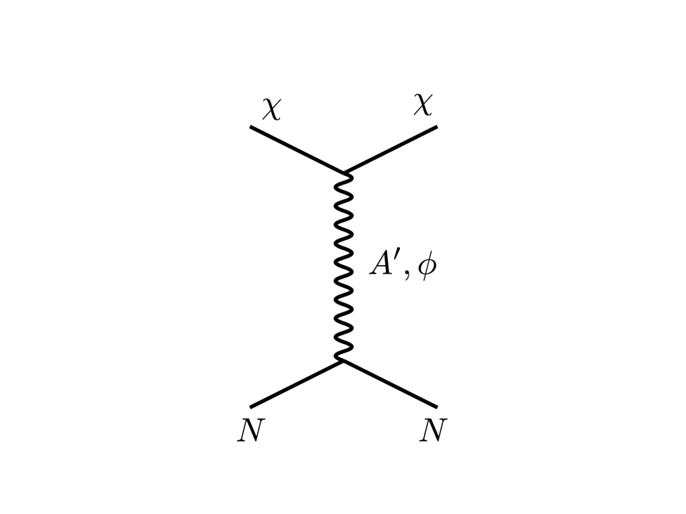





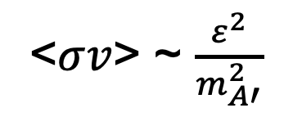
THE THERMAL RELIC LANDSCAPE
Particle
Colliders
Mass
MeV
GeV
TeV
1
Already
Discovered
Strongly Interacting
Heavy Particles
Too Little to be
Dark Matter
$$e$$
DM
$$ε$$
$$A’$$
$$ε$$
Interaction Strength
Just Right to
be Dark Matter
10⁻³
DM
$$e$$
<$σv$> ~ $\frac{ε^{2}}{m_{A′}^{2}}$
Weakly Interacting
Light Particles
Impossible to
Discover
10⁻⁶
Too Much to be
Dark Matter
Boehm, Fayet (2003)
Pospelov, Ritz, Voloshin (2007)
Feng, Kumar (2008)

Slide 12
FORWARD PHYSICS

Slide 13
SEARCHES FOR NEW LIGHT PARTICLES
If new particles are light and weakly interacting, the existing big LHC detectors are perfectly designed NOT to see them.
Existing detectors are designed to find new heavy particles. These particles are produced almost at rest and decay isotropically.
But new light particles are mainly produced in the decays of light particles: π, η, K, D and B mesons. These are mainly produced along the beamline, and so the new particles disappear through the holes that let the beams in.
Clearly we need a detector to exploit the “wasted” σ_{inel} ~ 100 mb and cover these “blind spots” in the forward region. If we go far enough away, the proton beams are bent by magnets (it’s a circular collider!), whereas the new light particles will go straight.

Slide 14
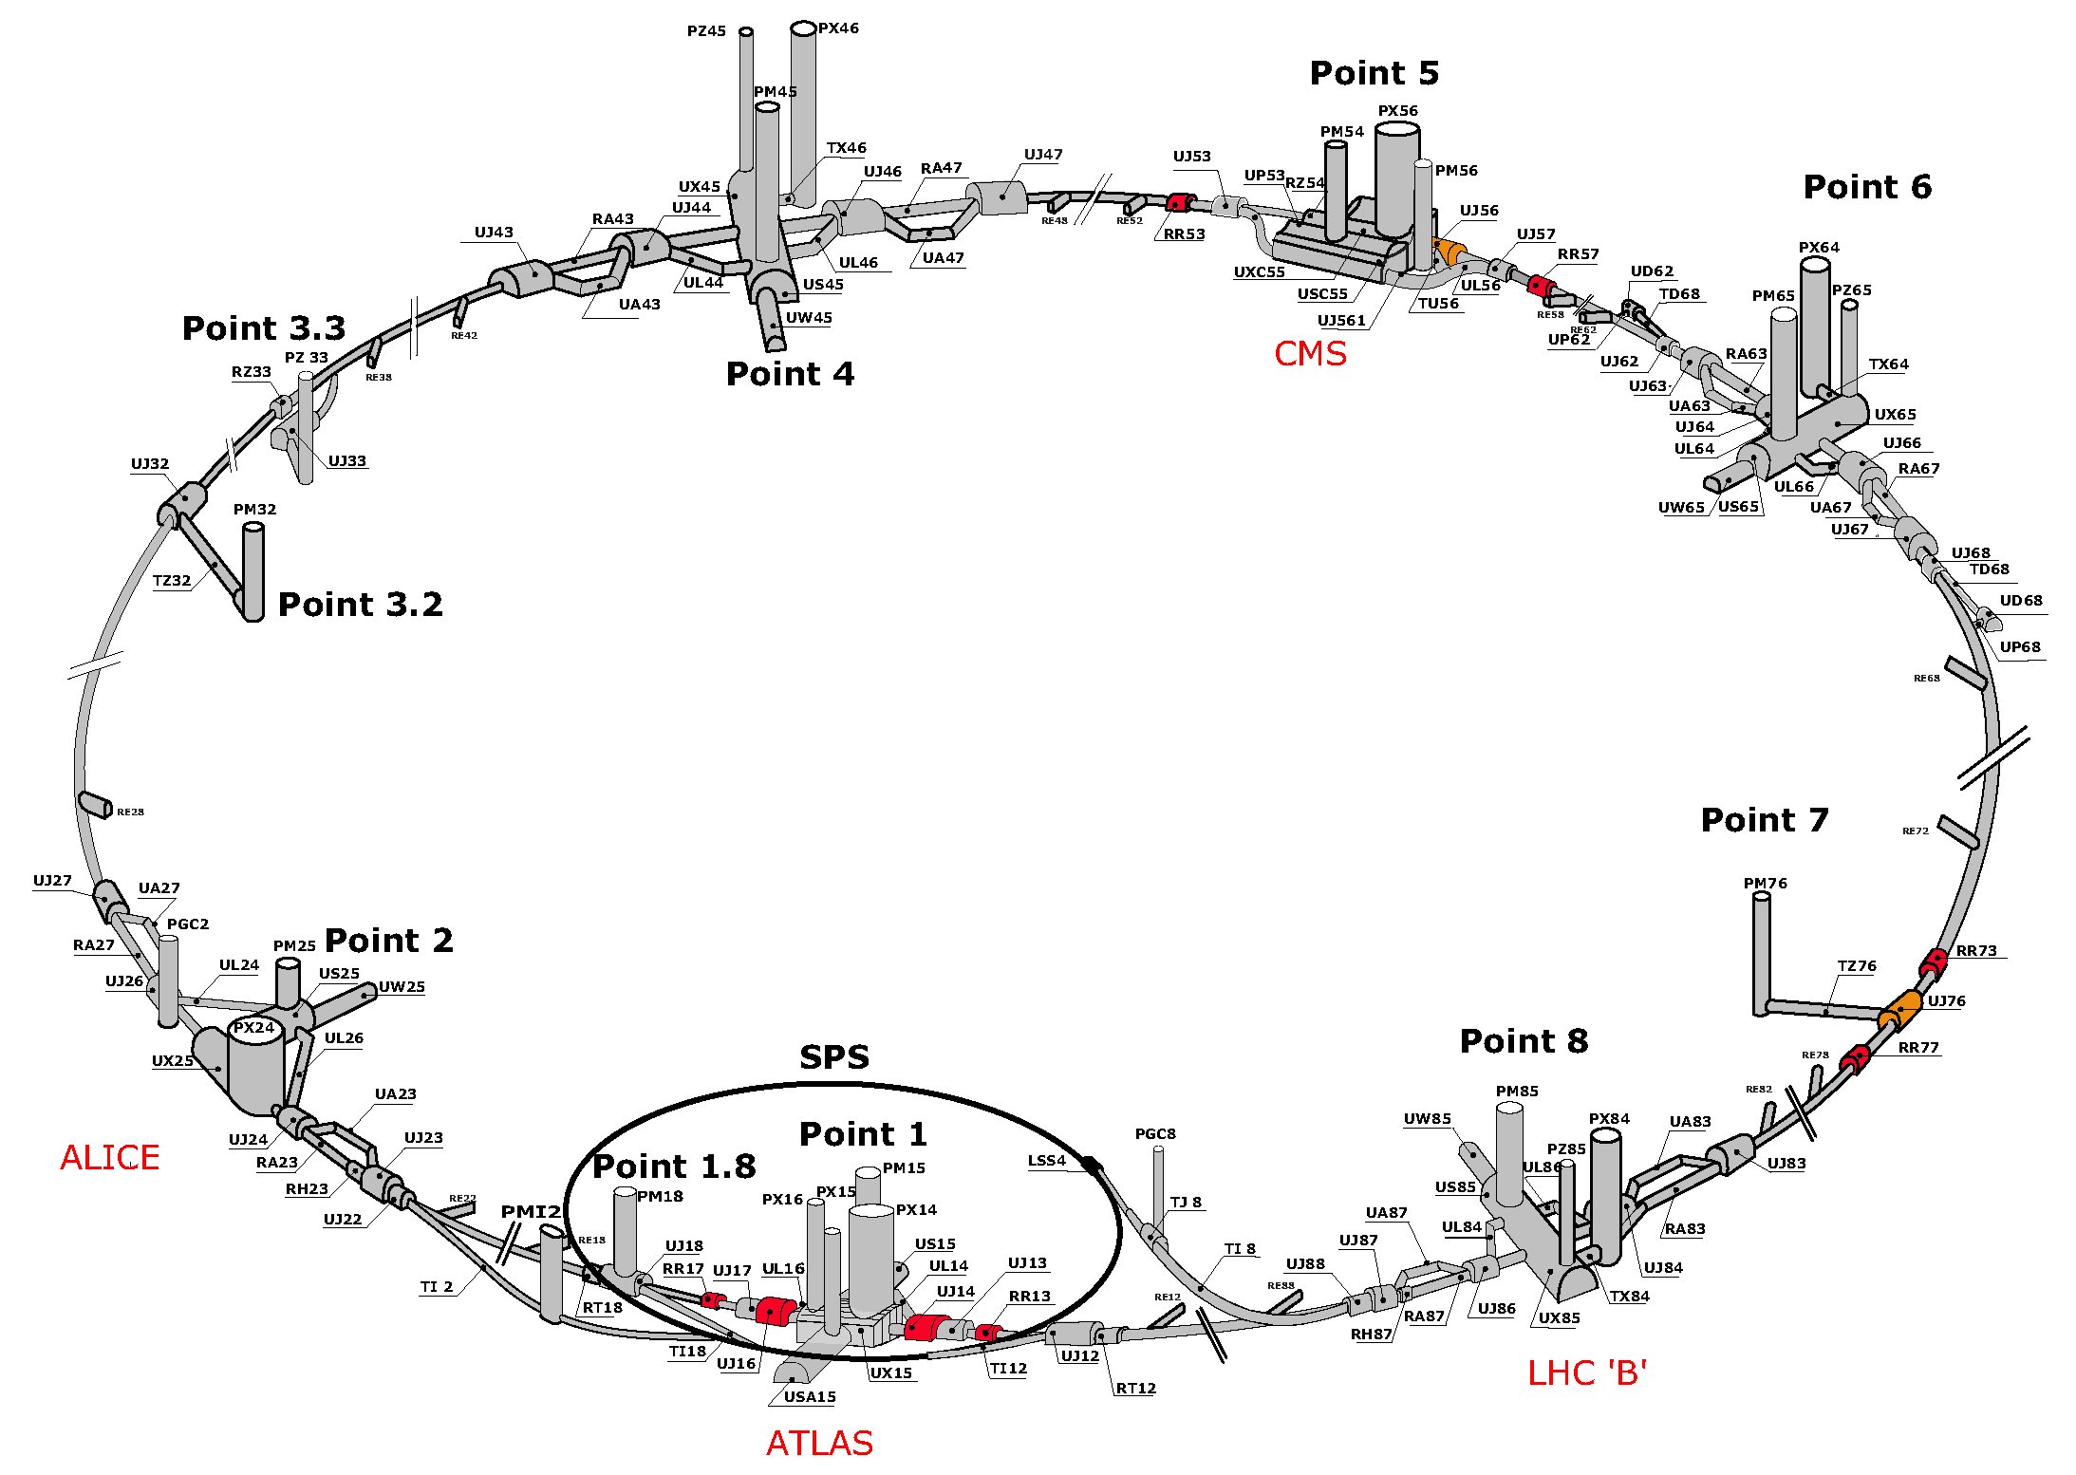
MAP OF LHC
!!!

Slide 15
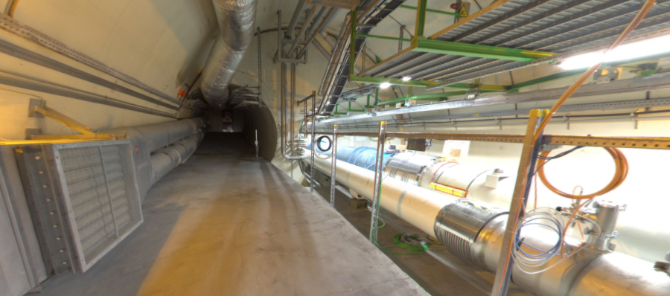
THE FAR-FORWARD REGION
Beam collision axis passes
through 100 m of rock, emerges in tunnel TI12, 480 m from ATLAS
UJ12
TI12 near UJ12
The view in UJ12 looking west (2019)
TI12
Beam collision axis
LHC beamline

Slide 16
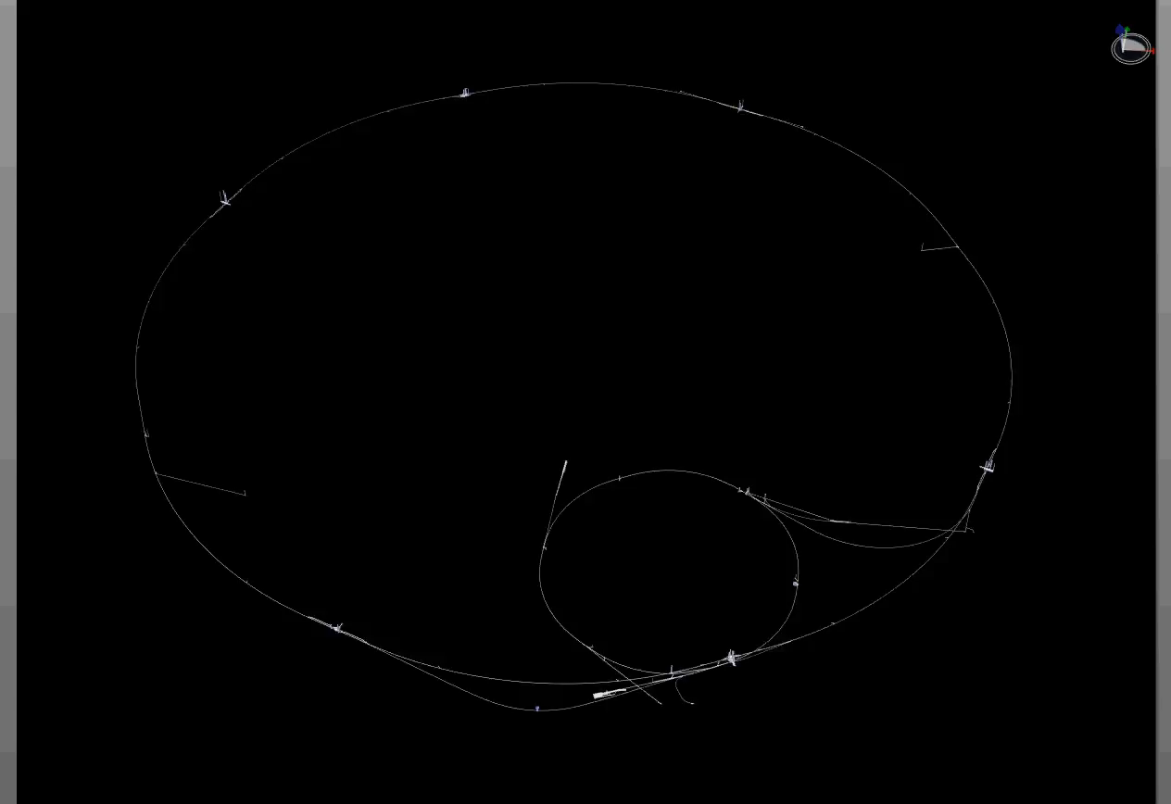
PARTICLE PATH FROM ATLAS TO TI12
Dougherty, CERN Integration (2019)

Slide 17
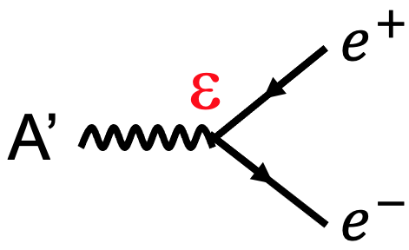
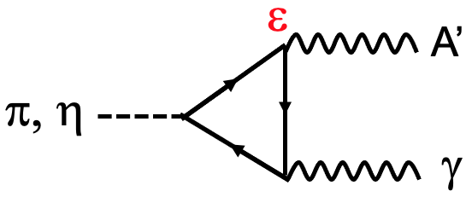
AN EXAMPLE SIGNAL: DARK PHOTONS
480 m
Produced Pions
Enormous event rates: N_{π}~10¹⁵ per bin
Huge range of p, but p_{T} is peaked at ~250 MeV
Produced A’s
Decays to A’ are rare:
N_{A’} ~ ε² N_{π}
But still N_{A’} ~ 10⁵ per bin, these travel straight
A’s decay in [480m, 483m]
Only highly boosted, ~TeV A’s decay in the tunnel
But these are highly collimated, and there are still many events
300 fb⁻¹
Feng, Galon, Kling, Trojanowski (2017)

Slide 18
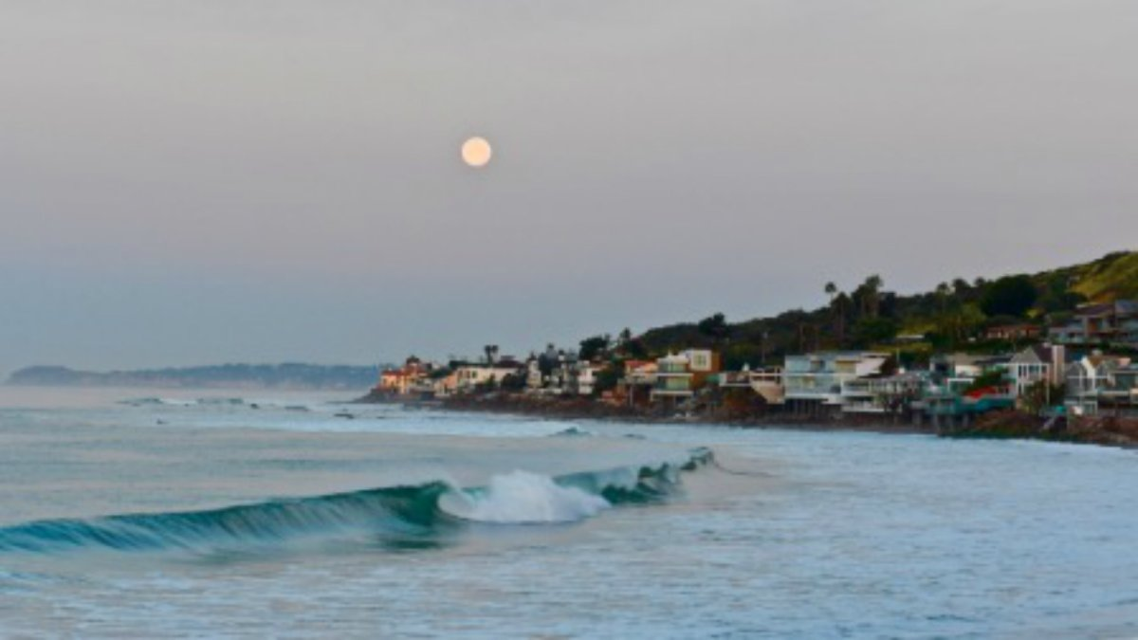
HOW BIG DOES THE DETECTOR HAVE TO BE?
Momentum:
Space:
250 MeV
1 TeV
12 cm
480 m
The opening angle is 0.2 mrad (η ~ 9); cf. the moon (7 mrad). Most of the signal passes through 1 sheet of paper at 480 m.
TeV dark photons (or any other new particles produced in π, η, K, D, B decay) are far more collimated than shown below, motivating a new, small, fast, cheap experiment at the LHC.

Slide 19


Slide 20
FASER TIMELINE
September 2017: Initial proposal (Feng, Galon, Kling, Trojanowski)
July 2018: Submitted LOI to CERN LHCC
October 2018: Approval from ATLAS SCT and LHCb Collaborations for use of spare detector modules
November 2018: Submitted Technical Proposal to LHCC
November 2018 – January 2019: Experiment funded by the Heising-Simons and Simons Foundations
March 2019: FASER approved as 8th LHC detector by CERN
December 2019: FASERν approved as 9th LHC detector by CERN
March 2021: FASER fully installed, commissioning of the detector begins
May 2021: FASERν announces first candidate collider neutrinos
Mid-2022: FASER and FASERν begin collecting data in Run 3

Slide 21
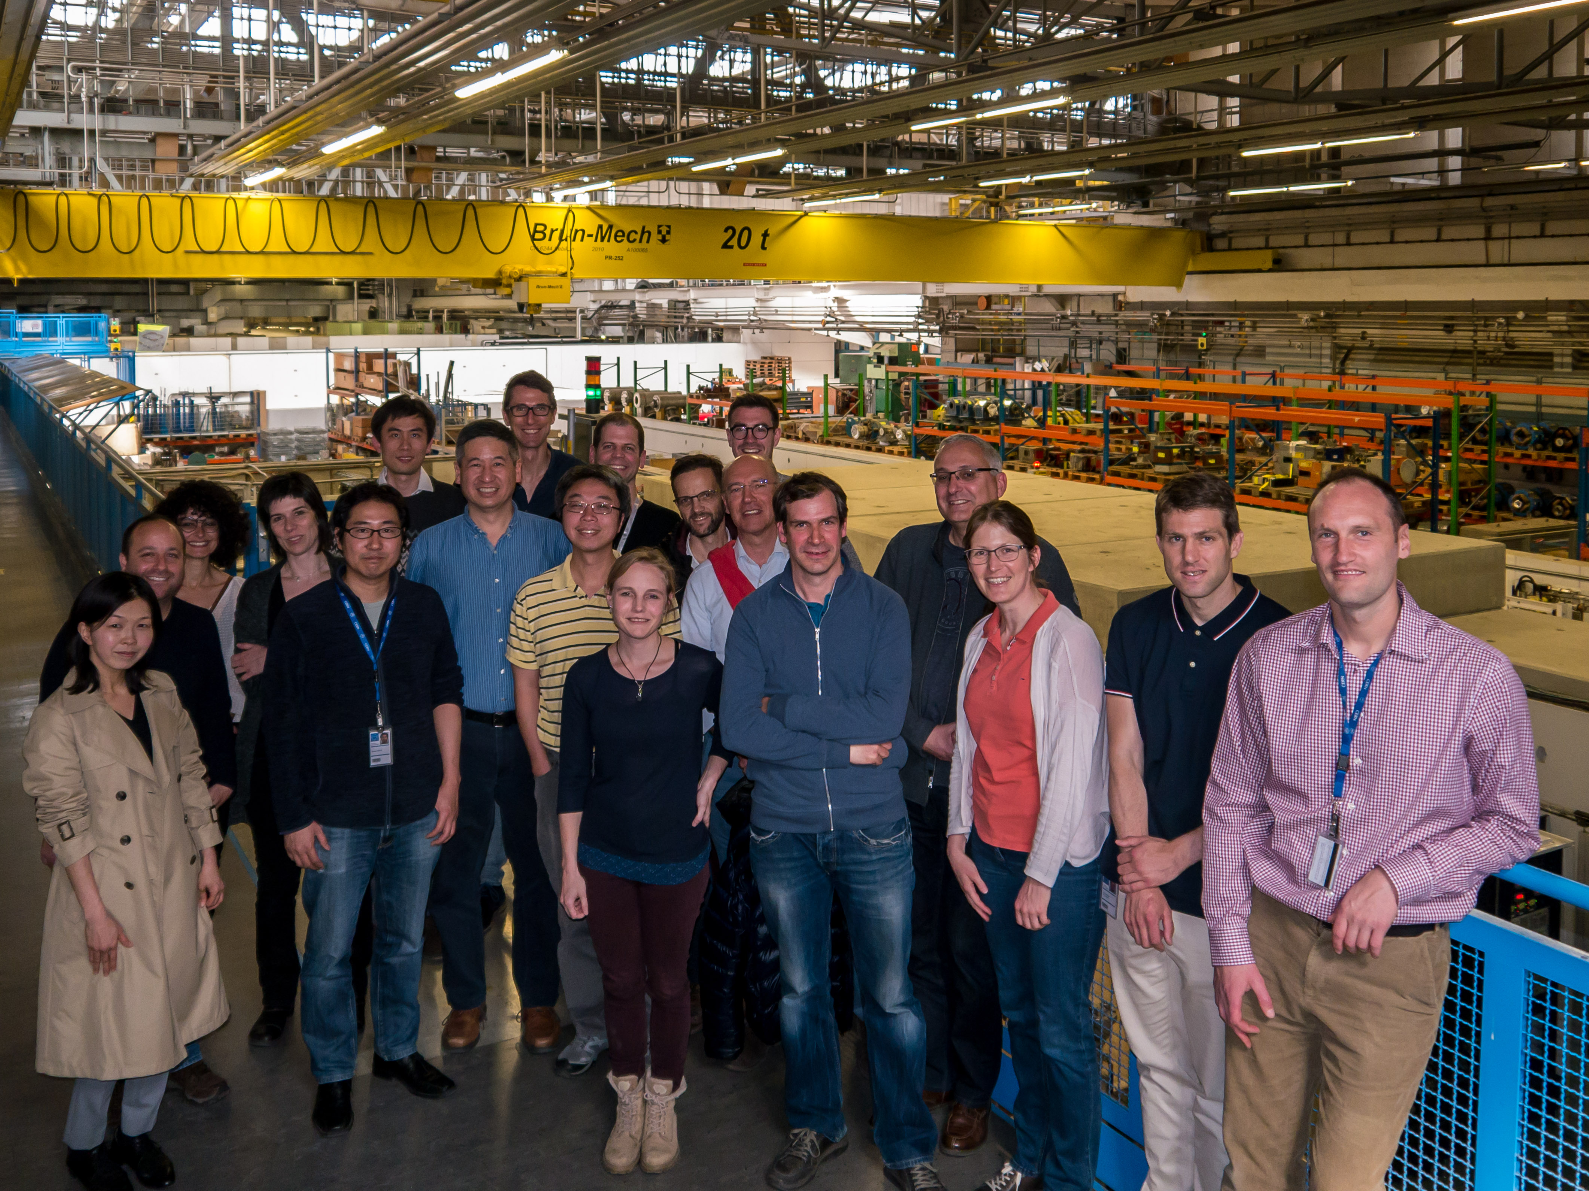
FIRST FASER COLLABORATION MEETING

Slide 22










FASER INSTITUTIONS TODAY
77 collaborators, 21 institutions, 9 countries

Slide 23
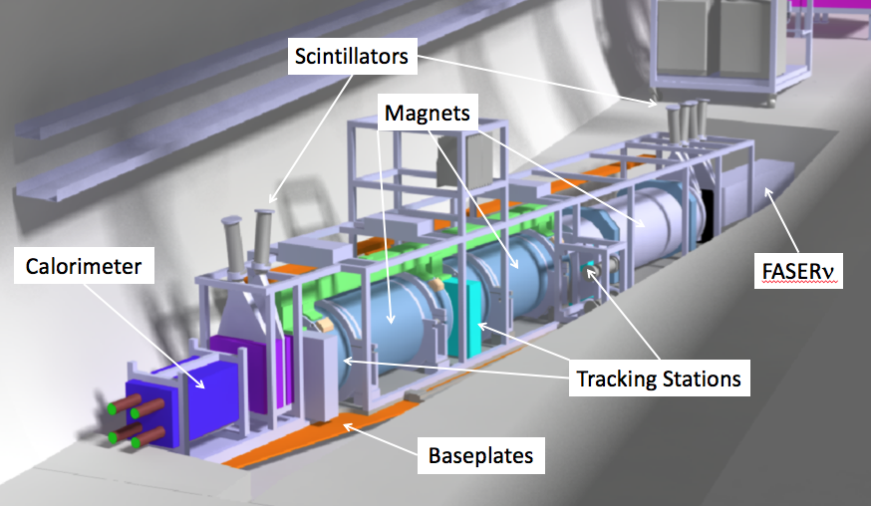
THE FASER DETECTOR
Nothing incoming and 2 ~TeV, opposite-sign charged tracks pointing back to the ATLAS IP: a “light shining through (100 m-thick) wall” experiment.
Scintillators veto incoming charged tracks (muons), magnets split the charged tracks, which are detected by tracking stations and a calorimeter.
LLP
ν
e⁺
e⁻

Slide 24
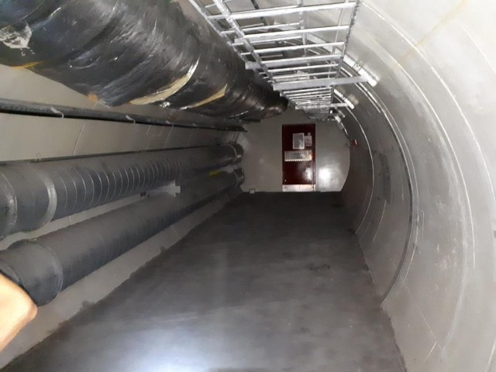
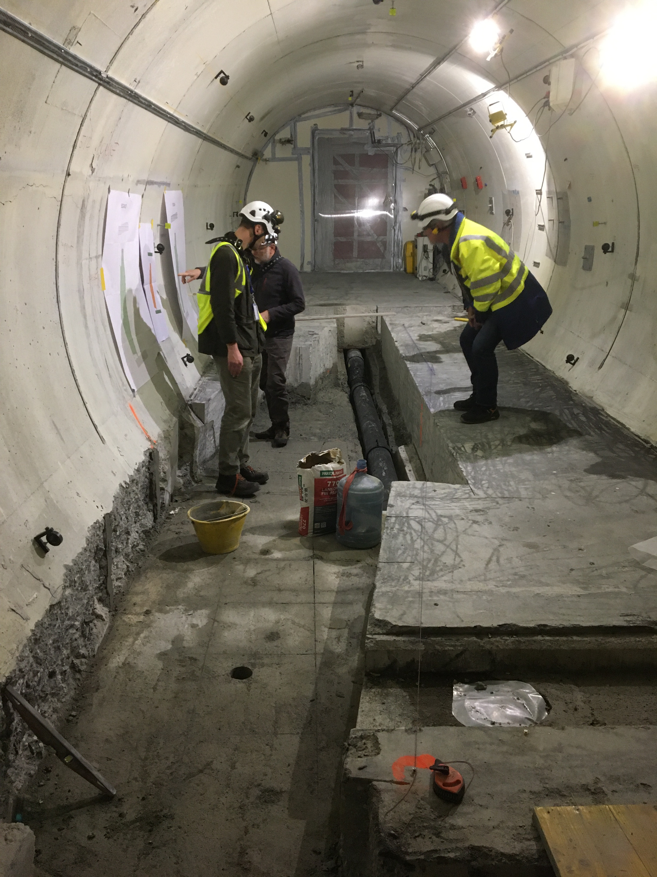
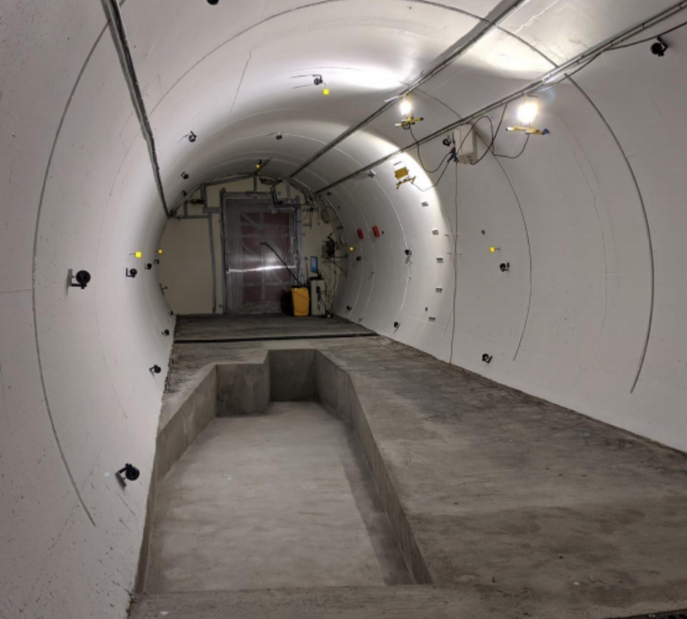
FASER IN TUNNEL TI12
The beam collision axis was located to mm accuracy by the CERN survey department. To place FASER on this axis, a trench was required to lower the floor by 46 cm.
The trench was completed by an Italian firm just hours before COVID shut down CERN in Spring 2020.
2019
Spring 2020
Summer 2020

Slide 25
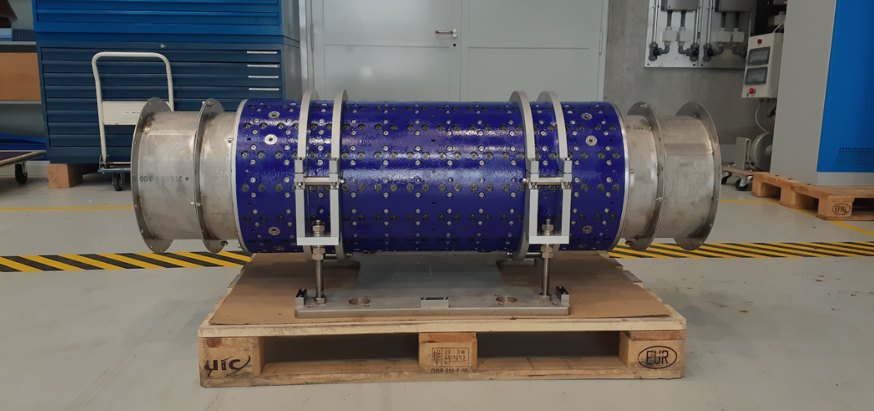
MAGNETS
FASER includes 3 magnets: 1.5 m, 1 m, and 1m long.
0.57 T permanent dipoles with an inner diameter of 20 cm, require little maintenance.
Constructed by the CERN magnet group.

Slide 26
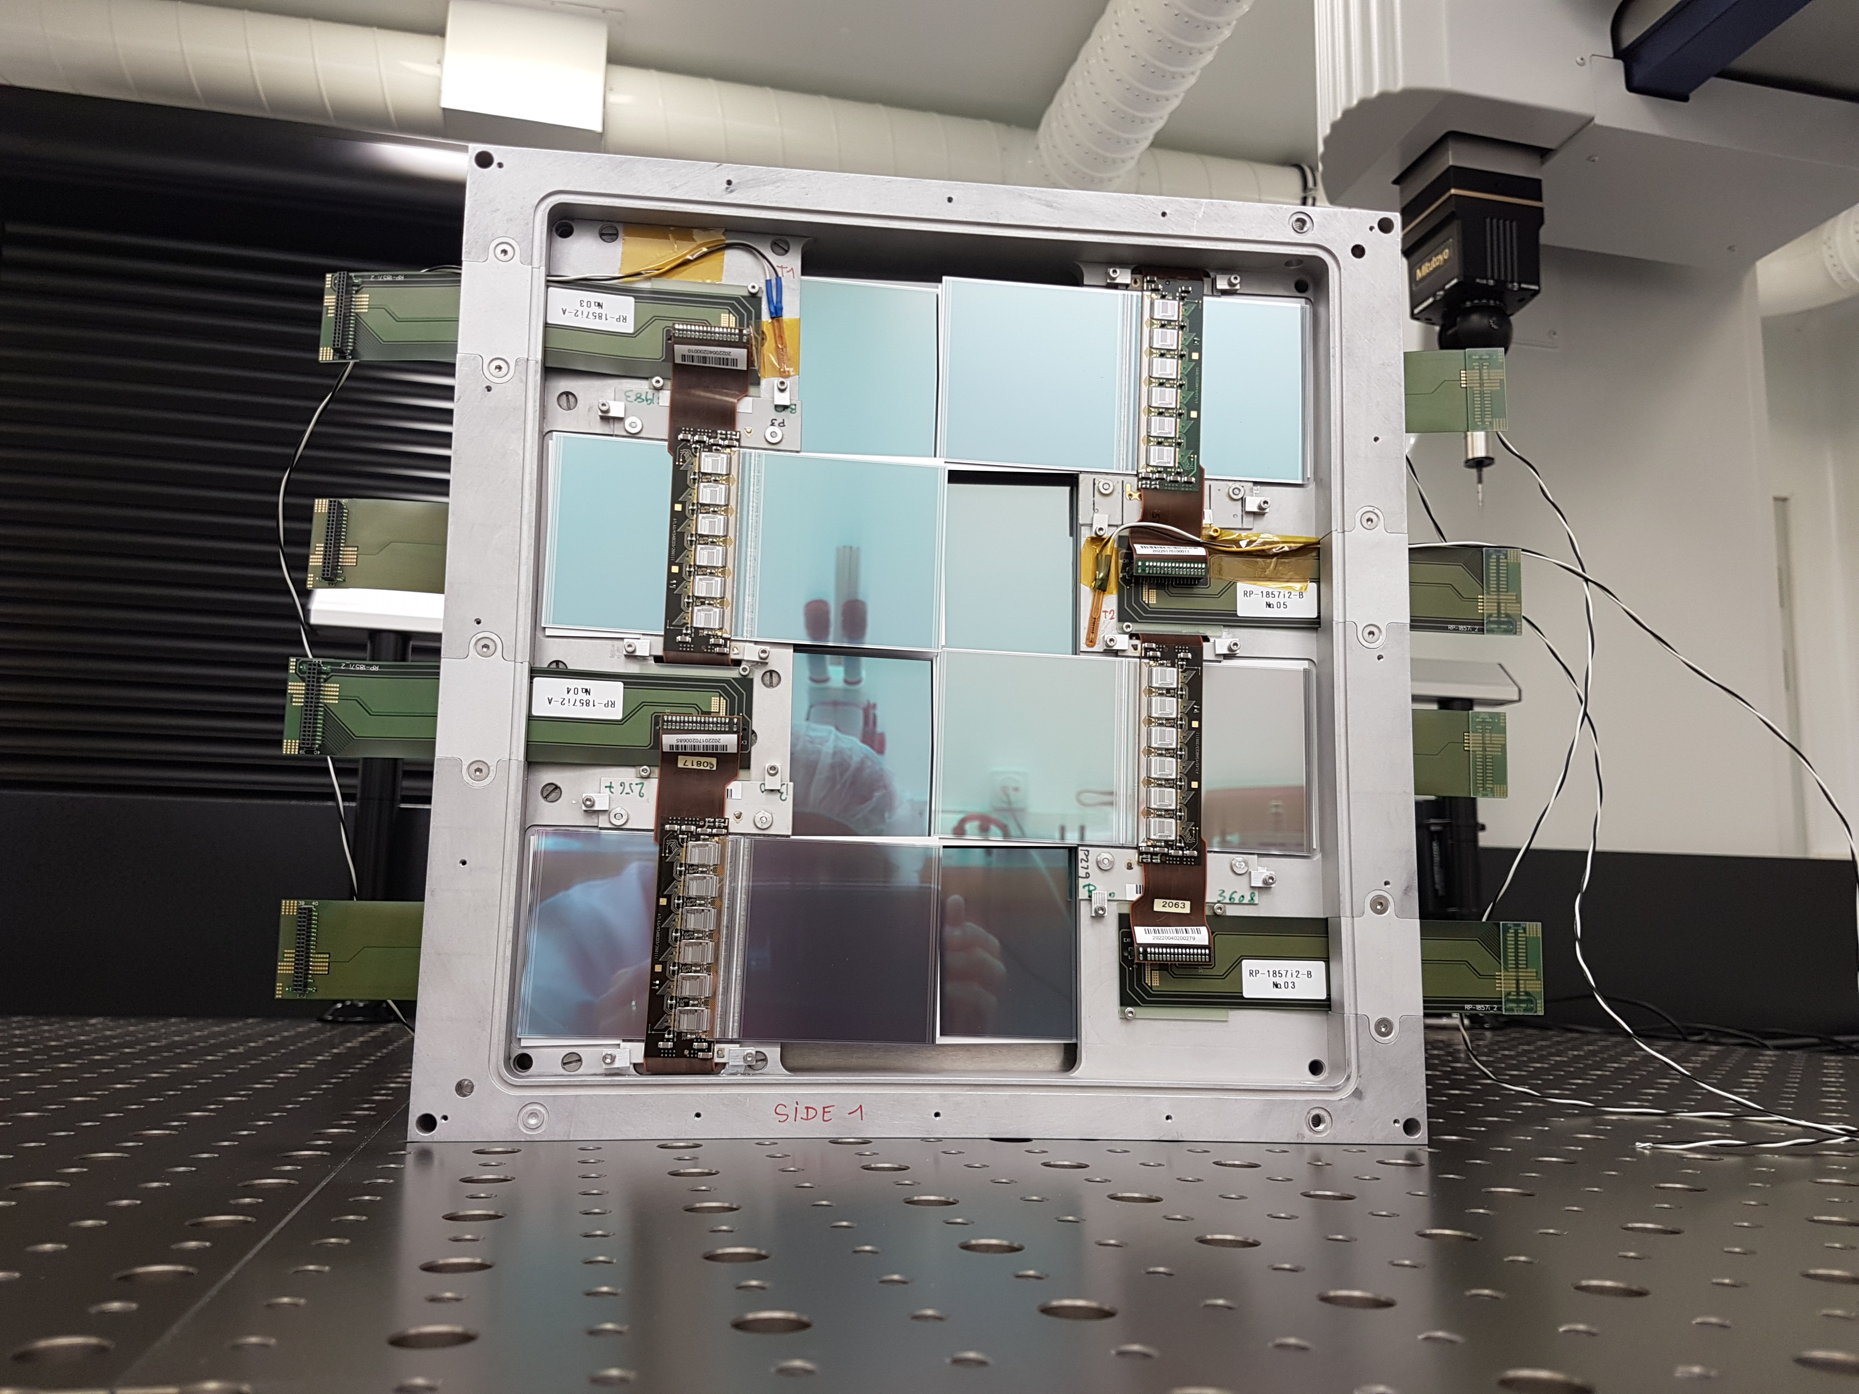
TRACKERS
ATLAS tracker consists of ~3000 SCT modules.
~300 spares were never used. ~100 of these were generously donated to FASER: 8 modules x 3 tracking planes x 4 tracking stations at FASER.

Slide 27
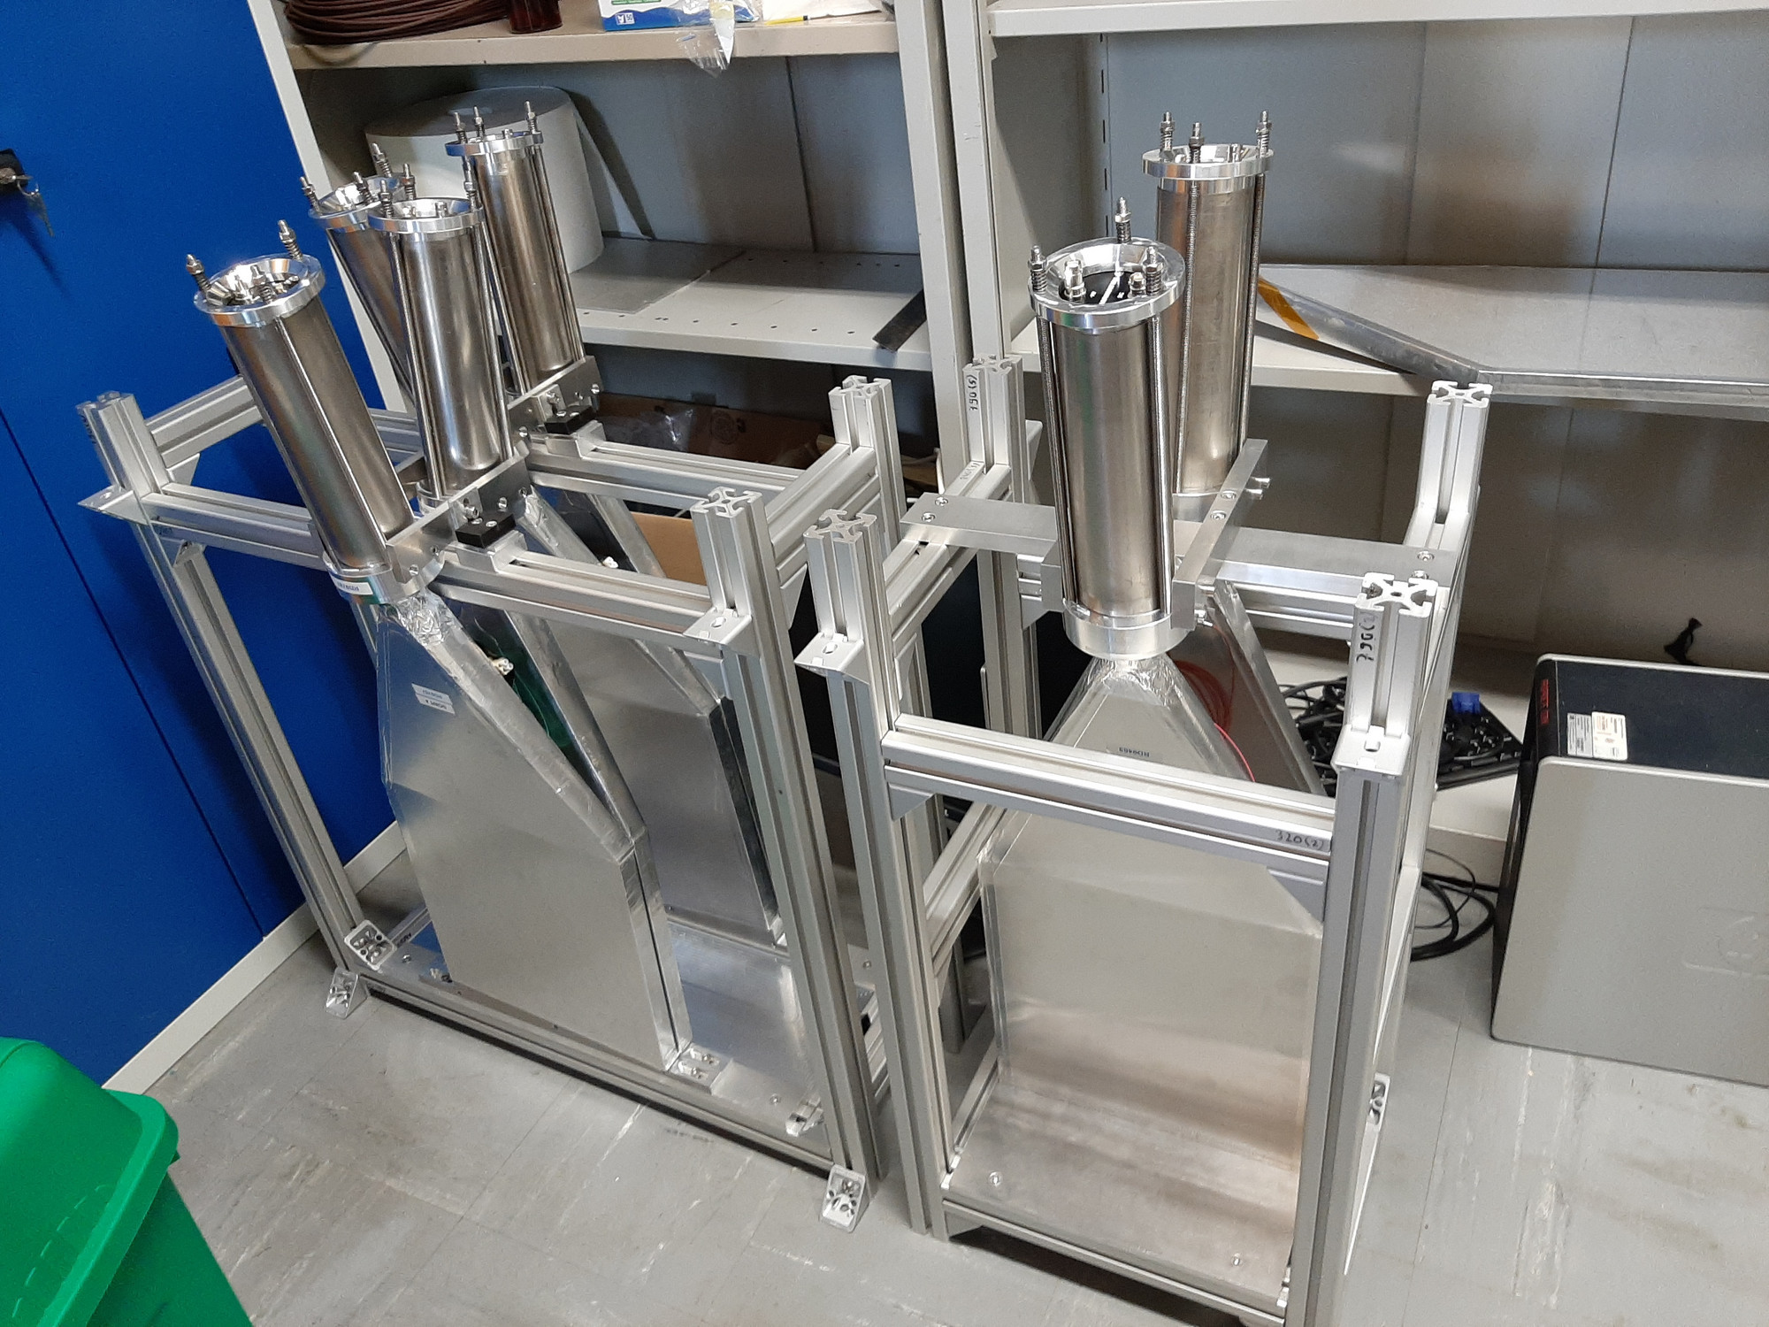
SCINTILLATORS
4 veto scintillators, each 2cm x 30cm x 30cm, upstream of the detector. Efficiency of each one is > 99.99%, makes muon background negligible.
Additional beam backgrounds, simulated with FLUKA and validated with pilot detectors in 2018, are also expected to be negligible.

Slide 28
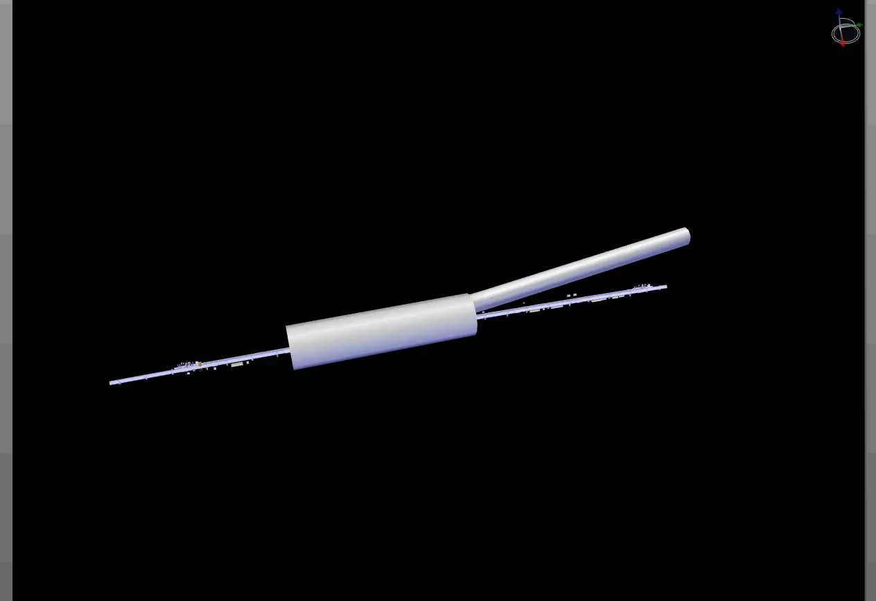
FASER INSTALLATION
Dougherty, CERN Integration (2019)

Slide 29
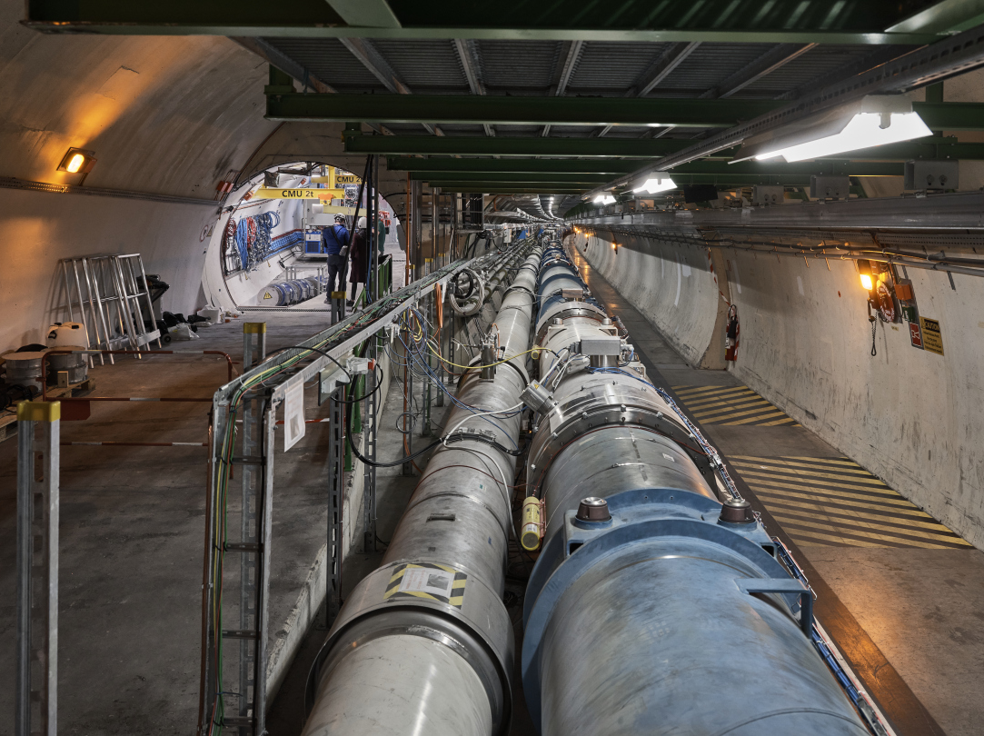
FASER CURRENT STATUS

Slide 30
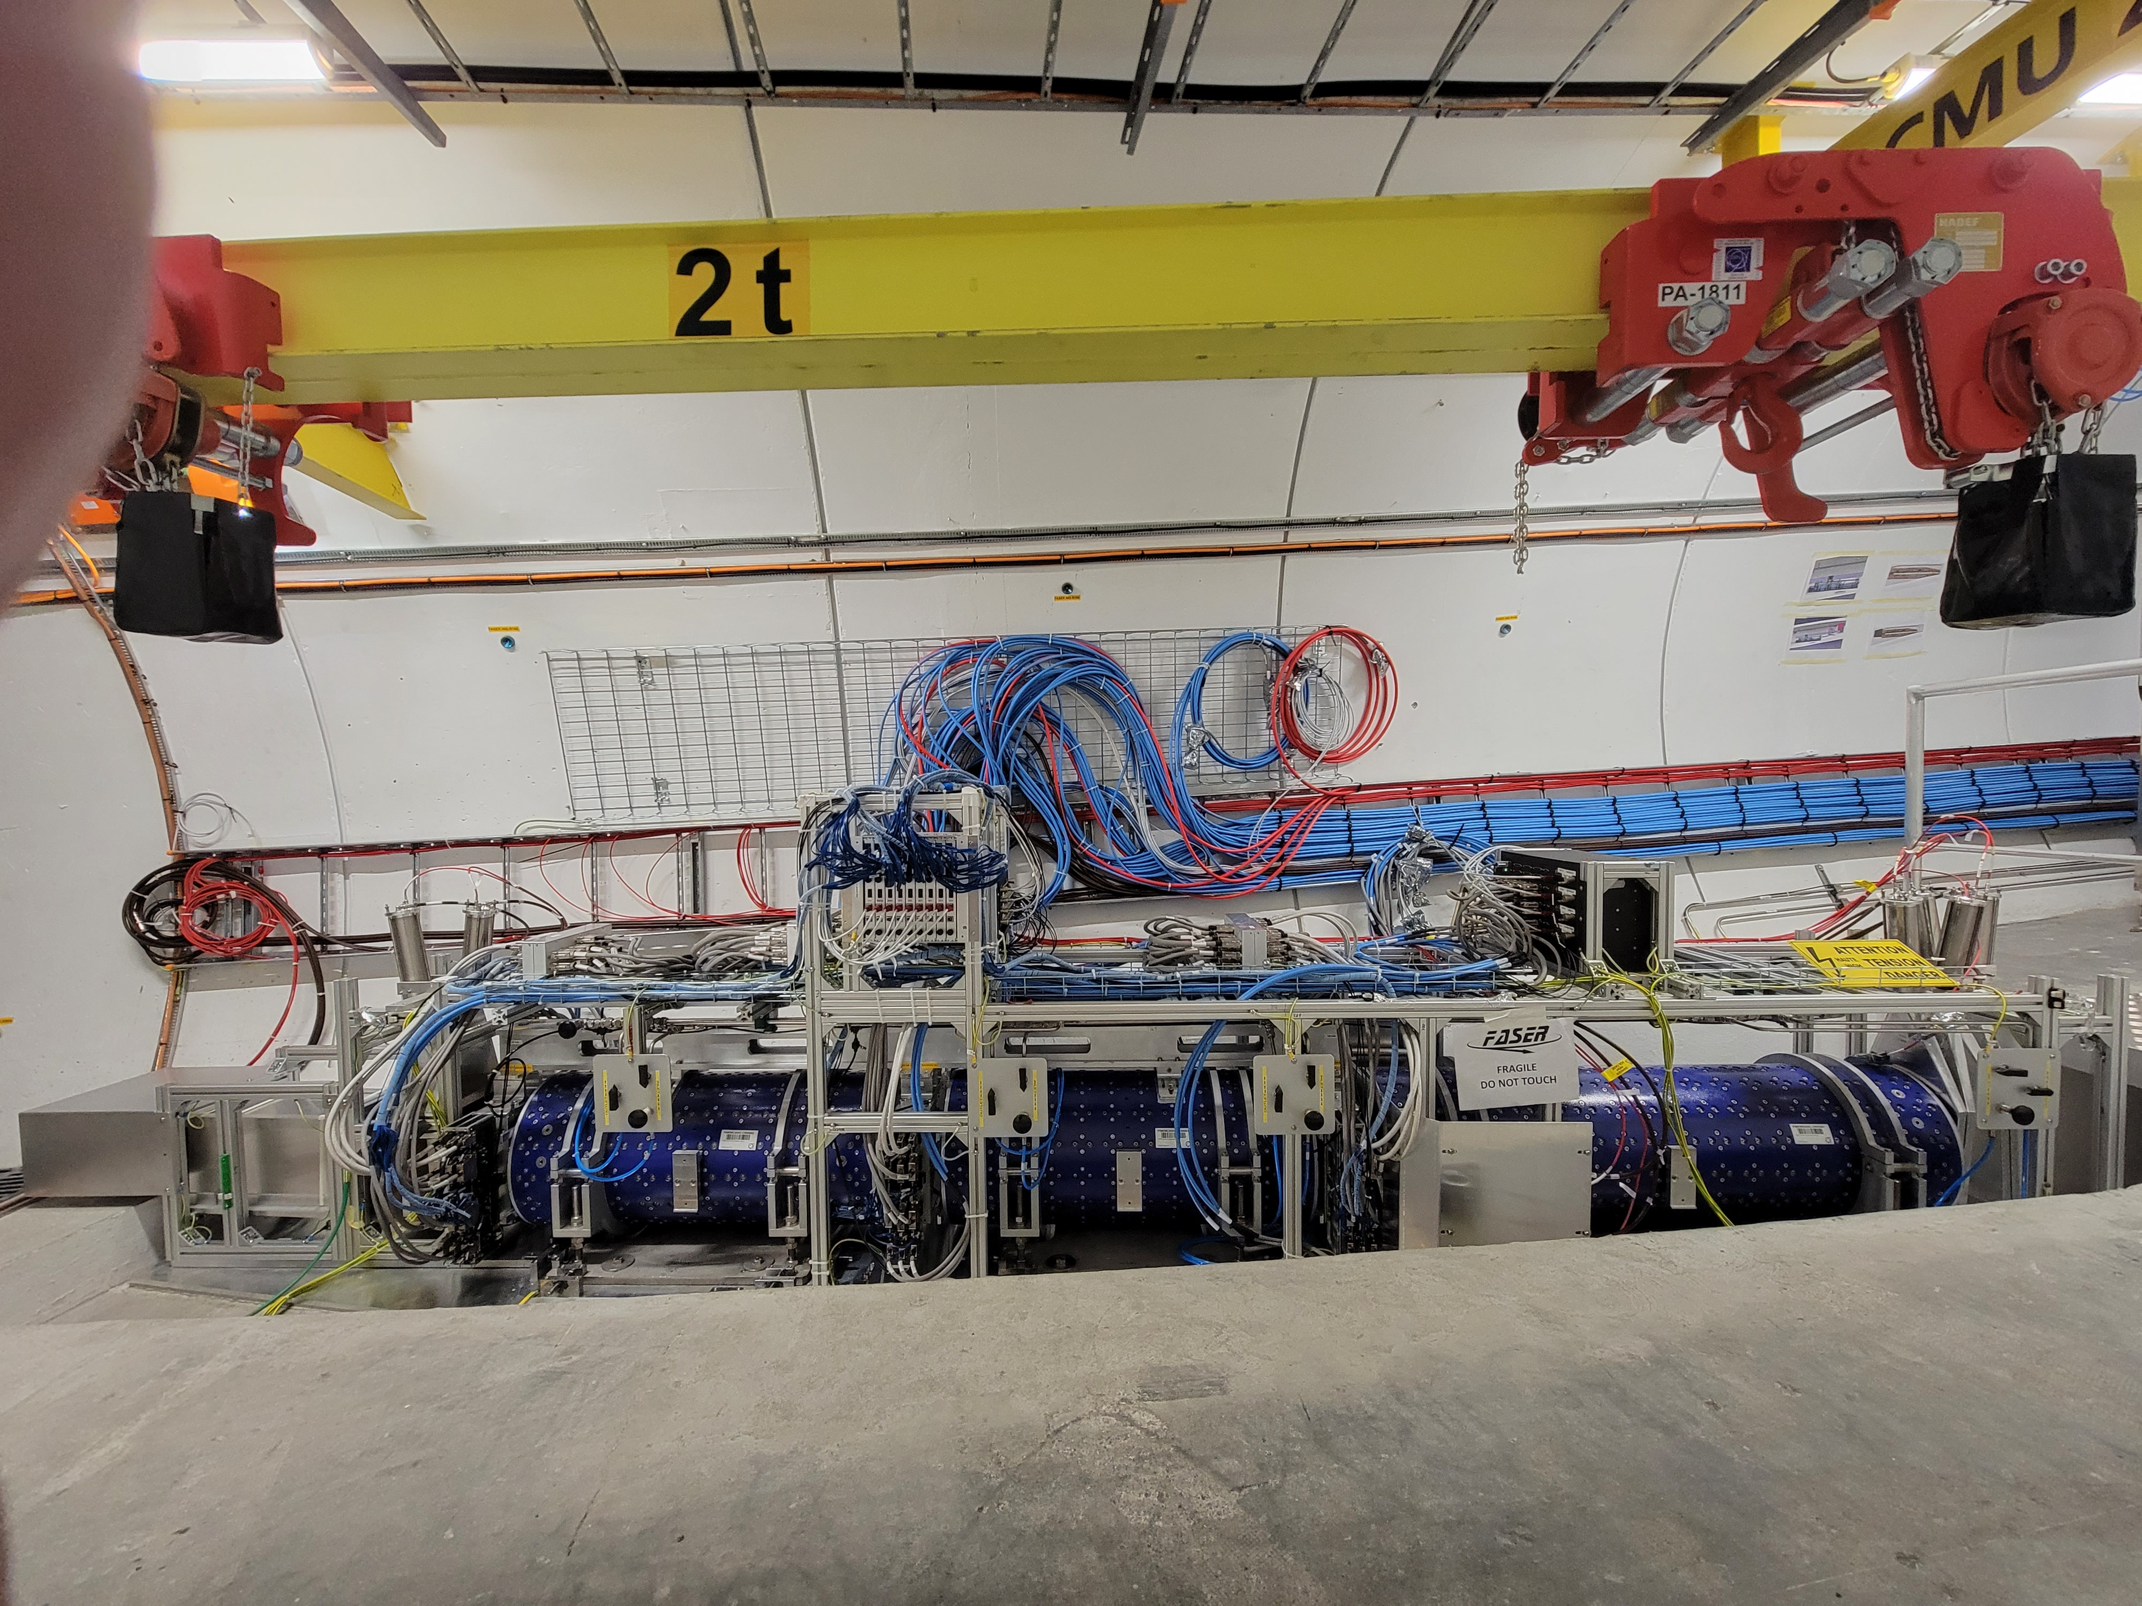
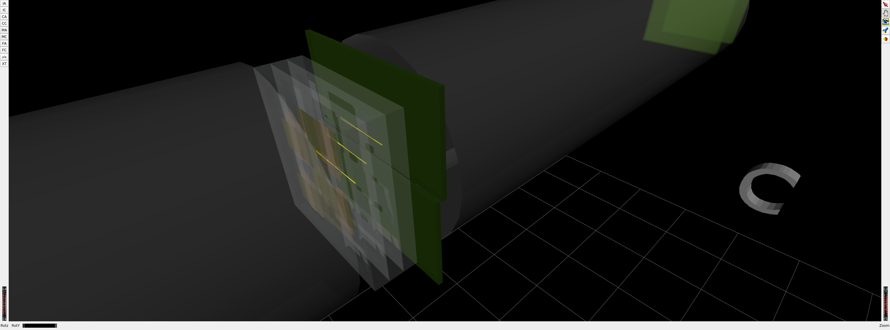
FASER CURRENT STATUS
1st Cosmic Ray
18 March 2021

Slide 31
DARK PHOTON SENSITIVITY REACH
FASER
FASER probes new parameter space with just 1 fb⁻¹ starting in 2022.
Without upgrade, HL-LHC extends (Luminosity*Vol) by factor of 3000 – could detect as many as 10,000 dark photons.
Possible upgrade to FASER 2 (R=1m, L=20m) extends (Luminosity*Vol) by factor of ~10⁶ – could detect as many as 3 x 10⁶ dark photons.
_{FASER Collaboration (2018)}

Slide 32

ν

Slide 33
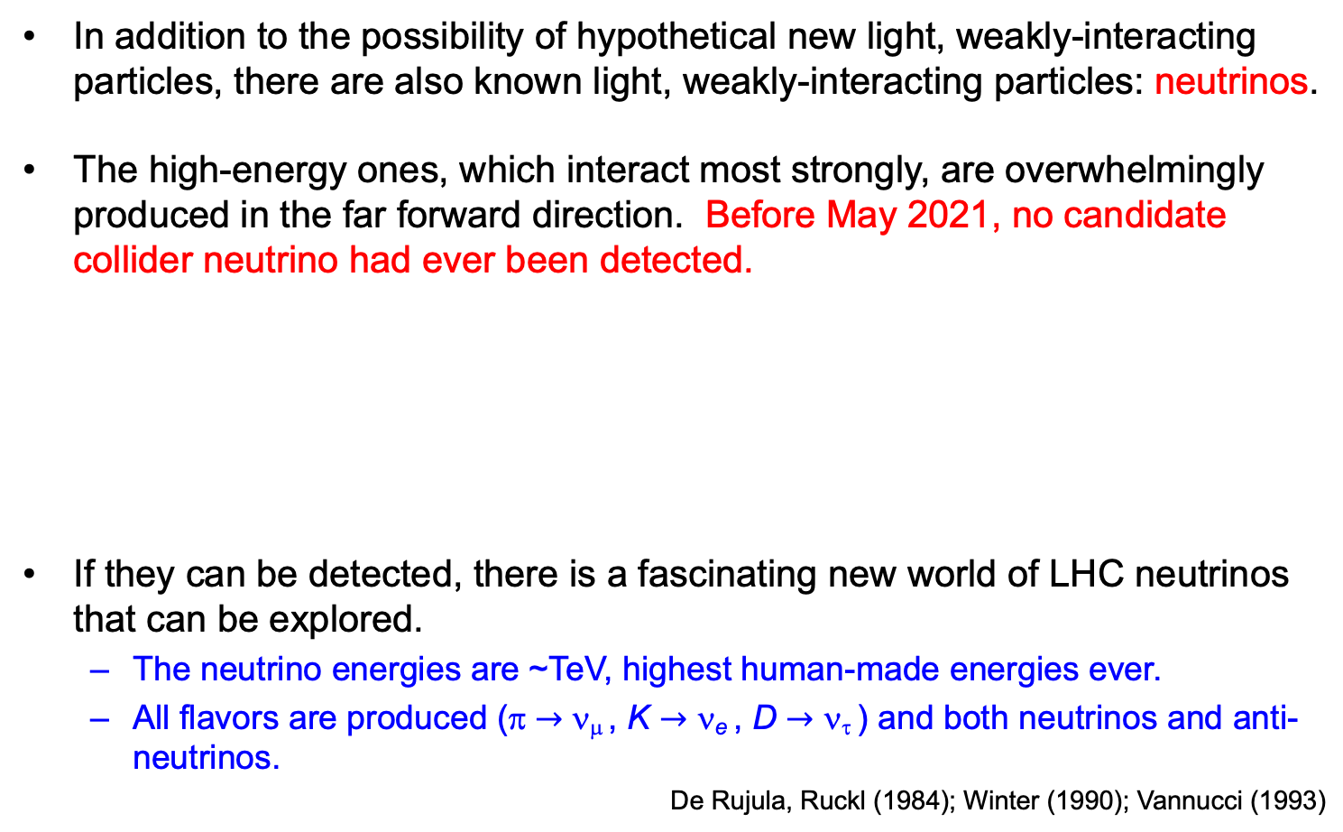
COLLIDER NEUTRINOS
In addition to the possibility of hypothetical new light, weakly-interacting particles, there are also known light, weakly-interacting particles: neutrinos.
The high-energy ones, which interact most strongly, are overwhelmingly produced in the far forward direction. Before May 2021, no candidate collider neutrino had ever been detected.
If they can be detected, there is a fascinating new world of LHC neutrinos that can be explored.
  The neutrino energies are ~TeV, highest human-made energies ever.
  All flavors are produced (π $→$ ν_{μ} , K $→$ ν_{e} , D $→$ ν_{τ} ) and both neutrinos and anti-neutrinos.
De Rujula, Ruckl (1984); Winter (1990); Vannucci (1993)

Slide 34
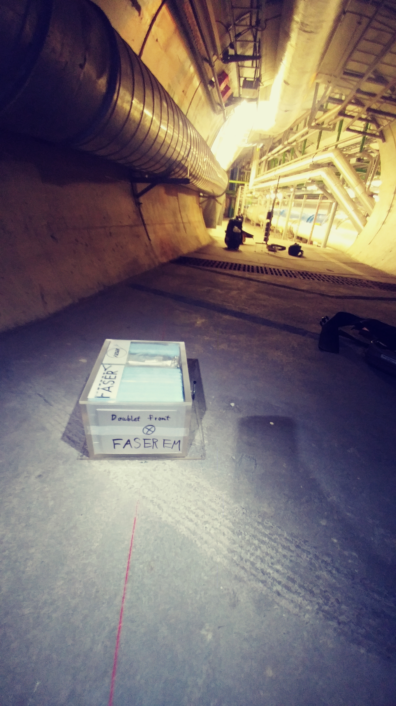
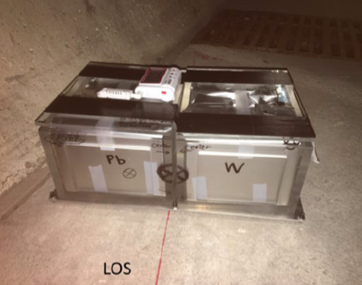
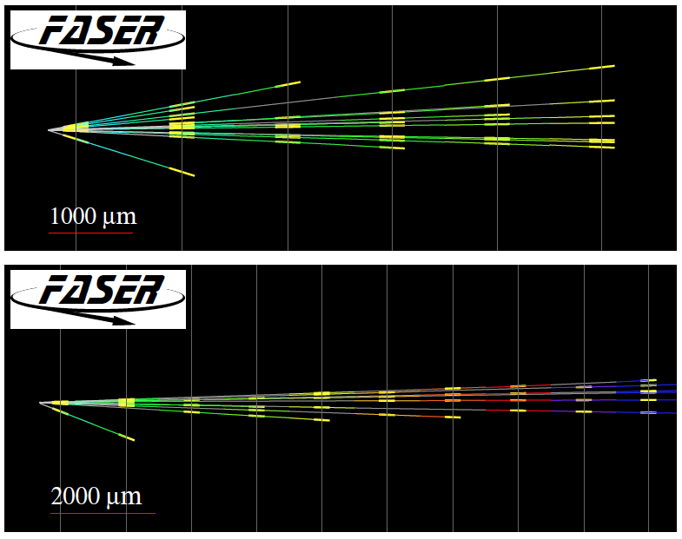
FIRST COLLIDER NEUTRINOS
In 2018 a FASER pilot emulsion detector with 11 kg fiducial mass collected 12.2 fb⁻¹ on the beam collision axis (installed and removed during Technical Stops).
In May 2021, the FASER Collaboration announced the direct detection of 6 candidate neutrinos above 12 expected neutral hadron background events (2.7σ).
Not the discovery of collider neutrinos, but a sign of things to come.

Slide 35
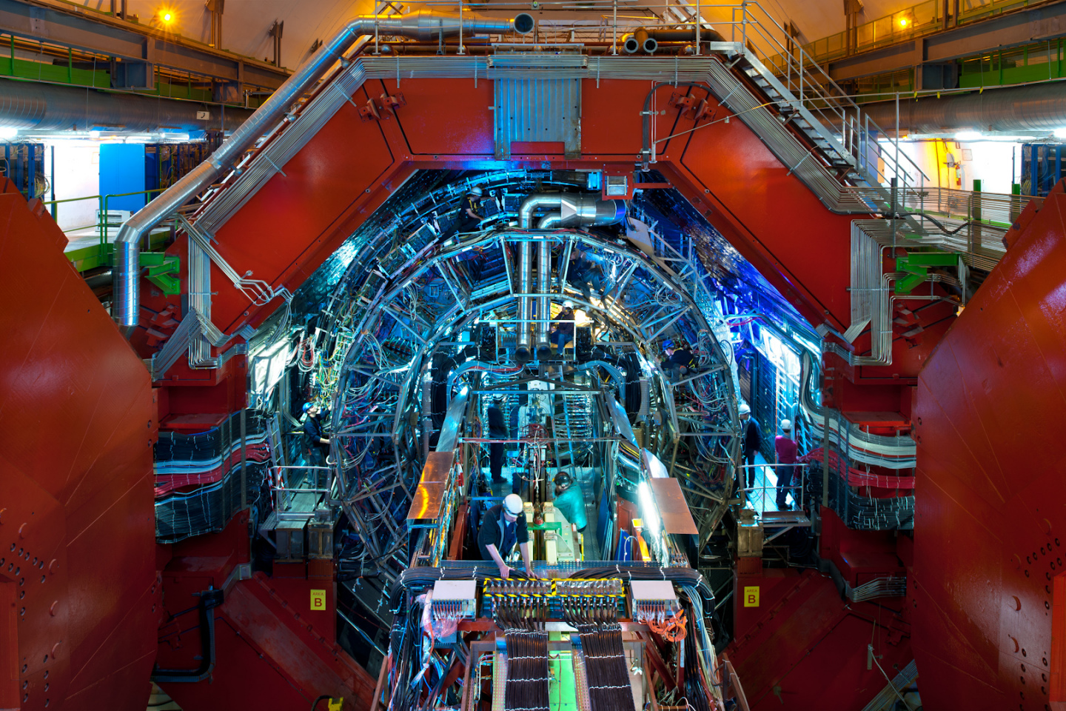
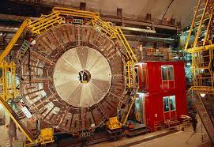
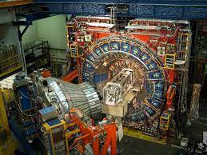
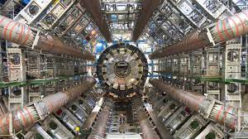
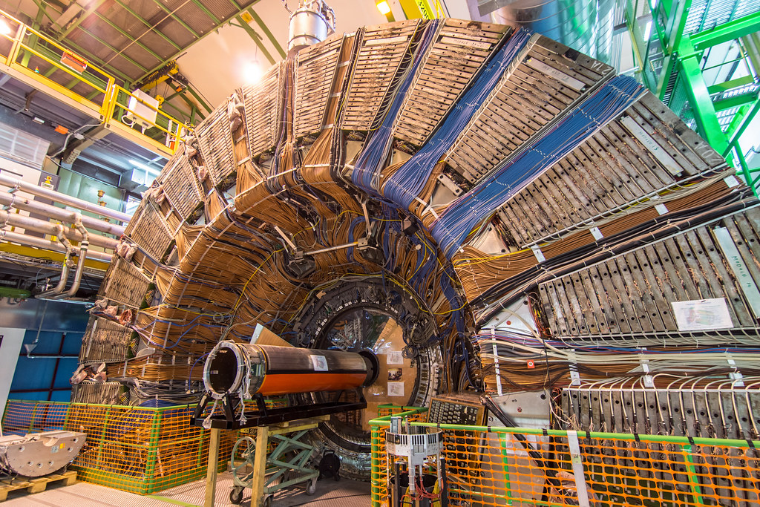
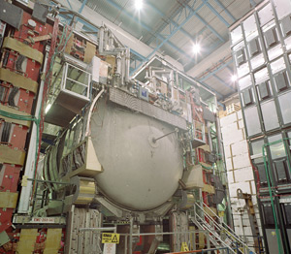
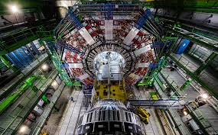
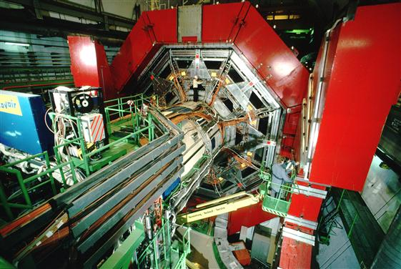

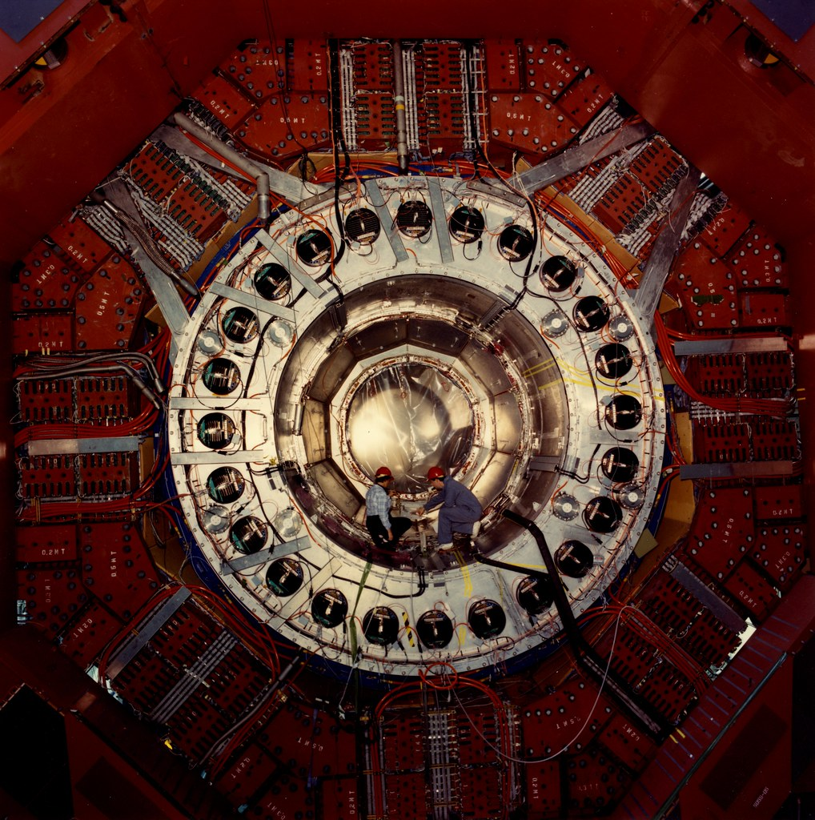
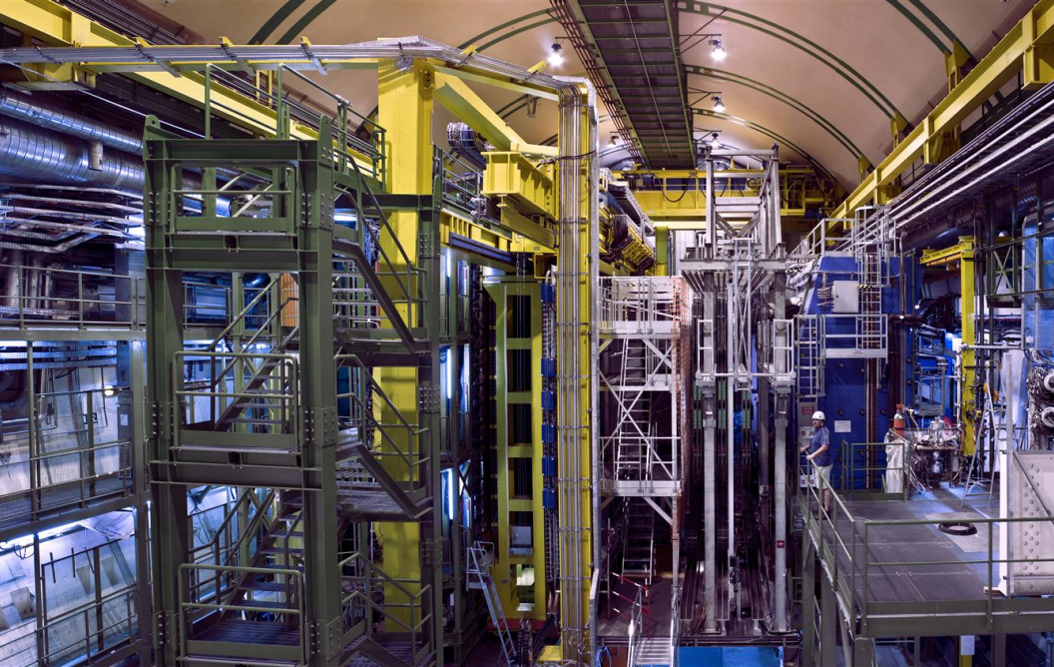
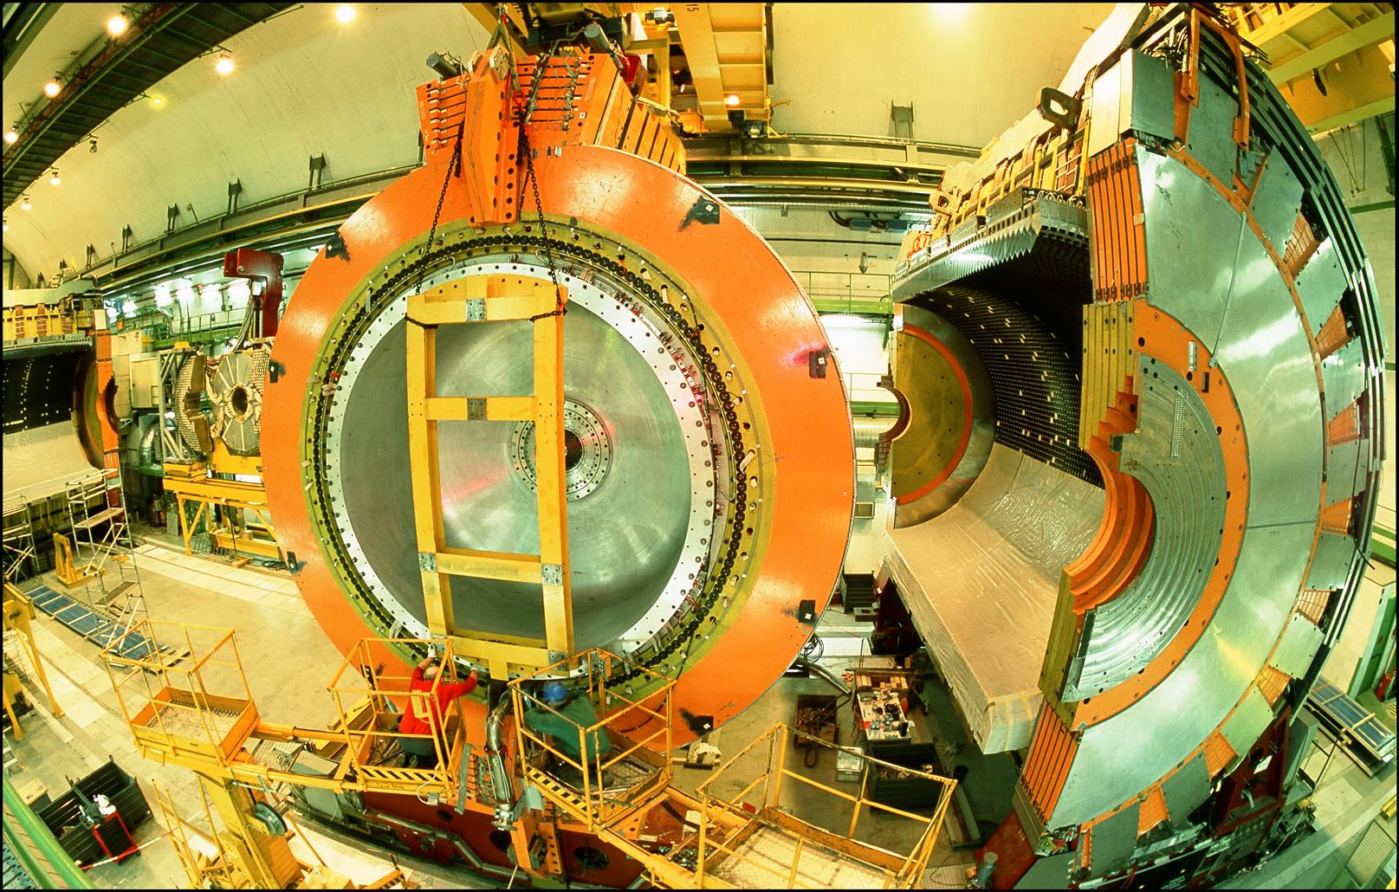
LOCATION, LOCATION, LOCATION
…
ALICE
ALEPH
CDF
FASER Pilot Detector
Suitcase-size, 4 weeks
$0 (recycled parts)
6 candidate neutrinos
ATLAS
DELPHI
D0
CMS
L3
LHCb
SLD
OPAL
All previous
collider detectors
Building-size, decades
~$10⁹
0 candidate neutrinos

Slide 36
THE FASERν DETECTOR
FASERν is designed to detect neutrinos of all flavors.
  25cm x 30cm x 1.1m detector consisting of 770 emulsion layers interleaved with 1 mm-thick tungsten plates; target mass = 1.1 tonnes.
  Emulsion swapped out every ~10-30 fb⁻¹, total 10 sets of emulsion for Run 3.
LLP
ν
e⁺
e⁻

Slide 37
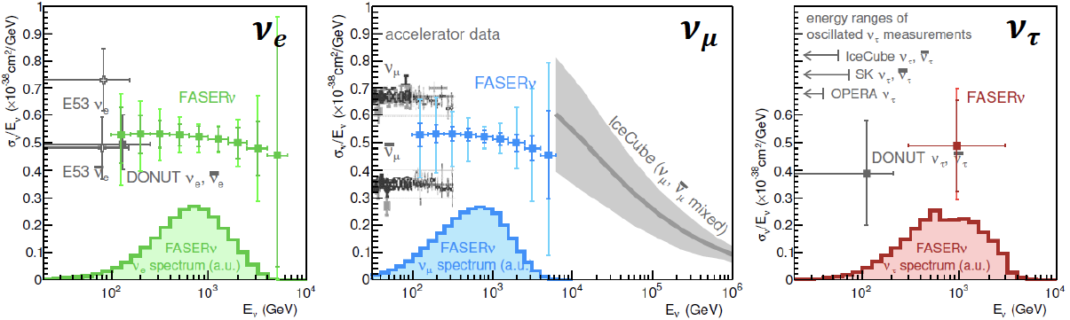
NEUTRINO PHYSICS
In Run 3 (2022-24), the goals of FASERν are to
  Detect the first collider neutrino.
  Record ~1000 ν_{e} , ~10,000 ν_{μ} , and ~10 ν_{τ} interactions at TeV energies, the first direct exploration of this energy range for all 3 flavors.
  Distinguish muon neutrinos from anti-neutrinos by combining FASER and FASERν data, and so measure their cross sections independently.
  Add significantly to the number of ν_{τ} and detect the first anti-ν_{τ} .
FASER Collaboration 1908.02310 (2019)

Slide 38
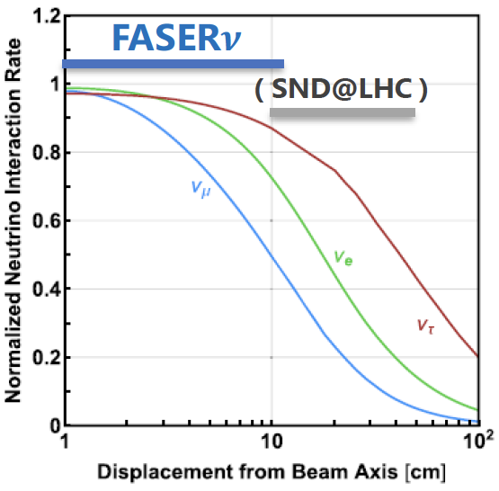


QCD PHYSICS
The forward production of hadrons is currently subject to large uncertainties. Forward ν experiments will provide useful insights.
  On- and off-axis neutrino detectors provide complementary information (π $→$ ν_{μ} , K $→$ ν_{e} , D $→$ ν_{τ} ).
  Different target nuclei (lead, tungsten) probe different nuclear pdfs.
  Strange quark pdf through νs $→$lc.
  Forward charm production, intrinsic charm.
  Refine simulations that currently vary greatly (EPOS-LHC, QGSJET, DPMJET, SIBYLL, PYTHIA…).
  Provide essential input to astroparticle experiments; e.g., distinguish galactic neutrino signal from atmospheric neutrino background at IceCube.

Slide 39


Slide 40
FORWARD PHYSICS FACILITY
FASER, FASERν, and other proposed far-forward detectors are currently highly constrained by 1980’s infrastructure that was never intended to support experiments.
The rich physics program in the far-forward region therefore strongly motivates creating a dedicated Forward Physics Facility to house far-forward experiments for the HL-LHC era from 2027-37.
FPF Meetings
  FPF Kickoff Meeting, 9-10 Nov 2020, https://indico.cern.ch/event/955956
  FPF2 Meeting, 27-28 May 2021, https://indico.cern.ch/event/1022352
  FPF3 Meeting, 25-26 Oct 2021, https://indico.cern.ch/event/1076733
FPF Short Paper: 75 pages, 80 authors completed in Sep 2021 (2109.10905).
The FPF White Paper (~300 pages) is being prepared for submission to Snowmass in Feb 2022 (conveners: Feng, Kling, Rojo, Reno, Soldin).

Slide 41



FPF LOCATION
Possibilities under active investigation: enlarge existing cavern UJ12, 480 m from ATLAS and shielded from the ATLAS IP by ~100 m of rock; or create a purpose-built facility ~612 m from ATLAS past UJ18.
UJ18
ATLAS
SPS
UJ12
LHC
LOS
Kincso Balazs, CERN CE
CERN GIS

Slide 42



Jonathan Gall, FPF Workshop
PURPOSE-BUILT FACILITY
Many advantages
  Construction access far easier
  Access possible during LHC operations
  Size and length of cavern more flexible
  Designed around needs of the experiments
Design by Liam Dougherty (EN-ACE-INT)

Slide 43

NEW PHYSICS SEARCHES AT THE FPF
The FPF will extend the current far-forward program by housing larger and a more diverse array of experiments.
FASER 2, with R = 1 m, L = 20 m, can discover all candidates with renormalizable couplings (dark photon, dark Higgs, HNL); ALPs with all types of couplings (γ, f, g); and many other particles.
Other experiments can discover mCPs, dark matter, and many other interesting ideas.
Benchmark Model | Underway | FPF
BC1: Dark Photon | $$\text{FASER}$$ | FASER 2
BC1’: U(1)_{B-L} Gauge Boson | $$\text{FASER}$$ | $$\text{FASER}\text{ 2}$$
BC2: Dark Matter | ⎼ | FLArE
BC3: Milli-Charged Particle | ⎼ | FORMOSA
BC4: Dark Higgs Boson | ⎼ | $$\text{FASER}\text{ 2}$$
BC5: Dark Higgs with hSS | ⎼ | $$\text{FASER}\text{ 2}$$
BC6: HNL with e | ⎼ | $$\text{FASER}\text{ 2}$$
BC7: HNL with μ | ⎼ | $$\text{FASER}\text{ 2}$$
BC8: HNL with τ | $$\text{⎼}$$ | $$\text{FASER}\text{ 2}$$
BC9: ALP with photon | $$\text{FASER}$$ | $$\text{FASER}\text{ 2}$$
BC10: ALP with fermion | $$\text{FASER}$$ | $$\text{FASER}\text{ 2}$$
BC11: ALP with gluon | $$\text{FASER}$$ | $$\text{FASER}\text{ 2}$$

Slide 44


MILLI-CHARGED PARTICLES
A completely generic possibility motivated by dark matter, dark sectors. Currently the target of the MilliQan experiment, located at the LHC near the CMS experiment in a “non-forward” tunnel.
The MilliQan Demonstrator (Proto-MilliQan) already probes new region. Full MilliQan can also run in this location in the HL-LHC era, but the sensitivity may be improved significantly by moving it to the FPF (FORMOSA).
Foroughi-Abari, Kling, Tsai (2020)

Slide 45




DARK MATTER
Light DM with masses at the GeV scale and below is famously hard to detect.
  Galactic halo velocity ~ 10⁻³ c, so kinetic energy ~ keV or below.
At the LHC, we can produce DM at high energies, look for the resulting DM to scatter in FLArE, Forward Liquid Argon Experiment, a proposed 10 to 100 tonne LArTPC.
FLArE is powerful in the region favored/allowed by thermal freezeout.
Batell, Feng, Trojanowski (2021)

Slide 46

QUIRKS
Kang, Luty (2008)
Quirks are new particles charged under a hidden strong force with mass m >> Λ_{hidden}. E.g., m ~ 500 GeV, Λ_{hidden} ~ keV.
Once produced a quirk-anti-quirk pair does not hadronize, but rather oscillates, with length scale ~ 1/ Λ_{hidden}.
The quirk-anti-quirk system has no p_{T}, and so travels down the beamline, escaping most LHC detectors, but ultimately leaving (strange!) tracks in FASER.
Li, Pei, Ran, Zhang, 2108.06748

Slide 47
SUMMARY
Coverage of the “blind spot” in the far-forward region is required to realize the physics potential of the LHC.
  Standard Model: opens a new field of neutrino physics at colliders, with ~1000 ν_{e}, ~10,000 ν_{μ}, ~10 ν_{τ} at TeV energies in Run 3, ~100 times more in HL-LHC. Implications for neutrino properties, forward hadron production, cosmic rays and cosmic neutrino physics.
  Beyond the Standard Model: dark photons, sterile neutrinos, dark scalars, axion-like particles, milli-charged particles, dark matter, new forces.
FASER and FASERν: 3.5 years from idea to completion, 5 m long, ~$2M. Along with SND@LHC, data-taking starts in mid-2022 with a rich physics program.
Forward Physics Facility: Proposed facility to house far-forward experiments in the HL-LHC era from 2027-37, including FASER2, FASERν2, Advanced SND, FORMOSA (MilliQan successor), and the Forward Liquid Argon Experiment (FLArE).

