Slide 1
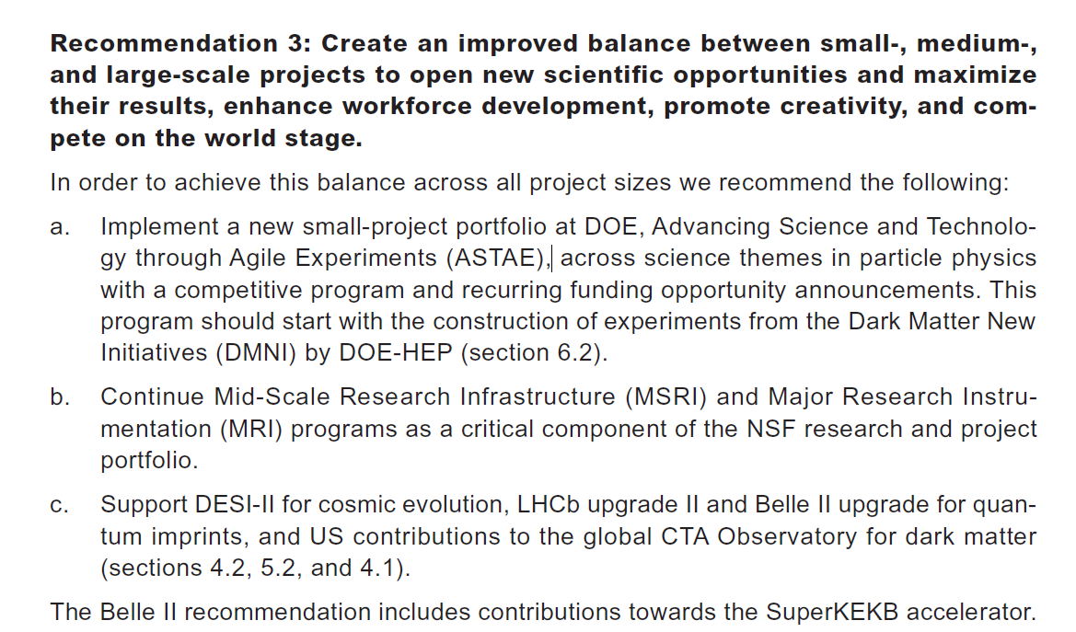
DPF PHENO 2024 panel: What is the ASTAE thing? (Sarah Eno)
n.b. DMNI are DOE Dark Matter New Initiatives based on Basic Research Needs (BRN) panel/report. (https://www.osti.gov/servlets/purl/1659757)

Slide 2
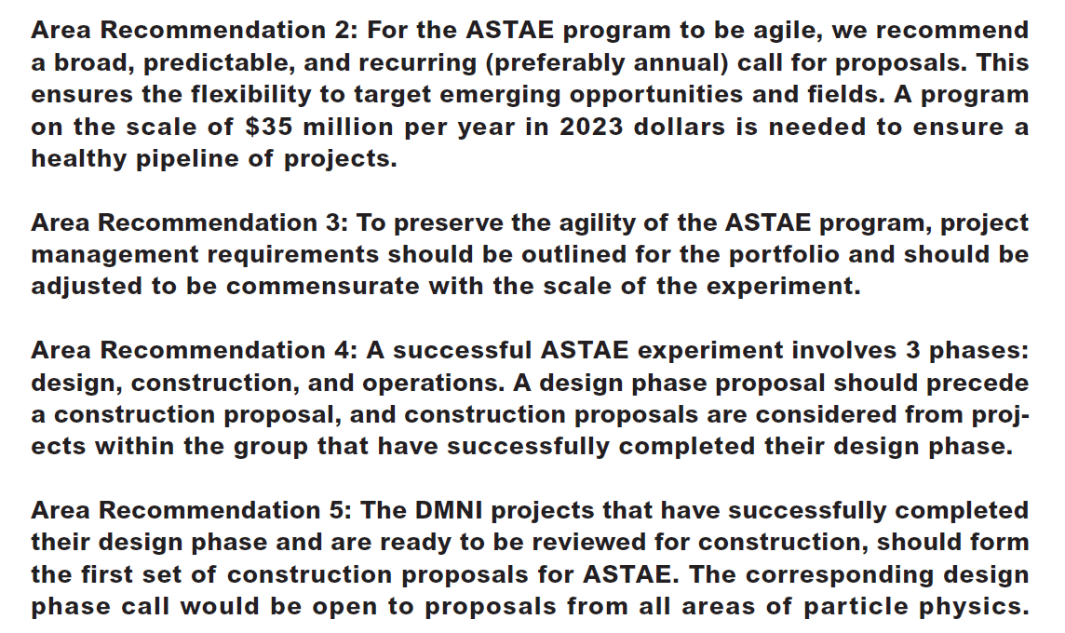

Slide 3
We are excited about ASTAE!
Here are some benefits we (and P5) have identified.
Filling in the gaps & making connections on different scales (time, size, range)
  Supports technology development
  Supports cross-frontier, cross-agency, international efforts
  Fills in holes for physics that has no home
  Allows fast response to new ideas
  Fully exploit existing facilities
Workforce development
  Experience across lifecycle of an experiment gives breadth of workforce education
  Provides leadership experiences
  Continuity of workforce development between big projects
Panelists will expand on these and pull out some examples

Slide 4
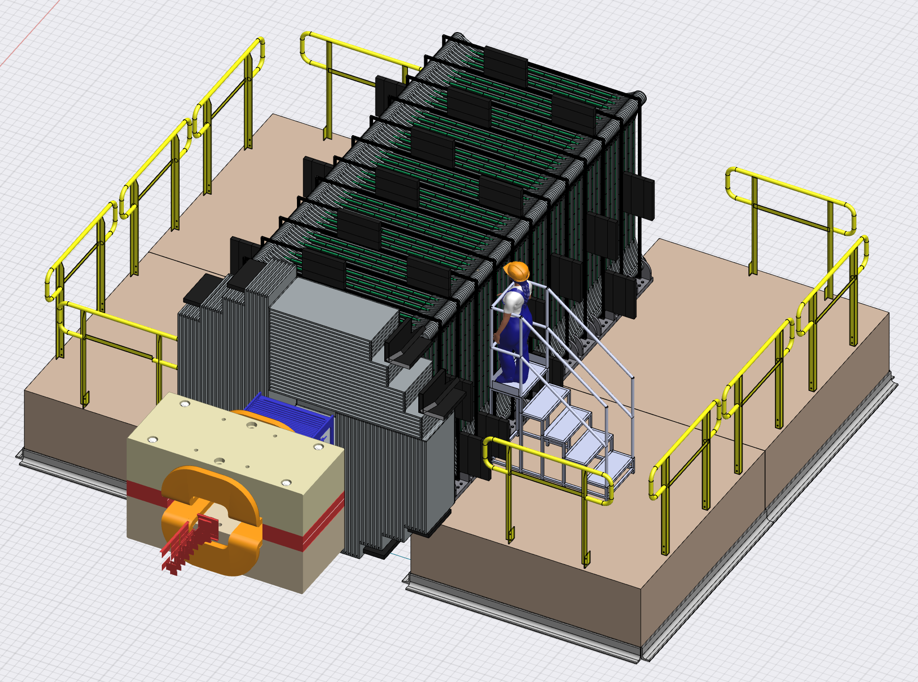
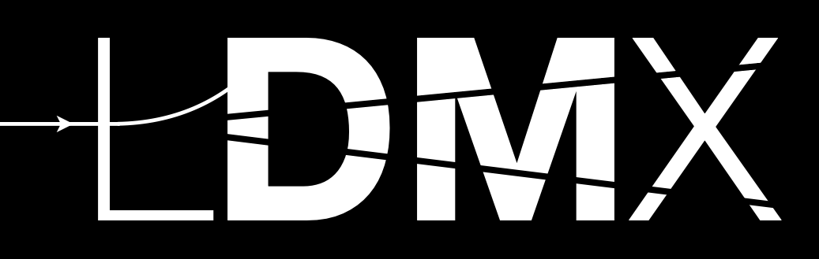
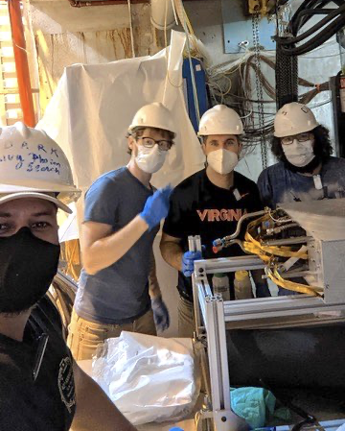
“What is the ASTAE Thing?”
Tim Nelson
Some highly motivated science goals require targeted small experiments.
  DMNI Example: Light Dark Matter eXperiment searches for sub-GeV dark matter, with sensitivity to fully explore couplings implied by observed relic abundance across the MeV-GeV mass range
LDMX, like many small experiments deploys technologies and techniques developed (or being developed) for large experiments (LCLS-II, CMS, Mu2e), leveraging major investments.
In addition, small experiments turn the clock back to a time when one could…
design, build, operate, analyze on one experiment as an early career researcher.
know the detailed workings of an entire experiment “from ionization to publication”.
lead a critical effort and be an important stakeholder as postdoc or student.
To enable small experiments to deliver these promises, ASTAE must…
Select small (cost+timescale) experiments with clear science impact
Provide consistent support and management needed to realize science in a timely way
There are some challenges in striking the right balance:
Science goals: wide open vs. topical by science driver (e.g. DMNI) or frontier?
Pipeline: breadth (size of portfolio) vs. cadence (timely implementation)
This forum presents an opportunity to hear current thinking from OHEP on key issues and elicit feedback from the community on ASTAE and small projects.
Postdocs and students installing HPS SVT

Slide 5

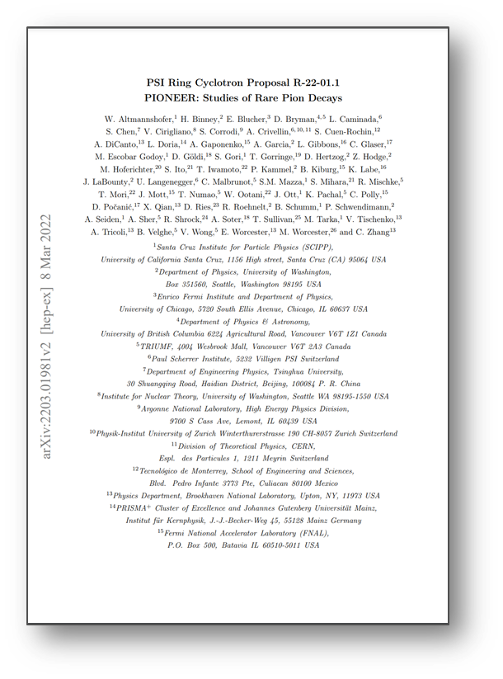
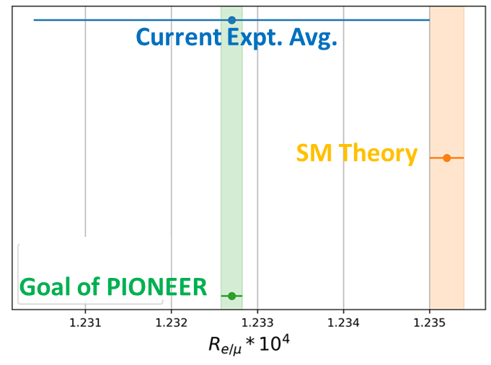
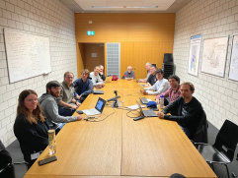
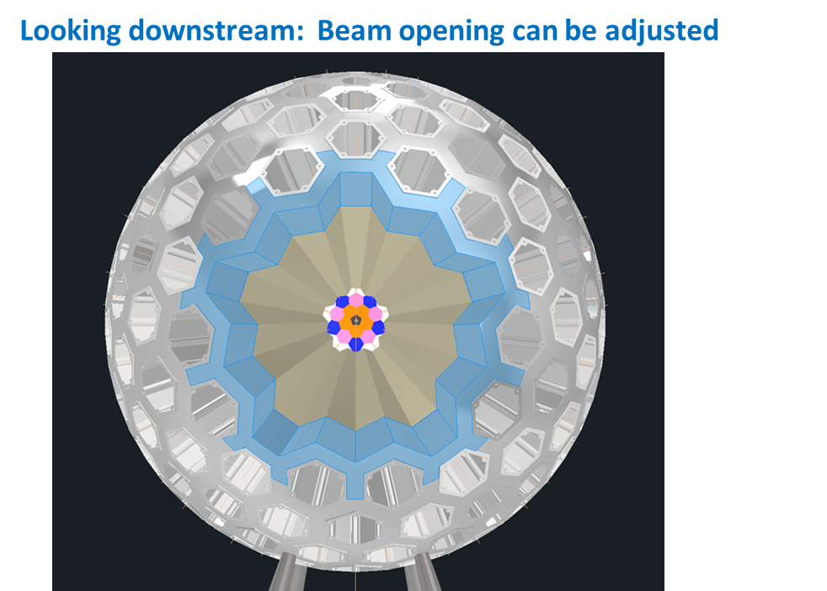
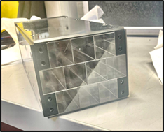
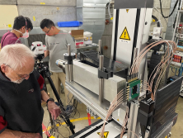
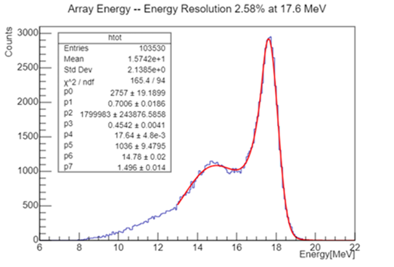









Support needed for the Life Cycle of new “small” initiatives in the context of ASTAE, David Hertzog
(I helped launch: MuLan, Muon g-2, Pioneer)
A Physics Idea* (perhaps, ideally approved by a lab)
Pre-ASTAE Stage needs:
  R&D seed funding to develop prototypes
  Personnel support of students/postdocs
  LDRD support for National Labs
  Travel for test beams
ASTAE Stage support**
  Mature design, large prototypes; engineering
  Project funding
Coordination among Agencies can be tricky
  DOE HEP & NP & NSF groups
  Negotiating US share with International partners
*Some kind of external “endorsement” required (PAC, or panel)
**1 or 2 rounds here depending on scale of Project
Pioneer: e-Print: 2203.01981

Slide 6
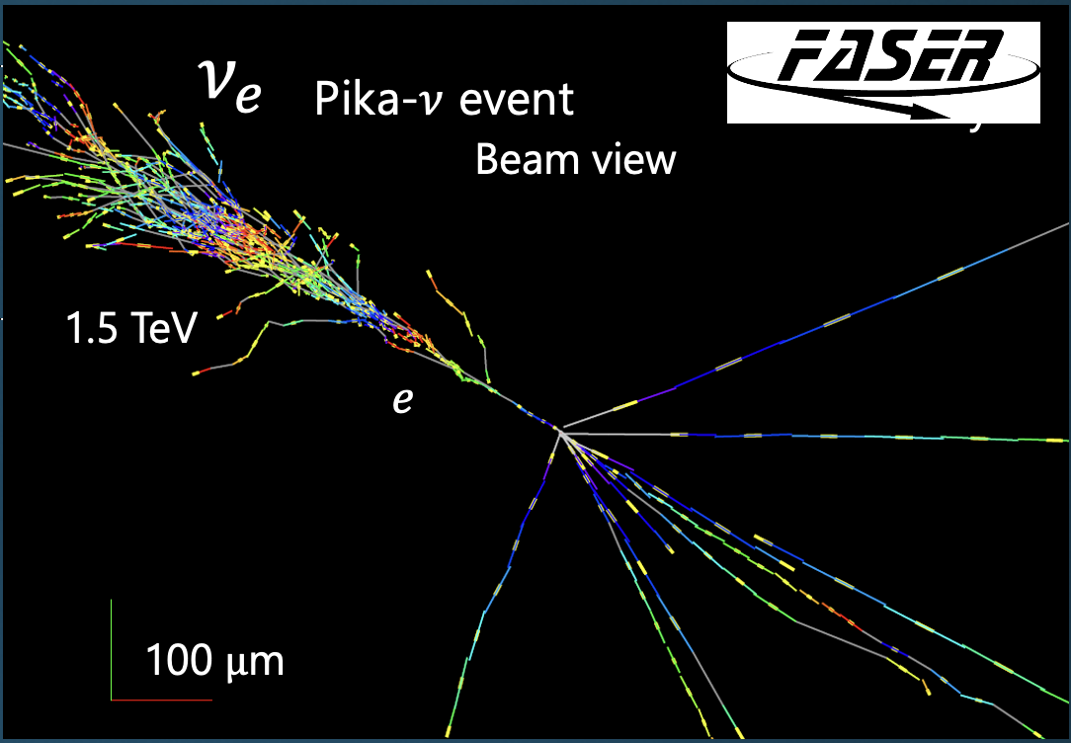
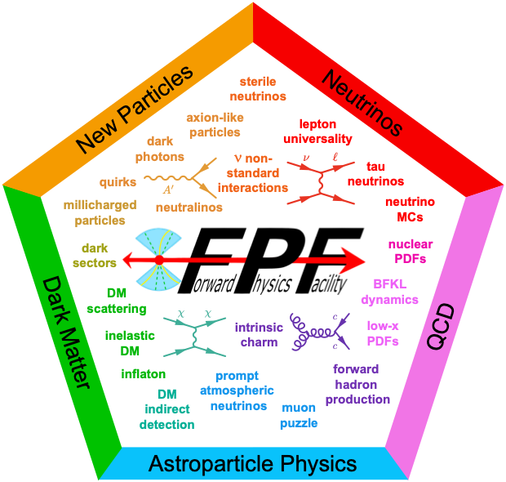
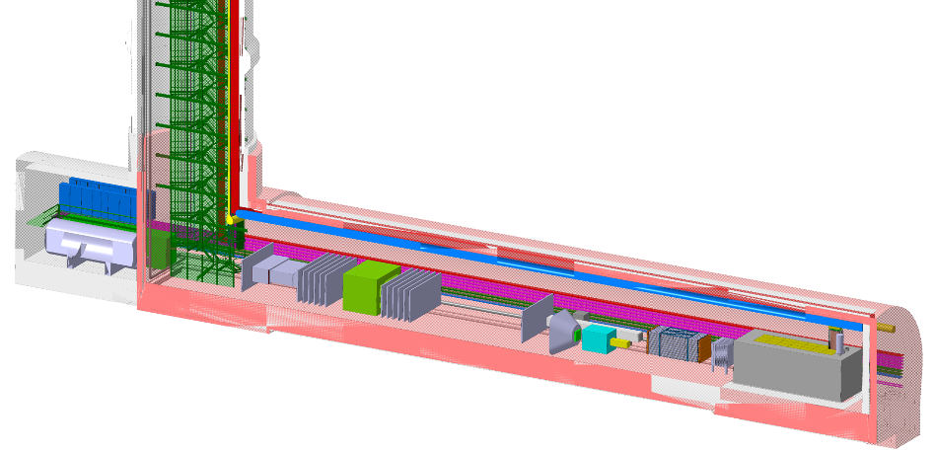
How can ASTAE be used to improve our field? Jonathan Feng
We have recently opened a new window on physics at the high energy frontier; ASTAE could be used to allow us to look through it.
2023: First direct detection of collider neutrinos: a new source (at TeV energies!), following reactors, acceler, solar, atm, SN,…what will we learn?
2029- : Forward Physics Facility @ HL-LHC: small, fast, ASTAE experiments will allow us to see millions of TeV neutrinos, search for BSM physics, enhance prospects for discovery at ATLAS, CMS, IceCube, …
Lessons from FASER:
– Small, cheap experiments can greatly (and quickly) enhance the physics potential of existing large investments;
– Construction to analysis in 1 grad student lifetime
– Provides continuity between large projects (e.g., between HL-LHC upgrades and future colliders)
– Develops future leaders of our field

Slide 7
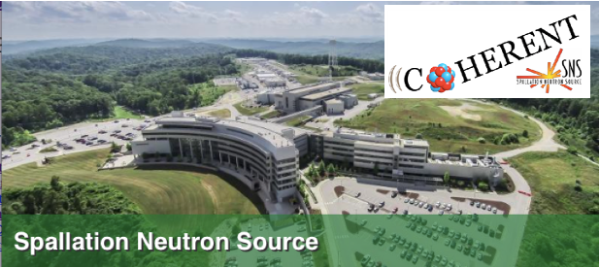
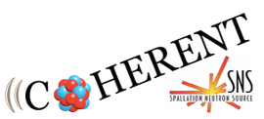
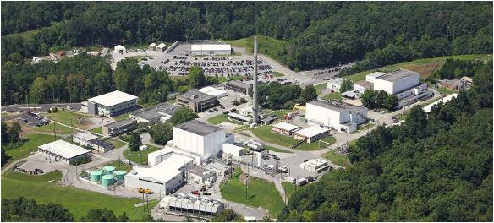

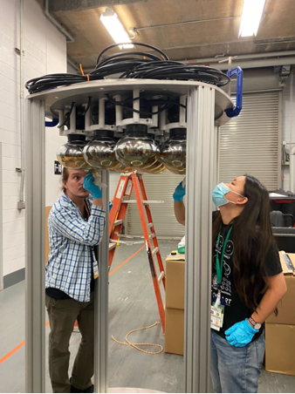
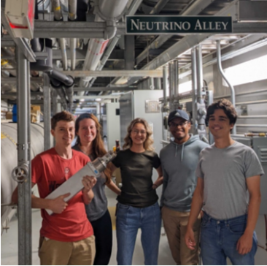
How can ASTAE be used to improve our field? Kate Scholberg
Support efforts that have
multiple homes or no home:
Physics that “falls between the cracks":
between physics frontiers (IF-CF),
between agencies (e.g. HEP-NP)
between fields (particle-nuclear-astro, …)
Optimize use of existing facilities
Broad training: Students and postdocs get to
experience the whole experimental life cycle,
and take leadership roles
Design, simulation, R&D
Construction & commissioning (hands on!)
Data analysis

Slide 8
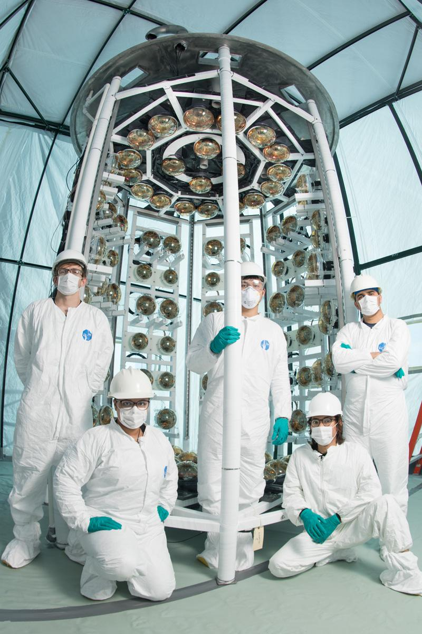
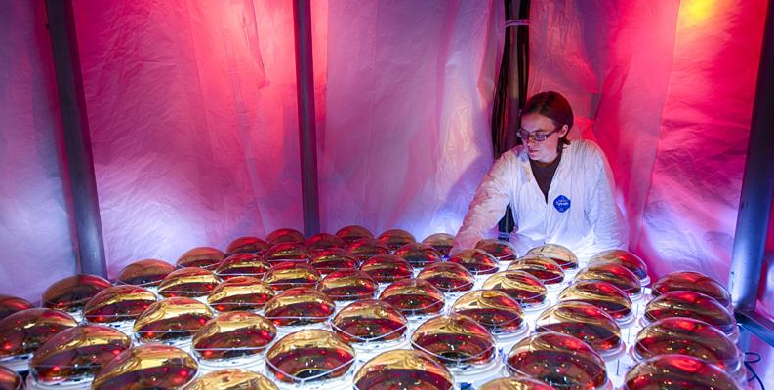
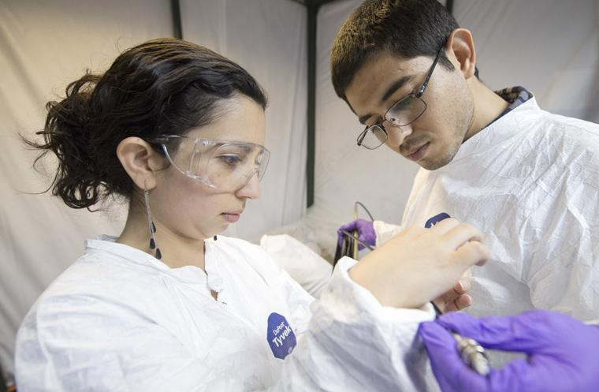
How can ASTAE be used to improve our field? Mayly Sanchez
It’s about the PEOPLE!
Essential hands-on training through the life cycle of an experiment: design, construction, installation, commissioning, data taking and analysis.
Neutrinos experiments like ANNIE, EMPHATIC, COHERENT have a high fraction of students and postdocs moving on to laboratory staff and faculty positions.
A predictable funding stream for a diverse portfolio of experiments provides opportunities for junior scientists to take on ownership and leadership of new ideas carrying them to fruition.

Slide 9
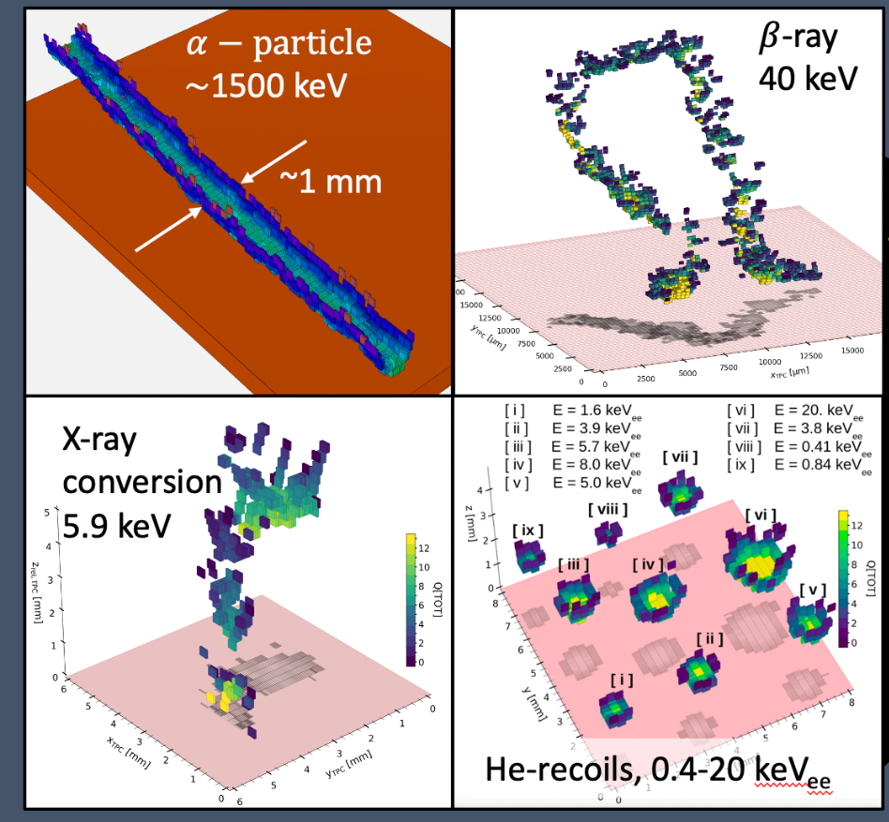
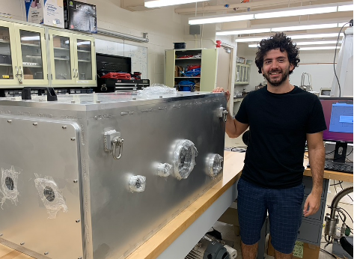
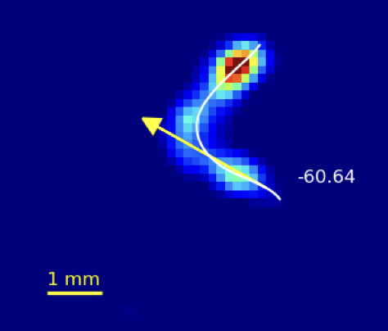
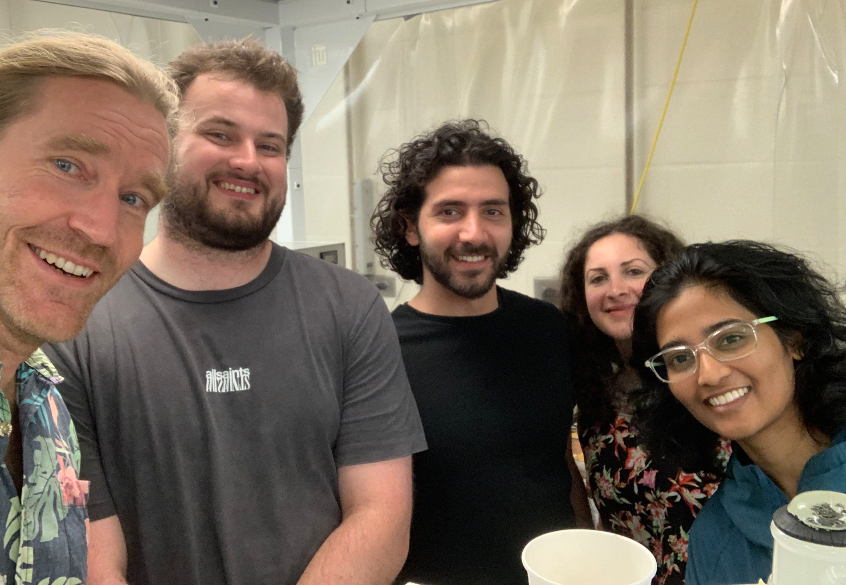
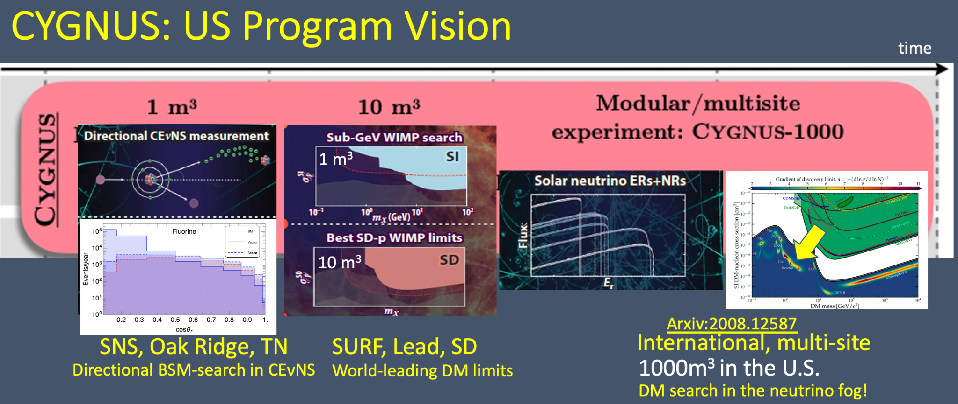
How can ASTAE be used to improve our field? Sven Vahsen
Technology: smaller experiments play vital role
Hands-on training of new detector R&D experts
Revitalize specialized tech workforce and capabilities
Incubators/pathfinders for new technologies that will eventually have much wider and larger applications
Example: advanced gaseous detectors
Required in virtually all HEP and NP experiments for
ionization detection in large volumes w/ low scattering
Lacking US investigators and manufacturing!
Science: ASTAE can enable groundbreaking new
experiments with multiple homes or no home
Example: CYGNUS Experiment
Advance ionization detection to the sensitivity limit
3D single-electron-counting in m³ volumes
30 eV threshold, room temperature operation
Comparable capabilities do not exist
Transformative for MIGDAL, CEvNS, DM ++
5.9 keV electron recoil
1-10 m³
10 m³

Slide 10
We are very excited about ASTAE!
What’s the optimum way to configure it to achieve the goals?
Should calls organized by Frontier or topic (like DMNI)?
Or should it be open to all areas? (recommended by P5 post DMNI first construction: "The corresponding design phase call would be open to proposals from all areas of particle physics. “ )
  Pros and Cons of an “open” call?
Or a combination of open and focused?
  Rotations among areas?
Require some “beyond focus” areas?
“Over time, this portfolio should maintain a balance of experiments across the science driver focus areas. The possibility of projects that push beyond these focus areas should be left open for compelling scientific or technological cases. The projects should be reviewed for their potential for discovery, technology innovation, and ability to provide critical inputs to the success of the greater HEP mission.”
How should ASTAE funding level scale with overall HEP program funding?
Notes:
Multiple outcomes imagined for different needs? [DH] KS: not sure what is meant?

Slide 11
A word from DOE: Mike Procario

Slide 12
Feeder questions
How can DOE-HEP and DOE-NP and NSF work together to fund small experiments that have mutual interest?
How can DOE establish some R&D to develop new ideas for small efforts?
What is the “just-right” mix of projects for the ASTAE portfolio?
In the case of a wide open call, how does one convene a panel capable of reviewing and prioritizing projects covering a vast range of science topics to choose only one per year? Similarly, how does one ensure that all of the best ideas for addressing a particular focus area are being compared to each proposal of a wide open call?
In the case of focused calls, how does one choose/order the calls to focus areas?
A disadvantage of agility is being more easily set aside than larger projects when there is budget stress. What guardrails will protect the ASTAE pipeline?
How will ASTAE prioritize and manage international partnerships? (DMNI FOA stated that projects were expected to be >75% DOE-funded.)
How does one balance/prioritize the “S” (science) vs. the “T” (technology)
How should the project management scale with size of the project?

