Slide 1



THE FALL AND RISE OF
FORWARD PHYSICS
Physics and Astronomy Colloquium, UC Davis
Jonathan Feng, UC Irvine, 21 April 2025

Slide 2
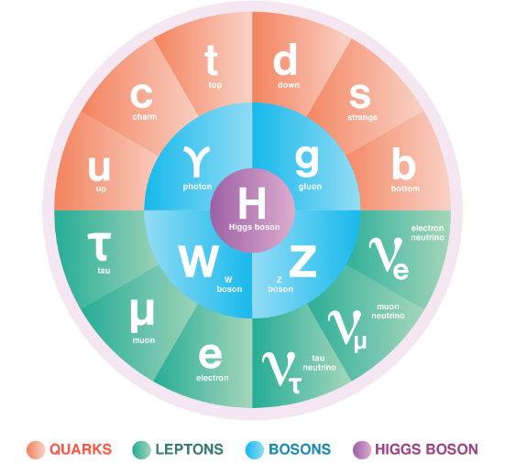
THE STANDARD MODEL OF PARTICLE PHYSICS
The Standard Model is the reigning theory of fundamental particles and their interactions. The last particle predicted by the SM, the Higgs boson, was discovered at CERN in 2012.
But the SM is not the last word, because many fundamental questions remain. For example:
  Neutrino Masses: the SM predicts that neutrinos are massless, but they aren’t.
  Dark Matter: The particles of the SM make up only ~15% of the matter in the universe.
These questions imply that there are more particles left to discover, and probably many more.

Slide 3


THE LARGE HADRON COLLIDER
.
FASER
Particle colliders have been key to progress for many decades. The state of the art is currently the LHC, which collides protons with protons at a center-of-mass energy of 13.6 TeV (v $≈$ 0.9999999905 c).
Notes:
3

Slide 4

LHC DETECTORS
The protons collide at 4 points, and each point is surrounded by a large detector to view the results of the collisions. These detectors cost billions of dollars and were constructed over decades by thousands of collaborators.
The ATLAS Detector
Notes:
4

Slide 5
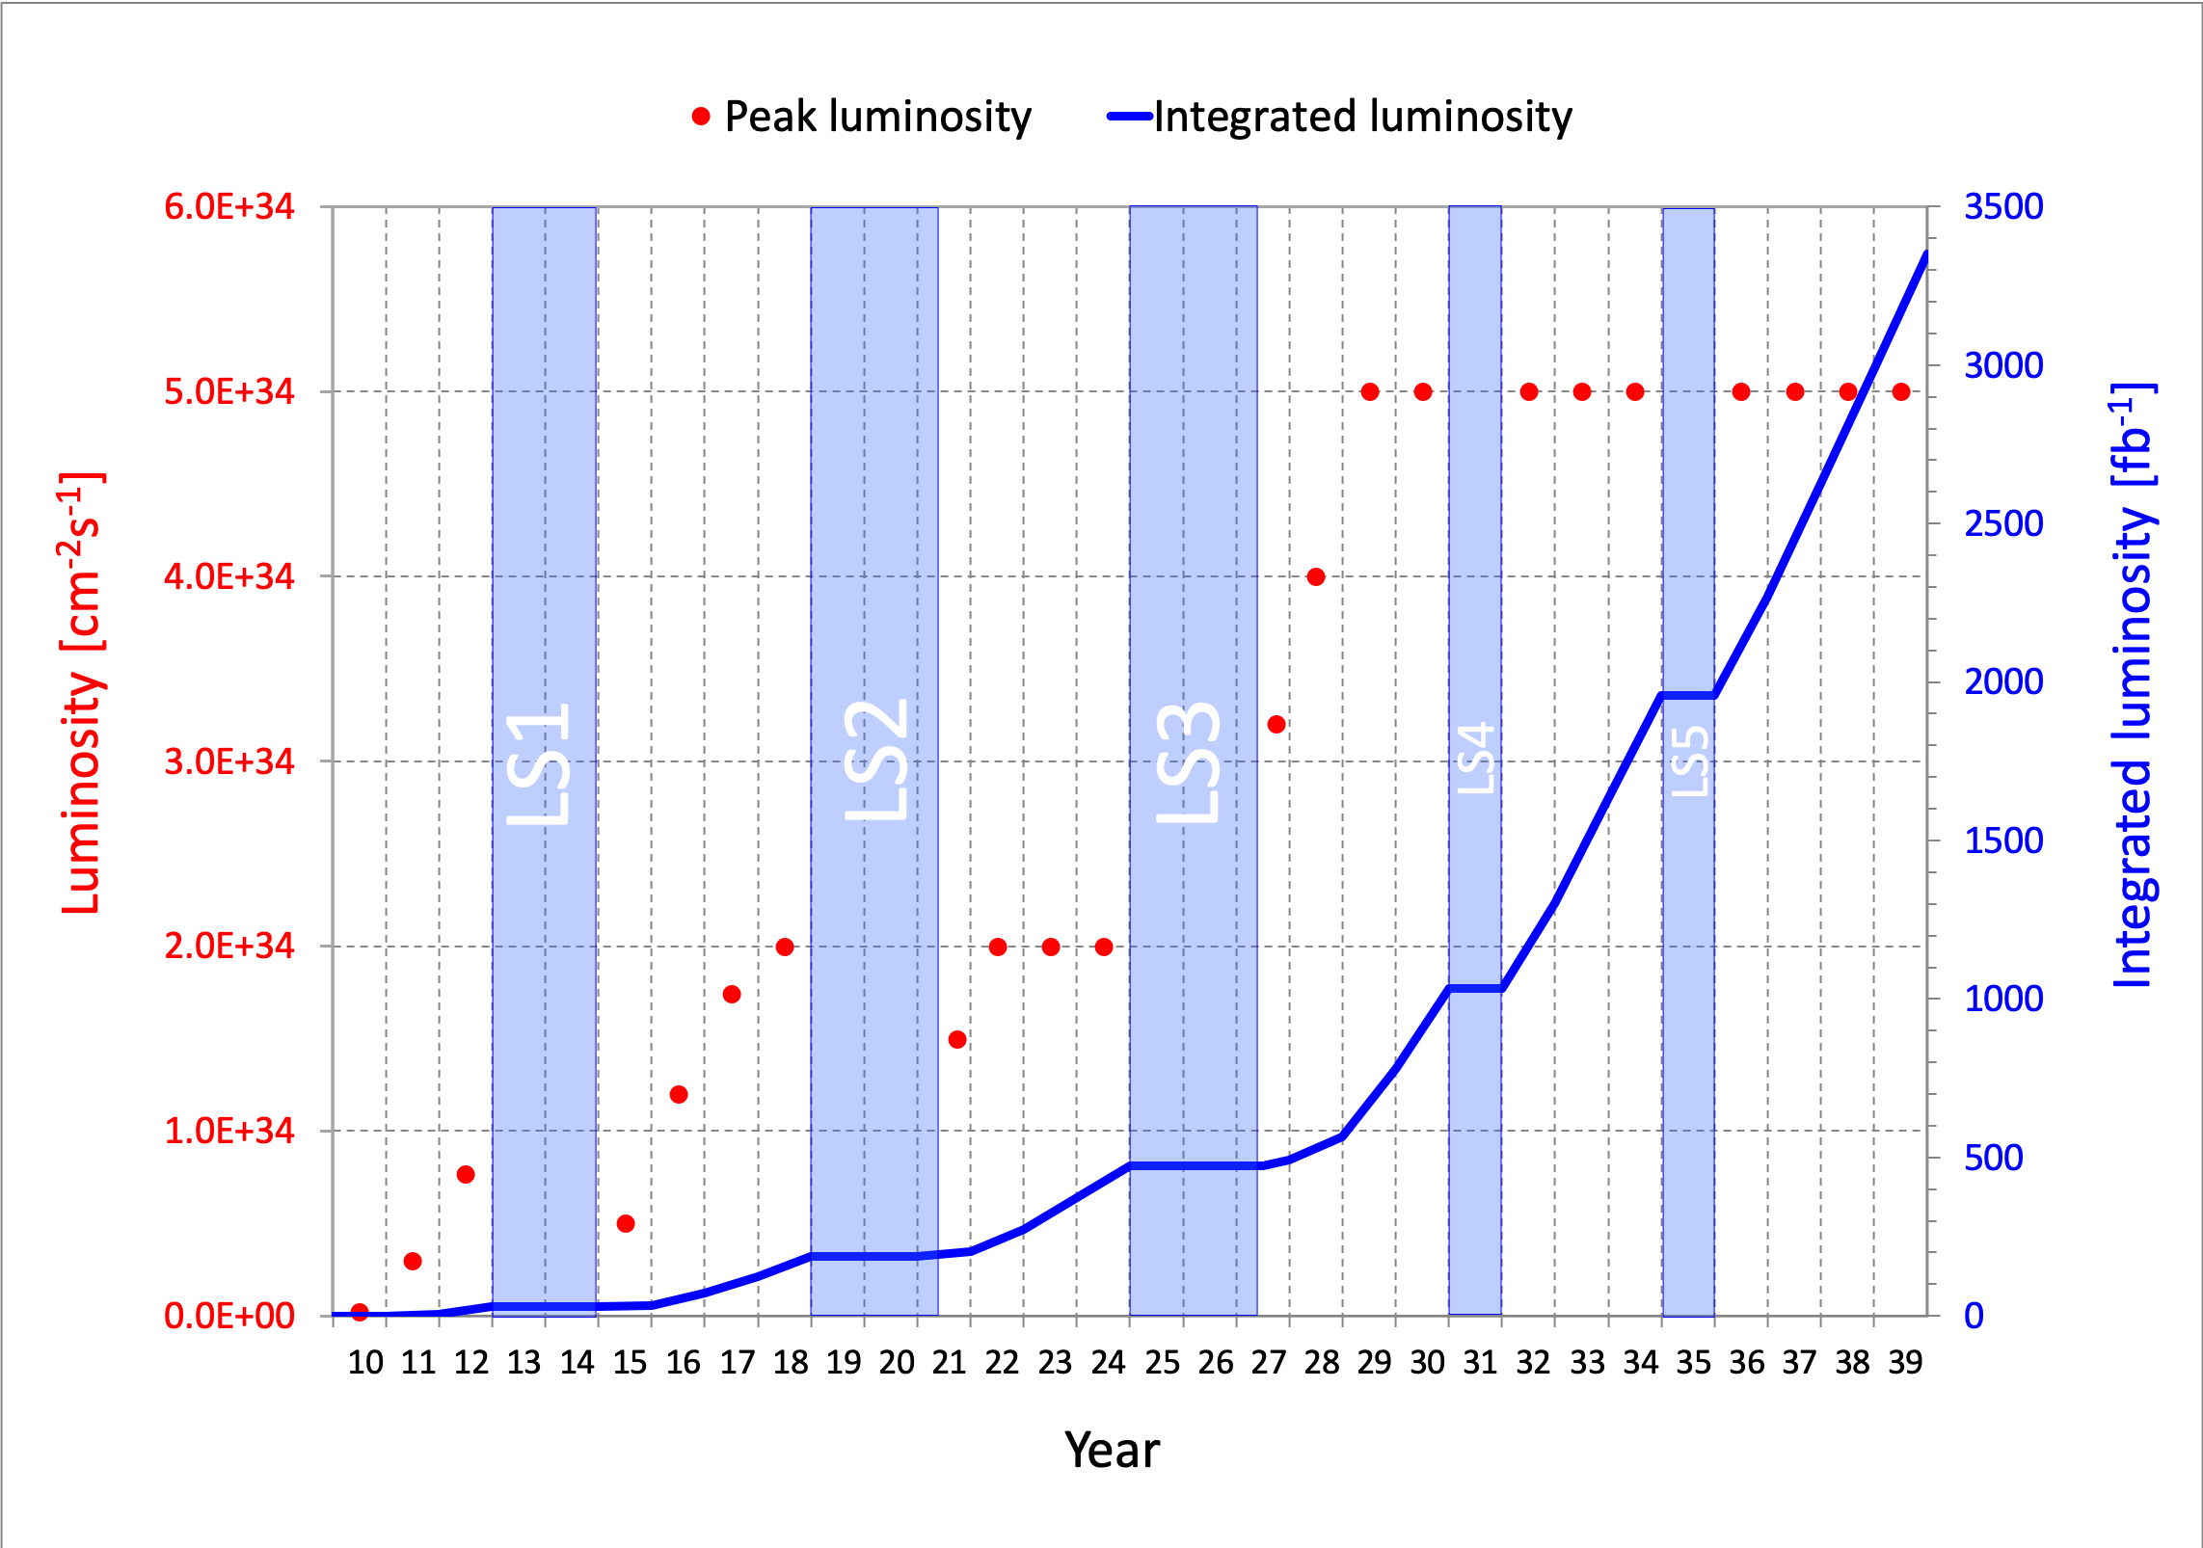
LIFETIME OF THE LHC
The LHC became the future of particle colliders in 1993 when the US canceled the SSC, which was being built in Texas.
The LHC started running in 2010 and is scheduled to run until the 2040s.
  Middle-aged in terms of years
  But a 4th grader in terms of integrated luminosity
Are we using the LHC to its full potential? What can we do to enhance its discovery prospects?
COVID

Slide 6
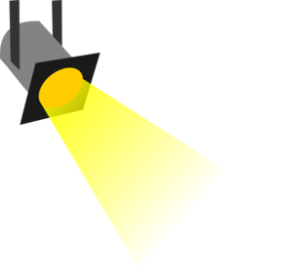
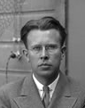
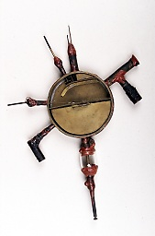
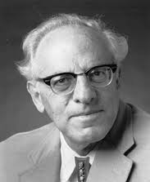





















THE NEW PARTICLE LANDSCAPE
Particle
Colliders
Mass
MeV
GeV
TeV
1
$$←$$
$$g$$
$$u$$
$$d$$
$$s$$
$$p$$
$$n$$
$$c$$
$$b$$
$$t$$
$$←$$
$$γ$$
$$e$$
$$μ$$
$$τ$$
$$W$$
$$Z$$
$$h$$
Already
Discovered
Strongly Interacting
Heavy Particles
Interaction Strength
10⁻³
$$ν_{e}$$
$$ν_{μ}$$
$$ν_{τ}$$
$$←$$
Weakly Interacting
Light Particles
Impossible to
Discover
10⁻⁶

Slide 7
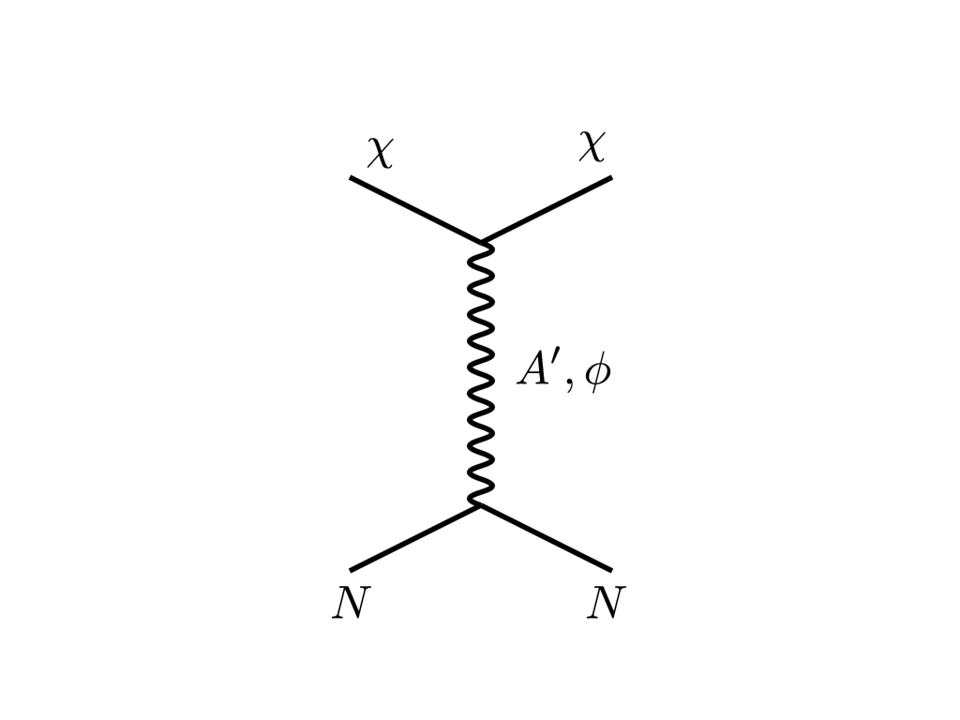



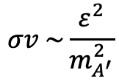


THE DARK MATTER LANDSCAPE
Particle
Colliders
Mass
MeV
GeV
TeV
1
Already
Discovered
Strongly Interacting
Heavy Particles
Too Little to be
Dark Matter
DM
$$e$$
$$ε$$
$$ε$$
Interaction Strength
Just Right to
be Dark Matter
10⁻³
$$A′$$
$$e$$
DM
$$σv \sim \frac{ε^{2}}{m_{A^{′}}^{2}}$$
Weakly Interacting
Light Particles
Impossible to
Discover
10⁻⁶
Too Much to be
Dark Matter
Boehm, Fayet (2003)
Pospelov, Ritz, Voloshin (2007)
Feng, Kumar (2008)

Slide 8

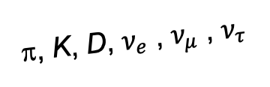
FORWARD PHYSICS
In 2017, we realized that the large LHC detectors, while beautifully optimized to discover new heavy particles, are also almost optimally configured to miss new light particles.
Heavy particles (W, Z, t, h, …) are produced at low velocity and decay roughly isotropically to other particles.
But high-energy light particles are dominantly produced in the forward direction and escape through the blind spots of these large detectors.
  This is true for all known light particles: pions, kaons, D mesons, all neutrinos.
  It is also true for many proposed new particles, especially those motivated by neutrino mass and dark matter.
These blind spots are the Achilles heels of the large LHC detectors.
Feng, Galon, Kling, Trojanowski (2017)
A’, a, mCPs, χ, …
π, K, D, $ν_{e}$ , $ν_{μ}$ , $ν_{τ}$
De Rujula, Ruckl (1984)

Slide 9
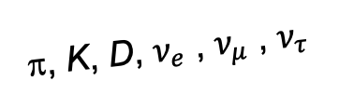
DETECTING FORWARD PARTICLES
To capture the enormous forward flux, we need to detect particles that are produced in the forward direction along the beamline.
Problem: we can’t just put the detector there, because it will block the protons from coming in.
Solution: the LHC is a circular collider! If we go far enough away, the LHC proton beam will be bent away, while all the light, weakly-interacting particles we are looking for will go straight.
A’, a, mCPs, χ, …
π, K, D, $ν_{e}$ , $ν_{μ}$ , $ν_{τ}$

Slide 10
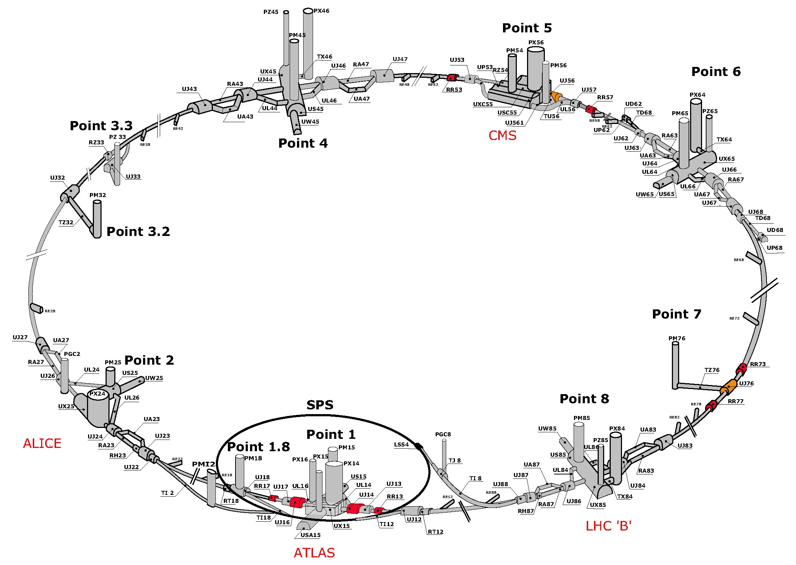
MAP OF LHC

Slide 11
MAP OF LHC
!!!

Slide 12
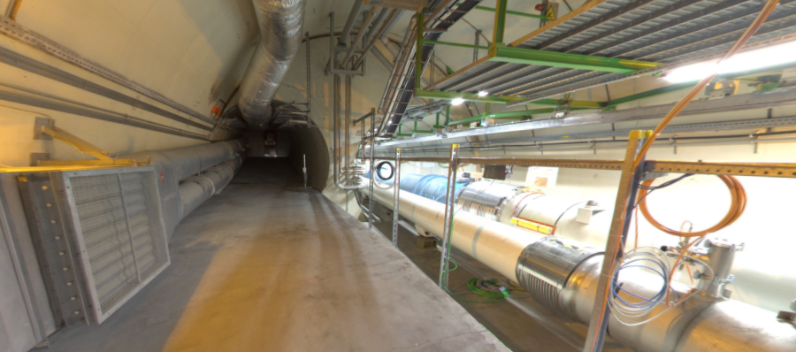
THE FORWARD REGION
Beam collision axis passes
through 100 m of rock, emerges in tunnel TI12, 480 m from ATLAS
UJ12
TI12 near UJ12
The view in UJ12 looking west in 2018
TI12
Beam collision axis:
dark matter, new particles could be streaming through this tunnel!
LHC beamline

Slide 13
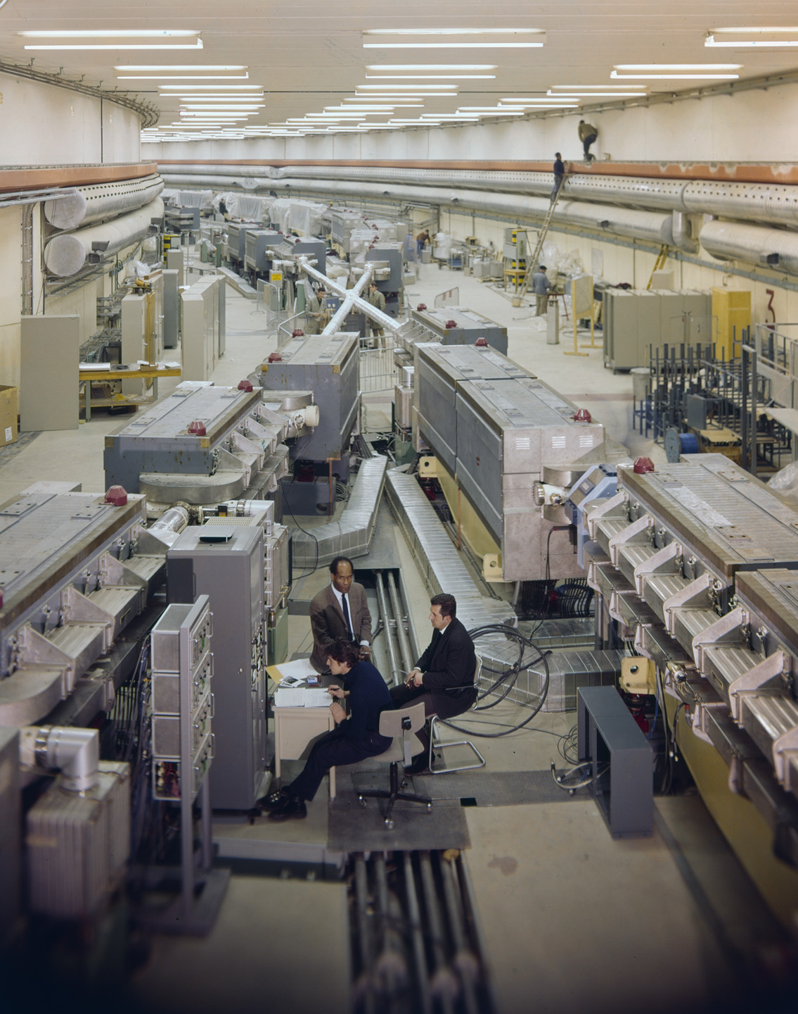
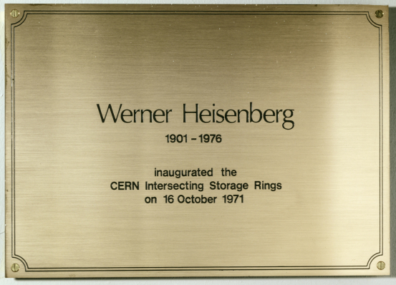
HISTORY: THE FALL OF FORWARD PHYSICS
Is it really possible that a collider is making new particles, and we are missing them simply because we are looking in the wrong place?
Yes. In fact, it happened before at CERN.
In 1971, the first hadron collider, CERN’s Intersecting Storage Rings (ISR), began operation.
It had a circumference of ~1 km, collided protons with protons at center-of-mass energy 30 GeV.

Slide 14

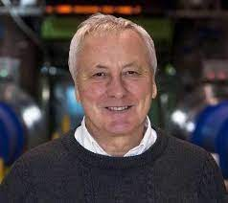
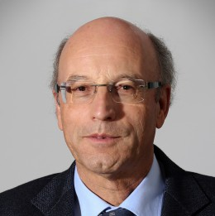
HISTORY: THE FALL OF FORWARD PHYSICS
During the ISR’s 50th anniversary, there were many fascinating articles and talks by eminent physicists
  “Enormous impact on accelerator physics, but sadly little effect on particle physics.” – Steve Myers, talk at “The 50th Anniversary of Hadron Colliders at CERN,” October 2021.
  “There was initially a broad belief that physics action would be in the forward directions at a hadron collider…. It is easy to say after the fact, still with regrets, that with an earlier availability of more complete… experiments at the ISR, CERN would not have been left as a spectator during the famous November revolution of 1974 with the J/ψ discoveries at Brookhaven and SLAC .” – Lyn Evans and Peter Jenni, “Discovery Machines,” CERN Courier (2021).
Bottom line: The collider was creating charm quarks, but, based on theoretical prejudice, experimentalists focused on the forward region and so missed them.
Since that time, forward physics at colliders has been almost completely ignored for new particle searches.
But are we making the same mistake now (in reverse)? And could there be another November revolution waiting for us in the forward direction?

Slide 15


Slide 16
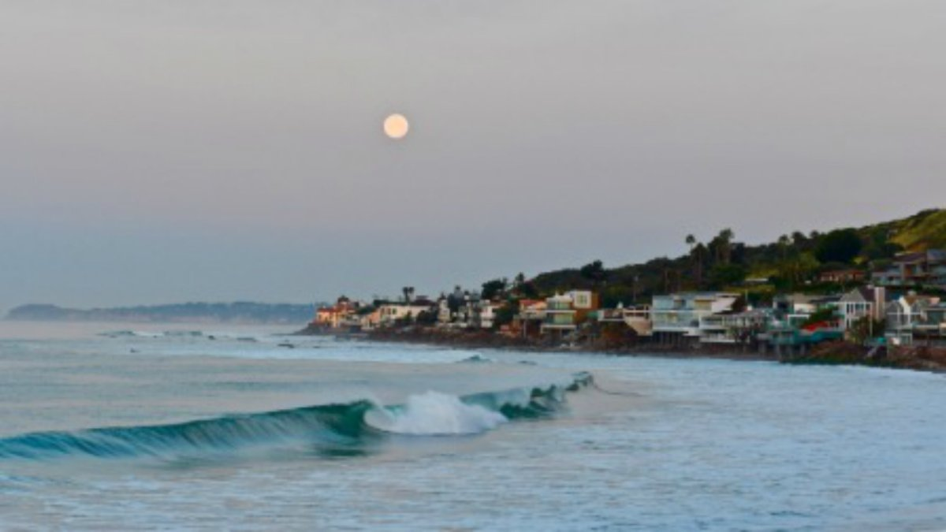
HOW BIG DOES THE DETECTOR HAVE TO BE?
Momentum:
Space:
250 MeV
1 TeV
12 cm
480 m
The opening angle is 0.2 mrad (the moon is 7 mrad). Even 480 m away, most of the signal passes through an 8.5” x 11” (A4) sheet of paper.
Neutrinos and many new particles are therefore much more collimated than shown below, motivating a relatively small, fast, and inexpensive experiment at the LHC: the ForwArd Search ExpeRiment (FASER).

Slide 17
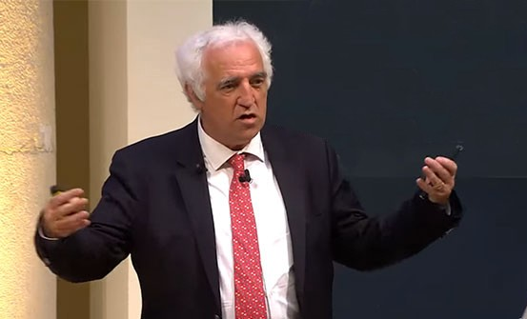
INITIAL REACTION
FASER was initially proposed in a paper I wrote with 3 fantastic postdocs at UCI in August 2017.
In November 2017, I gave a talk at the ICFA Seminar, the triennial gathering of the world’s lab directors. At a coffee break, I asked Freddy Bordry, then CERN’s Director for Accelerators and Technology, what he thought.
His response?
You must be joking

Slide 18
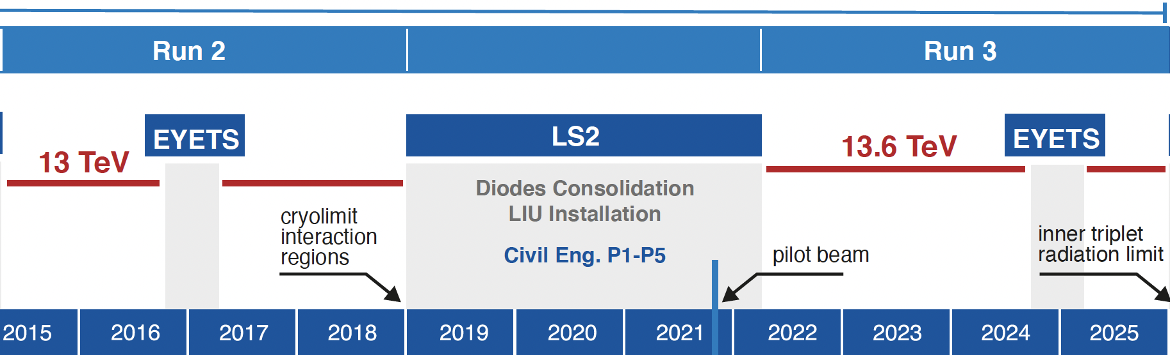
FASER AND FASERν TIMELINE
LOI submitted to CERN LHCC
FASER fully constructed and installed
FASERν fully constructed and installed
FASER announces first physics results
Technical Proposal submitted to CERN LHCC
FASER approved as 8th LHC detector by CERN
Concept paper: Feng, Galon, Kling, Trojanowski
FASERν approved as 9th LHC detector by CERN
FASER and FASERν begin collecting data in Run 3
FASER and FASERν announce more physics results
Funding from Heising-Simons and Simons Foundations
FASER and FASERν announce more physics results
Spare detector parts from ATLAS and LHCb Collaborations

Slide 19
















FASER COLLABORATION
107 collaborators, 27 institutions, 11 countries
International laboratory covered by a cooperation agreement with CERN

Slide 20
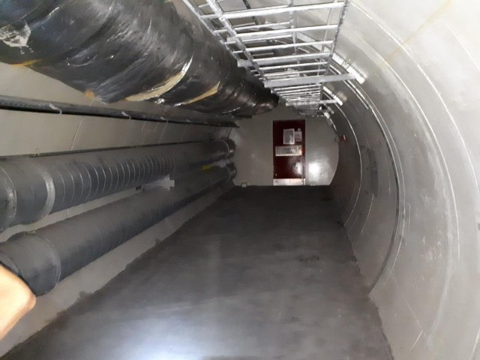
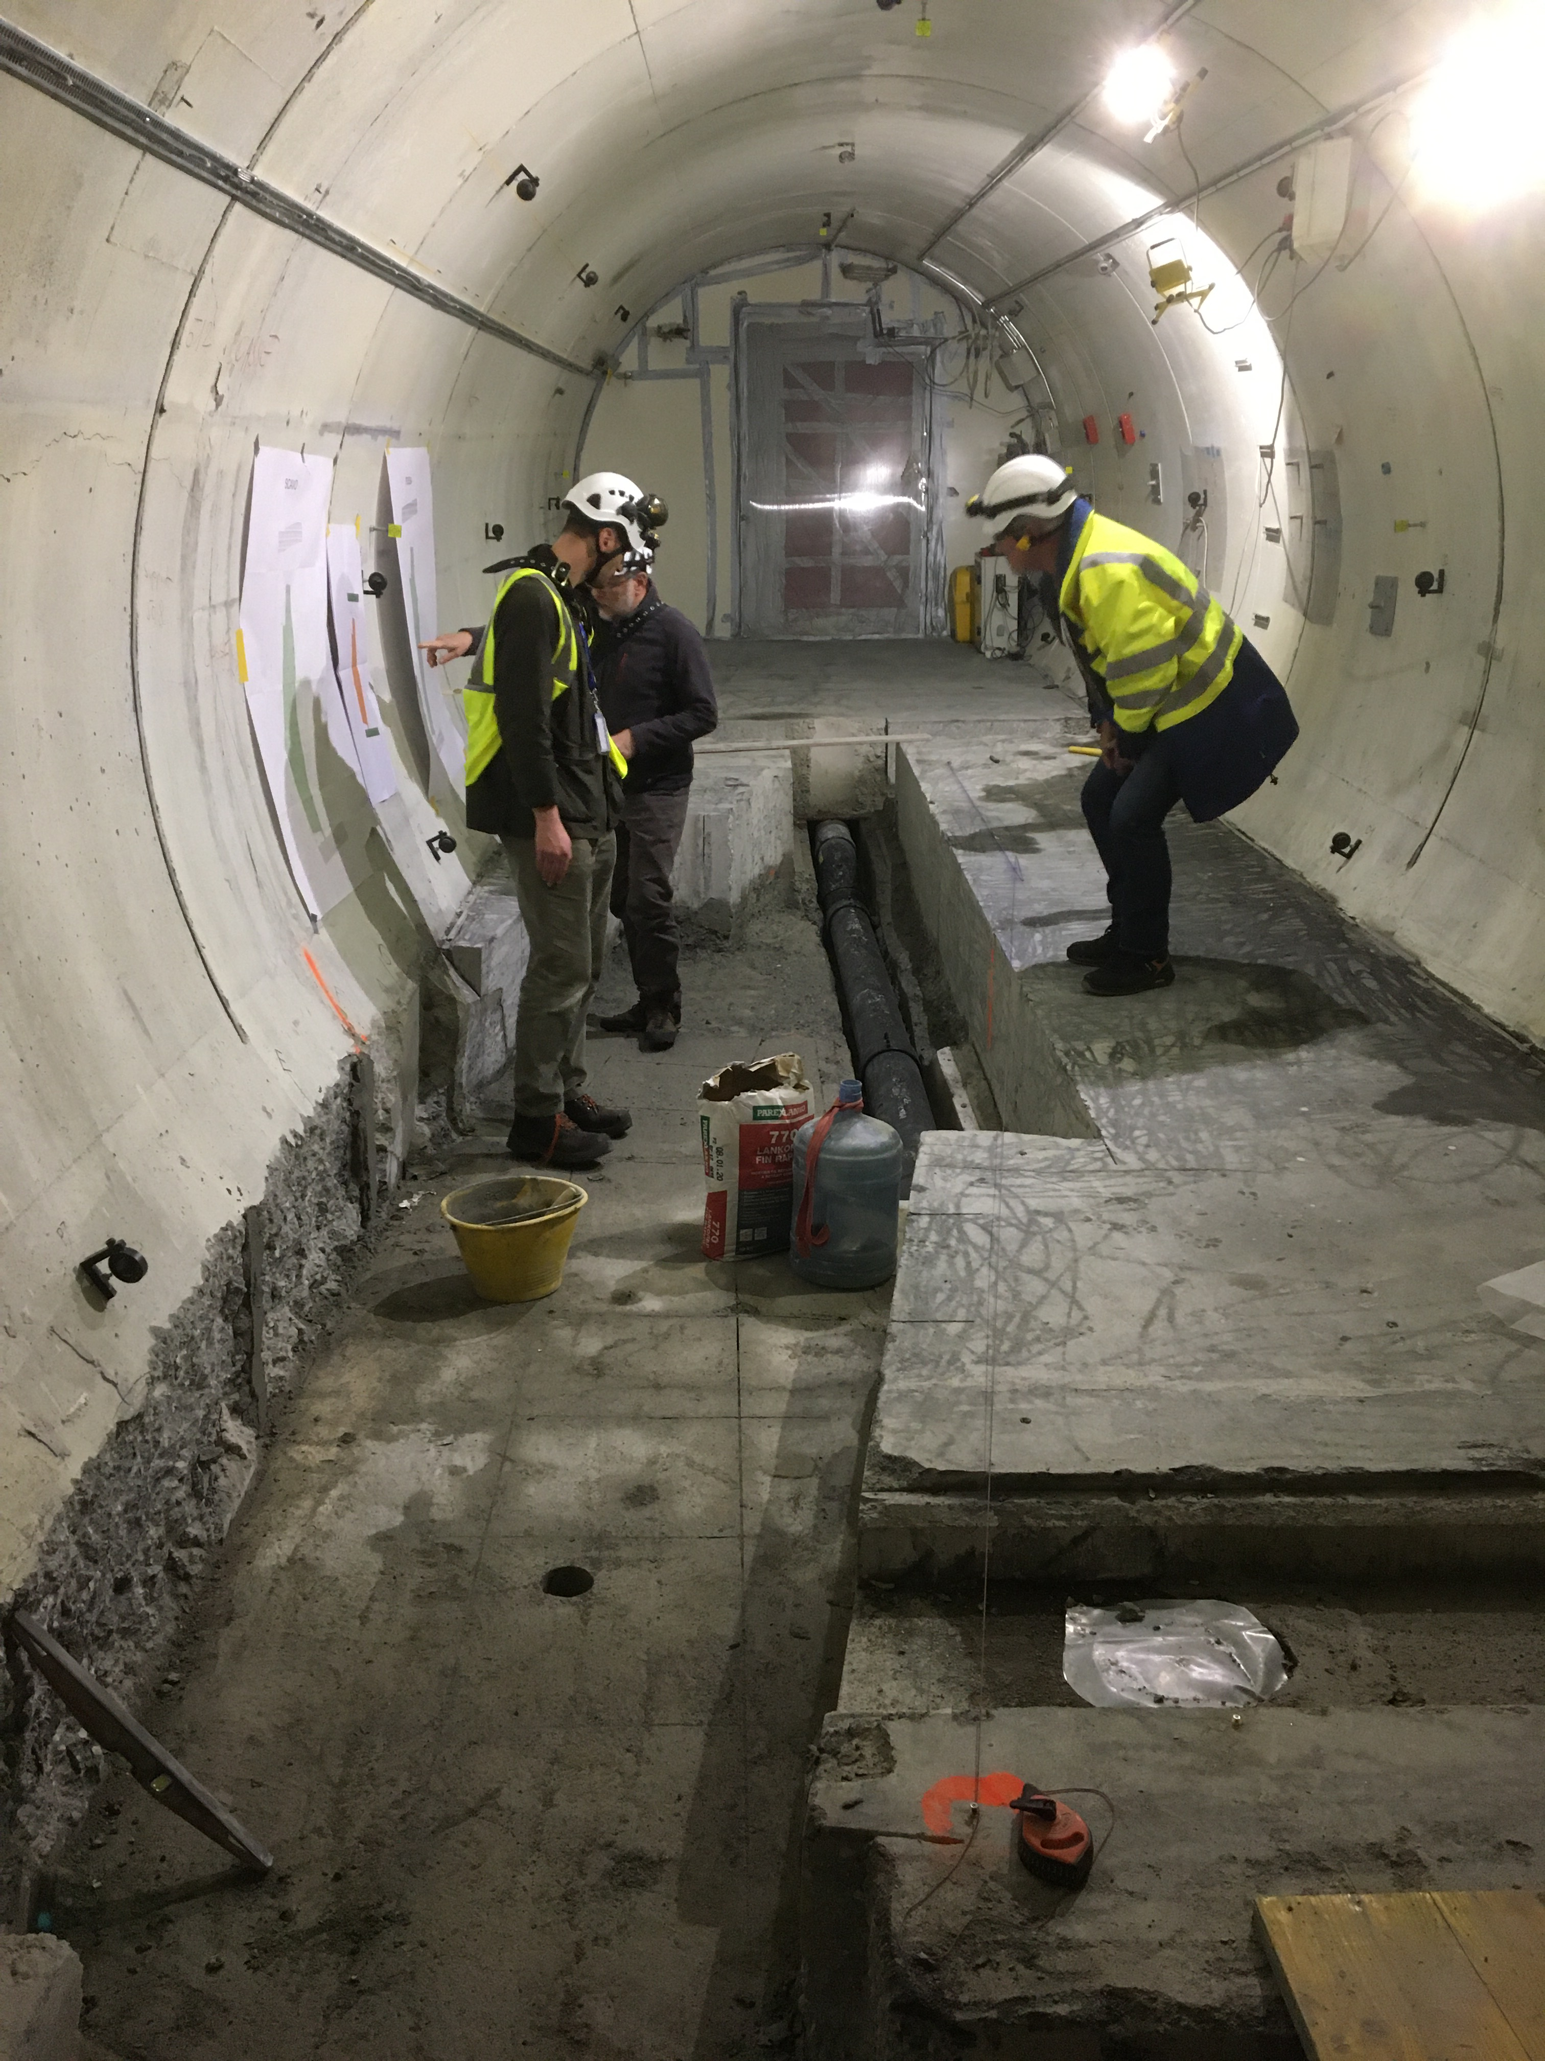
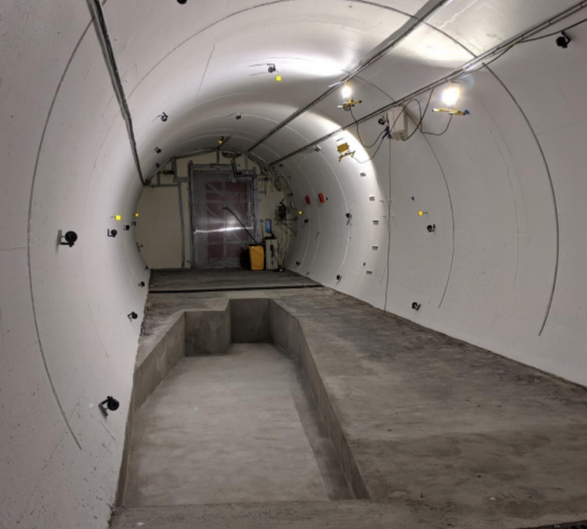
PREPARATION OF THE FASER LOCATION
The nominal beam collision axis was located to mm accuracy by the CERN survey department. (In fact, it moves around by several cm, depending on the beam crossing angle and orientation.) To place FASER on this axis, a trench was required to lower the floor by 46 cm.
The trench was completed by an Italian firm just hours before COVID shut down CERN in March 2020.
2019
Spring 2020
Summer 2020

Slide 21
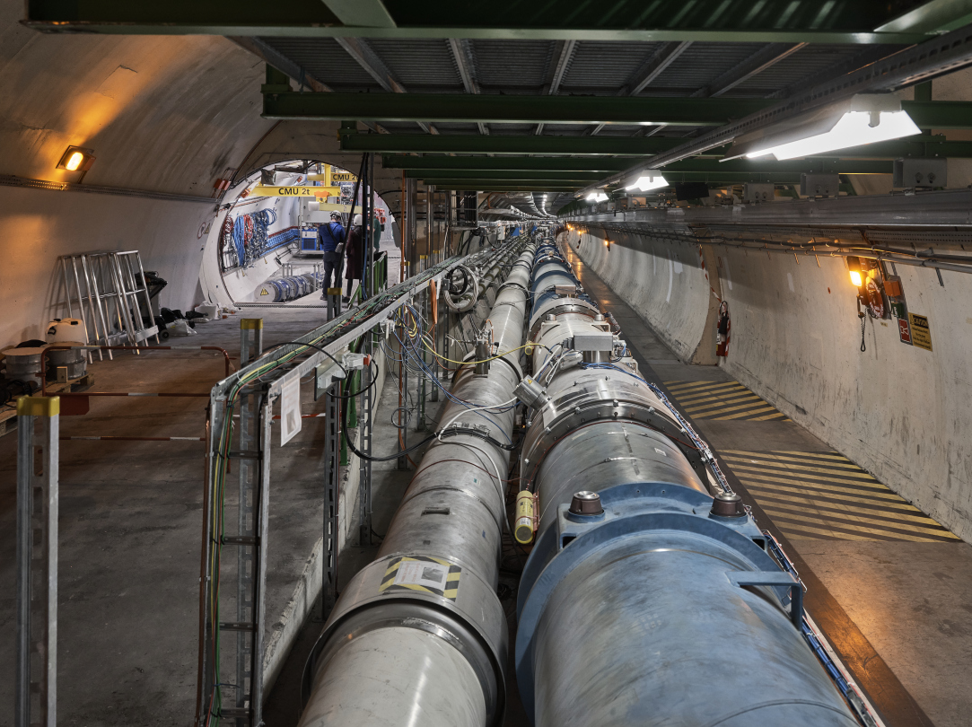
FASER AND THE LHC

Slide 22
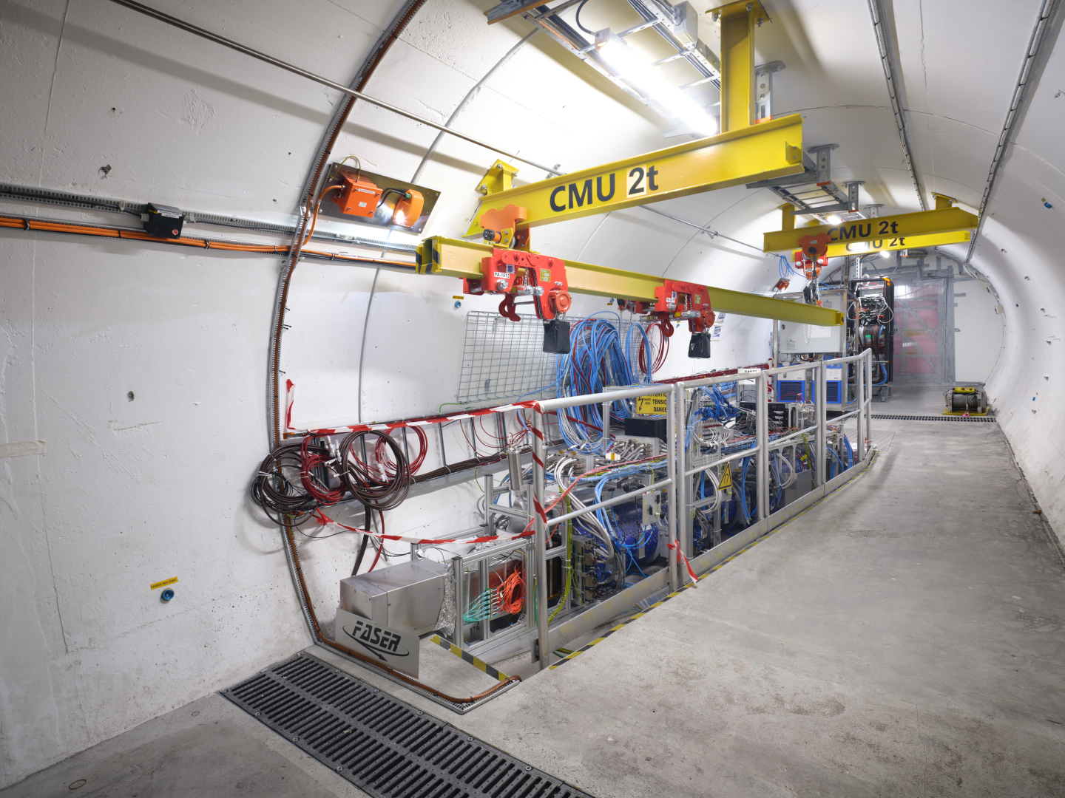
THE FASER DETECTOR

Slide 23
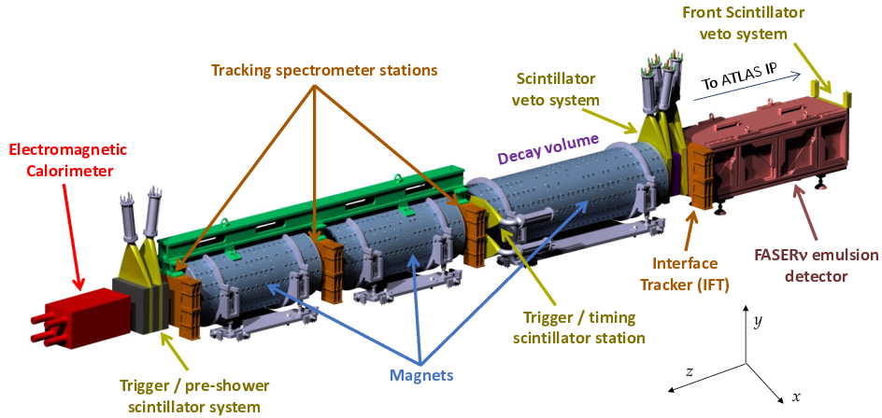
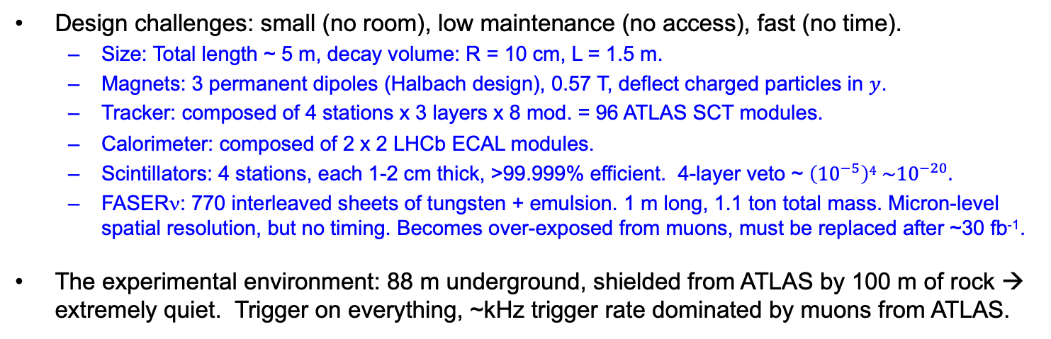
THE FASER DETECTOR
Design challenges: small (no room), low maintenance (no access), fast (no time).
  Size: Total length ~ 5 m, decay volume: R = 10 cm, L = 1.5 m.
  Magnets: 3 permanent dipoles (Halbach design), 0.57 T, deflect charged particles in $y$.
  Tracker: composed of 4 stations x 3 layers x 8 mod. = 96 ATLAS SCT modules.
  Calorimeter: composed of 2 x 2 LHCb ECAL modules.
  Scintillators: 4 stations, each 1-2 cm thick, >99.999% efficient. 4-layer veto ~ $\left({10}^{−5}\right)4 \sim {10}^{−20}.$
  FASERν: 770 interleaved sheets of tungsten + emulsion. 1 m long, 1.1 ton total mass. Micron-level spatial resolution, but no timing. Becomes over-exposed from muons, must be replaced after ~30 fb⁻¹.
The experimental environment: 88 m underground, shielded from ATLAS by 100 m of rock → extremely quiet. Trigger on everything, ~kHz trigger rate dominated by muons from ATLAS.
FASER Collaboration
(2207.11427)

Slide 24
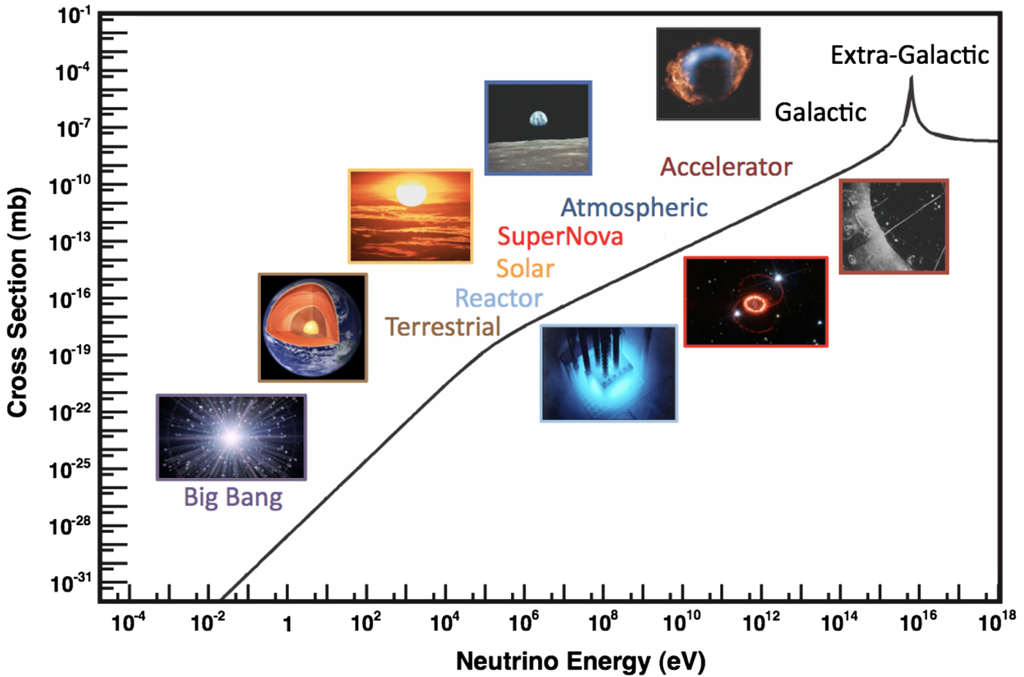
COLLIDER NEUTRINOS
Neutrinos are the least understood of all known particles, and the only ones with confirmed BSM properties.
They have been discovered from many sources, each time with stunning implications for particle physics, astrophysics, and cosmology.
Formaggio, Zeller (2012)
But before FASER, neutrinos produced at a particle collider had never been directly observed.
  Conventional wisdom: neutrinos interact very weakly so cannot be detected.
  The reality: the highest energy ones, which are most likely to interact, pass through the blind spots of existing detectors.

Slide 25
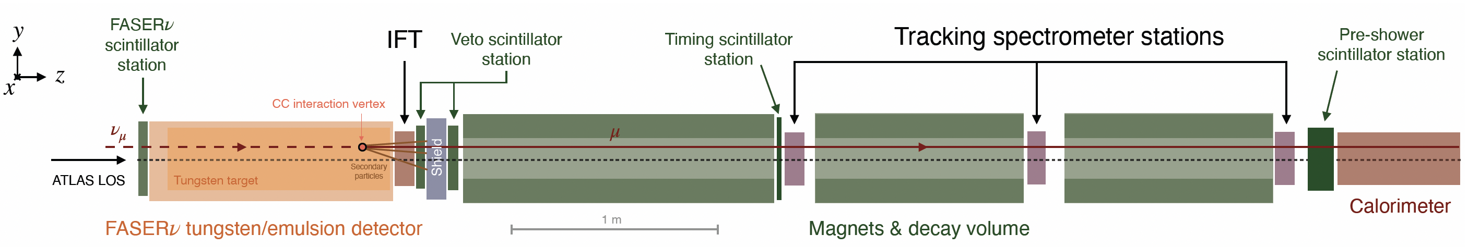
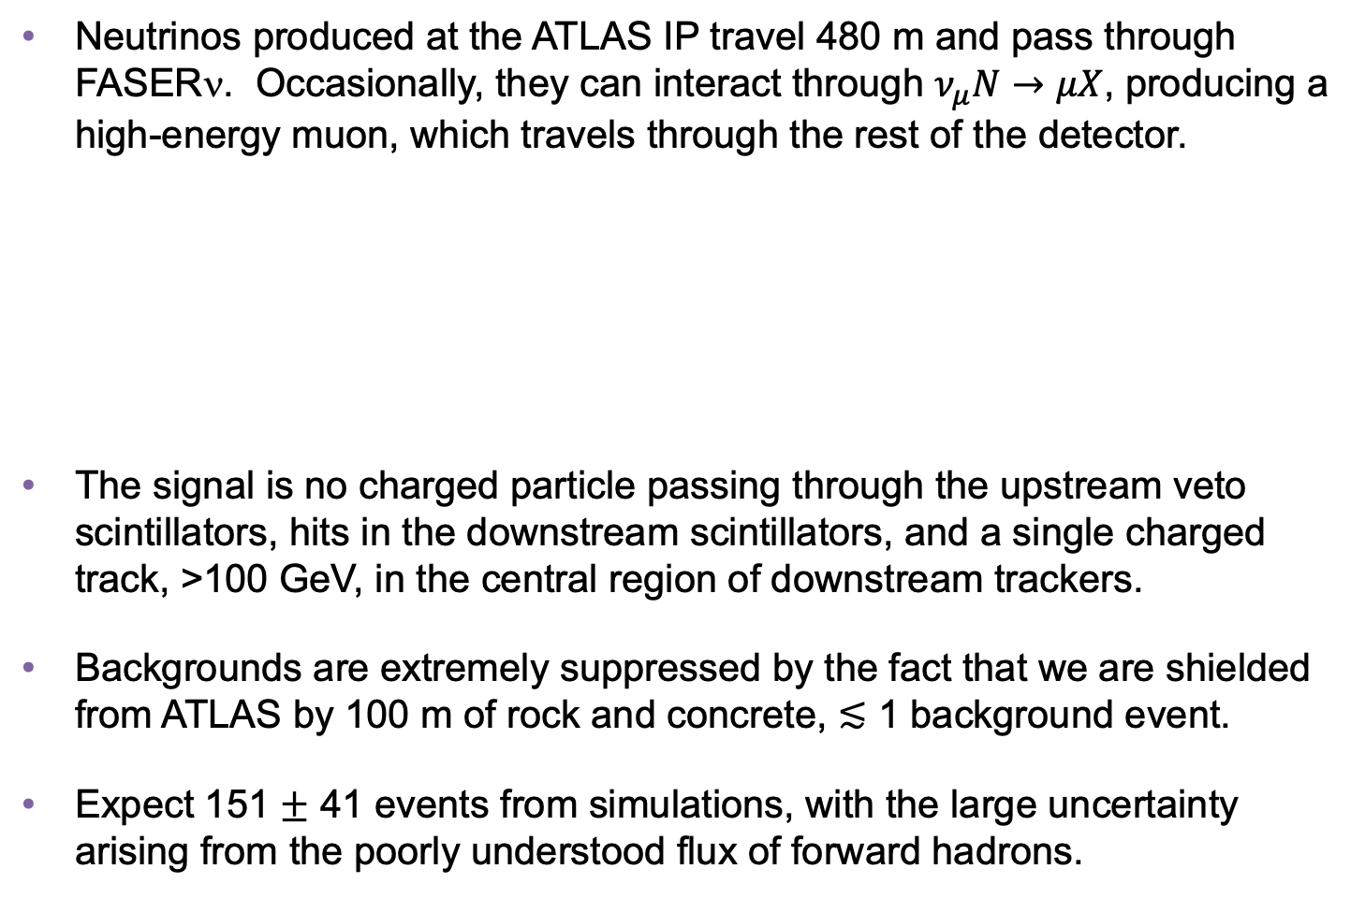
COLLIDER NEUTRINO SEARCH
Neutrinos produced at the ATLAS IP travel 480 m and pass through FASERν. Occasionally, they can interact through $ν_{μ}N→μX$, producing a high-energy muon, which travels through the rest of the detector.
The signal is no charged particle passing through the upstream veto scintillators, hits in the downstream scintillators, and a single charged track, >100 GeV, in the central region of downstream trackers.
Backgrounds are extremely suppressed by the fact that we are shielded from ATLAS by 100 m of rock and concrete, $≲$ 1 background event.
Expect 151 $±$ 41 events from simulations, with the large uncertainty arising from the poorly understood flux of forward hadrons.
FASER Collaboration (2303.14185, PRL)
Notes:
typical A’ that decays in FASER has ~TeV energy

Slide 26
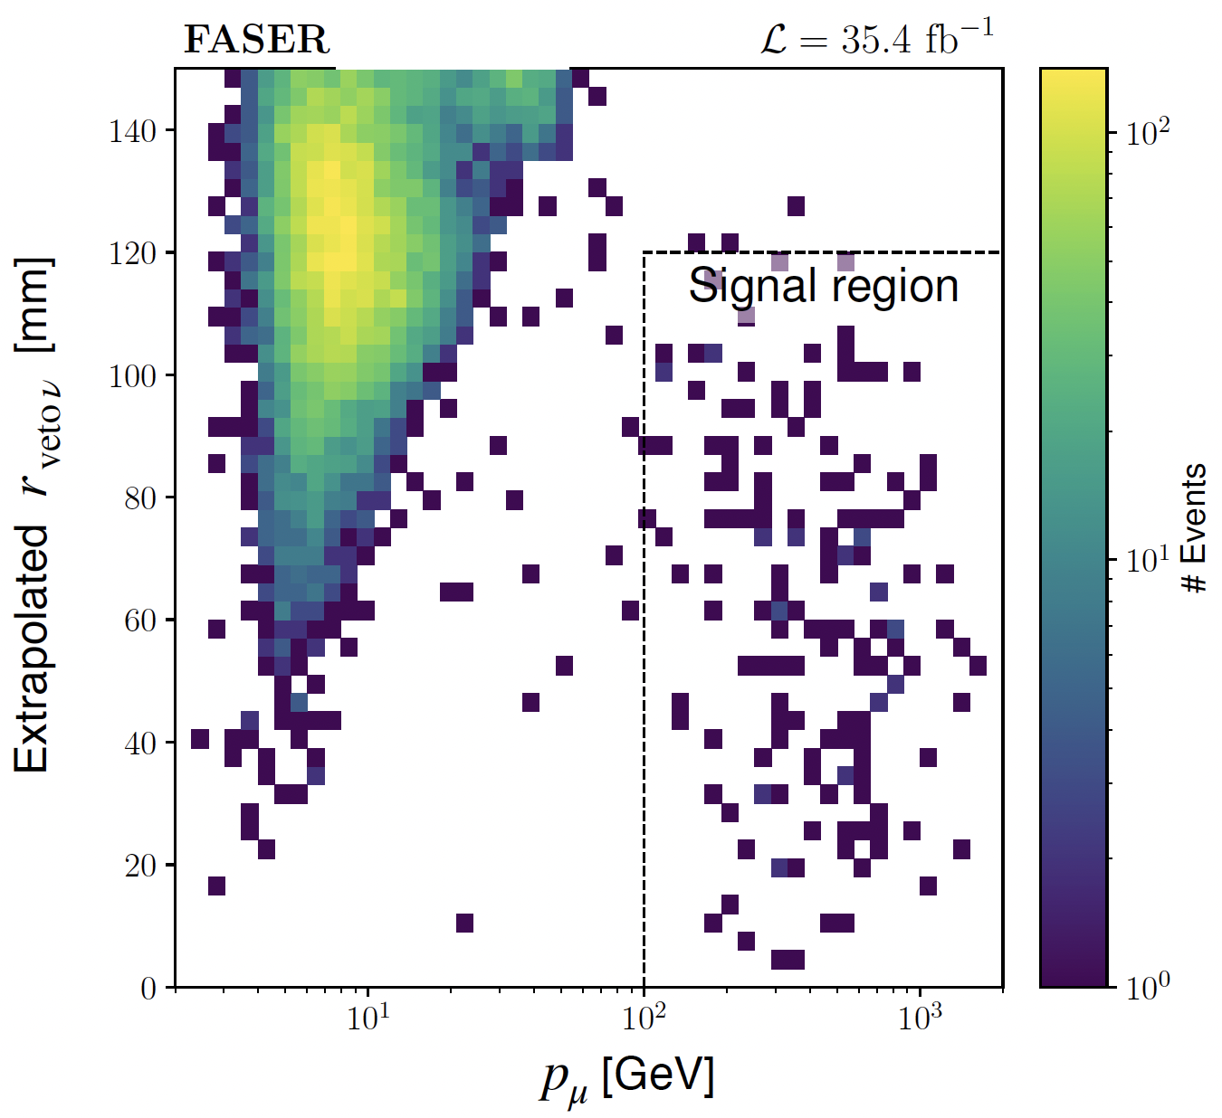
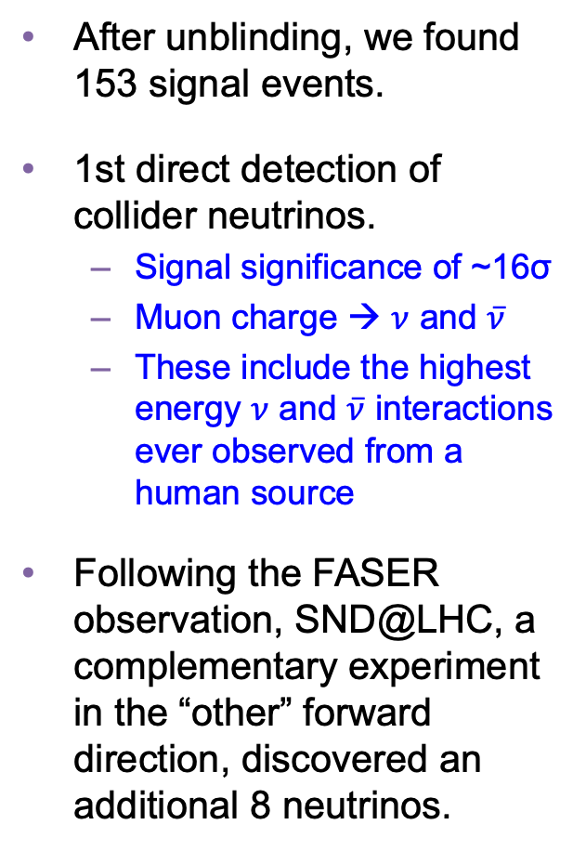
COLLIDER NEUTRINO RESULTS
After unblinding, we found 153 signal events.
1st direct detection of collider neutrinos.
  Signal significance of ~16σ
  Muon charge → $ν$ and $\overline{ν}$
  These include the highest energy $ν$ and $\overline{ν}$ interactions ever observed from a human source
Following the FASER observation, SND@LHC, a complementary experiment in the “other” forward direction, discovered an additional 8 neutrinos.
FASER Collaboration (2303.14185, PRL)

Slide 27
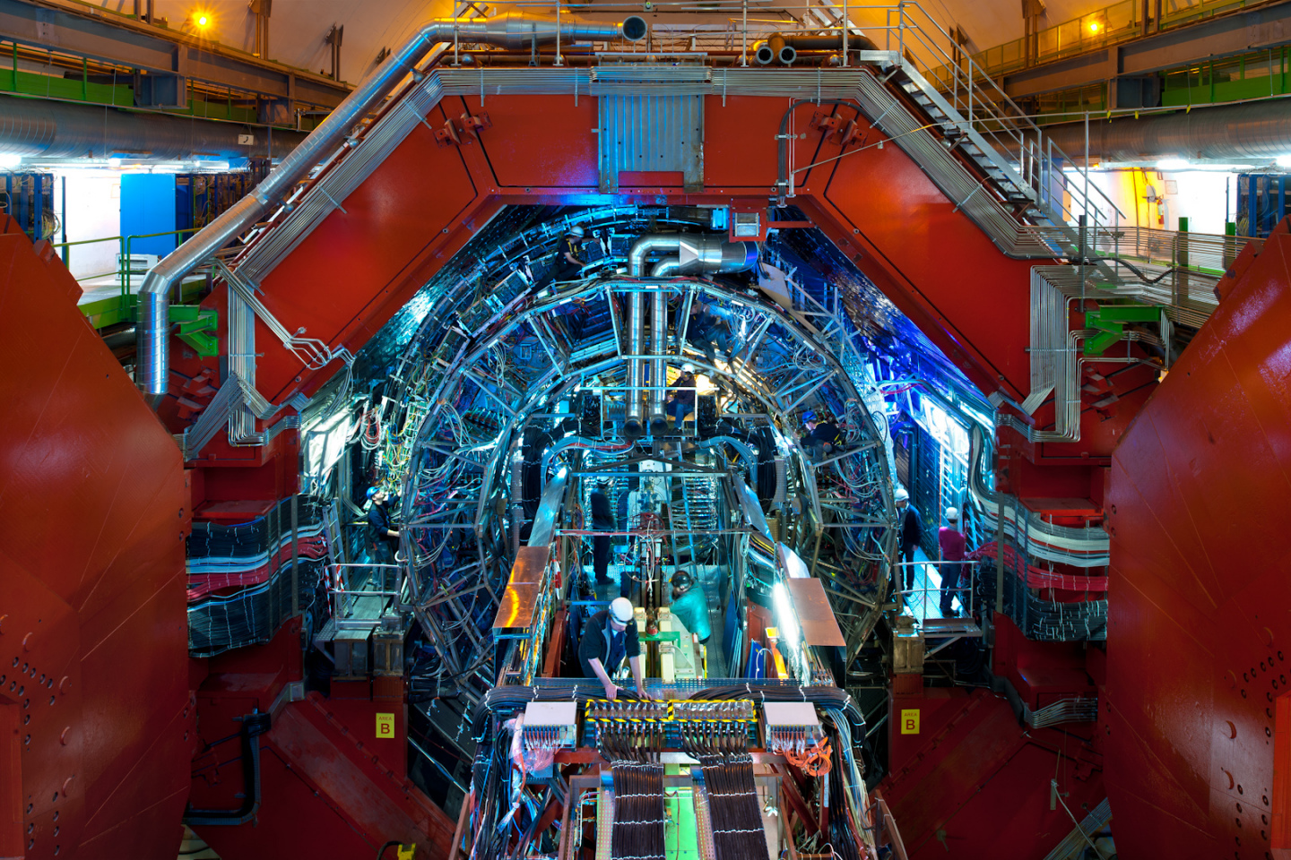
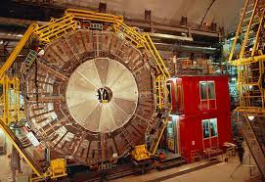
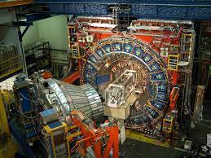
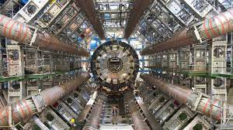
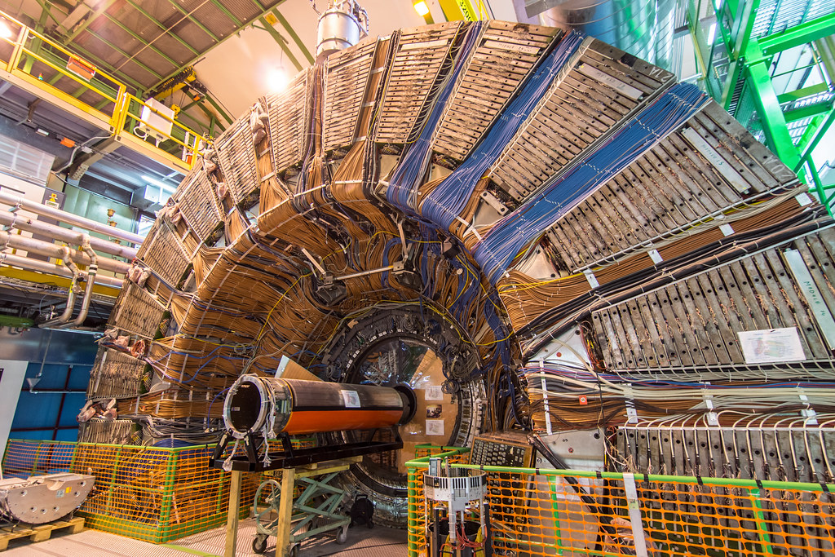
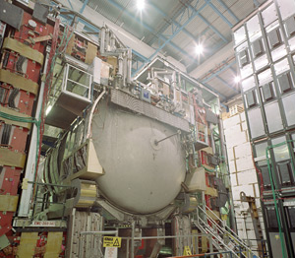
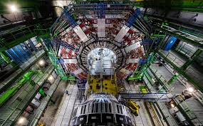
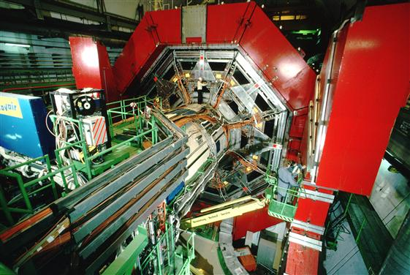

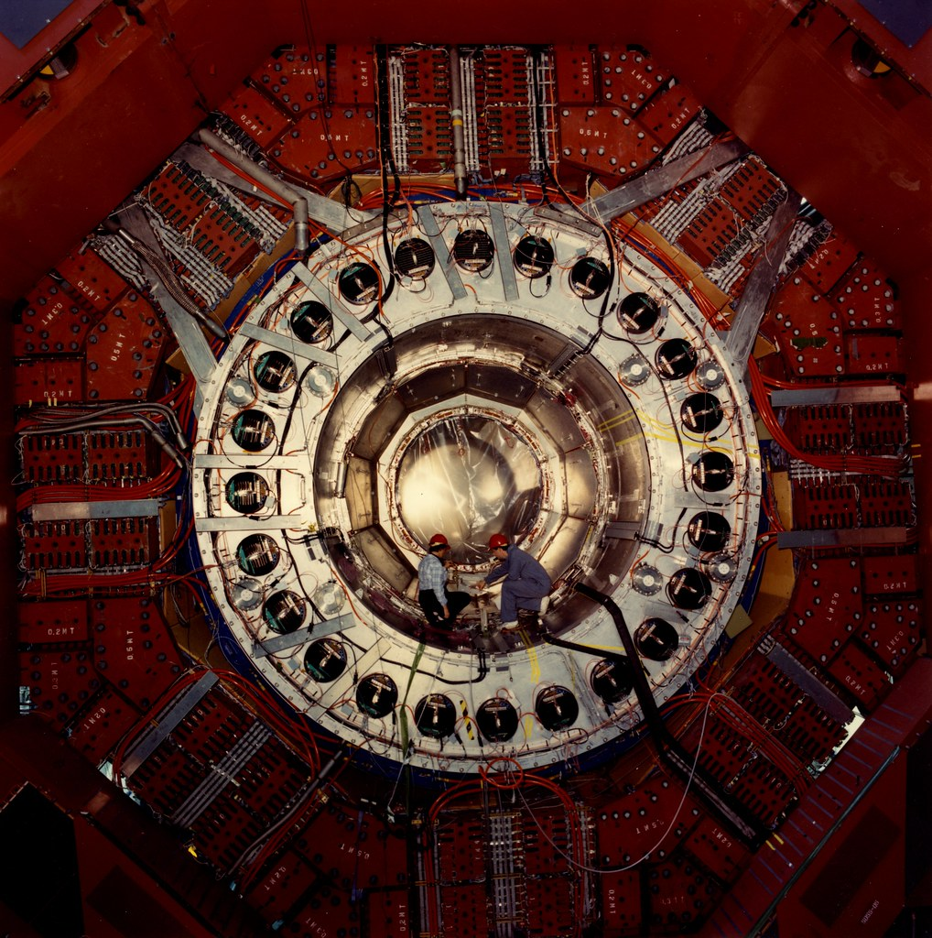
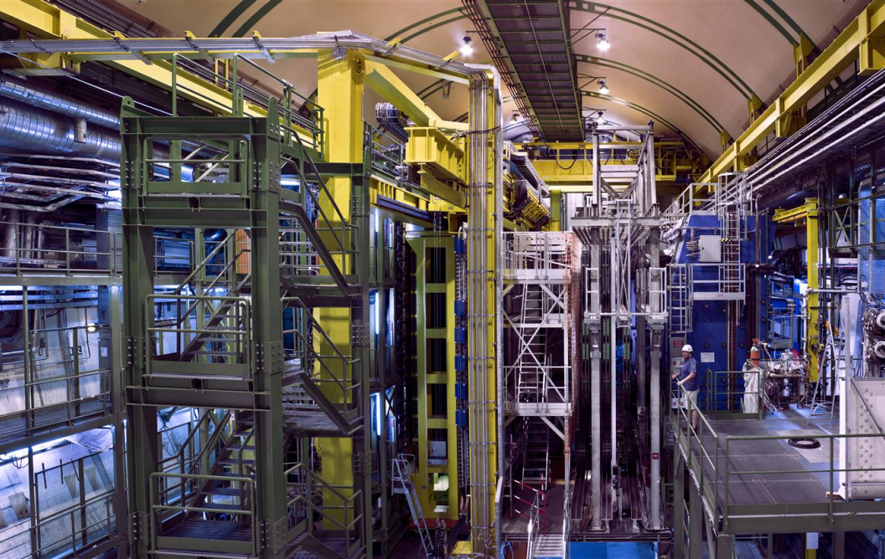
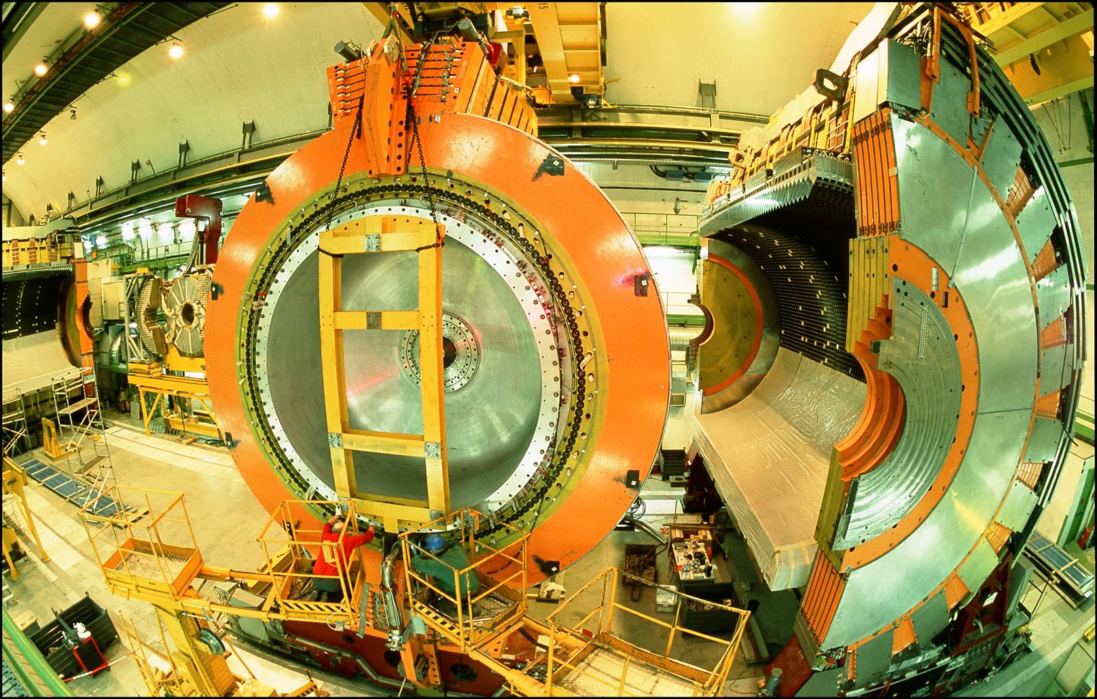
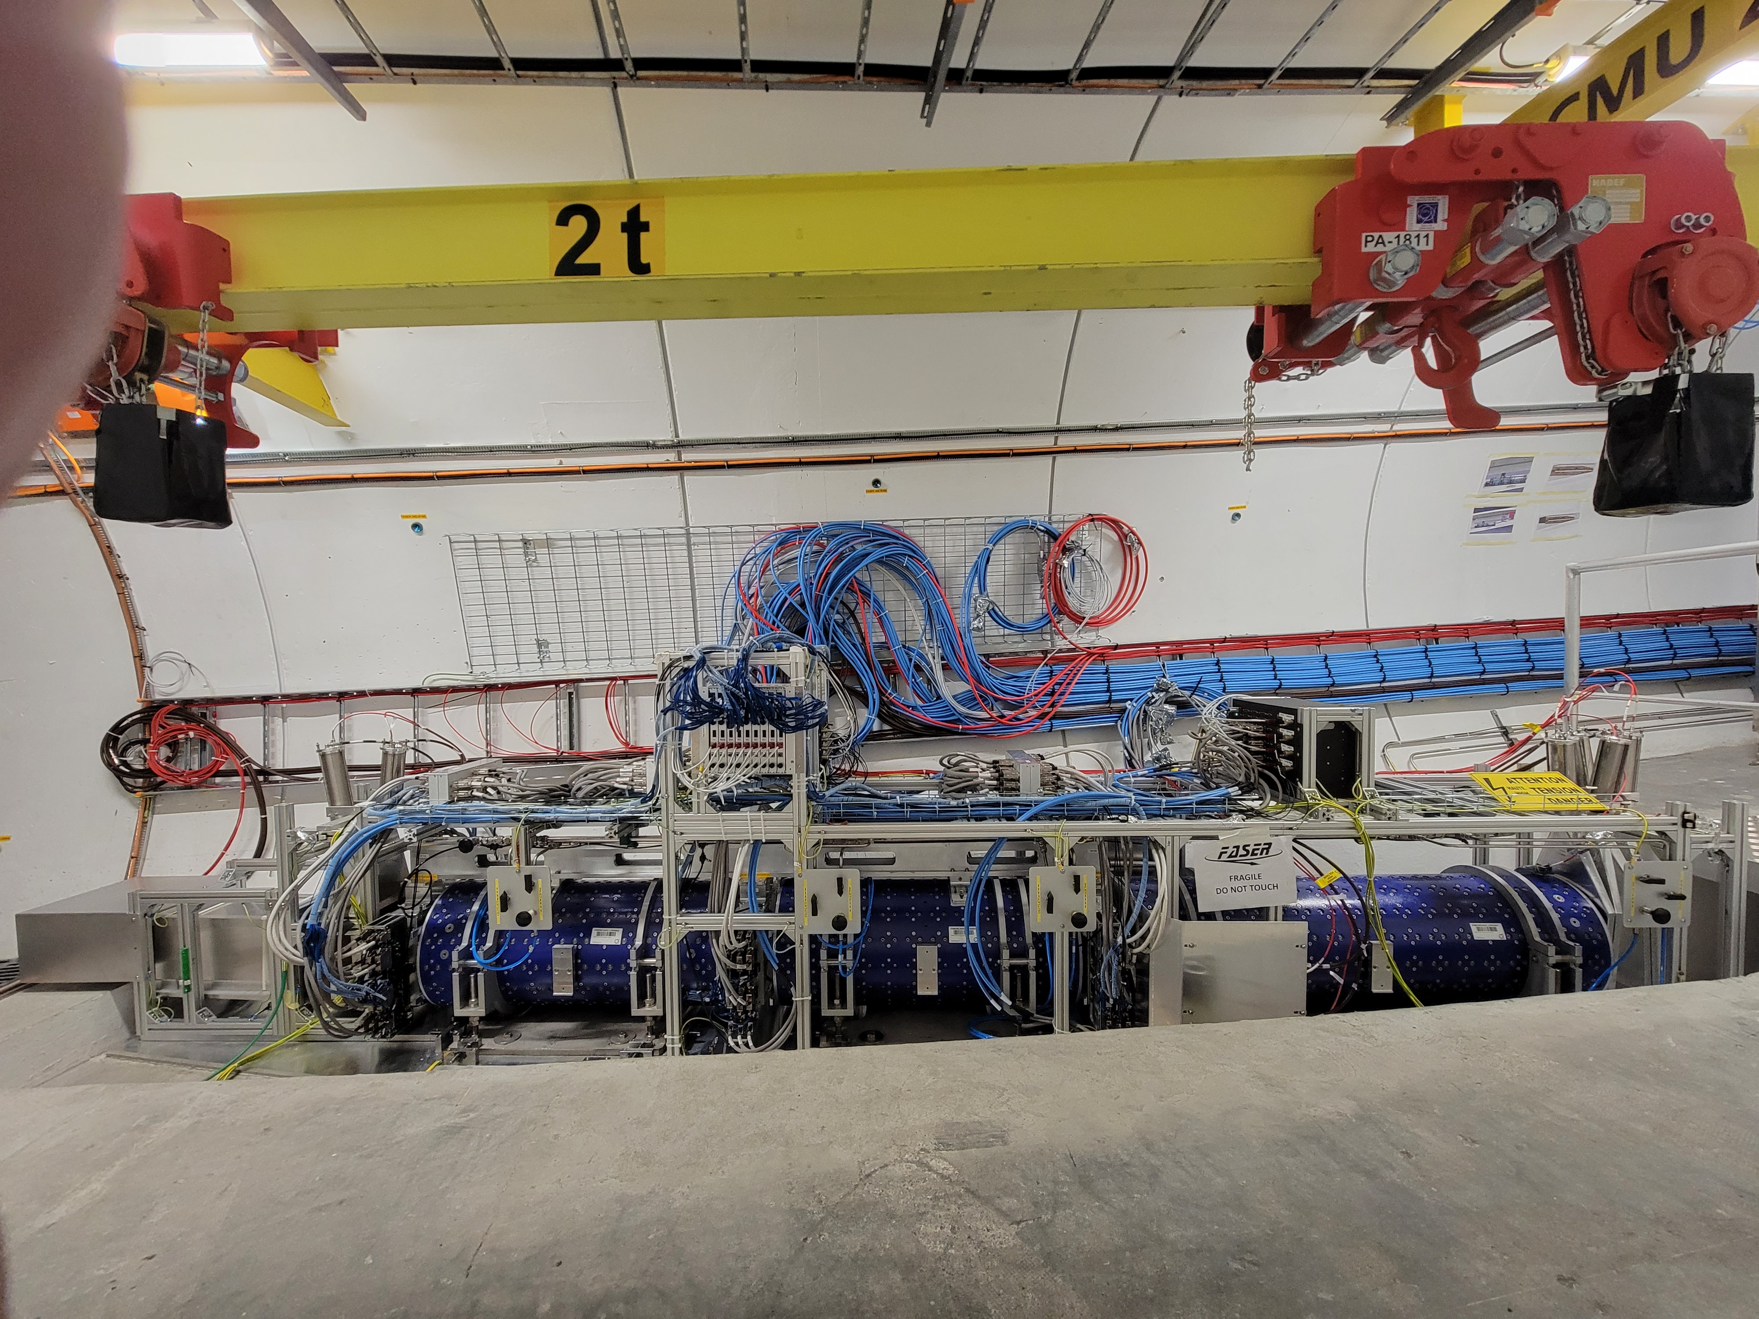
LOCATION, LOCATION, LOCATION
…
ALICE
ALEPH
CDF
FASER
“Tabletop,” 18 months,
~$1M
153 neutrinos
ATLAS
DELPHI
D0
CMS
L3
LHCb
SLD
OPAL
All previous
collider detectors
Building-size, decades,
~$1B
0 neutrinos
16σ discovery, opening a new window at the high energy frontier

Slide 28
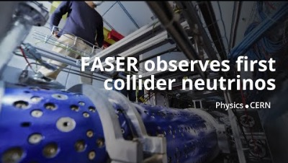
DISCOVERY OF COLLIDER NEUTRINOS

Slide 29
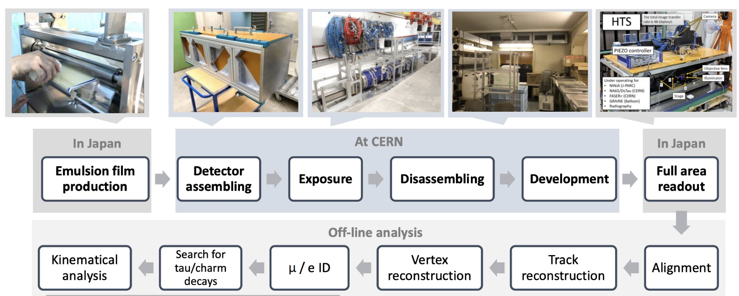
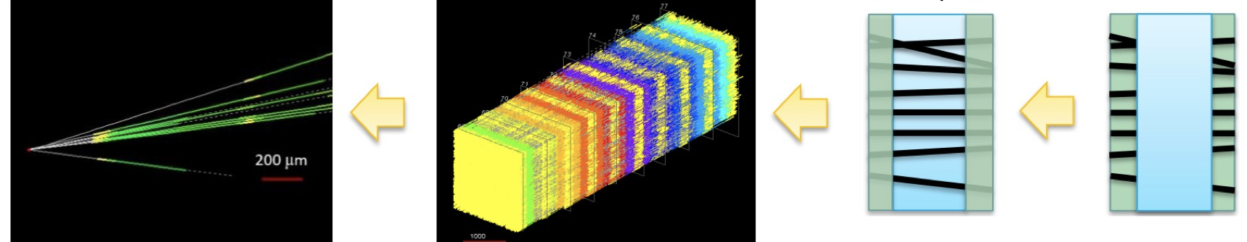
NEUTRINOS IN FASERν
At the front of FASER is FASERν, a 1.1-ton block of interleaved tungsten and emulsion plates. The first neutrino analysis treated this as a big block of matter, but the emulsion provides far more detailed information.
Emulsion is essentially old-fashioned photographic film, has unmatched spatial resolution (~0.5 microns).

Slide 30
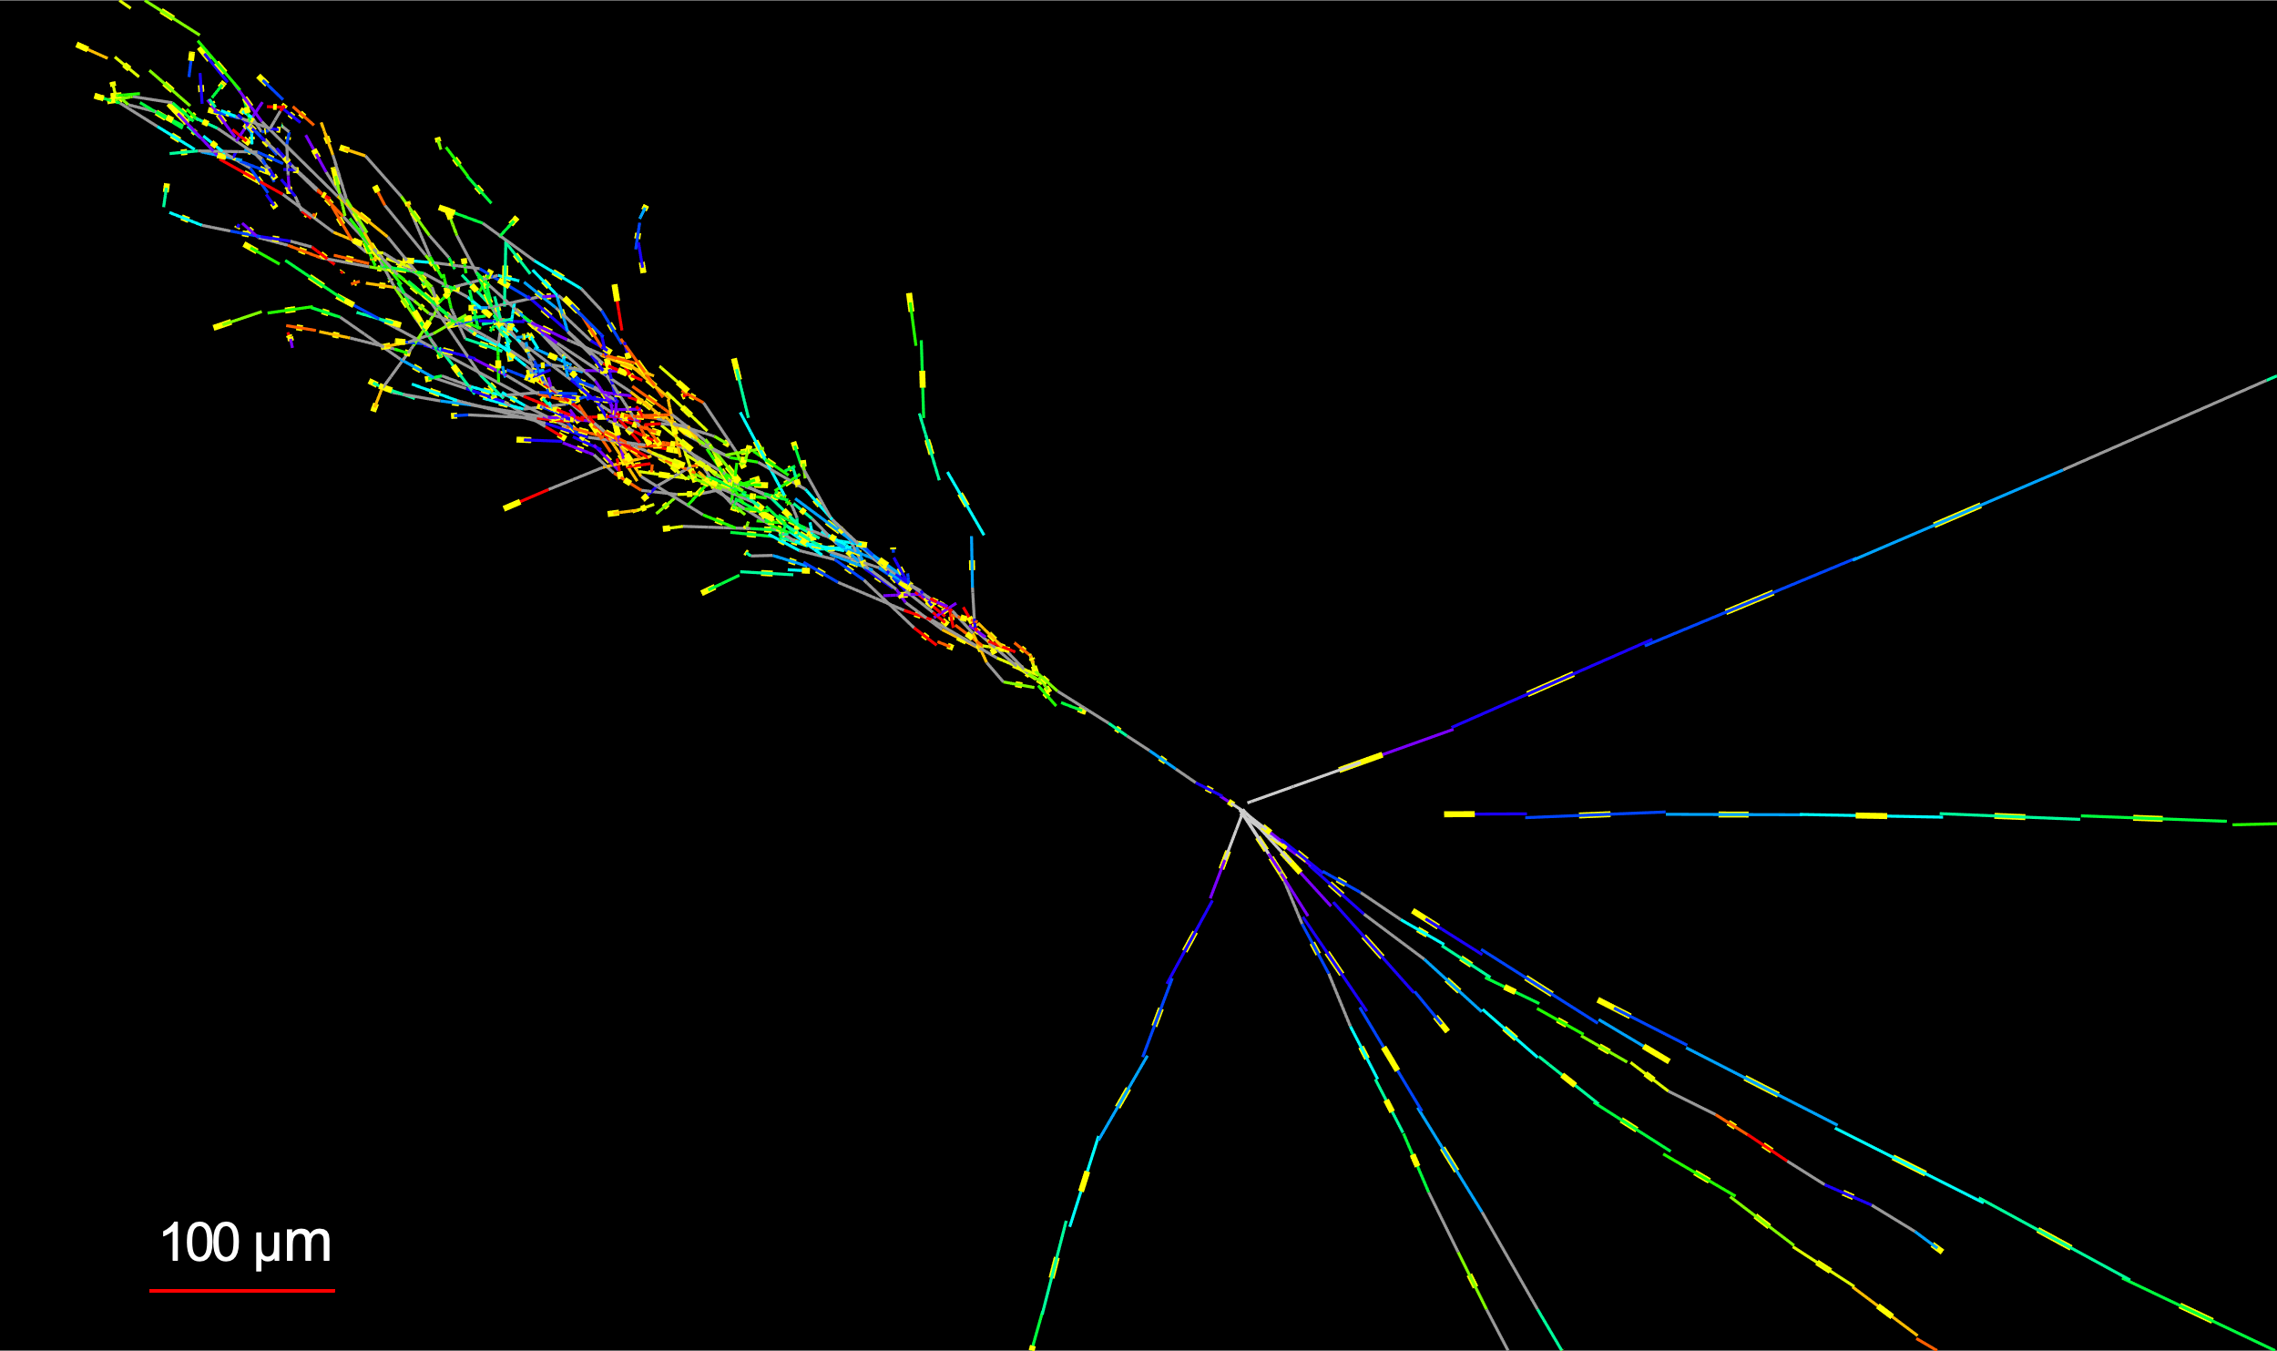

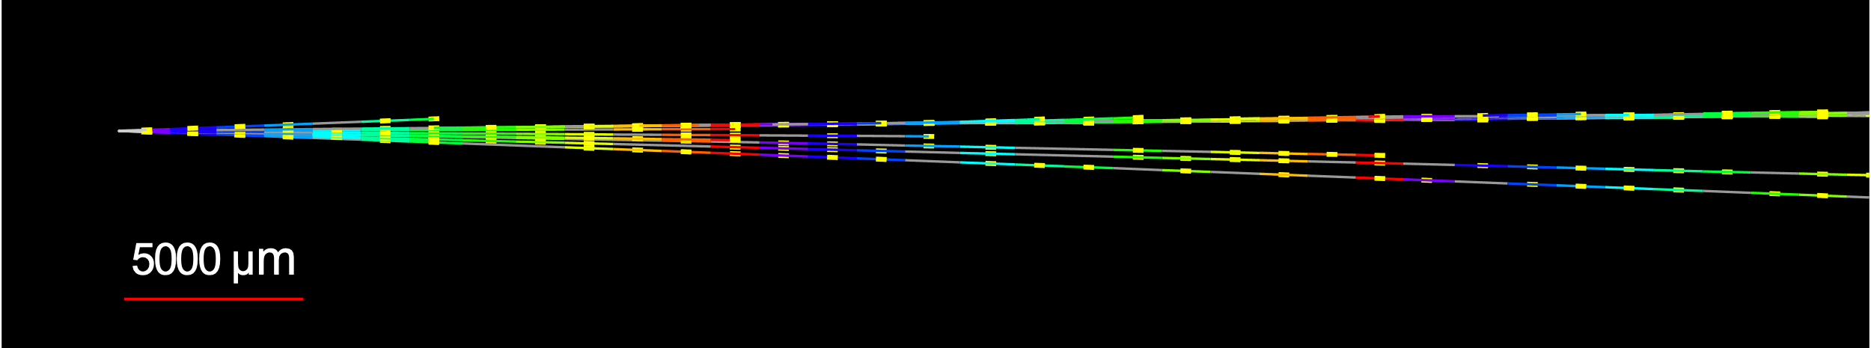


NEUTRINOS IN FASERν
With the emulsion, we have now observed the first collider electron neutrinos, including the “Pika-$ν$” event, the highest energy (1.5 TeV) electron neutrino ever seen from a lab source.
Side View
Vertex with 11 tracks
  615 µm inside tungsten
e-like track from vertex
  Single track for 2X₀
  Shower max @ 7.8Χ₀
  θ_{e} = 11 mrad to beam
Back-to-back topology
  175° between e & rest
$$e$$
Beam View
FASER Collaboration (2403.12520)

Slide 31
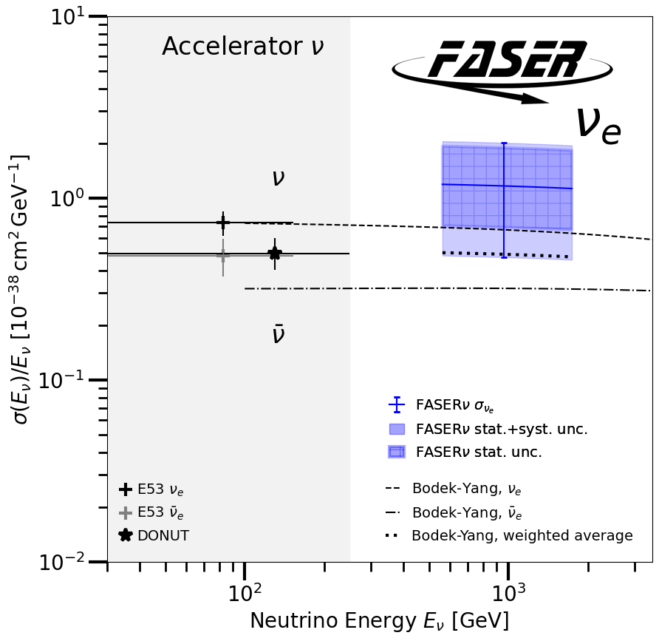
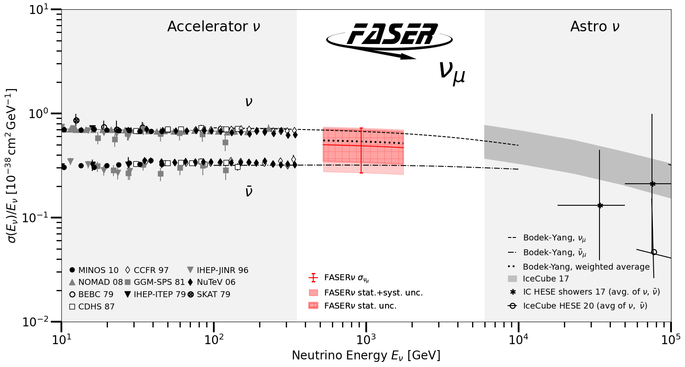
TEV NEUTRINO CROSS SECTIONS
After these discoveries, we have moved on to studies, including the first measurement of neutrino cross sections at TeV energies.
Results are consistent with SM DIS predictions.
These measurements use only 1.7% of the data collected in 2022 and 2023. We now have energy-dependent cross sections (2412.03186), and there is much more to come; triple the world’s supply of tau neutrinos, discover the first anti-tau neutrino (the last SM particle – it’s not the Higgs!), look for BSM physics, …
FASER Collaboration (2403.12520, included in PRL’s Collection of 2024)

Slide 32



NEW PARTICLE SEARCHES
FASER can also look for new light and weakly-interacting particles.
For example: suppose there is a dark sector that contains dark matter X and also a dark force: dark electromagnetism.
The result? Dark photons $A′$ , like photons, but with mass $m_{A′}$, couplings suppressed by $ε$.
For low $ε$, dark photons are long-lived particles (LLPs), can be produced in ATLAS, pass through rock and magnetic fields unhindered, and then decay through $A^{′}$ $→ e^{+}e^{−}$ in FASER.
SM
EM
Dark Sector
EM, X
A
$${εF}_{μν}F_{D}^{μν}$$
A_{D}
Holdom (1986)

Slide 33

DARK PHOTON RESULTS
After unblinding, no events seen, FASER sets limits on previously unexplored parameter space.
First new probe of the parameter space favored by dark matter from low coupling since the 1990’s.
Prospects for the future
  Background-free analysis
  Started probing new parameter space in the first day of running
  Ended up ~100 times more sensitive than previous experiments
  Improvements in analysis and 40 times more data to come
Existing bounds from DarkCast
FASER Collaboration (2308.05587, PLB)

Slide 34







MORE SEARCH RESULTS
We are now looking for many other new particles: other new force carriers (U(1)_{B-L}, U(1)_{B}, protophobic), axion-like particles with photon, W, gluon couplings, up-philic scalars, two Higgs doublet models, sterile neutrinos, dark matter, light neutralinos, quirks, etc., all with world-leading sensitivities.
FASER is approved to run through 2033, with improvements from the High-Luminosity LHC, and a high-resolution pre-shower detector and other upgrades.
FASER Collaboration (2308.05587, PLB; 2410.10363 )

Slide 35


Slide 36




FORWARD PHYSICS FACILITY
Following the results of FASER and SND@LHC, CERN is considering the possibility of creating a dedicated Forward Physics Facility to house far-forward experiments for the rest of the LHC era until the 2040s.
UJ18
ATLAS
SPS
LHC
LOS
FPF site selection study and core study have identified an ideal site in France just outside the CERN main gate
https://cds.cern.ch/record/2851822
CERN GIS

Slide 37

THE FPF AND ITS EXPERIMENTS
At present there are 4 experiments being designed for the FPF
  FASER2: magnetized spectrometer for BSM searches
  FASERν2: emulsion-based neutrino detector
  FLArE: LArTPC neutrino detector
  FORMOSA: scintillator array for BSM searches (successor to milliQan)
With strong support from CERN, the Facility has been designed in detail. Estimated (Class 4) cost is 35 MCHF for Facility, core costs of the experiments vary from 2 to 15 MCHF.

Slide 38
PHYSICS AT THE FPF
The FPF at the HL-LHC will have many unique capabilities:
  New physics in neutrino properties: neutrino blind → neutrino factory: 10⁶ neutrinos (1000 per day!) at the highest human-made energies ever.
  New particles:10,000 more powerful than current experiments, enhancement of conventional LHC searches, and many searches for particles that cannot be found anywhere else.

Slide 39


UNIQUE DISCOVERY OPPORTUNTIES
FPF experiments have the potential to discovery BSM physics that cannot be seen anywhere else. One of many examples: Millicharged particles.
Since the Millikan oil drop experiment: are the charges of all particles integer multiples of $e$? In fact, milli-charged particles are now well motivated by theories of dark matter and dark sectors.
The state-of-the art currently is the cleverly named milliQan experiment near CMS at the LHC.
But milliQan’s sensitivity can be greatly enhanced simply by moving it to the forward region, a detector idea called FORMOSA.
Currently being investigated with the FORMOSA Demonstrator behind FASER.
Matthew Citron and collaborators
Foroughi-Abari, Kling, Tsai (2020)

Slide 40

QUIRKS
Supposed there are new charged particles that are also charged under a new strong force: quirks.
If heavy, these are produced at the LHC, but move slowly down the beamline, oscillating about their center of mass.
By looking for 2 coincident slow or delayed tracks (out of time with the bunch crossing), forward experiments can discover quirks with masses up to ~TeV.
Unique discovery potential at FASER and the FPF: very challenging at ATLAS/CMS, impossible at all other expts.
Kang, Luty (2008)
Li, Pei, Ran, Zhang (2021)
Feng, Li, Liao, Ni, Pei (2024)

Slide 41


SUMMARY
Neglected for decades, the forward region at particle colliders turns out to be a treasure trove of interesting physics that can be mined with small, fast, inexpensive experiments.
At the LHC, initial work has already created the new field of collider neutrino physics and is probing dark matter and dark sectors with far greater sensitivity than previously imagined.
Is there another November revolution waiting for us in the forward region? Much more to come!

Slide 42
EXTRAS

Slide 43

A LESSON FROM BLAZING SADDLES

Slide 44




NEUTRINOS AT THE FPF
The FPF experiments will see ${10}^{5} ν_{e}$, ${10}^{6} ν_{μ}$, and ${10}^{4} ν_{τ}$ interactions at TeV energies. The last chance to probe this in a controlled environment for at least 50 years.
Neutrinos are produced by forward hadron production: $π, K, D, …$. Dependence on E, $η$ will inform
  Astroparticle physics: muon puzzle, …
  QCD: pdfs at x $\sim {10}^{−1}$, x $\sim {10}^{−7}$, intrinsic charm, small-x gluon saturation, …
  Neutrino oscillations: $ν_{s}$ with $∆m^{2}\sim {10}^{3}$ ${eV}^{2}$

Slide 45
PRODUCTION, PROPAGATION, INTERACTION
Neutrino event rates are sensitive to forward hadron production, neutrino propagation, and neutrino interactions. Double differential event rates as a function of energy and pseudorapidity for each neutrino flavor can disentangle these, probe a vast number of interconnected topics.
Rojo (2024)

Slide 46

ENHANCEMENT OF HIGH P_{T} SEARCHES
The FPF will provide new constraints on pdfs that will sharpen studies at ATLAS and CMS.
For example, W, Z, and Higgs boson studies.
Will also remove degeneracies between pdfs and new physics (“fitting away new physics”), extending the reach for new particle searches (e.g., ~10 TeV $W^{′}, Z′$ ).
Cruz-Martinez, Fieg, Giani, Krack,
Makela, Rabemananjara, Rojo (2023)

Slide 47





DARK MATTER
In the last few decades, there has been an intense effort to detect dark matter through non-gravitational couplings, all yielding null results.
One generic possibility that is infamously hard to detect: inelastic dark matter, where there are two nearly-degenerate dark states with off-diagonal couplings to the SM.
These generically lead to long-lived particles, but with soft decay products, but these are highly boosted to observable levels at the FPF.
Bottom line: the FPF can discover DM (or any compressed spectrum), which cannot be seen anywhere else (ATLAS/CMS, SHiP and other fixed target expts, direct and indirect DM searches, …)
$$m_{1}$$
$$χ_{1} →χ_{0}γ$$
$$m_{0}$$
0
Dienes, Fieg, et al. (2023)

