Slide 1



WHERE WE ARE AND WHERE WE’RE GOING:
A PERSONAL PERSPECTIVE
37th Rencontres de Blois on Particle Physics and Cosmology
Jonathan Feng, UC Irvine, 15 May 2026

Slide 2
PARTICLE PHYSICS AND COSMOLOGY
This Blois conference is about “Particle Physics and Cosmology.” This focus follows many previous Blois conferences, but it is not to be taken for granted!
From my own perspective, as a young particle physicist, I grew up under a steady diet of collider physics (LEP, SLC, Tevatron, …) and SUSY.
Then as a postdoc:
Following the pioneers, I became hooked on the synergy between probing the universe at the smallest and largest scales, and especially the remarkable fact that evidence from both pointed to the weak scale.
SUSY
PARTICLE PHYSICS
NEUTRALINO DM
(THE GATEWAY DRUG)
DARK MATTER
COSMOLOGY

Slide 3
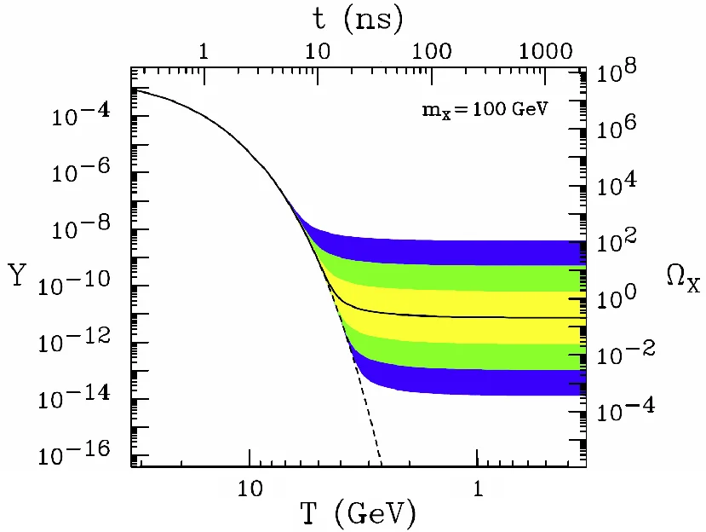
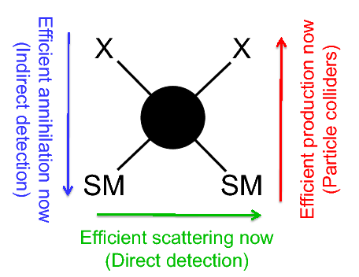
PARTICLE PHYSICS AND COSMOLOGY
Unfortunately, this enthusiasm was not adequately shared by others. In the early 2000’s, I tried to make the point in two ways:
These terms initially encountered resistance (including from the pioneers!).
The Blois conferences have brought together researchers at the intersection of particle physics and cosmology for many years, and it has been a pleasure to take part in the meeting this week.
THE WIMP MIRACLE
DARK MATTER COMPLEMENTARITY

Slide 4
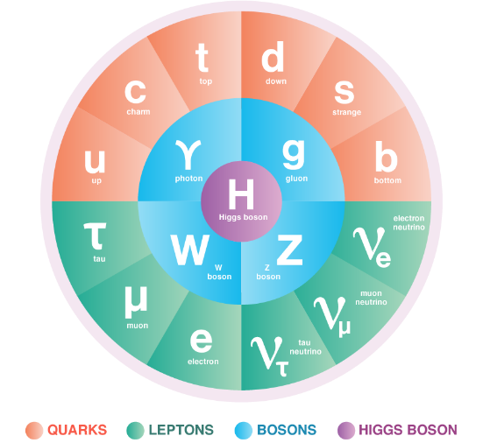
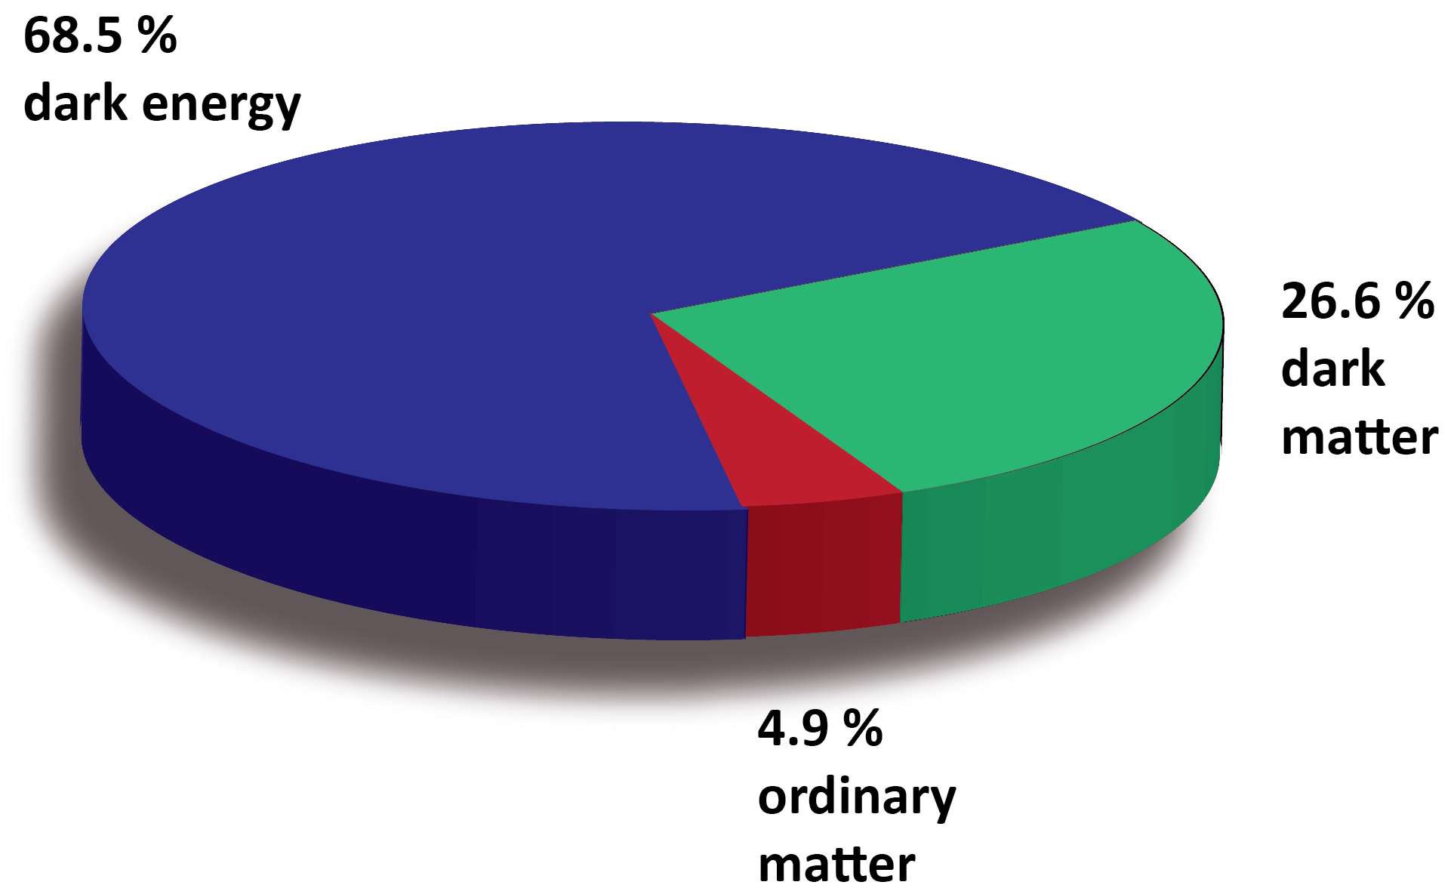
WHERE WE ARE
The Standard Models of particle physics and cosmology are tremendous achievements of human thought.
But they are not the last word, because many fundamental questions remain. For example:
  “What” problems: neutrino masses, dark matter, baryo/leptogenesis, inflation…
  “Why” problems: gauge hierarchy problem, strong CP problem, flavor problem, grand unification, cosmological constant problem, d=3+1 problem, …
These questions imply that there is BSM physics, with (many) more particles left to discover.
Many interesting avenues to pursue, as we have seen at this conference. What follows is a brief overview (with apologies to the many excellent parallel speakers, and for trying to fit square pegs into round holes).

Slide 5






















PARTICLE PHYSICS LANDSCAPE
Particle
Probes
Mass
MeV
GeV
TeV
1
$$←$$
$$g$$
$$u$$
$$d$$
$$s$$
$$p$$
$$n$$
$$c$$
$$b$$
$$t$$
$$←$$
$$γ$$
$$e$$
$$μ$$
$$τ$$
$$W$$
$$Z$$
$$h$$
Interaction Strength
10⁻³
$$ν_{e}$$
$$ν_{μ}$$
$$ν_{τ}$$
$$←$$
10⁻⁶

Slide 6
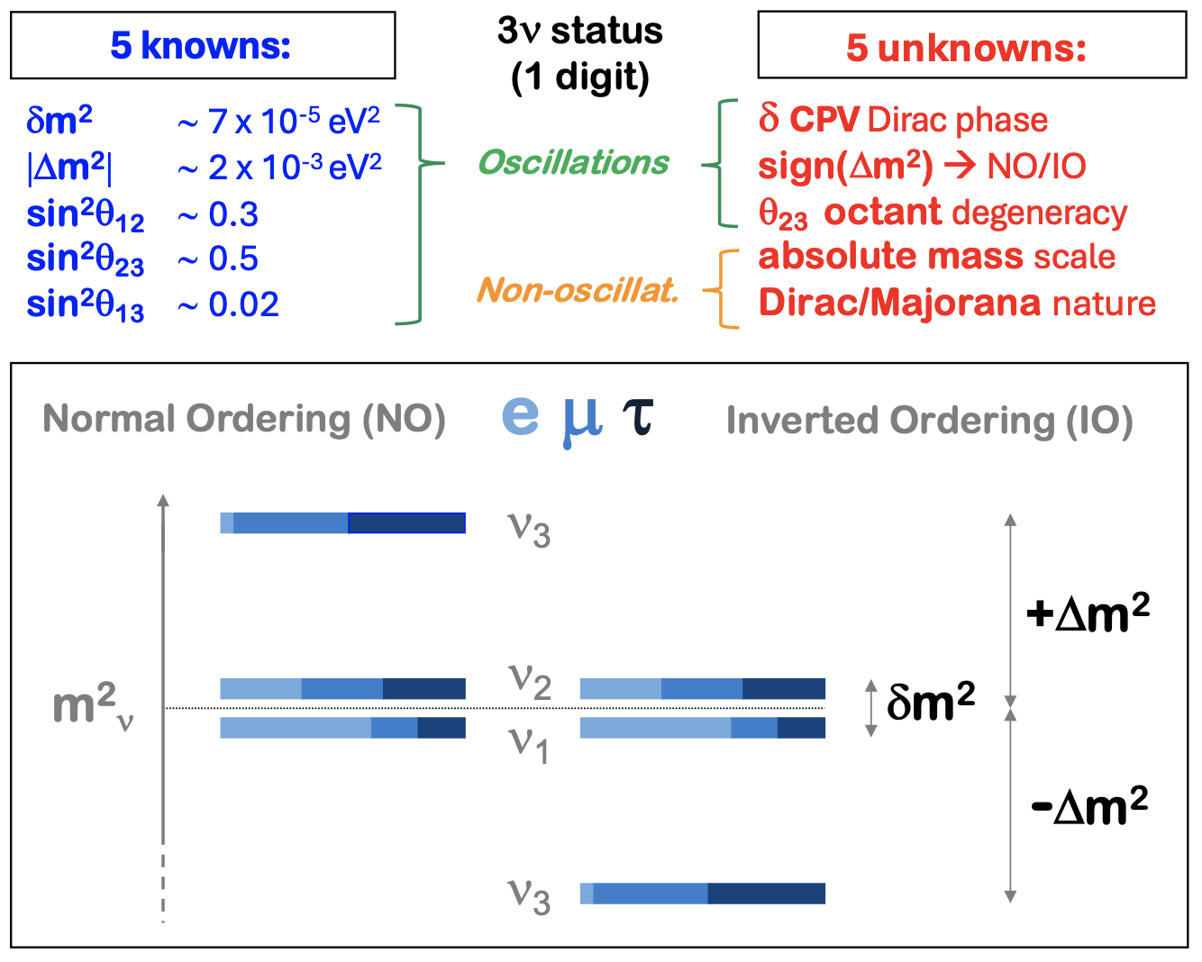
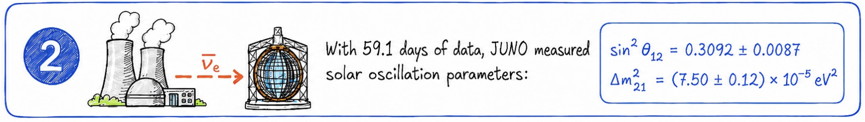
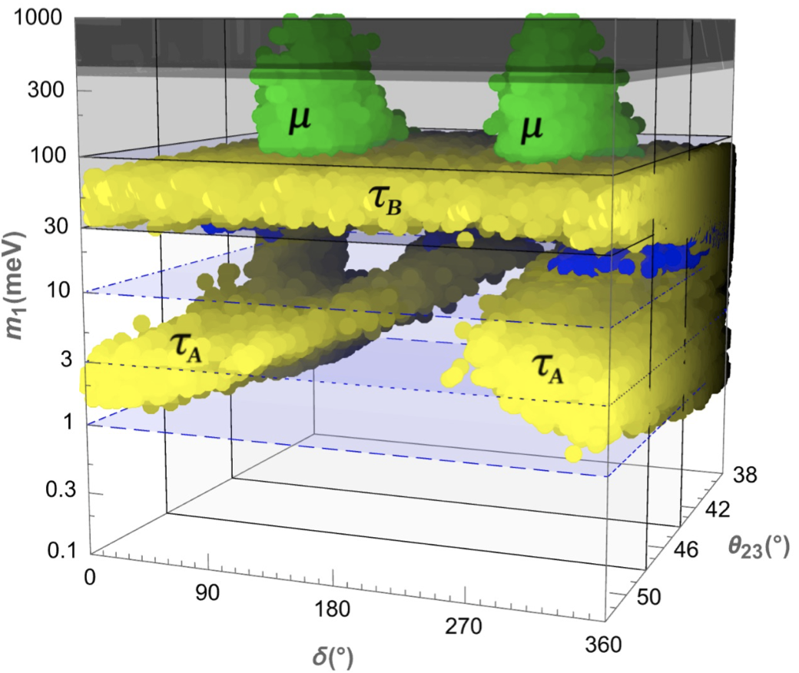
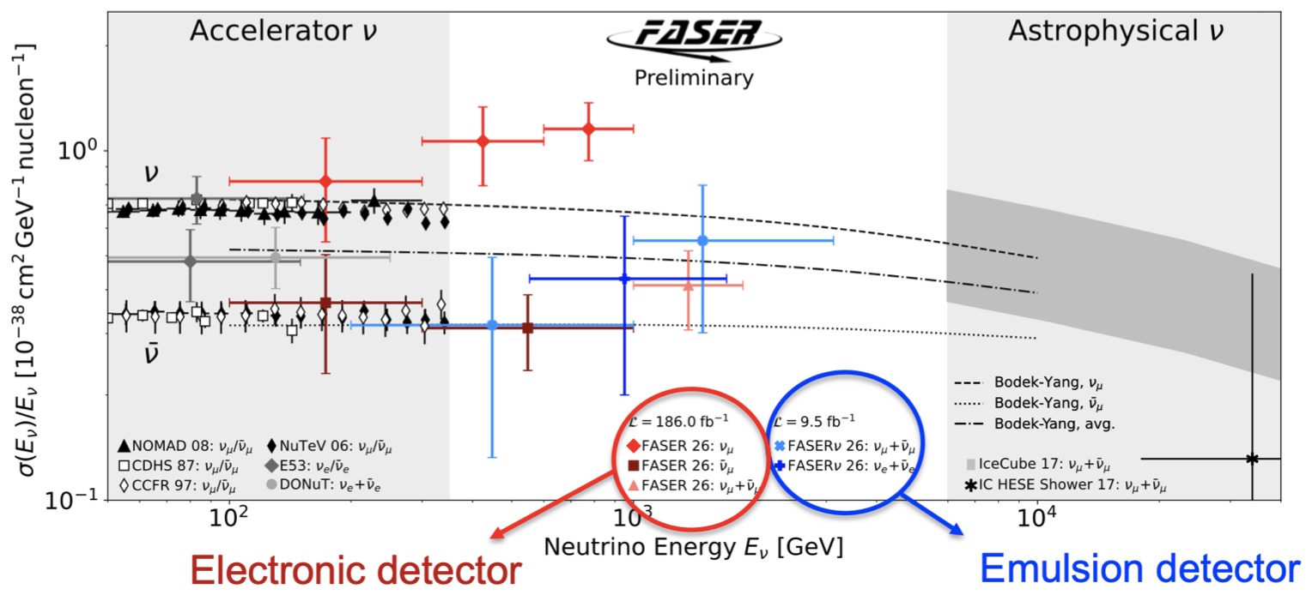
NEUTRINOS
Particle
Probes
Mass
An obvious place to start: every time we detect a neutrino, we are seeing BSM physics!
With JUNO, all mixing angles are now constrained, and with FASER and SND, many TeV neutrinos have been seen. An exciting area, with many outstanding questions: mass ordering, Dirac vs. Majorana, relevance for leptogenesis…
Ding, Sgalaberna, Lisi, di Bari
MeV
GeV
TeV
1
$$←$$
$$g$$
$$u$$
$$d$$
$$s$$
$$p$$
$$n$$
$$c$$
$$b$$
$$t$$
$$←$$
$$γ$$
$$e$$
$$μ$$
$$τ$$
$$W$$
$$Z$$
$$h$$
Interaction Strength
10⁻³
$$ν_{e}$$
$$ν_{μ}$$
$$ν_{τ}$$
$$←$$
10⁻⁶
Notes:
Cl: Ding, Sgalaberna, di Bari, Lisi

Slide 7
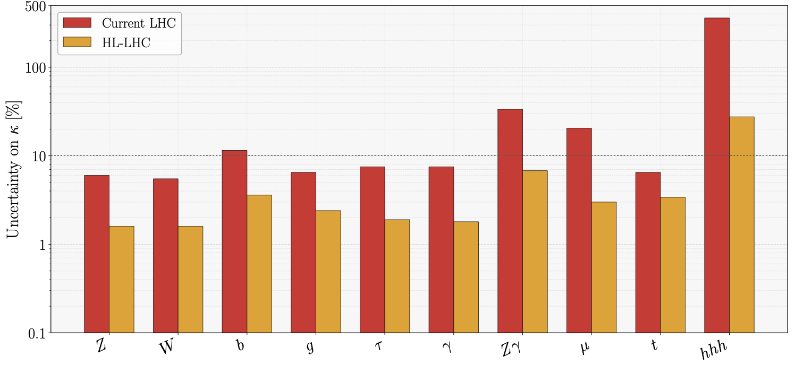
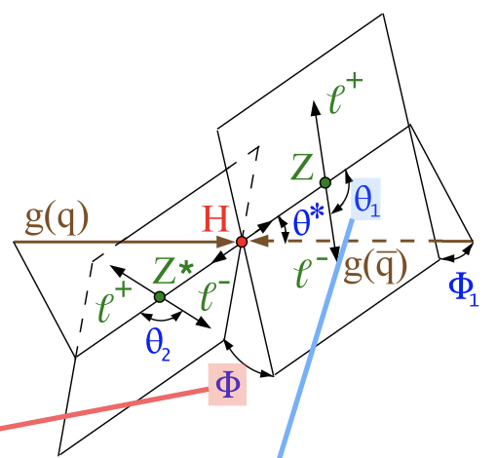
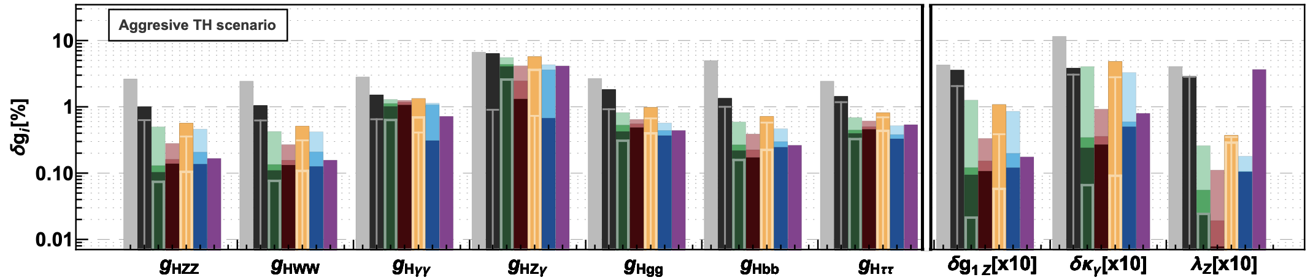
THE HIGGS BOSON
Particle
Probes
Mass
The Higgs boson is our newest toy. It has the wonderful property that all its production and decay modes are suppressed, providing sensitive windows on new physics.
Many properties already precisely known, but the self-coupling is far from measured.
Dunford, Stefanek, Frattari
MeV
GeV
TeV
1
$$←$$
$$g$$
$$u$$
$$d$$
$$s$$
$$p$$
$$n$$
$$c$$
$$b$$
$$t$$
$$←$$
$$γ$$
$$e$$
$$μ$$
$$τ$$
$$W$$
$$Z$$
$$h$$
Interaction Strength
10⁻³
$$ν_{e}$$
$$ν_{μ}$$
$$ν_{τ}$$
$$←$$
10⁻⁶
Notes:
Cl: Dunford, Frattari, Stefanek

Slide 8
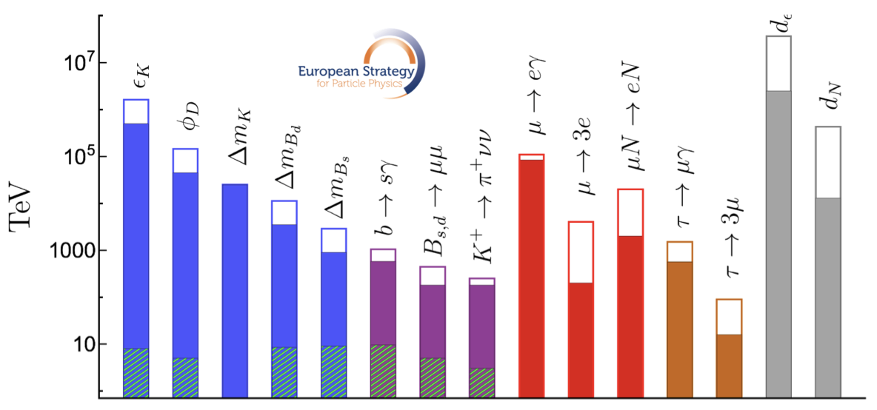
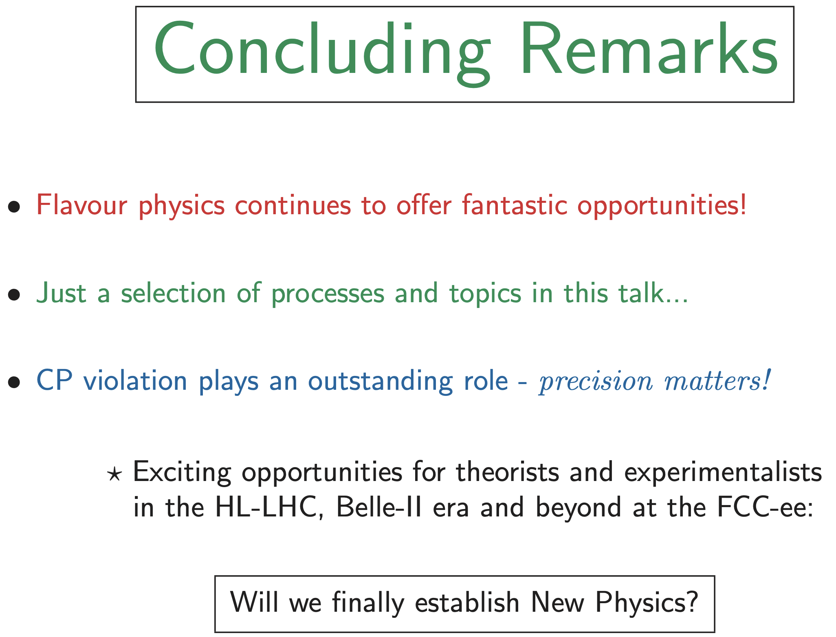
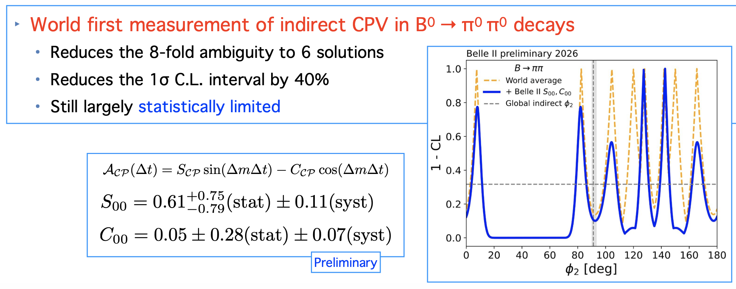
FLAVOR AND CP VIOLATION
Particle
Probes
Mass
Low-energy precision measurements probe (extremely!) high mass scales through virtual effects.
Muon g-2 anomaly is gone, CERN has canceled its kaon program, but many K, D, B, τ probes remain.
Ripp-Baudot, Amhis, Fleischer
MeV
GeV
TeV
1
$$←$$
$$g$$
$$u$$
$$d$$
$$s$$
$$p$$
$$n$$
$$c$$
$$b$$
$$t$$
$$←$$
$$γ$$
$$e$$
$$μ$$
$$τ$$
$$W$$
$$Z$$
$$h$$
Interaction Strength
10⁻³
$$ν_{e}$$
$$ν_{μ}$$
$$ν_{τ}$$
$$←$$
10⁻⁶

Slide 9
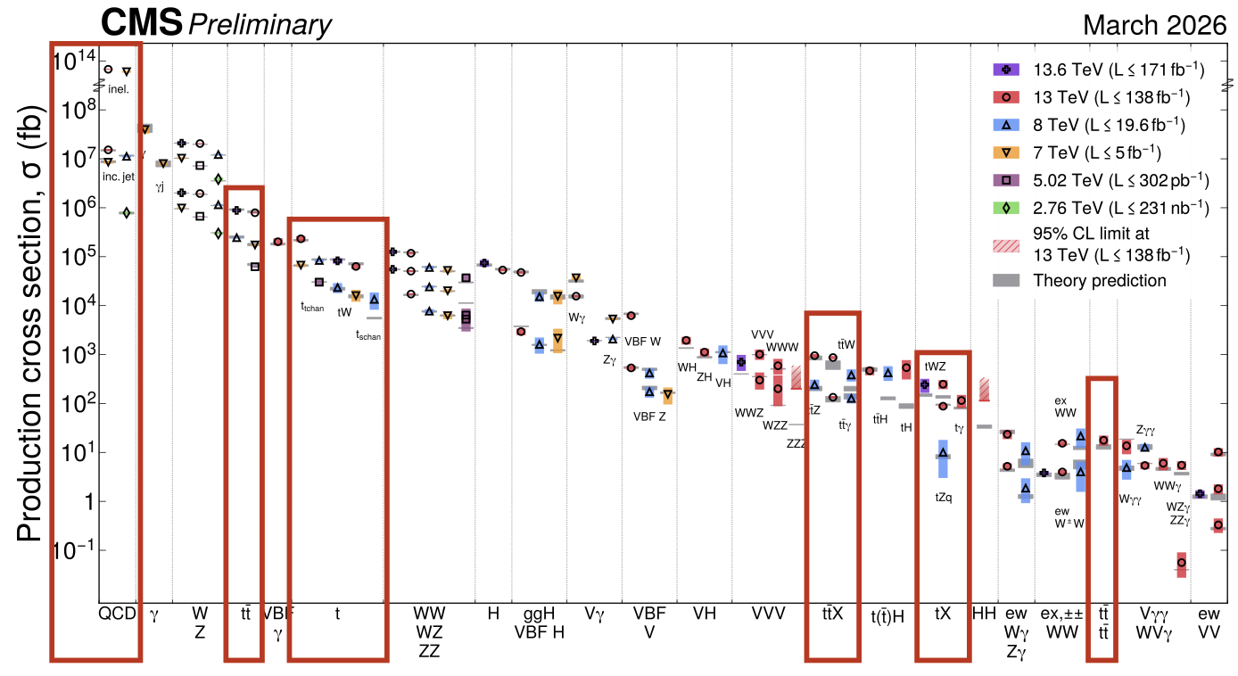
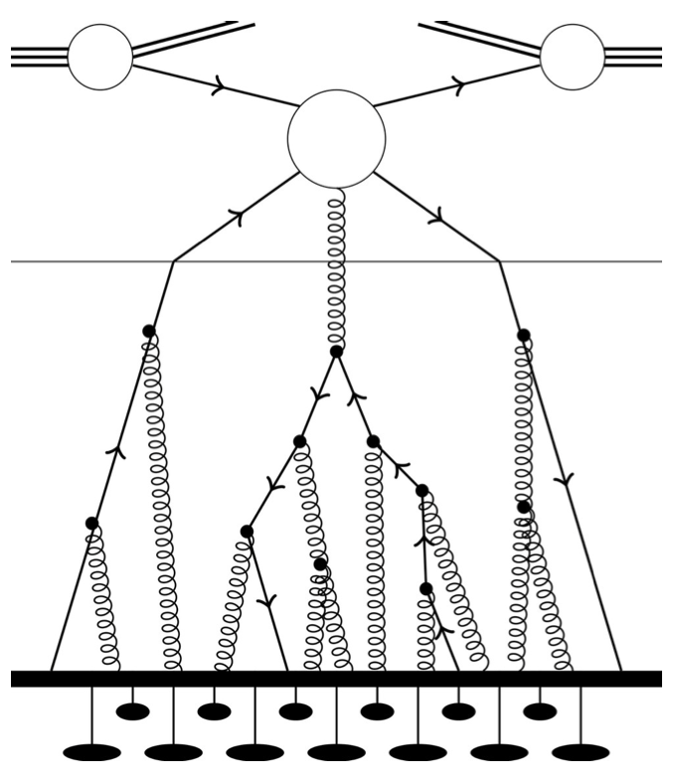
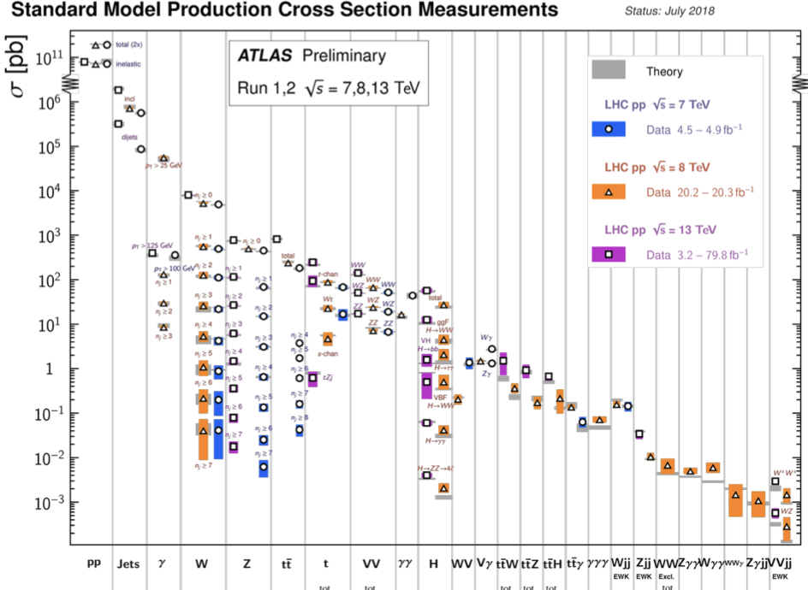
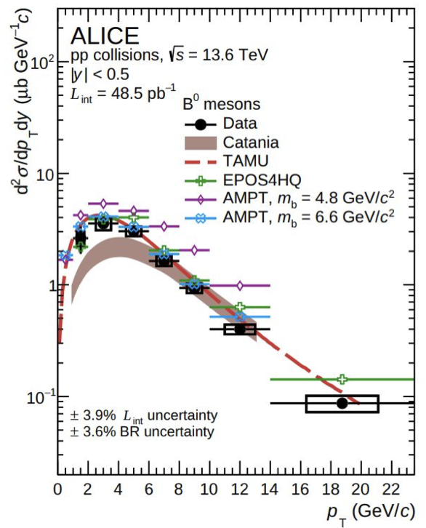
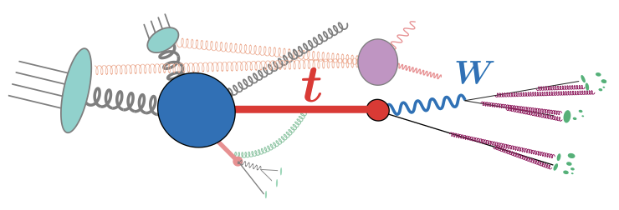
PRECISION EW AND QCD AT COLLIDERS
Particle
Probes
Mass
Precision at the theory/expt interface is crucial for (HL-)LHC to fulfill its potential: pdfs, higher-order parton cross sections, parton showering, hadronization, …
Chanon, Poncelet, Morodei, Faggin, Pathak
MeV
GeV
TeV
1
$$←$$
$$g$$
$$u$$
$$d$$
$$s$$
$$p$$
$$n$$
$$c$$
$$b$$
$$t$$
$$←$$
$$γ$$
$$e$$
$$μ$$
$$τ$$
$$W$$
$$Z$$
$$h$$
Interaction Strength
10⁻³
$$ν_{e}$$
$$ν_{μ}$$
$$ν_{τ}$$
$$←$$
10⁻⁶

Slide 10
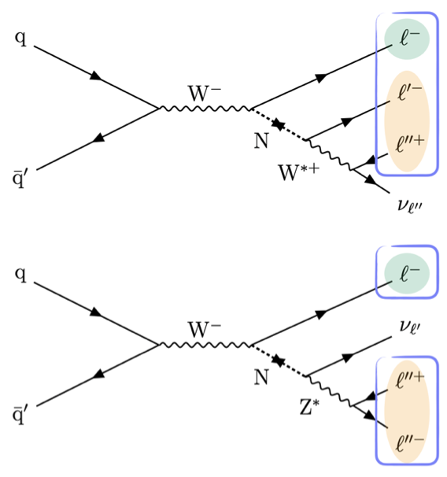
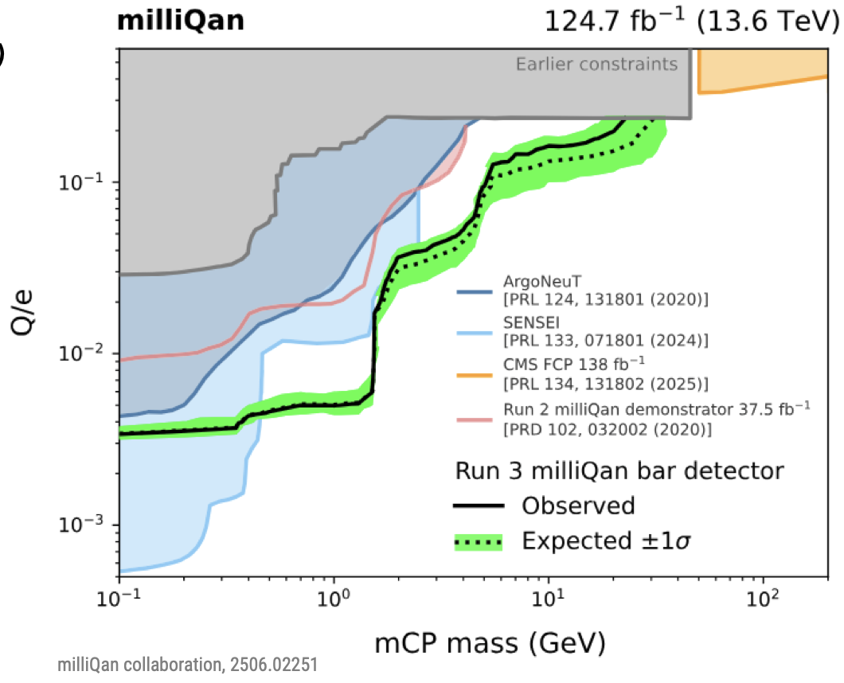
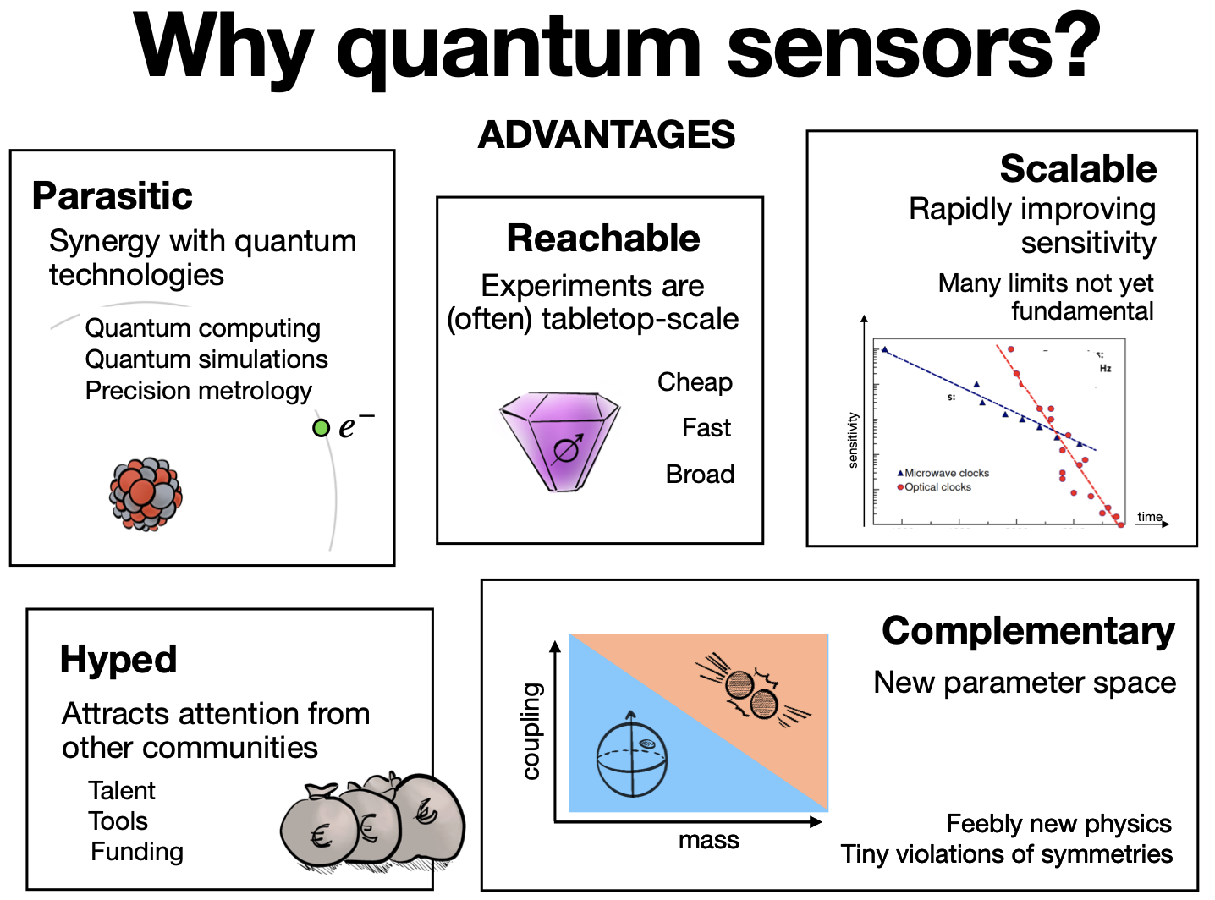
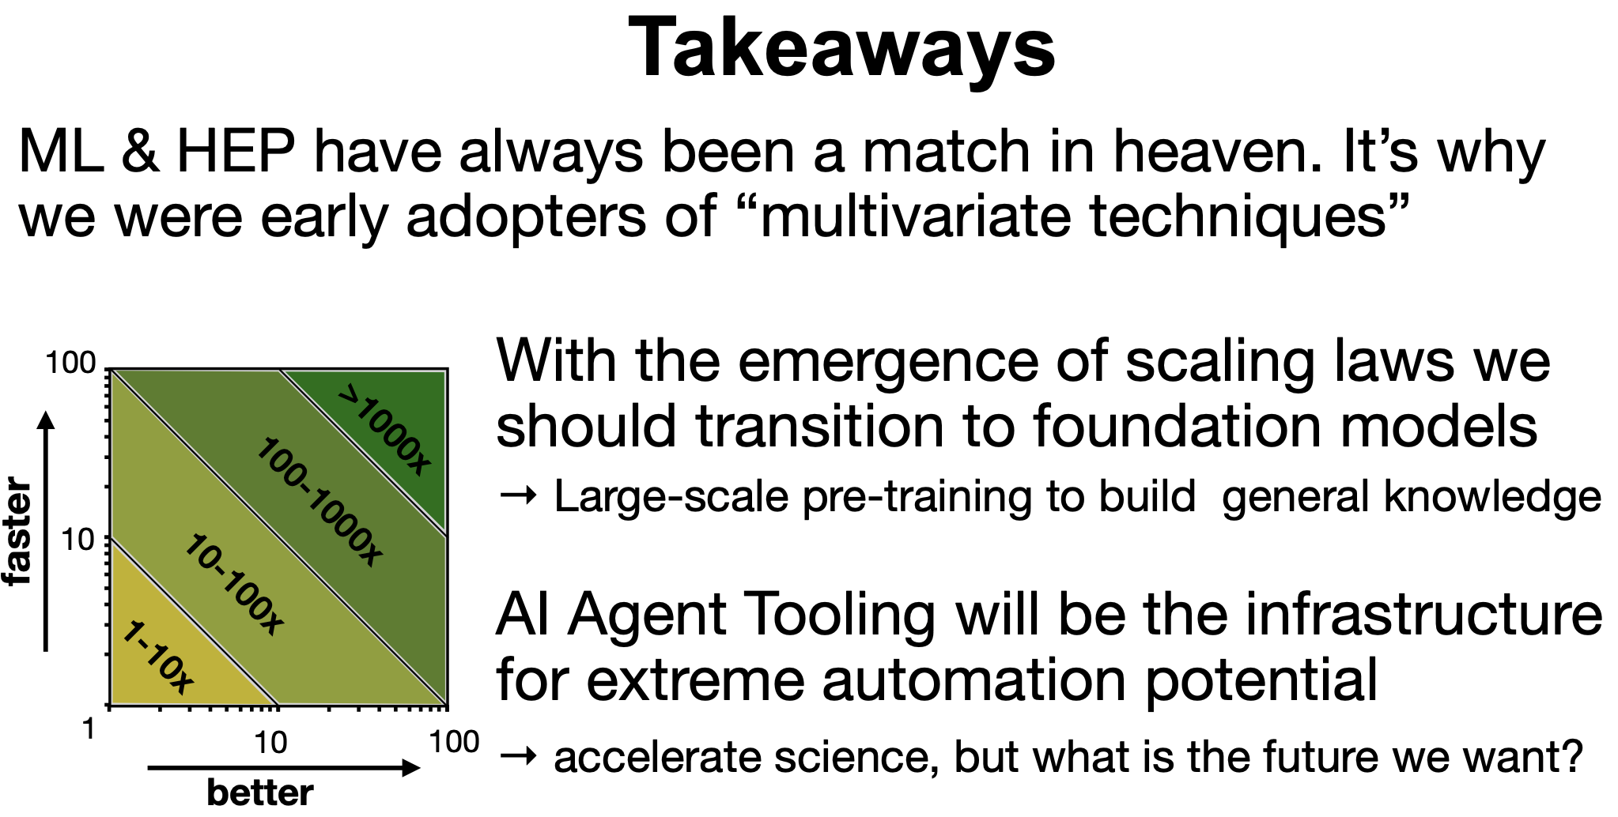
NEW TECHNIQUES FOR DISCOVERY
Particle
Probes
Mass
Are we missing something in the data?
AI/ML, new triggers, quantum sensors extend our sensitivity to new regimes.
Heinrich, Guedes, Tziaferi, Murgui Galvez
MeV
GeV
TeV
1
$$←$$
$$g$$
$$u$$
$$d$$
$$s$$
$$p$$
$$n$$
$$c$$
$$b$$
$$t$$
$$←$$
$$γ$$
$$e$$
$$μ$$
$$τ$$
$$W$$
$$Z$$
$$h$$
Interaction Strength
10⁻³
$$ν_{e}$$
$$ν_{μ}$$
$$ν_{τ}$$
$$←$$
10⁻⁶

Slide 11
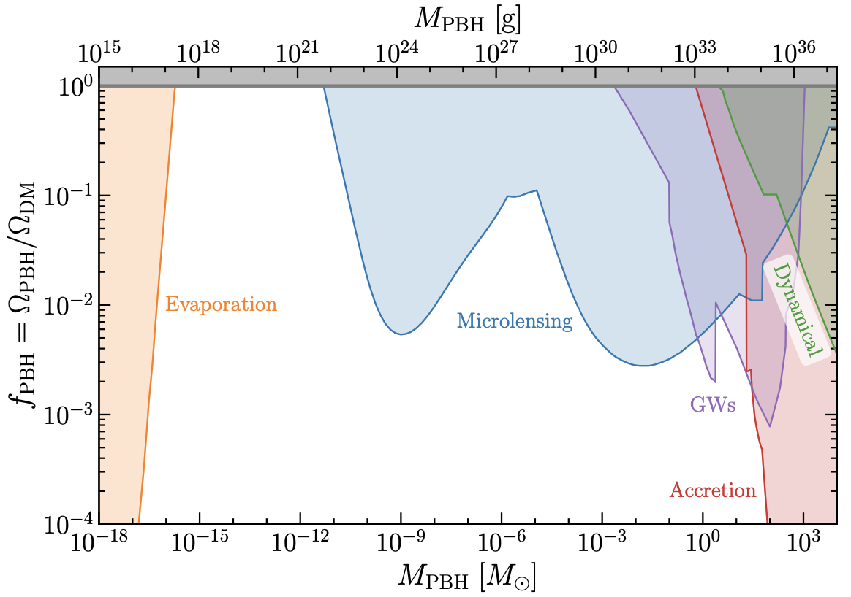
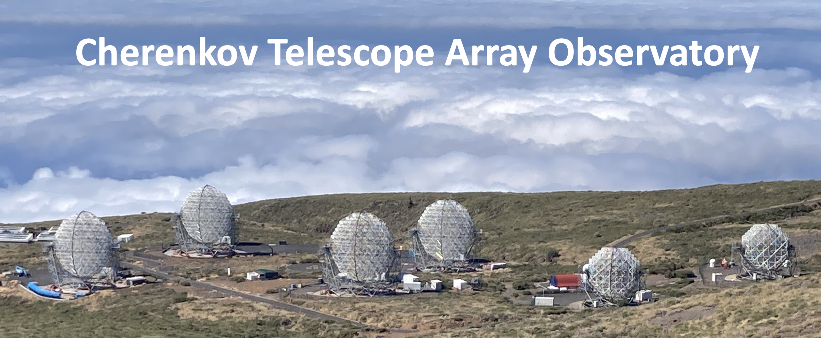
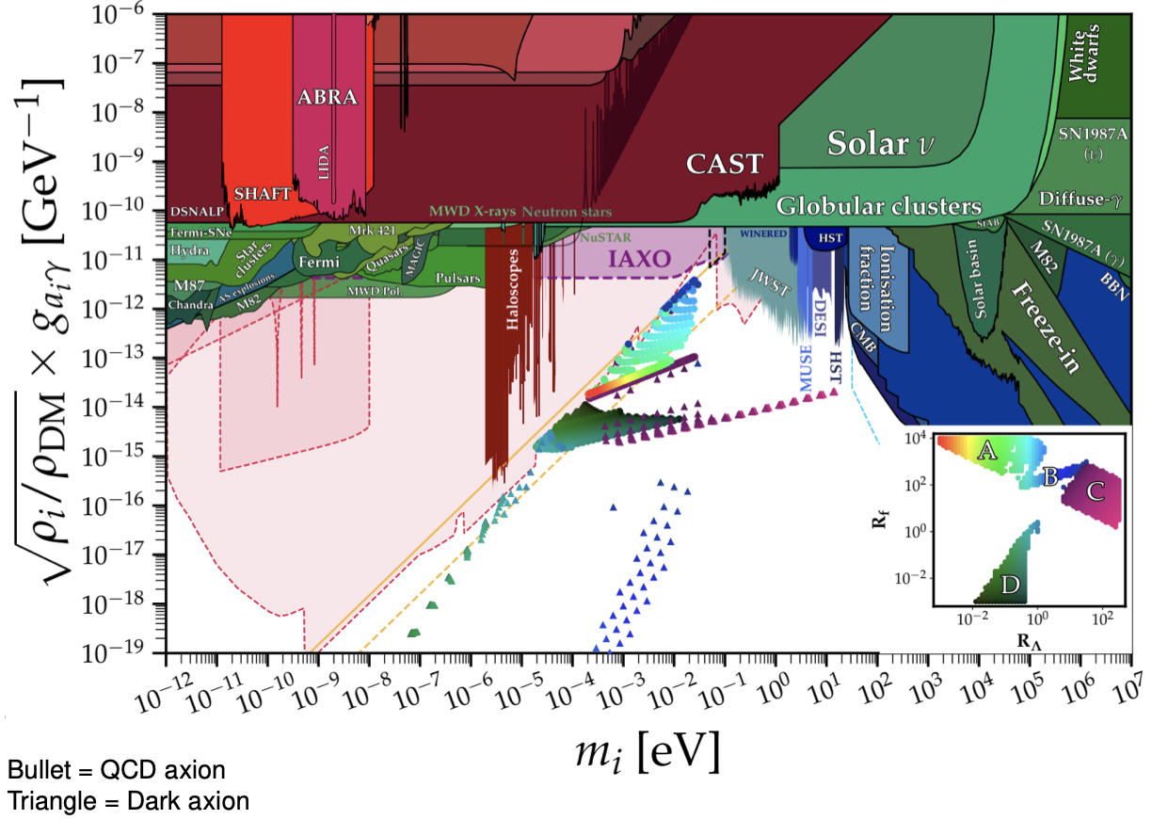
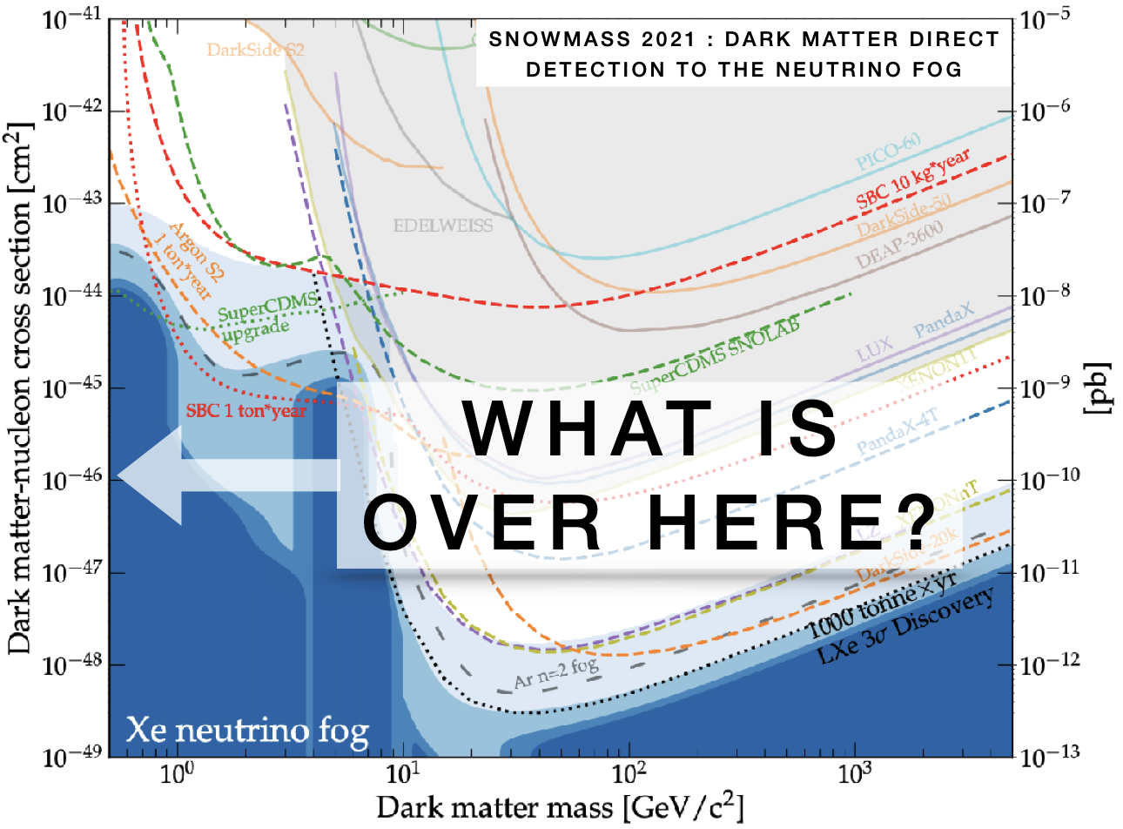
DARK MATTER
Particle
Probes
Mass
WIMP direct detection pushing to the neutrino fog and lower masses
WIMP indirect searches probing very heavy DM at the thermal cross section
Axion, PBH searches of all kinds (Helen Quinn to me: The WIMP fad is over.)
Ramos, Salemi, Plestid, Rogers, Manconi, Inada
MeV
GeV
TeV
1
$$←$$
$$g$$
$$u$$
$$d$$
$$s$$
$$p$$
$$n$$
$$c$$
$$b$$
$$t$$
$$←$$
$$γ$$
$$e$$
$$μ$$
$$τ$$
$$W$$
$$Z$$
$$h$$
Too Little to be
Dark Matter
Too Much to be
Dark Matter
Interaction Strength
Just Right to
be Dark Matter
10⁻³
$$ν_{e}$$
$$ν_{μ}$$
$$ν_{τ}$$
$$←$$
10⁻⁶

Slide 12
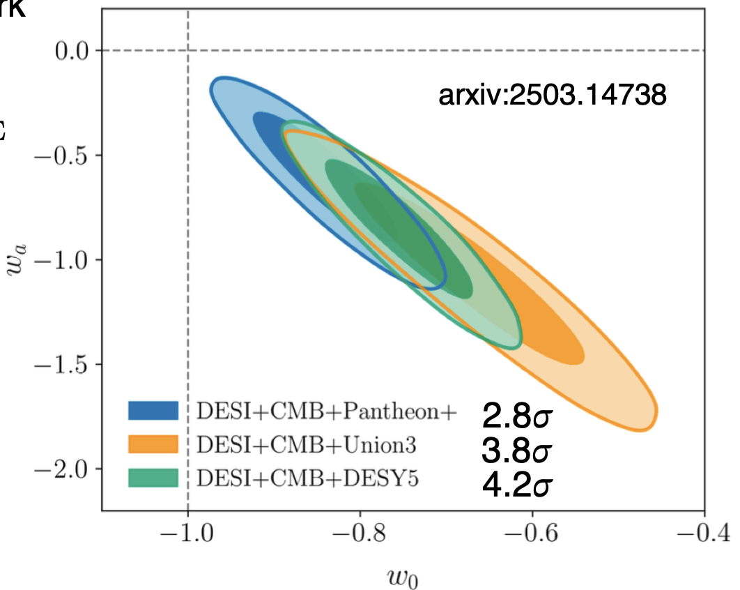
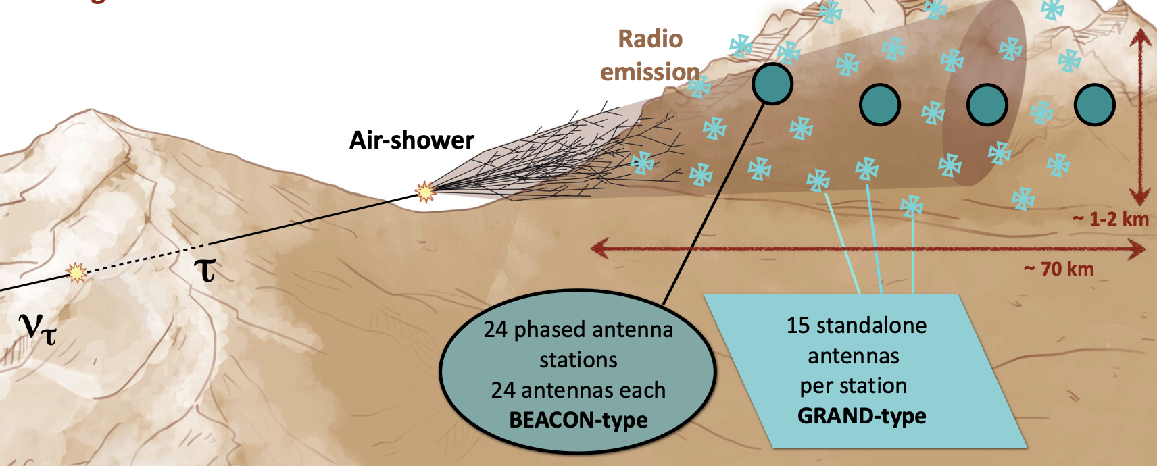
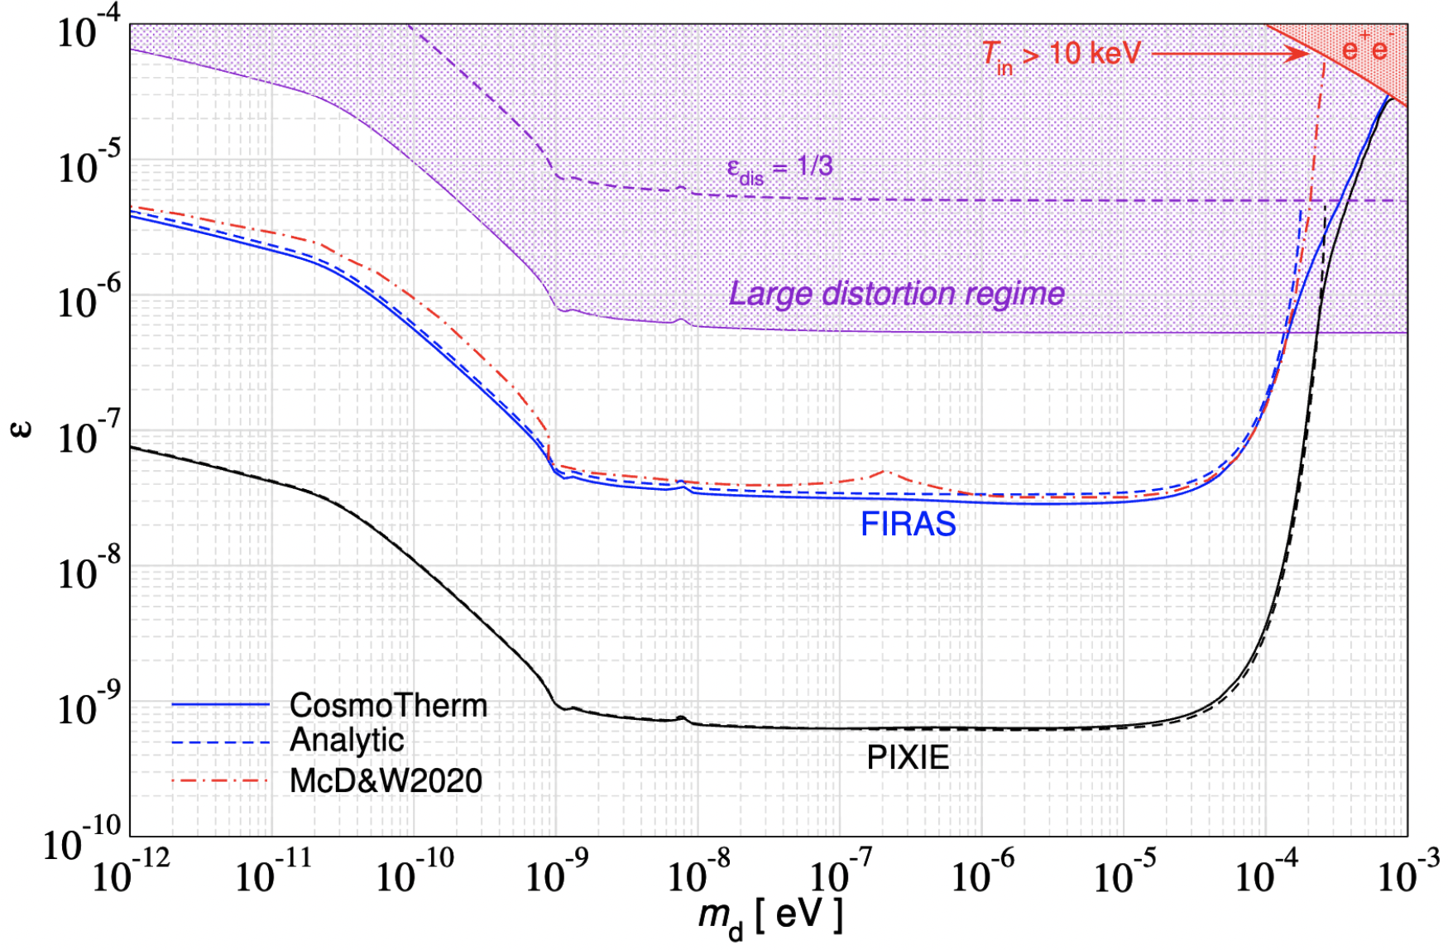
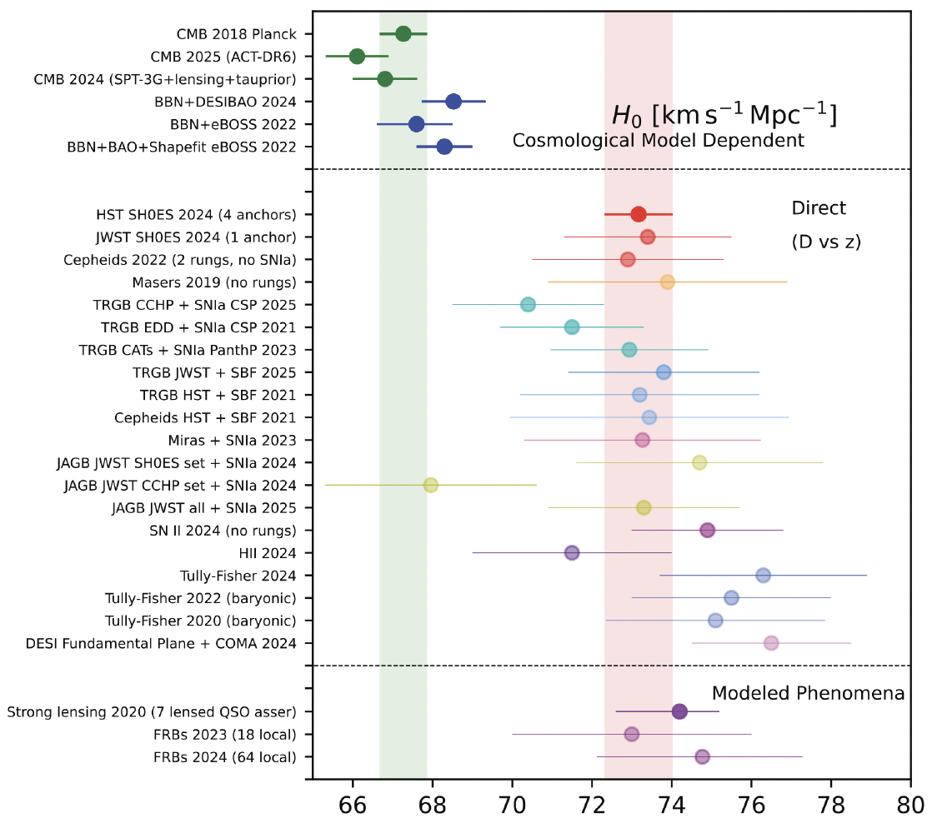
ASTROPARTICLE PHYSICS AND COSMOLOGY
Particle
Probes
Mass
We are limited by collider energies, but can use the universe as the ultimate accelerator: UHE cosmic rays, UHE neutrinos, PeV photons, …
Cosmology also probes particles in ways unimaginable for particle physics experiments, including very massive oe very weakly interacting particles, stress tests ΛCDM, and sheds light on dark energy.
Armengaud, Kotera, Giacinti, Buson, Bohacova, Cyr, Calderon, Teixeria
MeV
GeV
TeV
1
$$←$$
$$g$$
$$u$$
$$d$$
$$s$$
$$p$$
$$n$$
$$c$$
$$b$$
$$t$$
$$←$$
$$γ$$
$$e$$
$$μ$$
$$τ$$
$$W$$
$$Z$$
$$h$$
Interaction Strength
Just Right to
be Dark Matter
10⁻³
$$ν_{e}$$
$$ν_{μ}$$
$$ν_{τ}$$
$$←$$
10⁻⁶

Slide 13
WHERE WE’RE GOING

Slide 14
OUR FIELD HAS PHSD
PTSD: Post-Traumatic Stress Disorder. A mental health condition triggered by experiencing or witnessing terrifying, life-threatening, or traumatic events.
PHSD: Post-Higgs Search Disorder. A mental health condition triggered by experiencing or witnessing the discovery of the Higgs boson.
To discover the Higgs boson, the world came together to build a truly monumental machine which produced a truly monumental discovery. We are still recovering. Two extreme reactions:
This is the greatest time in particle physics! No, it is not. Please familiarize yourself with some of the history of our field (one of Steve Weinberg’s Four Golden Lessons). We should stop over-selling, and simply accept that we are in a new era, with no guaranteed discoveries, but lots of interesting trails to follow.
Particle physics is dead! No, it is not. We do not have a no-lose proposition like the Higgs boson, but this is not necessary to make revolutionary progress. Remember the muon: Who ordered that? We can be surprised, provided we keep our eyes and minds open.

Slide 15
PHSD’S IMPACT ON THE STRUCTURE OF OUR FIELD
It is also undeniable that the Higgs discovery has had a huge impact on the structure of our field.
Last year I had a medical problem that resulted in me being weak and bed-ridden for months. I read many books, including Loonshots, by Safi Bahcall. In it, he discusses how to catalyze breakthroughs. He also discusses conditions that stifle creativity and innovation:
  The Napolean complex: leaders do something great, but then stick around too long and surround themselves with people who agree with them. Sphere of influence >> sphere of competence.
  Silos: communities seal themselves off from others, removing cross-fertilization of ideas.
  Stake vs. rank (I’d call it “The Rule of 150”): as organizations grow past 150 members, they stop innovating. People are more concerned with their rank within the organization than the overall health and mission of the organization.
Do you recognize any of these problems in particle physics?
Example: “Our entire community of thousands of people have signed on to this plan that maps out the future of our field until to 2060.”
  Lab particle physicists: Great!
  University condensed matter physicists: Your field is dead. We’ll put our FTEs elsewhere.

Slide 16
A FEW SUGGESTIONS
How to fix this? There are no silver bullets: see the reports of P5 and NASEM in the US, and EPPSU in Europe. But just as a lack of a flagship project is an existential crisis for our labs, a lack of a diversity of smaller projects is an existential crisis for our field.
We can:
In planning committees, include people who are more concerned with stake than rank, people who have been a voice in the wilderness, people who have started new things.
Lower the barrier between theory and experiment. Value theorists (experimentalists) who really know some experiment (theory), and who can generate good ideas that can be tested realistically, quickly, and inexpensively.
Fence off funding for smaller projects, which can be distributed quickly. The relative cost is small, and at the very least, we will train the next generation of physicists, give them leadership opportunities, and preserve their enthusiasm.
Have small meetings (< 150 people), bringing together diverse expertise (no silos), with the freedom to challenge and question (no Napoleon).

Slide 17
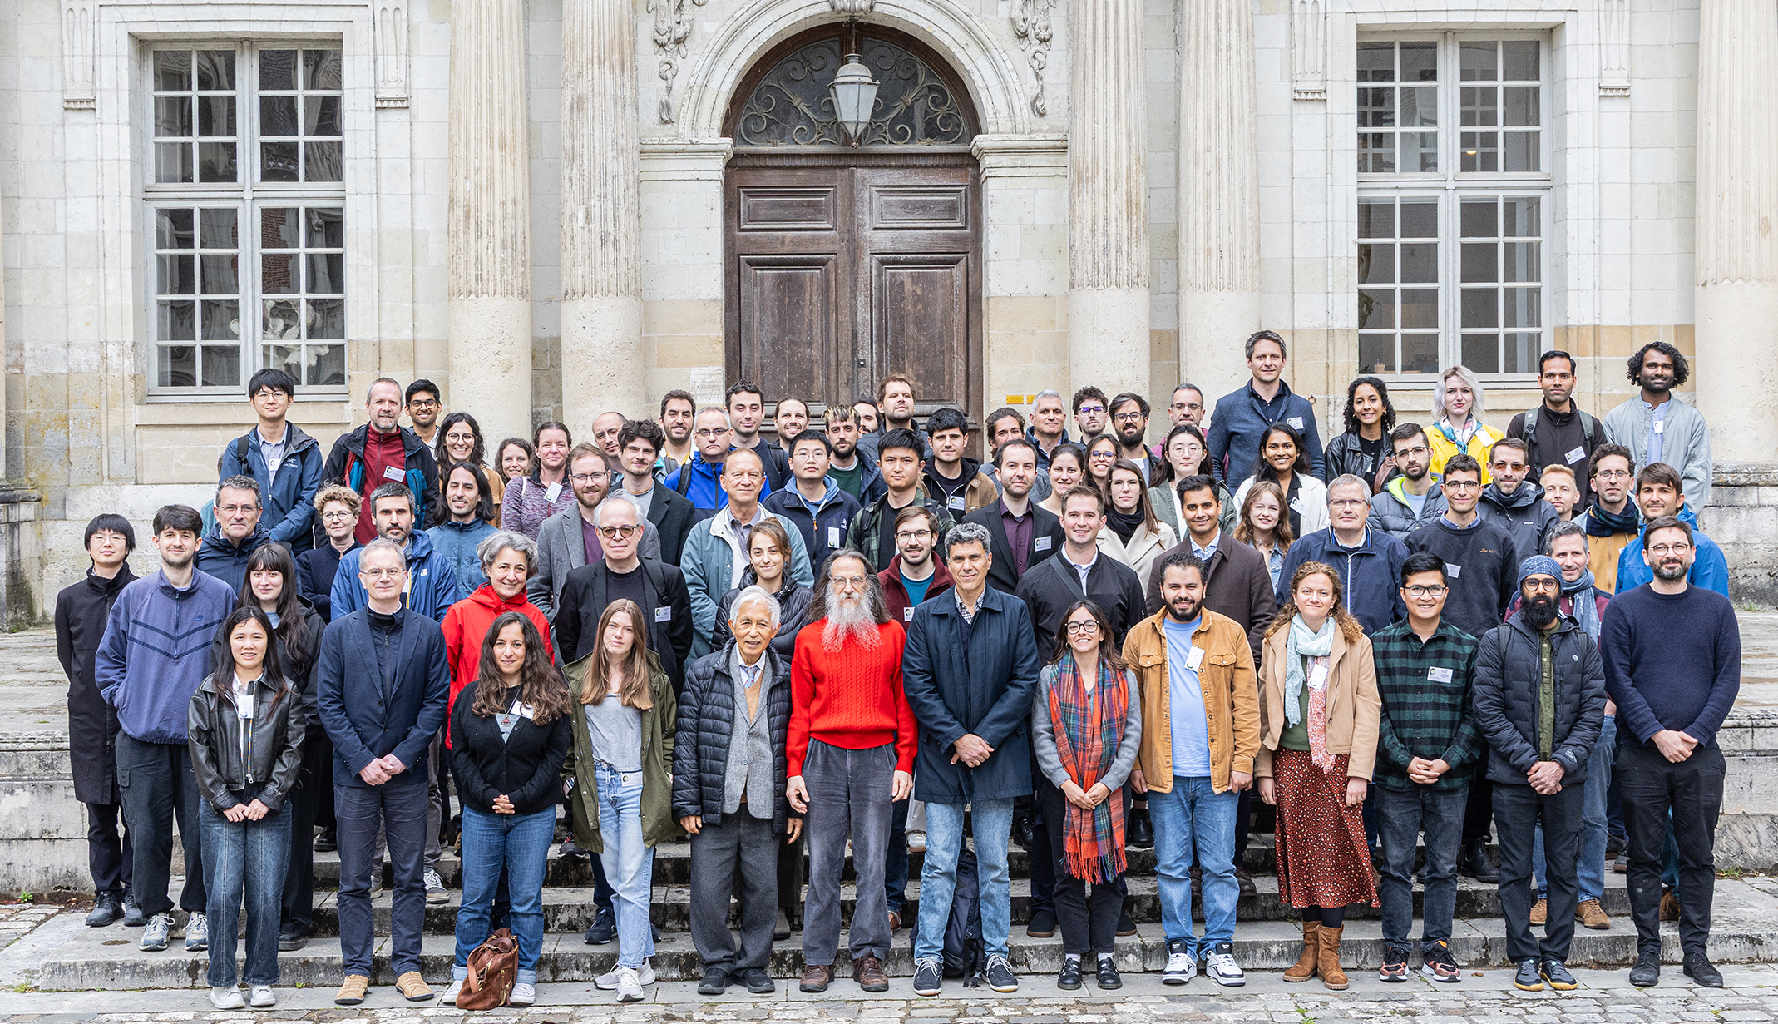
In short, more meetings like Blois! To Christophe, Jacques, Van, Thao, and all the organizers,
THANK YOU!

