Slide 1
PANEL:
NEW CAPACITIES FOR THE LHC EXPERIMENTS
SEARCH 2025, CERN
Jonathan Feng, UC Irvine, 21 October 2025

Slide 2
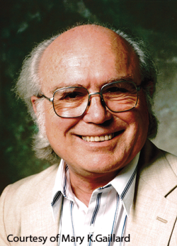
MY PERSPECTIVE
“I never thought it was going to be this hard.”
Bruno Zumino, c. 1996

Slide 3
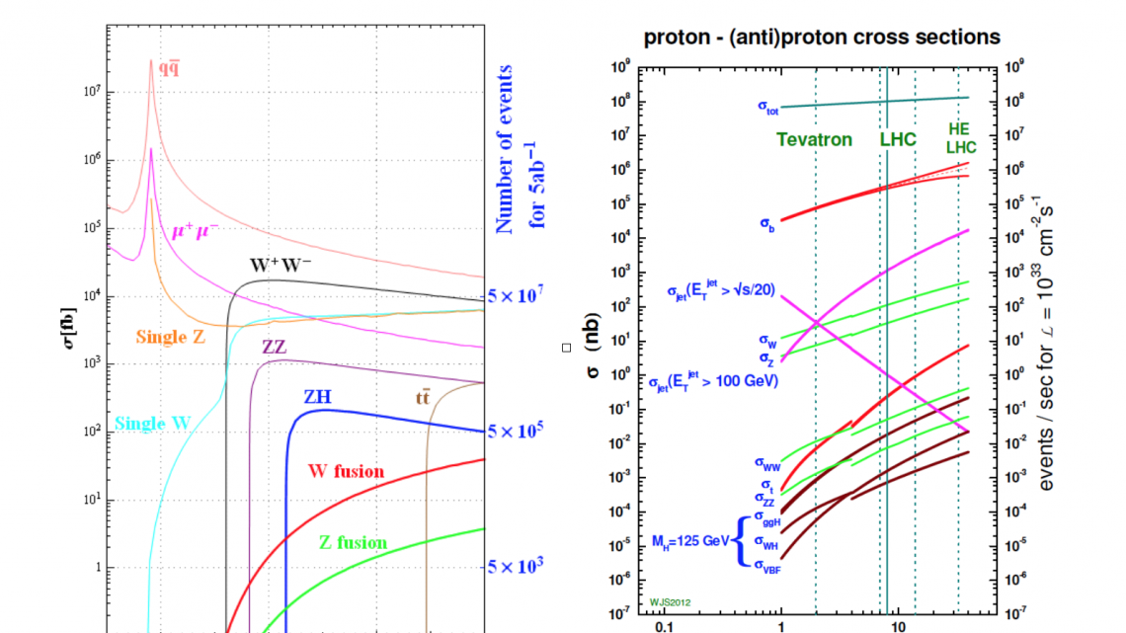
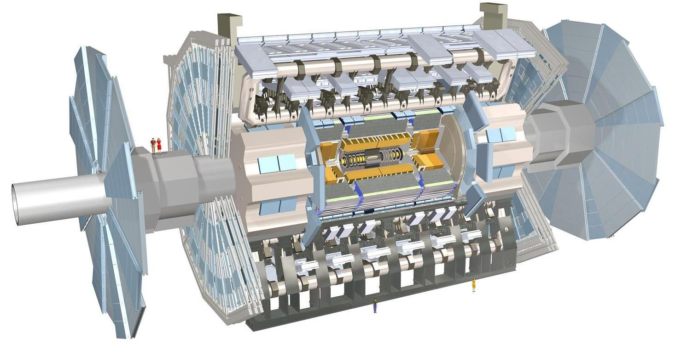

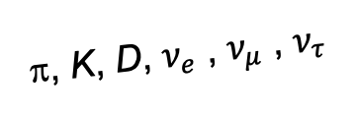
NEW CAPACITIES FOR THE LHC: FORWARD DETECTORS
ATLAS and CMS are nearly hermetic in $θ$, but not in $η$.
The total pp cross section is 0.1 barns, and transverse detectors miss almost all of it.
Given the enormous remaining integrated luminosity of the LHC, we should view this as unacceptable. Especially if we aim to carry out a broad search for new particles, we are missing a lot of discovery potential.
!!!
A’, a, mCPs, χ, …
π, K, D, $ν_{e}$ , $ν_{μ}$ , $ν_{τ}$
FASER and SND@LHC have been running since Run 3 started in 2022.
Planned upgrades for FASER and SND@LHC in Run 4, and additional detectors (FASER2, FASERν2, FLArE, FORMOSA) at the FPF.

Slide 4
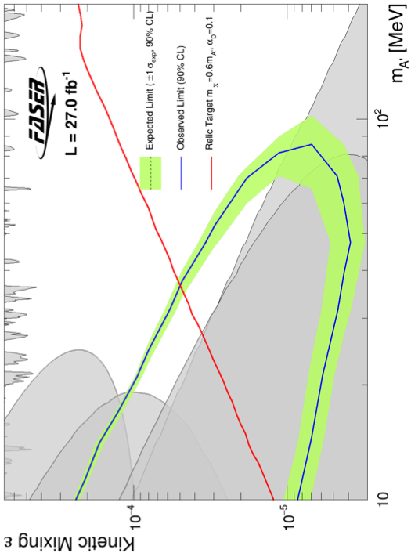
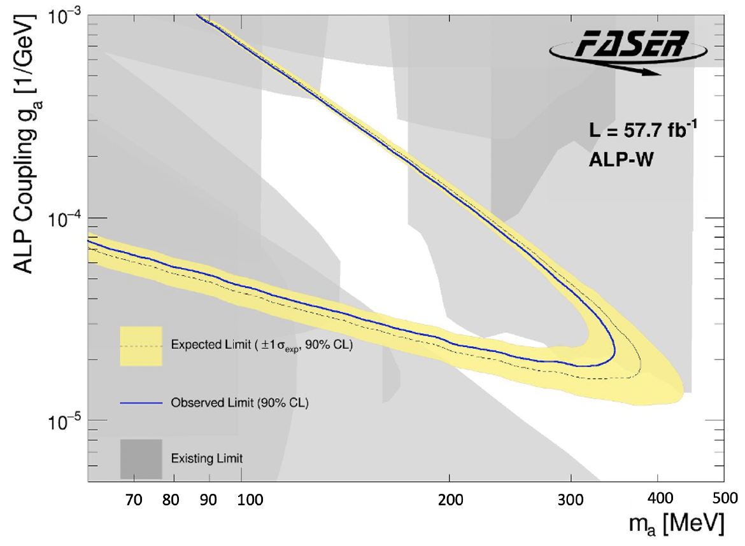
LIGHT NEW PHYSICS
To find new light particles, look where the existing light particles are.
Dark Photons
Axion-Like Particles
FASER, 2308.05587
FASER, 2410.10363

Slide 5
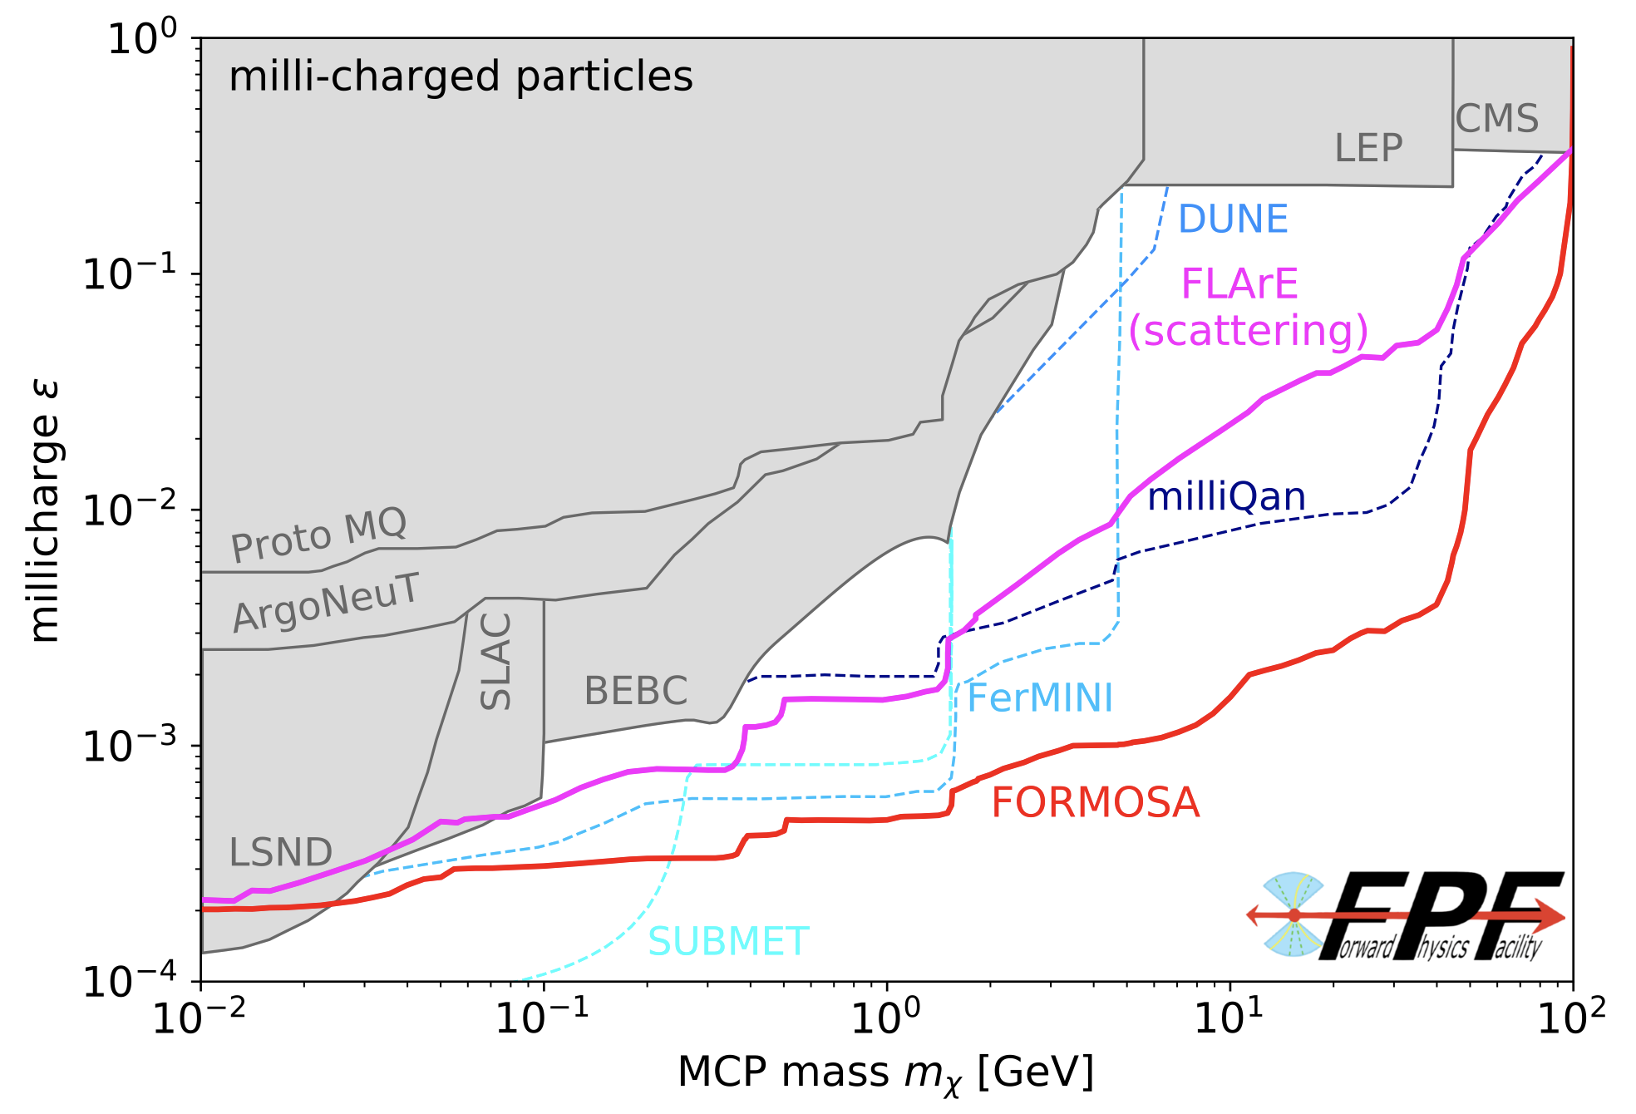
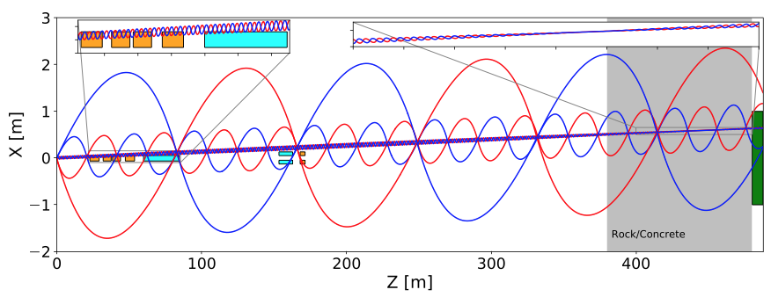
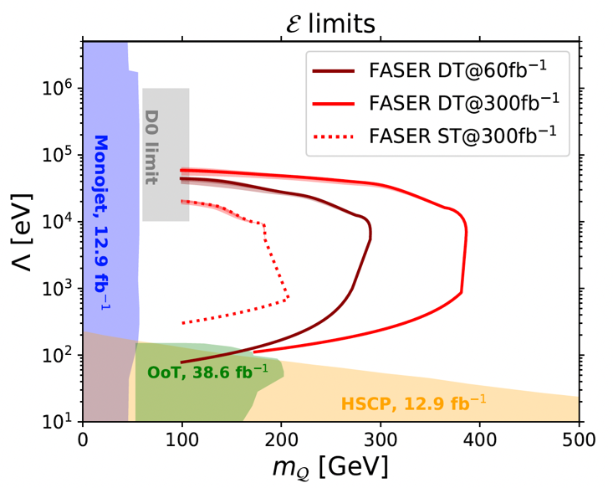
HEAVY NEW PHYSICS
The dark or hidden sector may have its own gauge forces: Abelian or non-Abelian.
Abelian: Milli-charged particles, ~10 MeV – 100 GeV
Non-Abelian: Quirks, ~100 GeV - TeV
Li, Pei, Ran, Zhang, 2108.06748
2503.19010

Slide 6
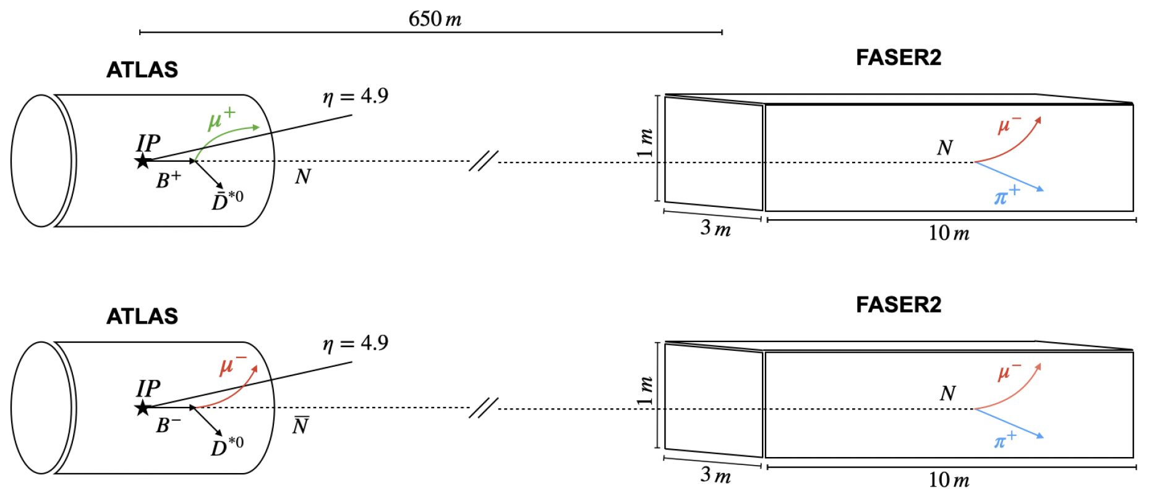
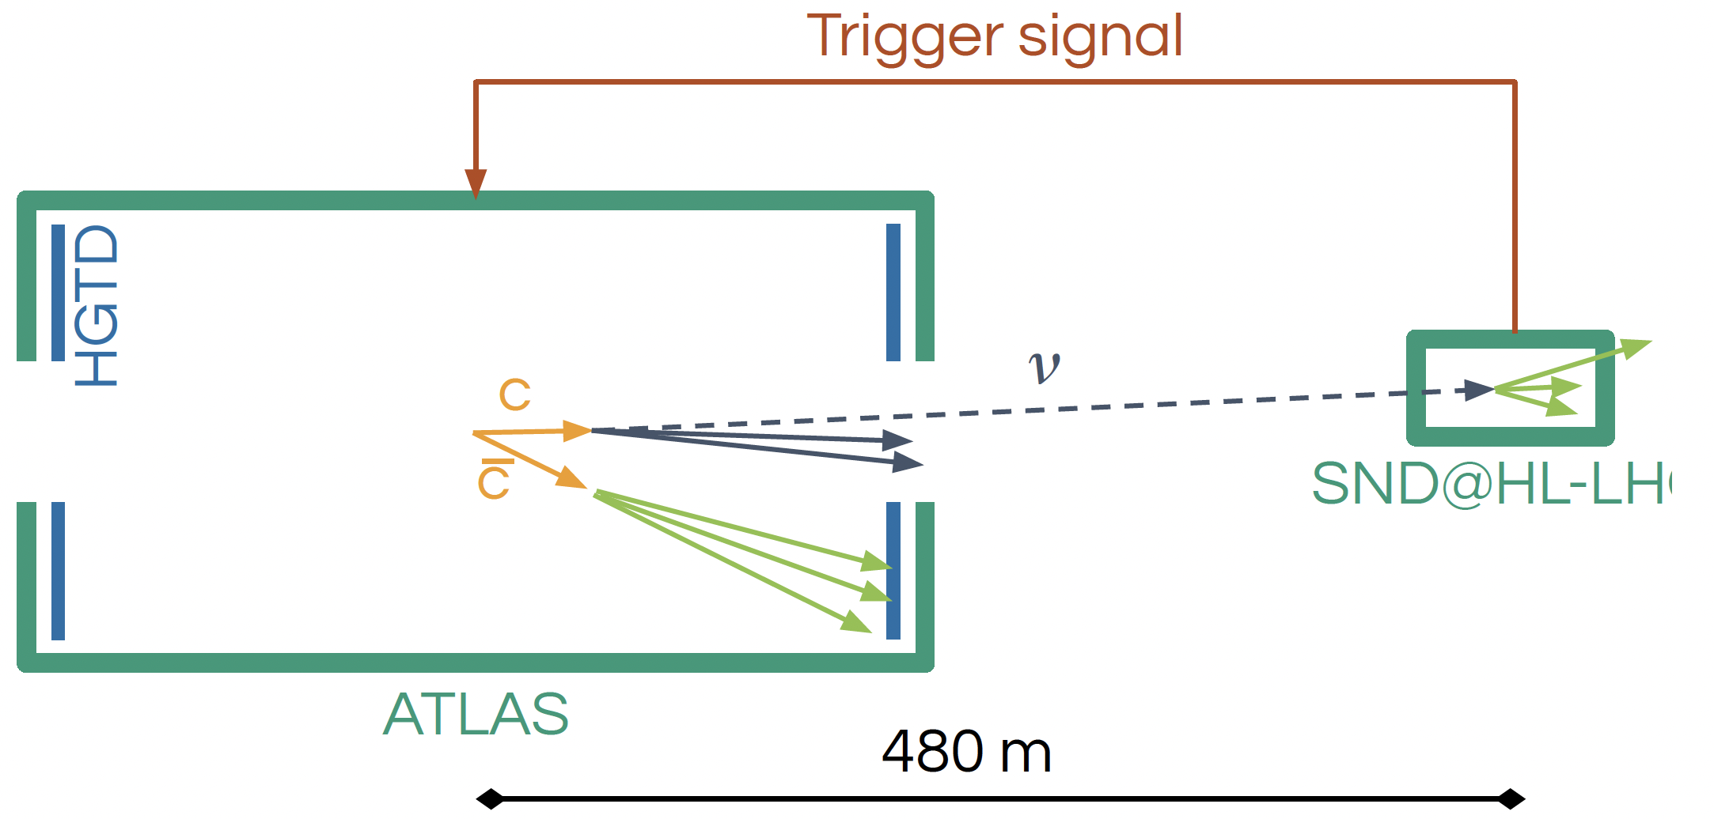
FORWARD DETECTORS AS TRIGGERS
Multi-faceted complementarity between forward and transverse detectors: direct searches and precision measurements, BSM physics and SM physics, charged particles and neutrinos, …
Maybe even on an ”event-by-event basis”! We have already detected ~1000 TeV neutrinos, FPF will see thousands per day. What can we do with these?
SND@LHC, 2503.24233
Feng, Hewitt, La Rocco, Whiteson, 2510.16107 (today)

